Slide 1
Using Text Data to Predict Supreme Court Case Rulings
Rachel Ballew
Data Scientist

Slide 2

About Me
Data Science
Creative Solutions
Always Learning
Challenging Myself
Quilting
Reading
Weightlifting

Slide 3
Problem Statement
Legal work requires much manual analysis of documents. Further, the documents available for lawyers to research is vast and expansive which, while invaluably important, can make finding relevant cases a daunting task.

Slide 4
Proposal
Predict issue area and supreme court ruling using natural language processing methods

Slide 5
Impact
Lawyers can spend more time on:
  Their clients
  Effectively highlighting salient points and logical arguments in their case
  Preparing for court ruling outcomes
As computers upended legal research, so too will natural language processing transform the legal space.

Slide 6
Unique NLP Challengs within the Legal Domain

Slide 7
Data Set

Slide 8
Data Wrangling
.csv provided by filevine
Extract entities per party using Spacy
Input text fields into Marqo vector database:
- facts
-legal_question
-conclusion
-issue_area
Using vector database extract three most similar scores for like fields
Join back to data on href
Input data into XGBoost
Data from oyez api wrapper:
- advocates
-judges
-question
-conclusion
Combine data sets and clean:
- remove HTML tags
- remove non-alphanumeric characters

Slide 9
Why Vector Database?
Specifically built to store high-dimensional vectors such as those used in word embeddings
Allow for fast and accurate similarity search and retrieval of data based on vector distance or similarity

Slide 10
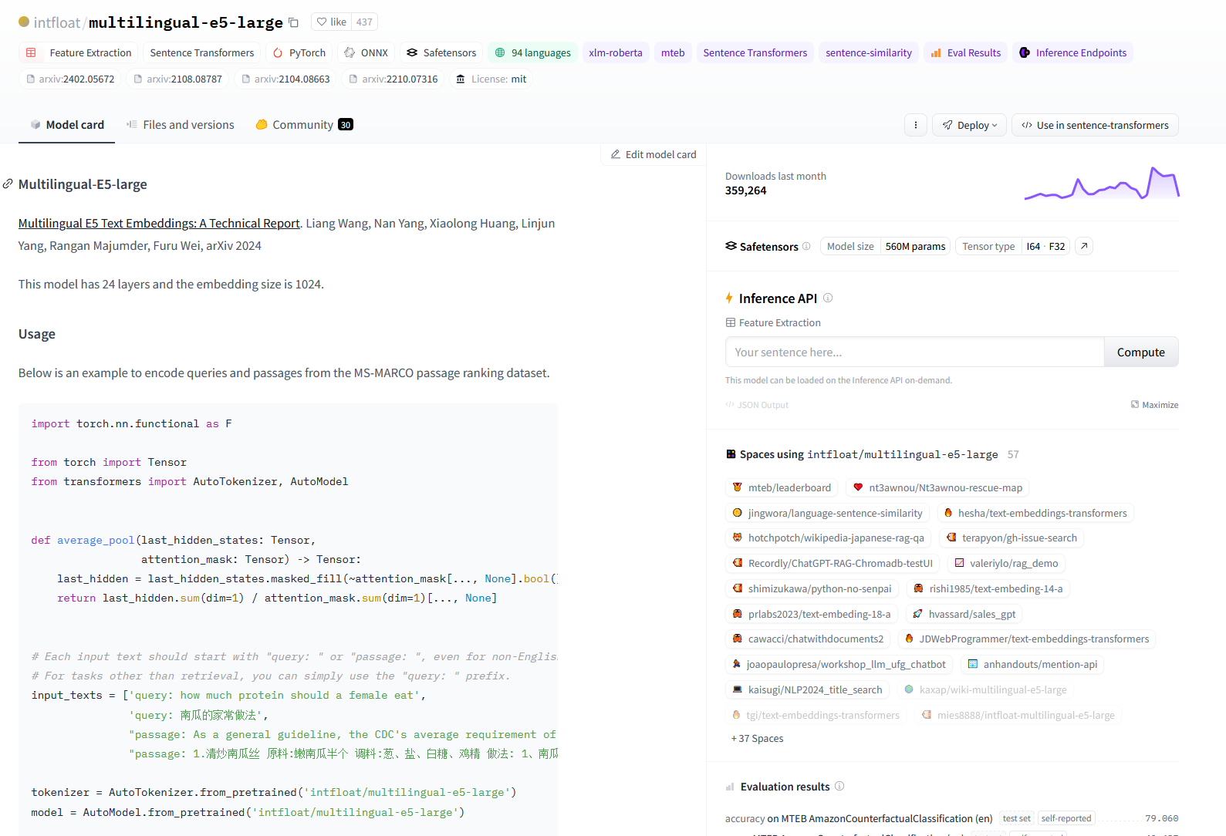
Model for Word Embedding
hf/multilingual-e5-large
24 layers
1024 dimensions
Much faster than legal bert base uncased

Slide 11
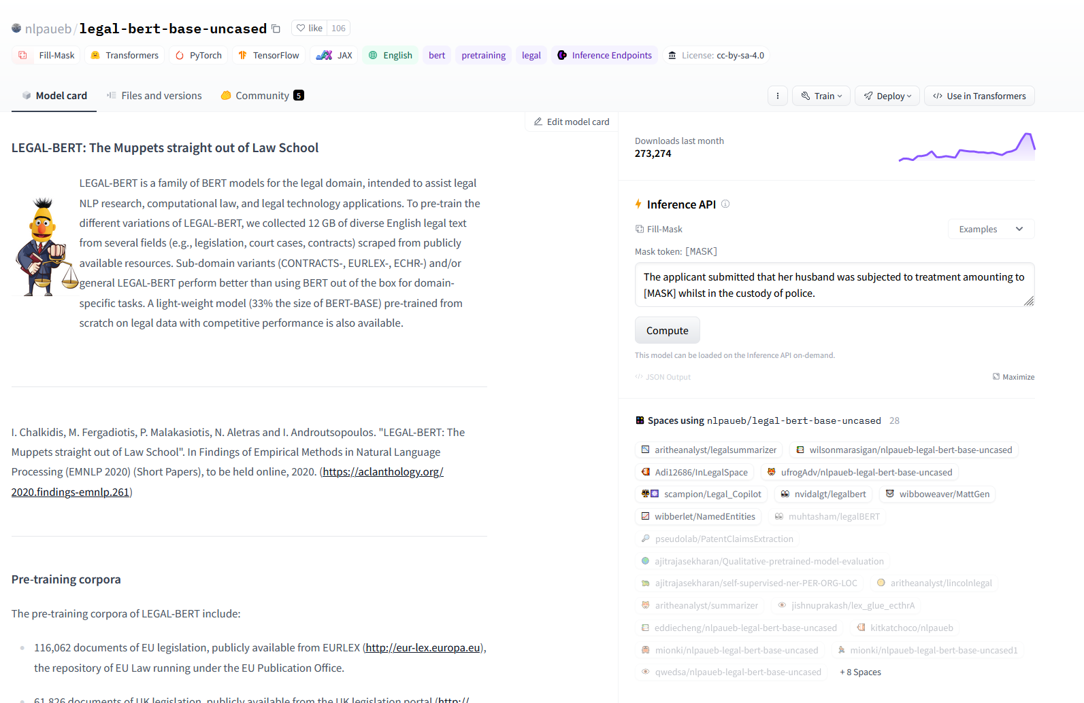
Model for Word Embedding
nlpaueb/legal-bert-base-uncased
512 max dimensions
“LEGAL-BERT is a family of BERT models for the legal domain, intended to assist legal NLP research, computational law, and legal technology applications. To pre-train the different variations of LEGAL-BERT, we collected 12 GB of diverse English legal text from several fields (e.g., legislation, court cases, contracts) scraped from publicly available resources. Sub-domain variants (CONTRACTS-, EURLEX-, ECHR-) and/or general LEGAL-BERT perform better than using BERT out of the box for domain-specific tasks. A light-weight model (33% the size of BERT-BASE) pre-trained from scratch on legal data with competitive performance is also available. “

Slide 12
Feature Selection

Slide 13
Model

Slide 14
Results

Slide 15
Comparison Against Baseline

Slide 16
Future Enhancements
Building a custom word embedding specific to Supreme Court Cases
Using judges’ previous experiences and court documents to predict their individual votes
Using news outlets to compare public opinion to gauge changing opinions over time

