Slide 1
Function Creation

Slide 2
The Vision:
Vision: To build a predictive application that enables the Commissioner’s Office to estimate property values and, more importantly, explain why those prices are shifting.
Strategy
CPI Adjustment: Normalize historical sales to today’s dollar.
Market Segmentation: Use “Market Type” (Single-Family vs. Multi-Family) as interaction terms—recognizing that an extra bedroom in a condo adds different value than an extra bedroom on a ranch.
The Application: An interactive application that will output pricing predictions and add transparency in the valuation process.

Slide 3
Methodology
Phase 1:
Feature Drivers: Identify the drivers of what makes properties different. These drivers are found in my PCA.
Phase 2:
Price Sub-Markets: Identify the sub-markets within housing markets (housing markets: single family, multi-family, etc.) These sub-markets are found in Ryan and Lucca’s UMAPS.
Phase 3:
Price Prediction: Utilize findings from feature extraction and sub-market classifications to then predict housing prices, adjusting for CPI in the process. The goal of these models is to capture 90% or more of the variation in price. These predictions are currently being curated!

Slide 4
Current Insights (Phase 1)
Insights: “The Standard vs. The Luxury”
Finding: Only 30% of property variation is driven by “Standard Features” (Bed/Bath/Sqft).
The “So What?”: 70% of what makes properties in Iron County unique comes from “Luxury” or “Nuance” features (sheds, pools, etc.). Interesting feature fact: Half Baths act like a “luxury” feature in the data.
Actionable Step: Our model cannot just look at the basics; we must include these “luxury” indicators to reach our 90% accuracy goal.

Slide 5
Road Map & Next Steps
CPI Adjustments
Reasoning: Due to inflation, the value of a dollar today is not the same as it was a year ago or will be in a year. To ensure that all of the dollar amounts we are predicting equate to the same value, we need to adjust for these market fluxuations. Role of the Students: Our role is to prepare the data for the adjustments by consolidating insights about markets and sub-markets in with a master dataset for the Commissioners office to work with. Role of the Commissioner Office: The role of the commissioner office is to conduct the CPI adjustments on the master dataset and return it back to the students for model integration.
Modeling
Modeling: As we move into the modeling, we want to combine insights from the unsupervised modeling into our supervised modeling process. As mentioned previously, we will want to add interaction variables for markets and sub-markets. Another interaction variable that may be beneficial is location, as rural areas may be priced differently compared to urban areas. As previously mentioned, the goal of the modeling is to account for 90% or more of the variation in price.
Validation: As we model, we need to validate the models so that the predictions can be trusted.
Application
Deployment: Once a model is chosen, it will then be implemented into a user-friendly platform for the Commissioners Office, such that predictions and drivers are identified.
Import Libraries

Slide 6
Unsupervised Learning
 | n_components n_components: int, float or 'mle', default=None Number of components to keep. if n_components is not set all components are kept:: n_components == min(n_samples, n_features) If ``n_components == 'mle'`` and ``svd_solver == 'full'``, Minka's MLE is used to guess the dimension. Use of ``n_components == 'mle'`` will interpret ``svd_solver == 'auto'`` as ``svd_solver == 'full'``. If ``0 < n_components < 1`` and ``svd_solver == 'full'``, select the number of components such that the amount of variance that needs to be explained is greater than the percentage specified by n_components. If ``svd_solver == 'arpack'``, the number of components must be strictly less than the minimum of n_features and n_samples. Hence, the None case results in:: n_components == min(n_samples, n_features) - 1 | None
 | copy copy: bool, default=True If False, data passed to fit are overwritten and running fit(X).transform(X) will not yield the expected results, use fit_transform(X) instead. | True
 | whiten whiten: bool, default=False When True (False by default) the `components_` vectors are multiplied by the square root of n_samples and then divided by the singular values to ensure uncorrelated outputs with unit component-wise variances. Whitening will remove some information from the transformed signal (the relative variance scales of the components) but can sometime improve the predictive accuracy of the downstream estimators by making their data respect some hard-wired assumptions. | False
 | svd_solver svd_solver: {'auto', 'full', 'covariance_eigh', 'arpack', 'randomized'}, default='auto' "auto" : The solver is selected by a default 'auto' policy is based on `X.shape` and `n_components`: if the input data has fewer than 1000 features and more than 10 times as many samples, then the "covariance_eigh" solver is used. Otherwise, if the input data is larger than 500x500 and the number of components to extract is lower than 80% of the smallest dimension of the data, then the more efficient "randomized" method is selected. Otherwise the exact "full" SVD is computed and optionally truncated afterwards. "full" : Run exact full SVD calling the standard LAPACK solver via `scipy.linalg.svd` and select the components by postprocessing "covariance_eigh" : Precompute the covariance matrix (on centered data), run a classical eigenvalue decomposition on the covariance matrix typically using LAPACK and select the components by postprocessing. This solver is very efficient for n_samples >> n_features and small n_features. It is, however, not tractable otherwise for large n_features (large memory footprint required to materialize the covariance matrix). Also note that compared to the "full" solver, this solver effectively doubles the condition number and is therefore less numerical stable (e.g. on input data with a large range of singular values). "arpack" : Run SVD truncated to `n_components` calling ARPACK solver via `scipy.sparse.linalg.svds`. It requires strictly `0 < n_components < min(X.shape)` "randomized" : Run randomized SVD by the method of Halko et al. .. versionadded:: 0.18.0 .. versionchanged:: 1.5 Added the 'covariance_eigh' solver. | 'auto'
 | tol tol: float, default=0.0 Tolerance for singular values computed by svd_solver == 'arpack'. Must be of range [0.0, infinity). .. versionadded:: 0.18.0 | 0.0
 | iterated_power iterated_power: int or 'auto', default='auto' Number of iterations for the power method computed by svd_solver == 'randomized'. Must be of range [0, infinity). .. versionadded:: 0.18.0 | 'auto'
 | n_oversamples n_oversamples: int, default=10 This parameter is only relevant when `svd_solver="randomized"`. It corresponds to the additional number of random vectors to sample the range of `X` so as to ensure proper conditioning. See :func:`~sklearn.utils.extmath.randomized_svd` for more details. .. versionadded:: 1.1 | 10
 | power_iteration_normalizer power_iteration_normalizer: {'auto', 'QR', 'LU', 'none'}, default='auto' Power iteration normalizer for randomized SVD solver. Not used by ARPACK. See :func:`~sklearn.utils.extmath.randomized_svd` for more details. .. versionadded:: 1.1 | 'auto'
 | random_state random_state: int, RandomState instance or None, default=None Used when the 'arpack' or 'randomized' solvers are used. Pass an int for reproducible results across multiple function calls. See :term:`Glossary `. .. versionadded:: 0.18.0 | None
Read in Parcel Data
<class 'pandas.core.frame.DataFrame'> RangeIndex: 53277 entries, 0 to 53276 Data columns (total 53 columns): # Column Non-Null Count Dtype --- ------ -------------- ----- 0 ParcelId 53277 non-null object 1 TaxYear 53277 non-null int64 2 Active 53277 non-null object 3 ImpOnly 53277 non-null int64 4 IsIncluded 53277 non-null bool 5 PropType 53277 non-null int64 6 PropTypeDescription 53277 non-null object 7 Subdivision 38318 non-null object 8 Acreage 53277 non-null float64 9 Jurisdiction 53277 non-null int64 10 RecordType 53277 non-null object 11 SpecificPropType 53277 non-null int64 12 SpecificPropTypeDescription 53277 non-null object 13 Lat 51923 non-null float64 14 Lng 51923 non-null float64 15 ReviewedDate 52414 non-null float64 16 ReviewedBy 52414 non-null object 17 NbhdCode2 53277 non-null object 18 Area 53277 non-null object 19 ImpCode 53277 non-null int64 20 Res Imp Count 21893 non-null float64 21 TotGLA 21893 non-null float64 22 Tot Bsmt 21893 non-null float64 23 EffYearBuilt_Weighted 21893 non-null float64 24 Quality_Weighted 21893 non-null float64 25 MainImp.GroupCode 21893 non-null object 26 Main_StyleDesc 21893 non-null object 27 FullBaths_Total 21893 non-null float64 28 HalfBaths_Total 21893 non-null float64 29 BsmtFinishPct_Weighted 9663 non-null float64 30 Laundry_Count 21893 non-null float64 31 KitchenCount 21893 non-null float64 32 CarportArea 21893 non-null float64 33 CarportCapacity 21893 non-null float64 34 GarageArea 21893 non-null float64 35 GarageCapacity 21893 non-null float64 36 Main_YearBuilt 21893 non-null float64 37 Count_DetGarage 10572 non-null float64 38 SqFt_DetGarage 2376 non-null float64 39 Count_ DetCarport 10572 non-null float64 40 SqFt_DetCarport 500 non-null float64 41 Count_Barn 10572 non-null float64 42 Sqft_Barn 162 non-null float64 43 Count_Guest_House 10572 non-null float64 44 SqFt_Guest_House 25 non-null float64 45 Count_Pools 10572 non-null float64 46 SqFt_Pools 84 non-null float64 47 Count_Recreational_Courts 10572 non-null float64 48 SqFt_Recreational_Courts 52 non-null float64 49 Count_Shed 10572 non-null float64 50 SqFt_Shed 3587 non-null float64 51 Count_Gazebo_Pavilion 10572 non-null float64 52 SqFt_Gazebo_Pavilion 110 non-null float64 dtypes: bool(1), float64(35), int64(6), object(11) memory usage: 21.2+ MB
View the Non-Numeric Variables
<class 'pandas.core.frame.DataFrame'> RangeIndex: 53277 entries, 0 to 53276 Data columns (total 12 columns): # Column Non-Null Count Dtype --- ------ -------------- ----- 0 ParcelId 53277 non-null object 1 Active 53277 non-null object 2 IsIncluded 53277 non-null bool 3 PropTypeDescription 53277 non-null object 4 Subdivision 38318 non-null object 5 RecordType 53277 non-null object 6 SpecificPropTypeDescription 53277 non-null object 7 ReviewedBy 52414 non-null object 8 NbhdCode2 53277 non-null object 9 Area 53277 non-null object 10 MainImp.GroupCode 21893 non-null object 11 Main_StyleDesc 21893 non-null object dtypes: bool(1), object(11) memory usage: 4.5+ MB
Index(['ParcelId', 'Active', 'IsIncluded', 'PropTypeDescription', 'Subdivision', 'RecordType', 'SpecificPropTypeDescription', 'ReviewedBy', 'NbhdCode2', 'Area', 'MainImp.GroupCode', 'Main_StyleDesc'], dtype='object')
View the Numeric Variables
<class 'pandas.core.frame.DataFrame'> RangeIndex: 53277 entries, 0 to 53276 Data columns (total 41 columns): # Column Non-Null Count Dtype --- ------ -------------- ----- 0 TaxYear 53277 non-null int64 1 ImpOnly 53277 non-null int64 2 PropType 53277 non-null int64 3 Acreage 53277 non-null float64 4 Jurisdiction 53277 non-null int64 5 SpecificPropType 53277 non-null int64 6 Lat 51923 non-null float64 7 Lng 51923 non-null float64 8 ReviewedDate 52414 non-null float64 9 ImpCode 53277 non-null int64 10 Res Imp Count 21893 non-null float64 11 TotGLA 21893 non-null float64 12 Tot Bsmt 21893 non-null float64 13 EffYearBuilt_Weighted 21893 non-null float64 14 Quality_Weighted 21893 non-null float64 15 FullBaths_Total 21893 non-null float64 16 HalfBaths_Total 21893 non-null float64 17 BsmtFinishPct_Weighted 9663 non-null float64 18 Laundry_Count 21893 non-null float64 19 KitchenCount 21893 non-null float64 20 CarportArea 21893 non-null float64 21 CarportCapacity 21893 non-null float64 22 GarageArea 21893 non-null float64 23 GarageCapacity 21893 non-null float64 24 Main_YearBuilt 21893 non-null float64 25 Count_DetGarage 10572 non-null float64 26 SqFt_DetGarage 2376 non-null float64 27 Count_ DetCarport 10572 non-null float64 28 SqFt_DetCarport 500 non-null float64 29 Count_Barn 10572 non-null float64 30 Sqft_Barn 162 non-null float64 31 Count_Guest_House 10572 non-null float64 32 SqFt_Guest_House 25 non-null float64 33 Count_Pools 10572 non-null float64 34 SqFt_Pools 84 non-null float64 35 Count_Recreational_Courts 10572 non-null float64 36 SqFt_Recreational_Courts 52 non-null float64 37 Count_Shed 10572 non-null float64 38 SqFt_Shed 3587 non-null float64 39 Count_Gazebo_Pavilion 10572 non-null float64 40 SqFt_Gazebo_Pavilion 110 non-null float64 dtypes: float64(35), int64(6) memory usage: 16.7 MB
Index(['TaxYear', 'ImpOnly', 'PropType ', 'Acreage', 'Jurisdiction', 'SpecificPropType', 'Lat', 'Lng', 'ReviewedDate', 'ImpCode', 'Res Imp Count', 'TotGLA', 'Tot Bsmt', 'EffYearBuilt_Weighted', 'Quality_Weighted', 'FullBaths_Total', 'HalfBaths_Total', 'BsmtFinishPct_Weighted', 'Laundry_Count', 'KitchenCount', 'CarportArea', 'CarportCapacity', 'GarageArea', 'GarageCapacity', 'Main_YearBuilt', 'Count_DetGarage', 'SqFt_DetGarage', 'Count_ DetCarport', 'SqFt_DetCarport', 'Count_Barn', 'Sqft_Barn', 'Count_Guest_House', 'SqFt_Guest_House', 'Count_Pools', 'SqFt_Pools', 'Count_Recreational_Courts', 'SqFt_Recreational_Courts', 'Count_Shed', 'SqFt_Shed', 'Count_Gazebo_Pavilion', 'SqFt_Gazebo_Pavilion'], dtype='object')
Move the Categorical Numeric Variables Out
(53277, 31)
Fill in NA’s with 0
::: {#filter-parcel-export-for-pca-(only-numeric-columns .cell cache=‘true’ execution_count=8}
<class 'pandas.core.frame.DataFrame'> RangeIndex: 53277 entries, 0 to 53276 Data columns (total 31 columns): # Column Non-Null Count Dtype --- ------ -------------- ----- 0 Acreage 53277 non-null float64 1 TotGLA 53277 non-null float64 2 Tot Bsmt 53277 non-null float64 3 EffYearBuilt_Weighted 53277 non-null float64 4 Quality_Weighted 53277 non-null float64 5 FullBaths_Total 53277 non-null float64 6 HalfBaths_Total 53277 non-null float64 7 BsmtFinishPct_Weighted 53277 non-null float64 8 Laundry_Count 53277 non-null float64 9 KitchenCount 53277 non-null float64 10 CarportArea 53277 non-null float64 11 CarportCapacity 53277 non-null float64 12 GarageArea 53277 non-null float64 13 GarageCapacity 53277 non-null float64 14 Main_YearBuilt 53277 non-null float64 15 Count_DetGarage 53277 non-null float64 16 SqFt_DetGarage 53277 non-null float64 17 Count_ DetCarport 53277 non-null float64 18 SqFt_DetCarport 53277 non-null float64 19 Count_Barn 53277 non-null float64 20 Sqft_Barn 53277 non-null float64 21 Count_Guest_House 53277 non-null float64 22 SqFt_Guest_House 53277 non-null float64 23 Count_Pools 53277 non-null float64 24 SqFt_Pools 53277 non-null float64 25 Count_Recreational_Courts 53277 non-null float64 26 SqFt_Recreational_Courts 53277 non-null float64 27 Count_Shed 53277 non-null float64 28 SqFt_Shed 53277 non-null float64 29 Count_Gazebo_Pavilion 53277 non-null float64 30 SqFt_Gazebo_Pavilion 53277 non-null float64 dtypes: float64(31) memory usage: 12.6 MB
:::
Experiments complete for 31 variables.
Index(['Acreage_inv', 'TotGLA_inv', 'Tot Bsmt_inv', 'EffYearBuilt_Weighted_inv', 'Quality_Weighted_inv', 'FullBaths_Total_inv', 'HalfBaths_Total_inv', 'BsmtFinishPct_Weighted_inv', 'Laundry_Count_inv', 'KitchenCount_inv', 'CarportArea_inv', 'CarportCapacity_inv', 'GarageArea_inv', 'GarageCapacity_inv', 'Main_YearBuilt_inv', 'Count_DetGarage_inv', 'SqFt_DetGarage_inv', 'Count_ DetCarport_inv', 'SqFt_DetCarport_inv', 'Count_Barn_inv', 'Sqft_Barn_inv', 'Count_Guest_House_inv', 'SqFt_Guest_House_inv', 'Count_Pools_inv', 'SqFt_Pools_inv', 'Count_Recreational_Courts_inv', 'SqFt_Recreational_Courts_inv', 'Count_Shed_inv', 'SqFt_Shed_inv', 'Count_Gazebo_Pavilion_inv', 'SqFt_Gazebo_Pavilion_inv'], dtype='object')
Scale and Conduct PCA

Slide 7
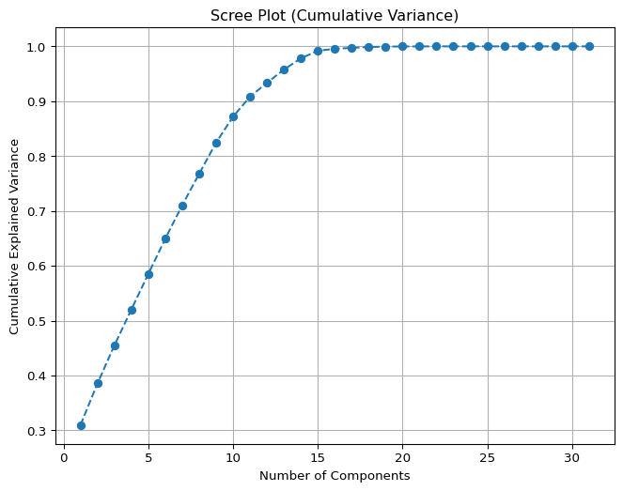
PCA Scree Plot

Slide 8
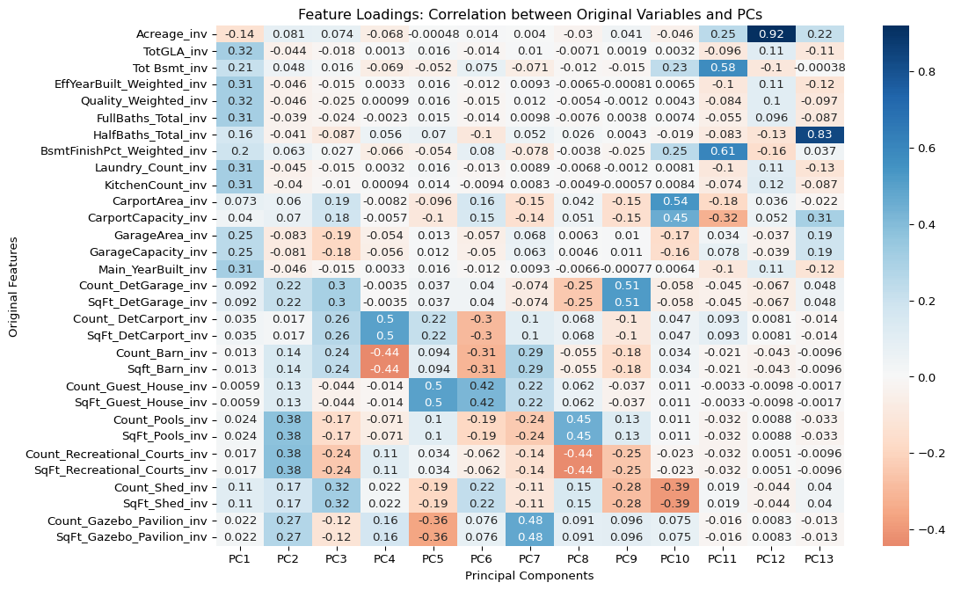
np.float64(0.957643490995838)
PCA Loading Matrix

Slide 9
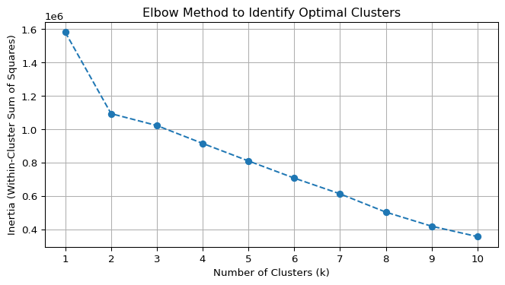
KMeans Cluster Scree Plot

Slide 10
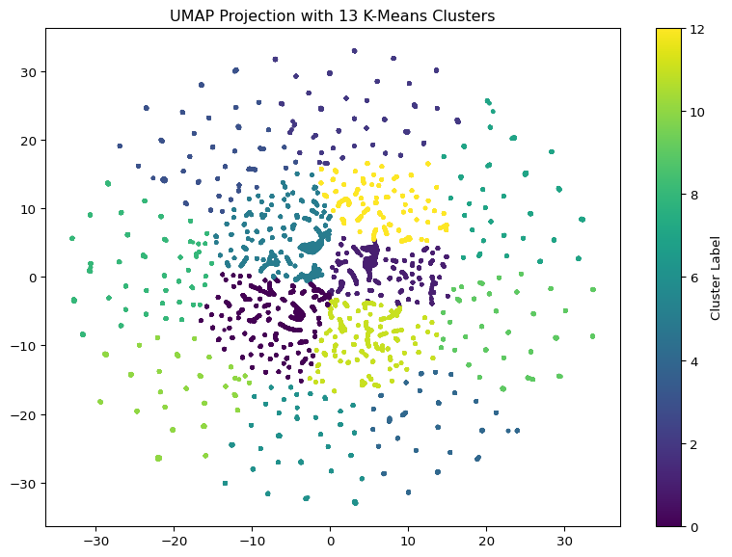
KMeans Clustering on UMAP

Slide 11
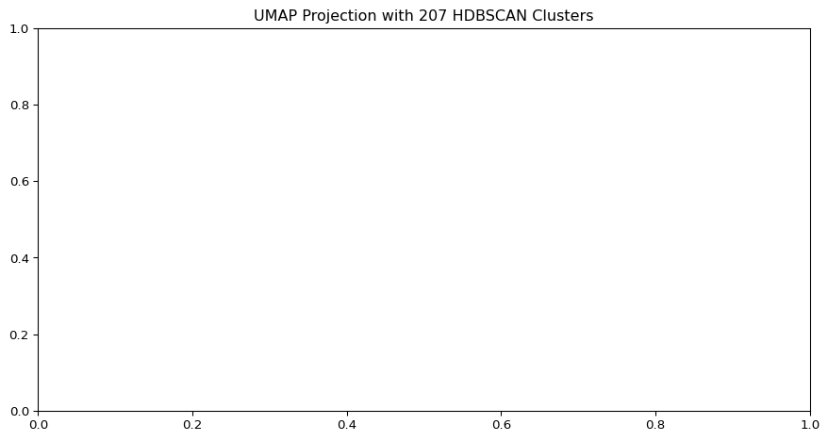
HDBSCAN Clustering on UMAP
HDBSCAN with min_cluster_size = 100 DBCV Score: 0.433

Slide 12
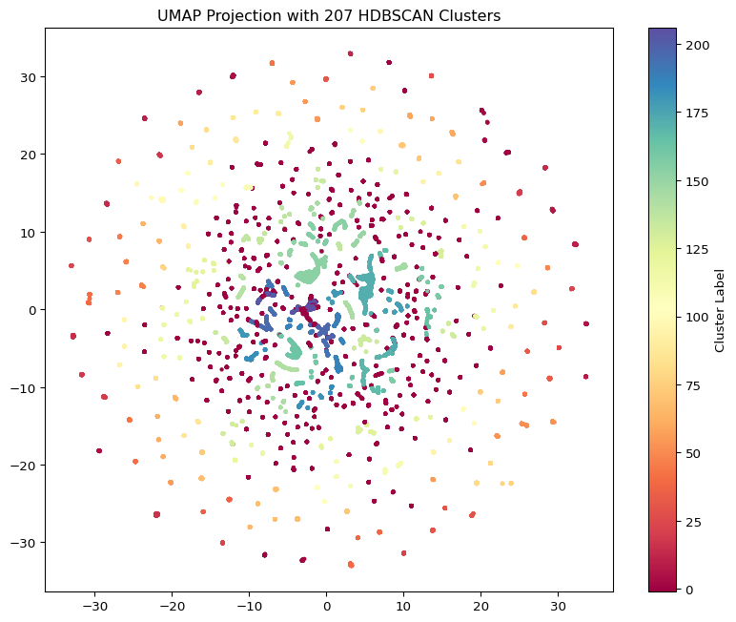

Slide 13
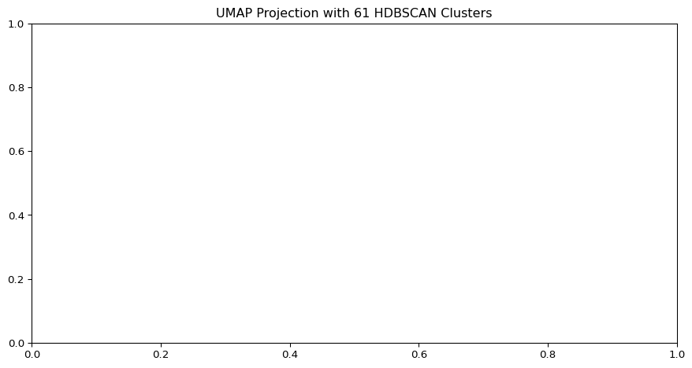
HDBSCAN with min_cluster_size = 200 DBCV Score: 0.204

Slide 14
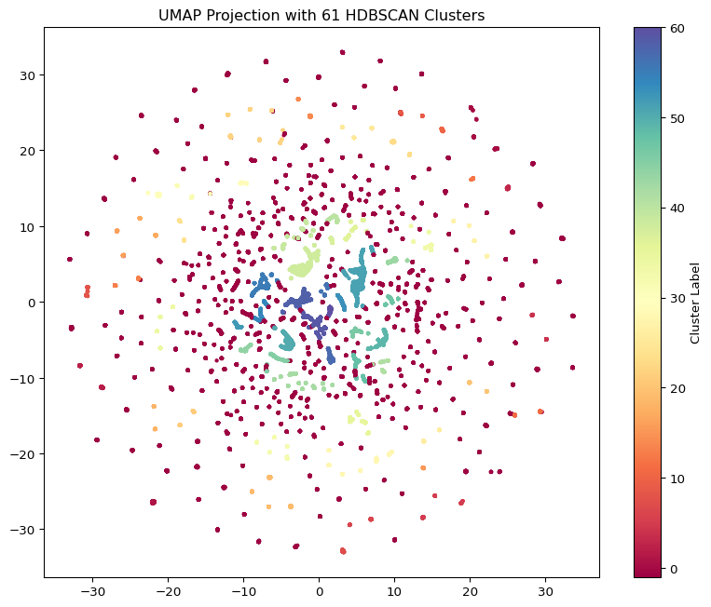

Slide 15

HDBSCAN with min_cluster_size = 300 DBCV Score: 0.105

Slide 16
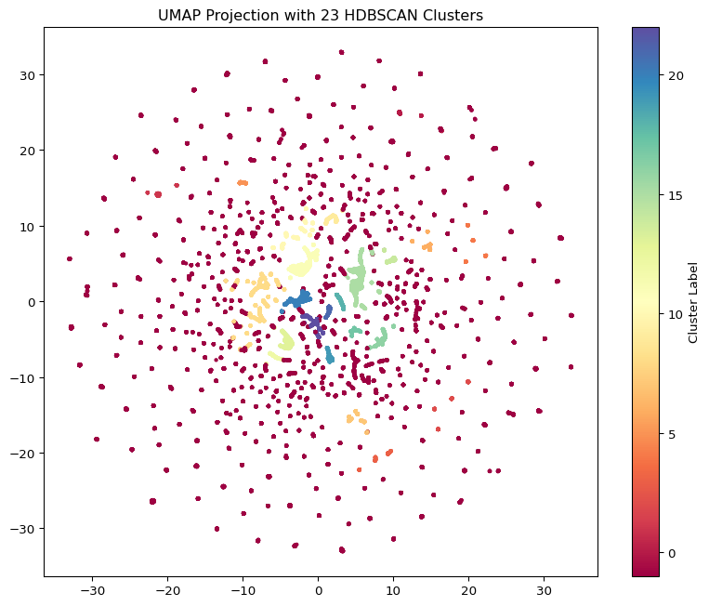

Slide 17

HDBSCAN with min_cluster_size = 400 DBCV Score: 0.109

Slide 18
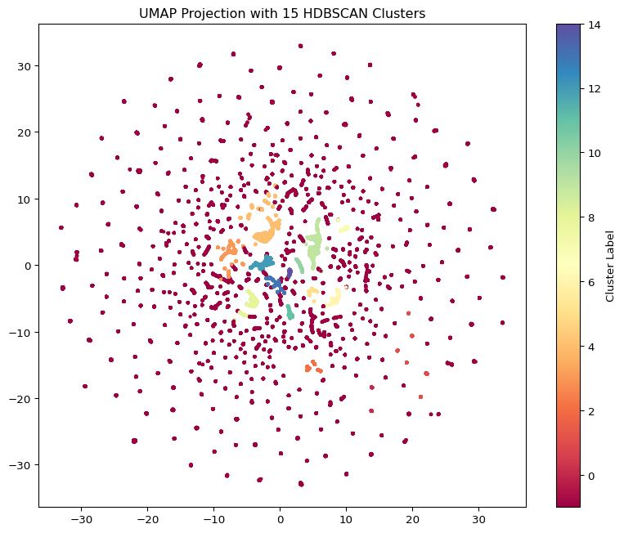

Slide 19

HDBSCAN with min_cluster_size = 500 DBCV Score: 0.128

Slide 20
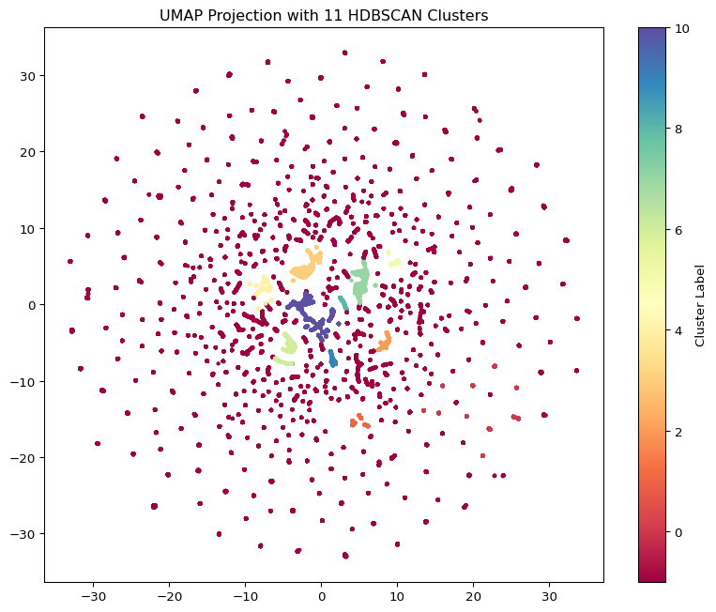

Slide 21
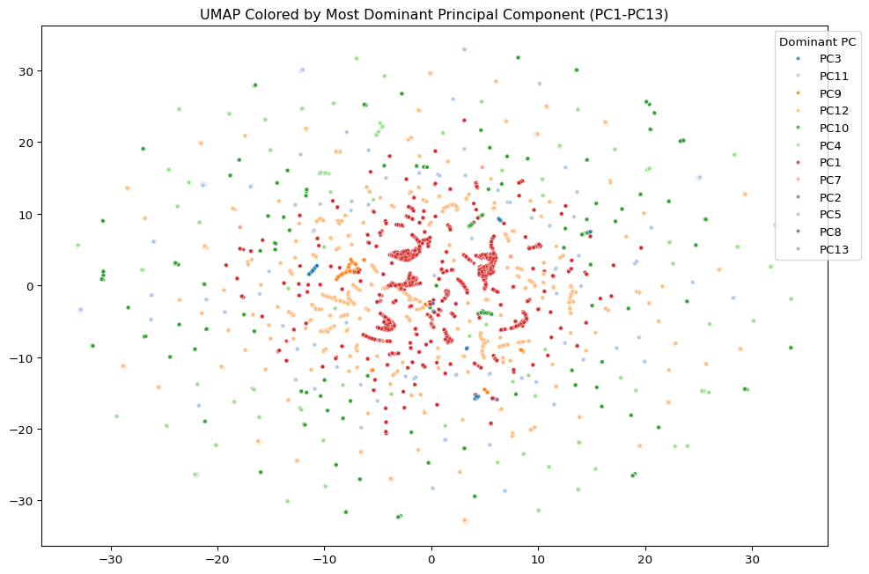
Cluster_ID -1 0 1 2 \ Acreage 18.336733 1.694803 4.232411 0.381417 TotGLA 376.522894 0.000000 2026.118644 2357.978076 Tot Bsmt 105.781521 0.000000 829.546139 0.000000 EffYearBuilt_Weighted 455.625879 0.000000 1947.155506 2016.424035 Quality_Weighted 0.730694 0.000000 3.184073 3.650960 FullBaths_Total 0.485541 0.000000 2.340866 2.204629 HalfBaths_Total 0.099164 0.000000 0.391714 1.057247 BsmtFinishPct_Weighted 0.048823 0.000000 0.243597 0.000000 Laundry_Count 0.243168 0.000000 1.035782 1.038977 KitchenCount 0.236682 0.000000 1.048964 1.046285 CarportArea 16.016536 0.000000 25.001883 0.000000 CarportCapacity 0.015921 0.000000 0.003766 0.000000 GarageArea 70.642465 0.000000 365.670433 787.194884 GarageCapacity 0.263754 0.000000 1.384181 2.781973 Main_YearBuilt 452.677562 0.000000 1927.000000 2010.567600 Count_DetGarage 0.023714 0.000000 0.915254 0.000000 SqFt_DetGarage 19.619315 0.000000 790.192090 0.000000 Count_ DetCarport 0.013177 0.000000 0.003766 0.000000 SqFt_DetCarport 4.086038 0.000000 0.783427 0.000000 Count_Barn 0.004333 0.000000 0.005650 0.000000 Sqft_Barn 13.853048 0.000000 13.529190 0.000000 Count_Guest_House 0.000154 0.000000 0.001883 0.000000 SqFt_Guest_House 0.044275 0.000000 1.647834 0.000000 Count_Pools 0.000103 0.000975 0.190207 0.000000 SqFt_Pools 0.072297 3.000000 91.598870 0.000000 Count_Recreational_Courts 0.000256 0.000000 0.101695 0.000000 SqFt_Recreational_Courts 0.754756 0.000000 177.617702 0.000000 Count_Shed 0.046839 0.000000 0.849341 0.000000 SqFt_Shed 44.036635 0.000000 287.860640 0.000000 Count_Gazebo_Pavilion 0.002641 0.000000 0.016949 0.000000 SqFt_Gazebo_Pavilion 0.787904 0.000000 4.483992 0.000000 Cluster_ID 3 4 5 6 \ Acreage 0.982635 6.759167 0.952322 9.586915 TotGLA 1715.797799 1963.410861 1668.413005 2113.201967 Tot Bsmt 1517.624949 475.091189 1392.783831 1365.997377 EffYearBuilt_Weighted 2011.217483 1968.827863 2008.167963 2011.410784 Quality_Weighted 3.369847 2.998924 3.299155 3.539513 FullBaths_Total 2.684876 2.200820 2.710018 2.533115 HalfBaths_Total 0.000000 0.299180 0.000000 0.859672 BsmtFinishPct_Weighted 0.722308 0.137387 0.742548 0.624643 Laundry_Count 1.028944 1.039959 1.029877 1.052459 KitchenCount 1.050958 1.060451 1.066784 1.082623 CarportArea 0.000000 38.840164 0.000000 0.000000 CarportCapacity 0.000000 0.000000 0.000000 0.000000 GarageArea 659.546270 313.729508 609.778559 650.291803 GarageCapacity 2.552385 1.190574 2.402460 2.423607 Main_YearBuilt 2000.587036 1954.908811 1992.815466 1999.491803 Count_DetGarage 0.000000 0.944672 0.000000 0.000000 SqFt_DetGarage 0.000000 852.193648 0.000000 0.000000 Count_ DetCarport 0.000000 0.000000 0.000000 0.000000 SqFt_DetCarport 0.000000 0.000000 0.000000 0.000000 Count_Barn 0.000000 0.000000 0.000000 0.000000 Sqft_Barn 0.000000 0.000000 0.000000 0.000000 Count_Guest_House 0.000000 0.001025 0.000000 0.000000 SqFt_Guest_House 0.000000 1.475410 0.000000 0.000000 Count_Pools 0.000000 0.000000 0.000000 0.000000 SqFt_Pools 0.000000 0.000000 0.000000 0.000000 Count_Recreational_Courts 0.000000 0.000000 0.001757 0.000000 SqFt_Recreational_Courts 0.000000 0.000000 3.149385 0.000000 Count_Shed 0.000000 0.000000 1.154657 0.284590 SqFt_Shed 0.000000 0.000000 234.254833 149.184918 Count_Gazebo_Pavilion 0.000000 0.000000 0.000000 0.000000 SqFt_Gazebo_Pavilion 0.000000 0.000000 0.000000 0.000000 Cluster_ID 7 8 9 10 Acreage 0.451026 0.360936 3.151010 13.889657 TotGLA 1828.140428 1695.228522 1418.329470 1561.472169 Tot Bsmt 0.000000 1544.281787 1029.377483 189.669546 EffYearBuilt_Weighted 2001.016772 2015.025973 2001.504073 1916.957261 Quality_Weighted 3.415253 3.476343 3.088960 2.775813 FullBaths_Total 2.145287 2.137457 2.311258 1.822137 HalfBaths_Total 0.000000 0.000000 0.000000 0.220409 BsmtFinishPct_Weighted 0.000000 0.000000 0.761385 0.106628 Laundry_Count 1.018950 1.017182 1.100993 1.000320 KitchenCount 1.011176 1.017182 1.259934 0.998401 CarportArea 0.000000 0.000000 0.000000 10.813180 CarportCapacity 0.000000 0.000000 0.000000 0.000000 GarageArea 643.680758 653.635739 0.000000 161.756558 GarageCapacity 2.427600 2.549828 0.001656 0.604287 Main_YearBuilt 1994.310982 2008.520619 1967.812914 1900.779591 Count_DetGarage 0.000000 0.000000 0.000000 0.095329 SqFt_DetGarage 0.000000 0.000000 0.000000 87.182022 Count_ DetCarport 0.000000 0.000000 0.000000 0.000000 SqFt_DetCarport 0.000000 0.000000 0.000000 0.000000 Count_Barn 0.000000 0.000000 0.000000 0.000000 Sqft_Barn 0.000000 0.000000 0.000000 0.000000 Count_Guest_House 0.000000 0.000000 0.001656 0.005438 SqFt_Guest_House 0.000000 0.000000 0.173841 2.743442 Count_Pools 0.000000 0.000000 0.000000 0.000320 SqFt_Pools 0.000000 0.000000 0.000000 0.255918 Count_Recreational_Courts 0.000000 0.000000 0.000000 0.000640 SqFt_Recreational_Courts 0.000000 0.000000 0.000000 1.215611 Count_Shed 0.000000 0.000000 0.000000 0.298784 SqFt_Shed 0.000000 0.000000 0.000000 63.856366 Count_Gazebo_Pavilion 0.000000 0.000000 0.000000 0.000000 SqFt_Gazebo_Pavilion 0.000000 0.000000 0.000000 0.000000
PCA Clustering on UMAP

Slide 22
Key Findings: PCA Components: - PC1: contains standard variables. - PC2: focus on recreational outdoor features (ex pools, rec courts, etc) - PC3: focus on utility outdoor features (ex sheds, barns, etc) - PC4: focus on aggrecultural vs recreational utility features (carport v barn) - PC5: focus on guest features vs personal features (guest house v gazebo) - PC6: focus on niche - PC7: focus on niche - PC8: focus on niche - PC9: focus on external vehical storage vs general utility (detached garage v shed) - PC10: focus on attached vehical storage vs general utility (carport v shed) - PC11: focus on basement space and completion over vehical storage - PC12: focus on the land - PC13: focus on half-bath
Essentially, the standard features are evaluated in the first PC. All subsequent components look at the different combonations of features for various focuses, such as recreation, utility, etc.
The first PC (standard features) account for approximately 30% of variation in the home. All other feature account for 70% of what makes one home different from one another, with the biggest focuses for differentiation being recreation, utility, and, storage. Features such as half-bathrooms, while accounting for varation take up minimal percentage of differentiation.
This is specifically with Iron county properties. As the majority of these homes are rural and thus are chosen based on these features, it makes sense that they account for 70% of home variation.
If the final project is a program that will take features and output price, it may also be useful to adapt this toward the buyer themself, and allow them to determine their focus, placing weights on the pc’s themselves based on desired focus.

Slide 23
Supervised Learning
 | Sold Price | CPI Adjusted Sold Price
count | 8.471000e+03 | 8.469000e+03
mean | 4.245680e+05 | 4.216113e+05
std | 1.892971e+05 | 1.874102e+05
min | 0.000000e+00 | 0.000000e+00
25% | 3.148500e+05 | 3.116984e+05
50% | 3.900000e+05 | 3.899000e+05
75% | 4.950000e+05 | 4.890000e+05
max | 2.370000e+06 | 2.370000e+06
Create Merged Dataset
View Merged Numeric Variables
['3/4 Baths', 'Acreage', 'Basement SqFt', 'BsmtFinishPct_Weighted', 'Cancel Date', 'CarportArea', 'CarportCapacity', 'Concessions Amount', 'Concessions4', 'Count_ DetCarport', 'Count_Barn', 'Count_DetGarage', 'Count_Gazebo_Pavilion', 'Count_Guest_House', 'Count_Pools', 'Count_Recreational_Courts', 'Count_Shed', 'Days on Market', 'EffYearBuilt_Weighted', 'End Date', 'Fallthrough Date', 'Finished SqFt', 'Fireplaces2', 'Full Baths', 'Full Baths3', 'FullBaths_Total', 'Garage Capacity', 'GarageArea', 'GarageCapacity', 'HOA Dues $', 'Half Baths', 'HalfBaths_Total', 'ImpCode', 'ImpOnly', 'Jurisdiction', 'KitchenCount', 'Kitchens', 'Lat', 'Laundry_Count', 'List Number', 'List Price', 'Lng', 'Lofts', 'Lot Acres', 'Lot Dimensions', 'MLS Area', 'Main SqFt', 'Main_YearBuilt', 'Marketing Begin Date', 'Original List Price', 'Postal Code', 'PropType ', 'Quality_Weighted', 'Res Imp Count', 'ReviewedDate', 'Sold Price', 'Sold Price Per/SqFt', 'Special Taxes (SID)$', 'SpecificPropType', 'SqFt_DetCarport', 'SqFt_DetGarage', 'SqFt_Gazebo_Pavilion', 'SqFt_Guest_House', 'SqFt_Pools', 'SqFt_Recreational_Courts', 'SqFt_Shed', 'Sqft_Barn', 'TaxYear', 'Tot Bsmt', 'TotGLA', 'Total Bedrooms', 'Total SqFt', 'Total Taxes', 'Total Units', 'Upstairs SqFt', 'Withdrawal Date', 'Year Built']
View Merged Non-Numeric Variables
['Accessability', 'Active', 'Address', 'Address 2', 'Agency Email', 'Agency Name', 'Agency Phone', 'Area', 'Basement', 'Book Section', 'Bsmt % Finish', 'Card Format', 'City', 'Co-Listing Agent', 'Co-Selling Agent', 'Concessions', 'Concessions Available', 'Contingent', 'Contingent Remarks', 'County', 'Covered Parking', 'Delayed Marketing Exempt Listing', 'Directions', 'Elementary', 'Features', 'Financing Remarks', 'Fireplaces', 'For Sale or Rent', 'Garage Type', 'HOA', 'HOA Dues Frequency', 'How Sold', 'IsIncluded', 'Jr. High', 'Laundry', 'Listing Agent', 'Listing Agent Email', 'Listing Agent Phone', 'Listing Date', 'Listing Type', 'MainImp.GroupCode', 'Main_StyleDesc', 'NbhdCode2', 'Owner', 'Owner/Agent', 'PUD', 'Parcel ID Check', 'ParcelId', 'Parking Covered', 'Parking Uncovered', 'Photo URL', 'Private Remarks', 'PropTypeDescription', 'Property Type', 'Public Remarks', 'RecordType', 'ReviewedBy', 'Road Condition', 'Rooms', 'Selling Agency', 'Selling Agency Email', 'Selling Agency Phone', 'Selling Agent', 'Selling Agent Email', 'Selling Agent Phone', 'Senior Community', 'Sold Date', 'SpecificPropTypeDescription', 'Square Foot Source', 'Sr. High', 'St. #', 'St. Dir.', 'State/Province', 'Status', 'Status Change Date', 'Street Direction Sfx', 'Street Name', 'Street Suffix', 'Sub Type', 'Subdivision_x', 'Subdivision_y', 'Tax Serial #', 'Type', 'Under Contract Date', 'Utilities', 'Zoned', 'mod_timestamp']
Identify City
Loading formatted geocoded file...
city Cedar City 24138 Enterprise 12232 Enoch 8953 Parowan 8805 Takoradi 1722 Unknown 1355 Pioche 463 Milford 94 Panguitch 69 Beaver 43 Toquerville 30 Name: count, dtype: int64
CPI Adjusted Sales Price

Slide 24
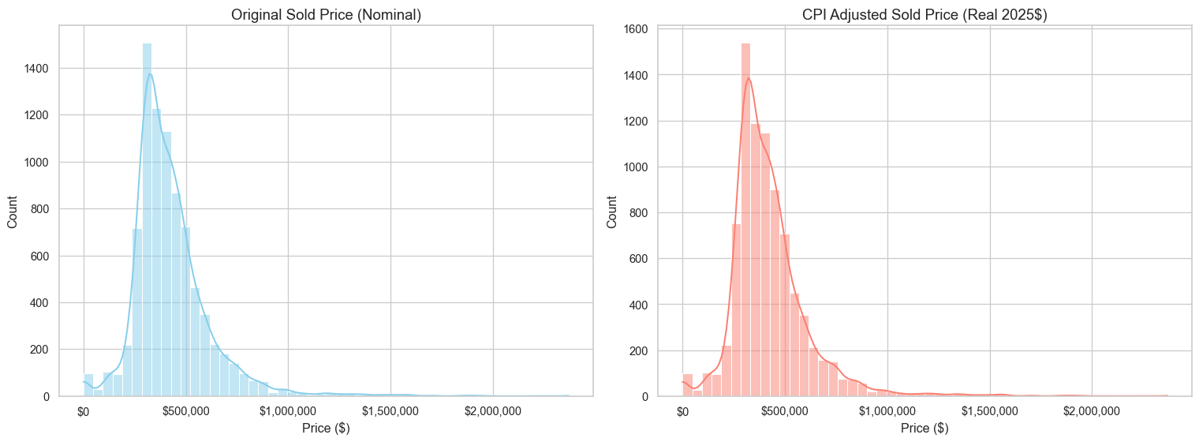
Price Evaluation

Slide 25
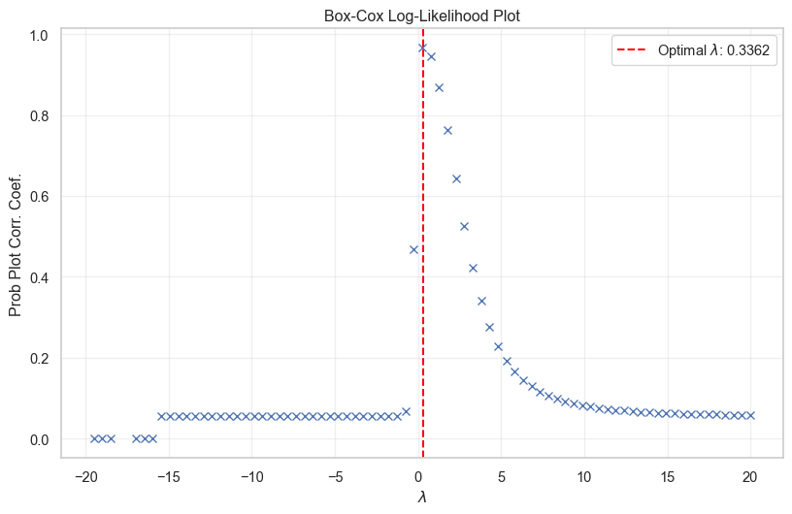
BoxCox Plot

Slide 26
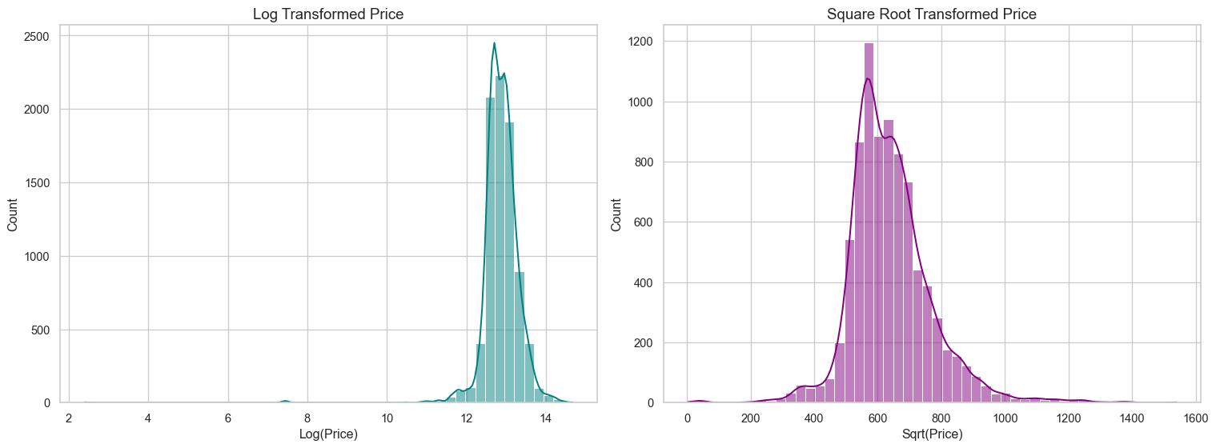
Price Transformation

Slide 27
count 8469.000000 mean 633.438221 std 142.722652 min 0.000000 25% 558.299542 50% 624.419731 75% 699.285349 max 1539.480432 Name: Sqrt CPI Adjusted Sold Price, dtype: float64
Primary Component Regression
OLS Regression Results ======================================================================================== Dep. Variable: Sqrt CPI Adjusted Sold Price R-squared: 0.285 Model: OLS Adj. R-squared: 0.284 Method: Least Squares F-statistic: 207.3 Date: Thu, 05 Mar 2026 Prob (F-statistic): 0.00 Time: 21:52:47 Log-Likelihood: -42108. No. Observations: 6775 AIC: 8.424e+04 Df Residuals: 6761 BIC: 8.434e+04 Df Model: 13 Covariance Type: nonrobust ============================================================================== coef std err t P>|t| [0.025 0.975] ------------------------------------------------------------------------------ const 671.3390 3.619 185.482 0.000 664.244 678.434 PC1 -1.4480 0.979 -1.479 0.139 -3.367 0.471 PC2 10.8828 0.918 11.856 0.000 9.083 12.682 PC3 -0.9912 0.801 -1.237 0.216 -2.562 0.579 PC4 -11.8402 0.788 -15.032 0.000 -13.384 -10.296 PC5 -0.4351 0.944 -0.461 0.645 -2.286 1.416 PC6 0.0710 0.922 0.077 0.939 -1.737 1.879 PC7 -0.1284 0.912 -0.141 0.888 -1.916 1.659 PC8 -3.2435 1.011 -3.208 0.001 -5.226 -1.262 PC9 8.9847 0.927 9.692 0.000 7.167 10.802 PC10 -3.8824 0.934 -4.156 0.000 -5.714 -2.051 PC11 44.6430 1.208 36.949 0.000 42.275 47.012 PC12 87.9426 2.695 32.632 0.000 82.660 93.226 PC13 30.2995 1.522 19.913 0.000 27.317 33.282 ============================================================================== Omnibus: 1882.974 Durbin-Watson: 1.993 Prob(Omnibus): 0.000 Jarque-Bera (JB): 24892.473 Skew: -0.957 Prob(JB): 0.00 Kurtosis: 12.193 Cond. No. 10.3 ============================================================================== Notes: [1] Standard Errors assume that the covariance matrix of the errors is correctly specified. feature VIF 0 const 6.043072 12 PC12 1.620867 1 PC1 1.544146 13 PC13 1.494614 11 PC11 1.383479 2 PC2 1.168315 5 PC5 1.164134 7 PC7 1.125575 6 PC6 1.125246 3 PC3 1.094661 4 PC4 1.061337 10 PC10 1.038623 9 PC9 1.026177 8 PC8 1.022681
This is the Physical Property Effect. Approximately 30% of the variance in price is explained by the weighted features of the home.
Pre-PCA Regression
OLS Regression Results ======================================================================================== Dep. Variable: Sqrt CPI Adjusted Sold Price R-squared: 0.484 Model: OLS Adj. R-squared: 0.481 Method: Least Squares F-statistic: 203.7 Date: Thu, 05 Mar 2026 Prob (F-statistic): 0.00 Time: 21:52:47 Log-Likelihood: -41006. No. Observations: 6775 AIC: 8.208e+04 Df Residuals: 6743 BIC: 8.229e+04 Df Model: 31 Covariance Type: nonrobust ============================================================================================= coef std err t P>|t| [0.025 0.975] --------------------------------------------------------------------------------------------- const 564.0150 4.201 134.245 0.000 555.779 572.251 Acreage 4.4738 0.424 10.563 0.000 3.644 5.304 TotGLA 0.1106 0.004 30.462 0.000 0.104 0.118 Tot Bsmt 0.0416 0.003 15.421 0.000 0.036 0.047 EffYearBuilt_Weighted -0.2606 0.120 -2.164 0.030 -0.497 -0.025 Quality_Weighted 46.4397 3.030 15.329 0.000 40.501 52.379 FullBaths_Total -3.1202 3.062 -1.019 0.308 -9.122 2.882 HalfBaths_Total -33.0046 2.802 -11.780 0.000 -38.497 -27.512 BsmtFinishPct_Weighted 36.3948 5.555 6.552 0.000 25.506 47.284 Laundry_Count -2.8292 8.181 -0.346 0.729 -18.867 13.209 KitchenCount 1.7034 6.780 0.251 0.802 -11.587 14.994 CarportArea 0.0706 0.017 4.261 0.000 0.038 0.103 CarportCapacity -12.8534 7.277 -1.766 0.077 -27.119 1.412 GarageArea 0.0704 0.008 9.321 0.000 0.056 0.085 GarageCapacity -1.9296 1.976 -0.976 0.329 -5.804 1.945 Main_YearBuilt 0.1068 0.122 0.878 0.380 -0.132 0.345 Count_DetGarage 17.5565 7.590 2.313 0.021 2.678 32.435 SqFt_DetGarage 0.0255 0.007 3.650 0.000 0.012 0.039 Count_ DetCarport -12.2928 12.123 -1.014 0.311 -36.057 11.472 SqFt_DetCarport 0.0209 0.034 0.611 0.541 -0.046 0.088 Count_Barn 49.7795 30.889 1.612 0.107 -10.773 110.332 Sqft_Barn 0.0047 0.017 0.272 0.786 -0.029 0.039 Count_Guest_House 341.6486 290.612 1.176 0.240 -228.042 911.339 SqFt_Guest_House -1.7106 1.356 -1.261 0.207 -4.370 0.949 Count_Pools 38.9031 36.294 1.072 0.284 -32.244 110.051 SqFt_Pools -0.3083 0.183 -1.687 0.092 -0.666 0.050 Count_Recreational_Courts -88.5585 143.072 -0.619 0.536 -369.024 191.907 SqFt_Recreational_Courts 0.0833 0.107 0.780 0.435 -0.126 0.293 Count_Shed 2.5707 3.924 0.655 0.512 -5.121 10.262 SqFt_Shed -0.0038 0.011 -0.364 0.716 -0.024 0.017 Count_Gazebo_Pavilion 53.0459 34.866 1.521 0.128 -15.303 121.395 SqFt_Gazebo_Pavilion -0.3660 0.157 -2.337 0.019 -0.673 -0.059 ============================================================================== Omnibus: 4042.256 Durbin-Watson: 1.986 Prob(Omnibus): 0.000 Jarque-Bera (JB): 119695.097 Skew: -2.338 Prob(JB): 0.00 Kurtosis: 23.054 Cond. No. 7.50e+05 ============================================================================== Notes: [1] Standard Errors assume that the covariance matrix of the errors is correctly specified. [2] The condition number is large, 7.5e+05. This might indicate that there are strong multicollinearity or other numerical problems. feature VIF 15 Main_YearBuilt 3103.788815 4 EffYearBuilt_Weighted 3065.655487 23 SqFt_Guest_House 47.640107 22 Count_Guest_House 47.627853 26 Count_Recreational_Courts 13.458923 27 SqFt_Recreational_Courts 13.229463 0 const 11.244707 5 Quality_Weighted 6.882671 24 Count_Pools 5.196083 25 SqFt_Pools 5.174715 9 Laundry_Count 4.852767 6 FullBaths_Total 4.456338 13 GarageArea 4.163046 2 TotGLA 4.119720 14 GarageCapacity 3.855262 10 KitchenCount 3.744640 30 Count_Gazebo_Pavilion 3.413992 31 SqFt_Gazebo_Pavilion 3.232883 21 Sqft_Barn 2.792220 20 Count_Barn 2.768442 16 Count_DetGarage 2.692618 8 BsmtFinishPct_Weighted 2.677584 17 SqFt_DetGarage 2.667627 3 Tot Bsmt 2.226790 18 Count_ DetCarport 2.160068 19 SqFt_DetCarport 2.089658 11 CarportArea 1.679029 12 CarportCapacity 1.525499 28 Count_Shed 1.484609 29 SqFt_Shed 1.391041 7 HalfBaths_Total 1.252252 1 Acreage 1.093759
The reason the PCA’s were used initially are because the PC’s are orthgonal to eachother, which means there is no multicollinearity between the components. In a model using the same variables as what was used to compute the PC’s, we do see a higher $R^{2}$ value, but that is due to the overfitting of the model which is a result of the multicollinearity evidenced by the VIF output.

