Slide 1

ECG Heartbeat Classification
Addressing Class Imbalance with SMOTE in Deep Residual CNNs
Ribbie Mohammad Omar
Roll: 2110041
Md. Abdullah Ibna Shad
Roll: 2110042
Department of ECE
1-D ResNet
TensorFlow
SMOTE
MIT-BIH Dataset
5-Class
1 / 13

Slide 2
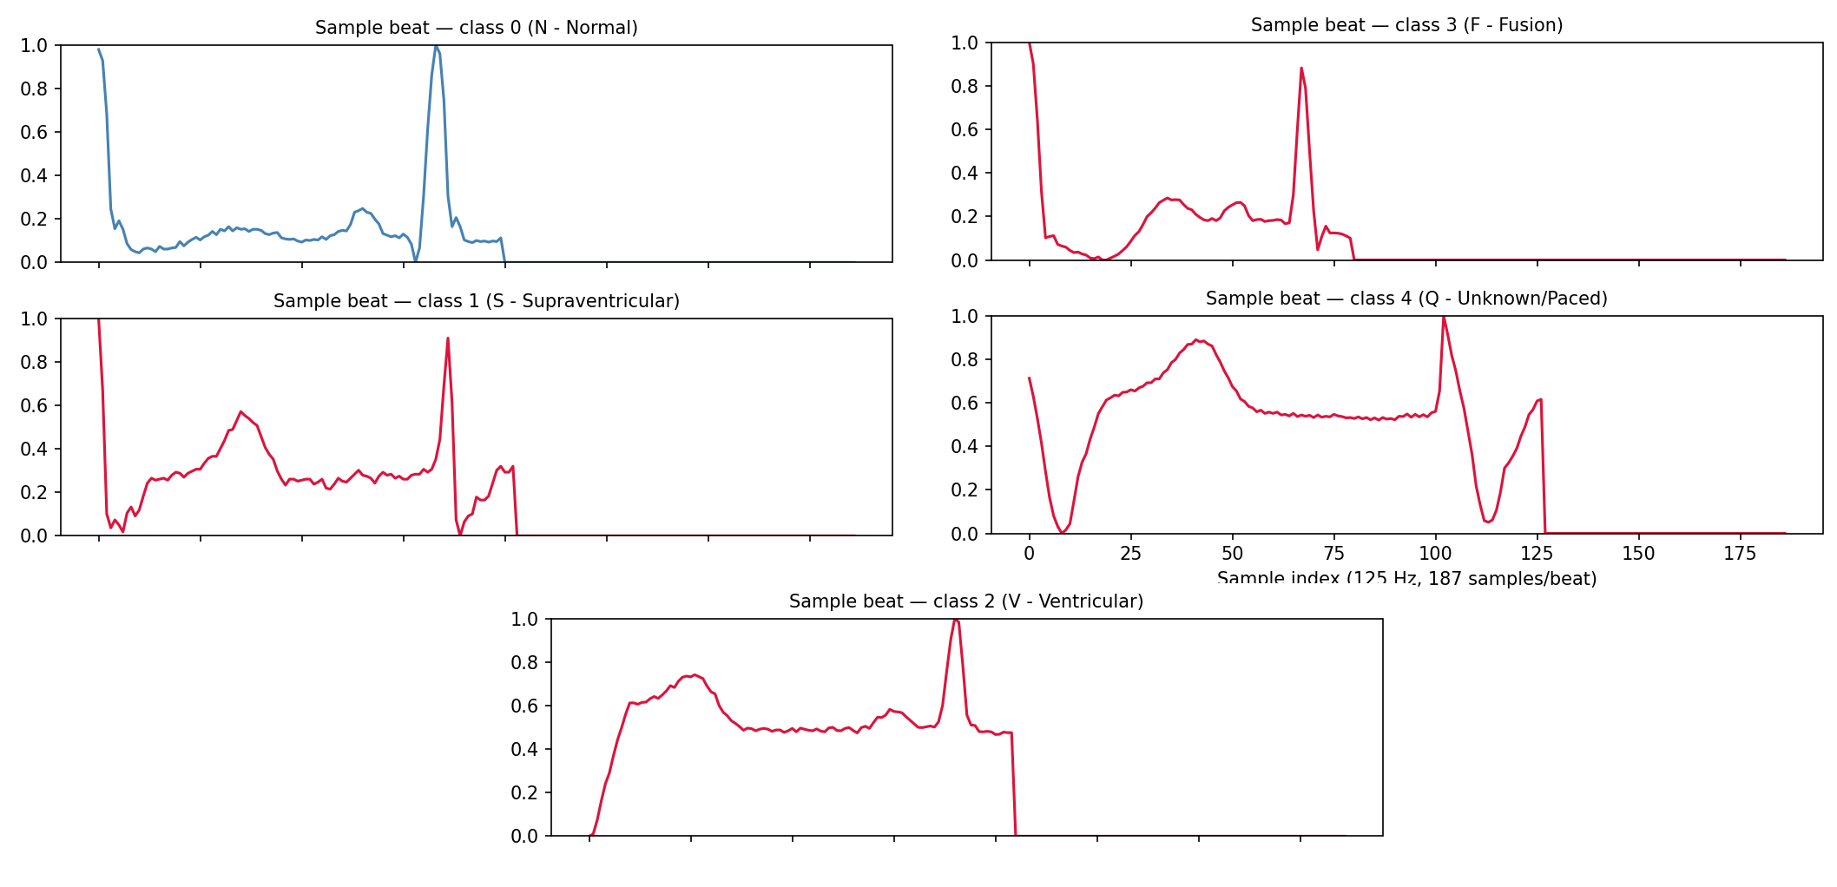
BACKGROUND
Why Automated ECG Classification?
Patient
ECG Waveform Morphology
ECG Recording
Beat Detection
AI Classification
Clinical Decision
Manual ECG analysis is time-intensive and error-prone — deep learning automates reliable arrhythmia detection.
2 / 13

Slide 3
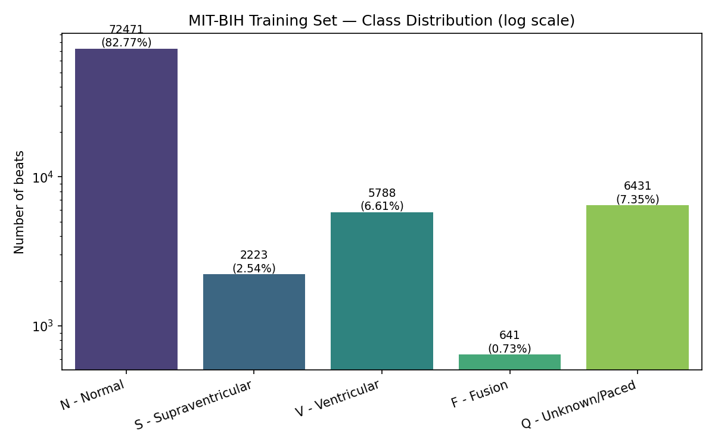
PROBLEM
The Class Imbalance Problem
Training Set Distribution
N — Normal
82.7%
Q — Paced
7.3%
V — Ventricular
6.6%
S — Supraventricular
2.5%
F — Fusion
0.7%
⚠ 82.7% Normal beats dominate — standard models miss rare, dangerous arrhythmias
3 / 13

Slide 4
LITERATURE
Evolution of ECG Classification
1
2
3
4
5
Traditional ML
Handcrafted Features
CNN
Residual CNN
Our Approach
SVM, KNN Decision Trees
Wavelets Statistical
Automated Feature Learning
Skip Connections Deep Networks
ResNet + SMOTE Balanced Training
Reference: Kachuee et al. (2018) — ECG Heartbeat Classification: A Deep Transferable Representation
4 / 13

Slide 5
OBJECTIVES
Project Objectives
🏗️
⚖️
🎯
📊
Implement Residual CNN
Handle Class Imbalance
Improve Minority Recall
Compare Baseline vs SMOTE
Reproduce Kachuee et al. 1-D ResNet architecture
Apply SMOTE to balance training distribution
Increase sensitivity for S and F arrhythmia classes
Controlled experiment with identical architectures
5 / 13

Slide 6
METHODOLOGY
Proposed Pipeline
MIT-BIH Dataset
Pipeline Details
Color Legend
87,554 Train · 21,892 Test
▸ CSV → Numpy → Reshape (N, 187, 1)
Baseline
▸ SMOTE applied to training set ONLY
Preprocessing
SMOTE
▸ Same CNN for both experiments
Shared
▸ Adam optimizer, LR = 1e-3
Baseline Path
SMOTE Path
▸ Batch size: 256, Epochs: 30
▸ EarlyStopping (patience=5)
▸ ReduceLROnPlateau (patience=3)
1-D Residual CNN
▸ Evaluated on identical test set
Evaluation & Comparison
6 / 13

Slide 7
ARCHITECTURE
1-D Residual CNN Architecture
Input (187, 1)
Residual Block Detail
Model Stats
Conv1D (32, 5)
Input Tensor
Conv Layers
11
Skip Connection → Add
Residual Blocks
5
Residual Block × 5
Conv1D + ReLU
Dense Layers
3
Conv1D
Flatten
Kernel Size
5
Add (Skip)
Dense (32) + ReLU
Filters
32
ReLU
Pool Size
5
Dense (32) + ReLU
MaxPool1D (5,2)
Pool Stride
2
Softmax (5)
The same CNN architecture was used for both experiments to ensure a fair, controlled comparison.
7 / 13

Slide 8
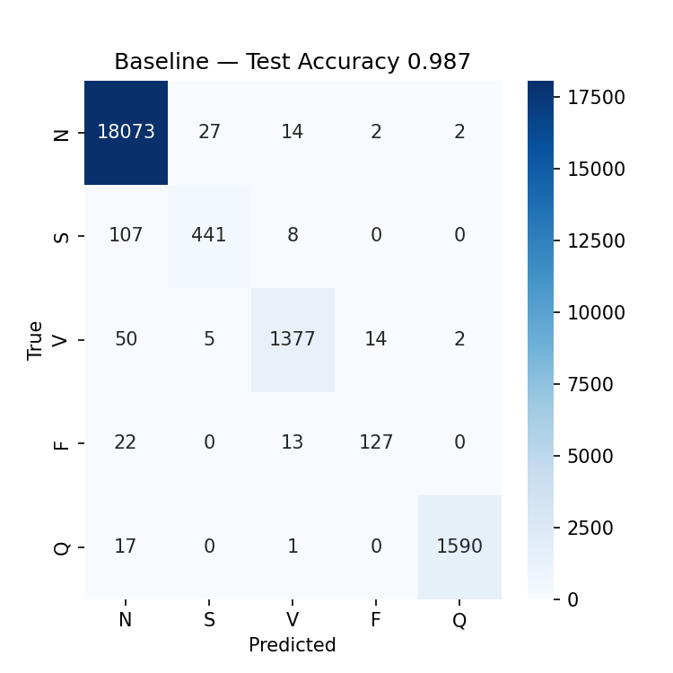
BASELINE RESULTS
Baseline Model Performance
98.70%
92.78%
Overall Accuracy
Macro F1-Score
79.3%
78.4%
Recall — Class S
Recall — Class F
95.1%
98.9%
Recall — Class V
Recall — Class Q
⚠ Missing >20% of S and F arrhythmias
8 / 13

Slide 9
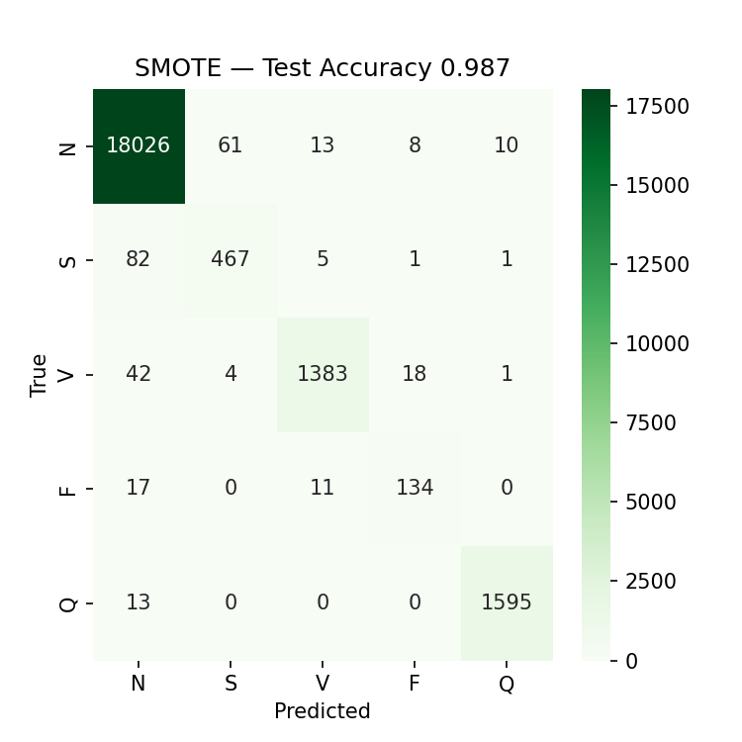
SMOTE RESULTS
SMOTE Model Performance
98.69%
92.81%
Overall Accuracy
Macro F1-Score
▲ +4.7%
▲ +4.3%
84.0%
82.7%
Recall — Class S
Recall — Class F
95.5%
99.2%
Recall — Class V
Recall — Class Q
✓ SMOTE significantly improved minority class detection
9 / 13

Slide 10
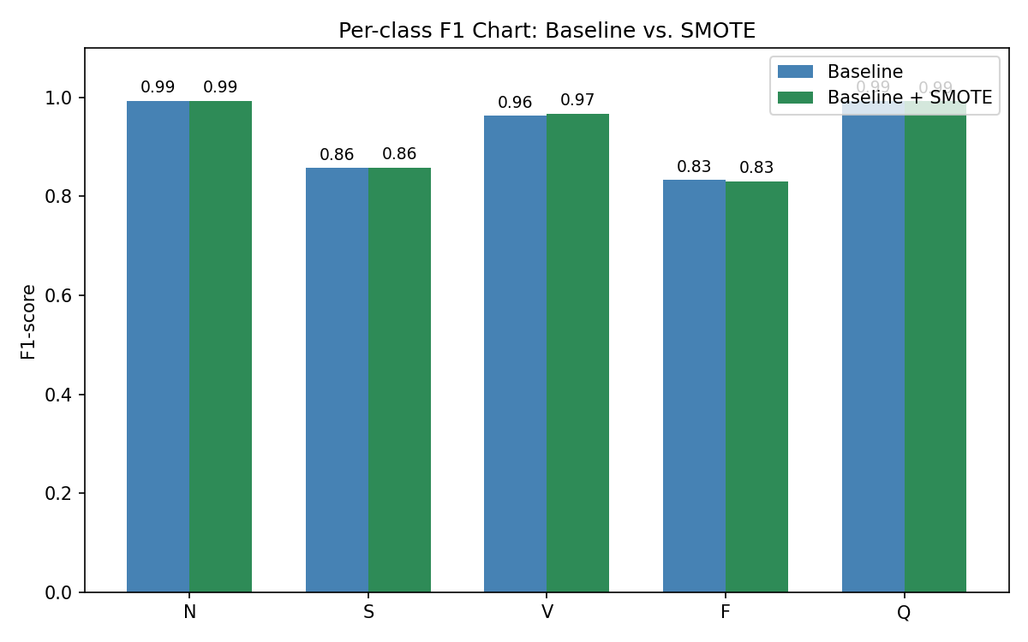
COMPARISON
Baseline vs SMOTE — Head-to-Head
Overall Accuracy
≈ Same
98.70% → 98.69%
Minority Recall
▲ Improved
S: +4.7% F: +4.3%
Clinical Sensitivity
▲ Improved
Fewer missed arrhythmias
Metric Comparison
Metric
Baseline
SMOTE
Delta
Accuracy
98.70%
98.69%
-0.01%
Macro F1
92.78%
92.81%
+0.03%
Recall (S)
79.3%
84.0%
+4.67%
Recall (F)
78.4%
82.7%
+4.32%
10 / 13

Slide 11
KEY INSIGHTS
Key Findings
📈
🏥
⚖️
SMOTE Effectiveness
Recall Over Accuracy
Precision-Recall Trade-off
Synthetic oversampling improved minority class detection by up to +4.67% recall without degrading overall accuracy.
In medical diagnosis, missing a dangerous arrhythmia (false negative) is far worse than a false alarm. Recall is the priority metric.
SMOTE shifted decision boundaries: precision on Class S dropped from 93.2% → 87.8% while recall rose from 79.3% → 84.0%.
Overall accuracy is a misleading metric in imbalanced medical datasets — class-specific recall reveals the true clinical picture.
11 / 13

Slide 12
CONCLUSION
Conclusion
SMOTE improved minority heartbeat detection while maintaining excellent overall CNN performance.
✓
Baseline Successfully Reproduced
98.70% accuracy on MIT-BIH dataset
✓
Minority Recall Improved
Class S: +4.67% | Class F: +4.32%
✓
Reproducible Pipeline
Modular code, documented, open-source ready
12 / 13

Slide 13
Thank You
Questions?
Ribbie Mohammad Omar · Md. Abdullah Ibna Shad
Department of Electrical and Computer Engineering
13 / 13

