Slide 1

PROJECT PROPOSAL | ECE - 4144 BIOMEDICAL ENGINEERING
ECG Heartbeat Classification
A Deep Transferable Representation — and fixing its class-imbalance blind spot
PROJECT MEMBERS:
RIBBIE MOHAMMAD OMAR 2110041 MD. ABDULLAH IBNA SHAD
2110042
Base paper: Kachuee, Fazeli & Sarrafzadeh — IEEE ICHI 2018 (arXiv:1805.00794)

Slide 2

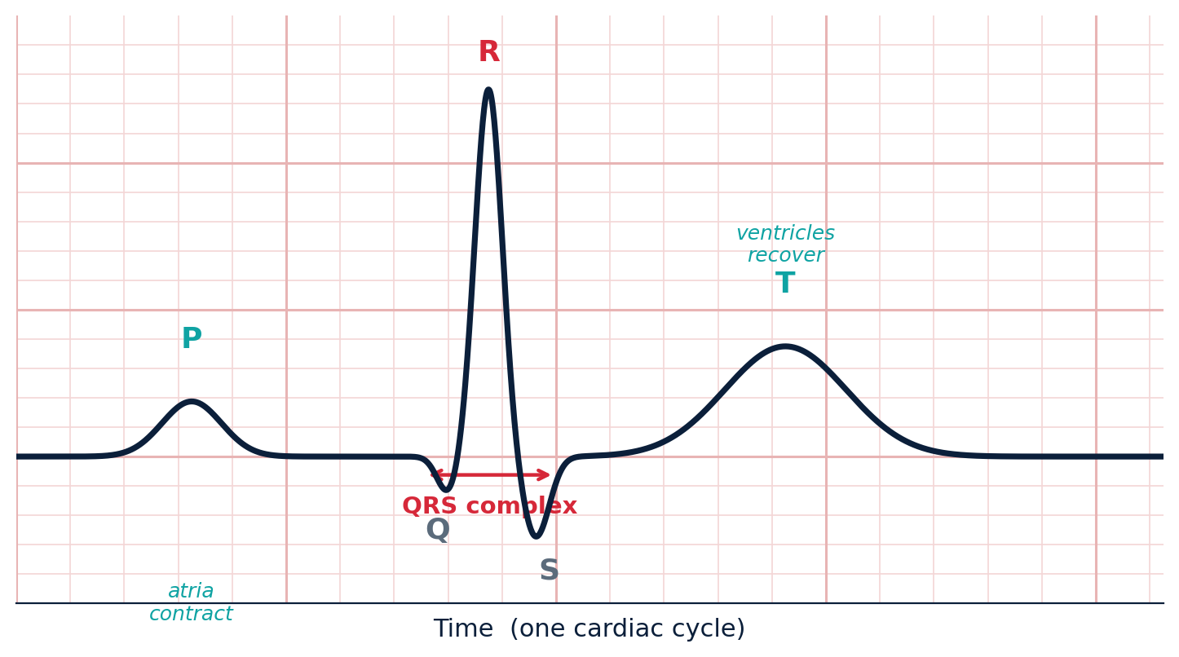
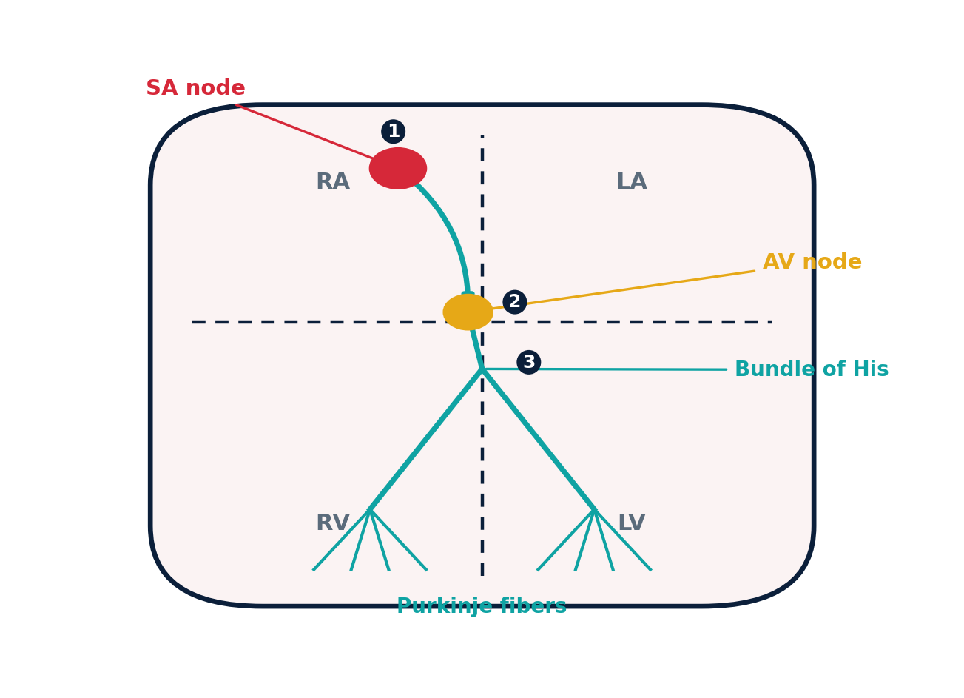
Background
The signal, and why it needs automating
ECG = the heart's electrical signal across one cardiac cycle.
P wave: atria contract · QRS: ventricles contract · T wave: ventricles recover.
Manual interpretation is slow and doesn't scale → motivates automated classification.
AAMI EC57 standard groups beats into 5 classes: N, S, V, F, Q.
PQRST waveform — what the signal looks like
Conduction system (SA→AV→Purkinje) — why it looks that way

Slide 3


Literature Review
Where the base paper sits, and what beats it
Work | Approach | Handles imbalance? | MIT-BIH accuracy
Kachuee et al., 2018 (base paper) | 1-D residual CNN | No | 93.4%
Hybrid CNN + BLSTM (2022) | CNN + bidirectional LSTM | Yes — SMOTE | 94.24%
Improved ResNet-18 (2021) | Deeper residual CNN | No | 96.50%
1-D deep ResNet + SMOTE (2023) | 1-D ResNet | Yes — SMOTE | Strong per-class F1
Takeaway: handling the class imbalance is a cheaper route to better scores than piling on a deeper architecture.

Slide 4

Motivation
One class drowns out the rest
Training set is 82.8% Normal vs. ~17% combined arrhythmia beats.
"Always predict Normal" already scores ≈ 83% → headline accuracy is misleading.
The rarest class (F, 0.7%) is exactly the clinically dangerous one.
Fix: rebalance the training data before the classifier ever sees it.
MIT-BIH training beats per class
83%
accuracy from guessing "Normal" every time

Slide 5

Tentative Model & Dataset
Same backbone, one new block
Raw ECG
beats
Preprocess
& segment
SMOTE
balancing
1-D Residual
CNN
Softmax
→ 5 classes
lead II · 125 Hz
187 samples/beat
NEW — our block
baseline backbone
N · S · V · F · Q
Evaluation now reports accuracy AND per-class precision / recall / F1 — not accuracy alone.
Dataset — MIT-BIH Arrhythmia (PhysioNet) via the pre-processed Kaggle CSVs
109,446
187
125 Hz
87,554 / 21,892
5
total beats
samples / beat
sampling rate
train / test split
AAMI classes
Gray blocks = unchanged baseline · Teal block = our entire contribution

Slide 6




Conclusion
PROBLEM
FIX
EXPECTED GAIN
Imbalance hides failure
Add SMOTE balancing
Higher recall on rare beats
Baseline reports strong overall accuracy but likely under-detects rare arrhythmias.
Rebalance minority classes before training — no architecture change, ~3 lines of code.
Similar overall accuracy, clearly better recall / F1 on S, V, F, Q — the dangerous classes.
Why it matters: the classes SMOTE improves are exactly the clinically dangerous arrhythmias.

