Slide 1
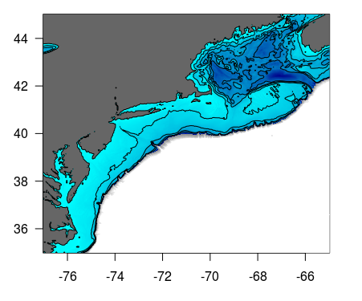
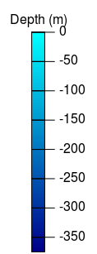
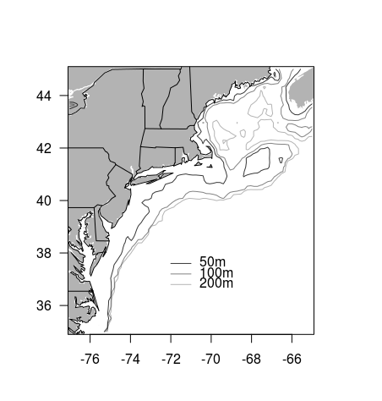

Slide 2
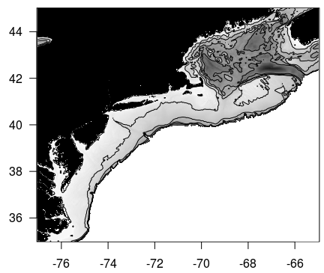
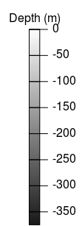
GOM
JB
WB
GR BB
GB
NS
GBK
MAB

Slide 3
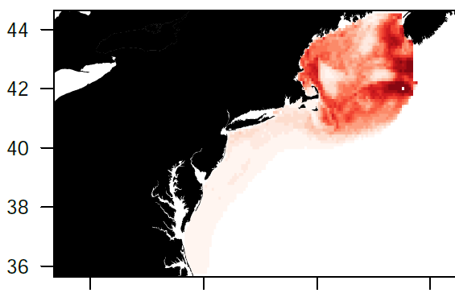
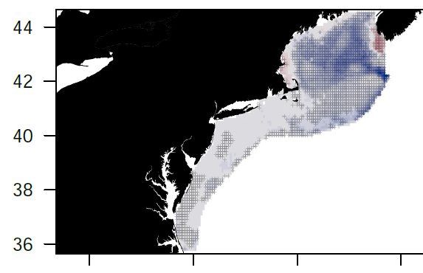
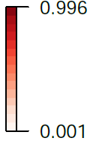
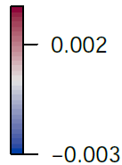
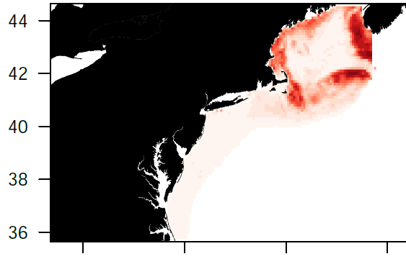
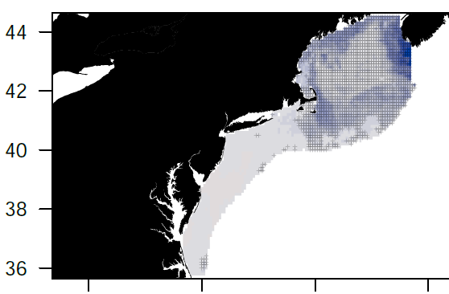
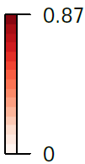
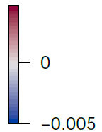
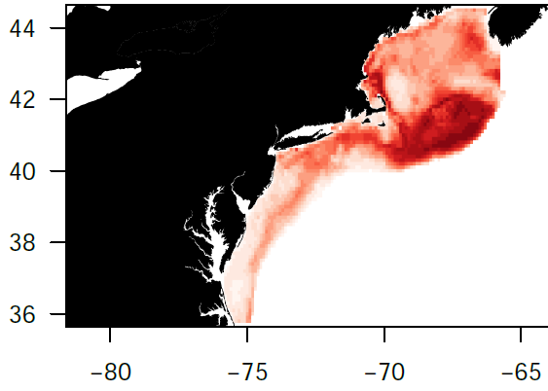
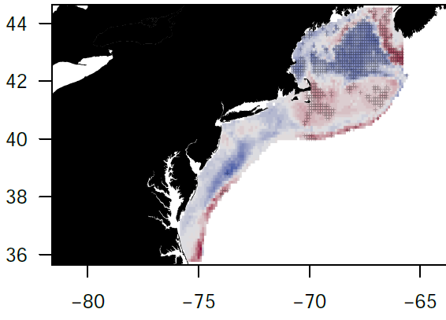
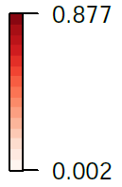
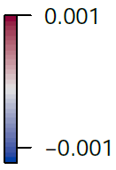
Ad cod
Ad cod
Jv cod
Jv cod
Ic cod
Ic cod
FIGURE 2
Mean habitat probability (left panels) and habitat probability trends (right panels) for cod during spring for adults (top row), juveniles (middle row), and ichthyoplankton (bottom row). Habitat areas with significant linear trends are shown with a crosshatched pattern.
Spr Cod GS

Slide 4
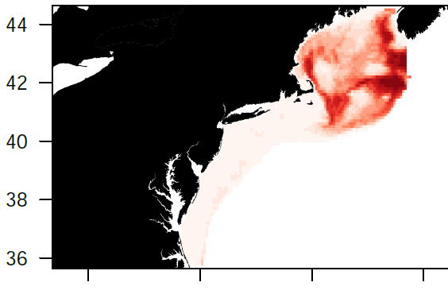
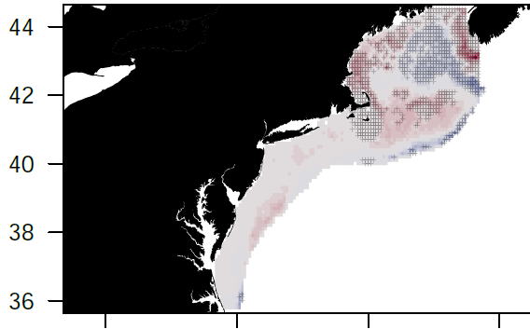
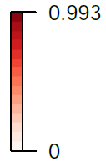
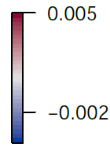
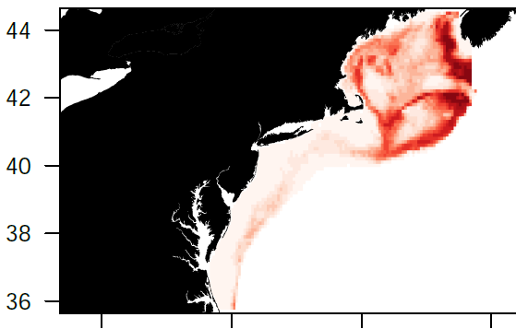
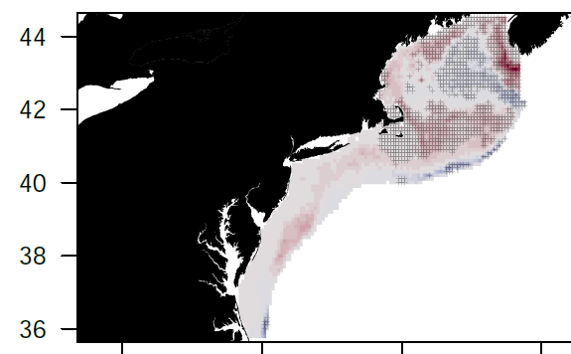
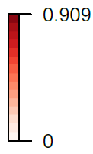
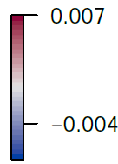
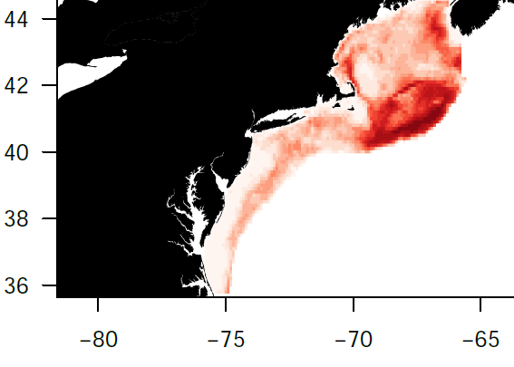
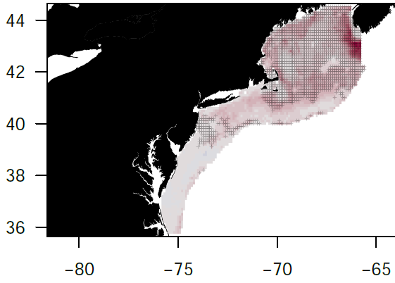
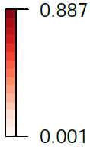
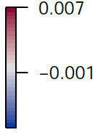
Ad had
Ad had
Jv had
Jv had
Ic had
Ic had
FIGURE 2
Mean habitat probability (left panels) and habitat probability trends (right panels) for haddock during spring for adults (top row), juveniles (middle row), and ichthyoplankton (bottom row). Habitat areas with significant linear trends are shown with a crosshatched pattern.
Spr Haddock GS

Slide 5
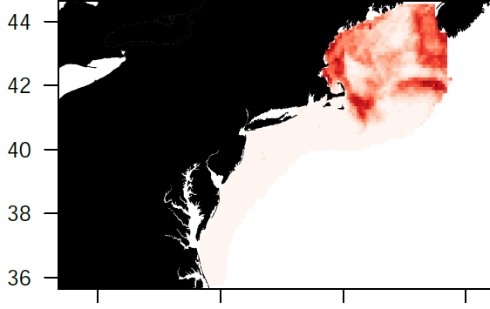

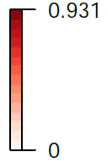
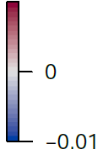
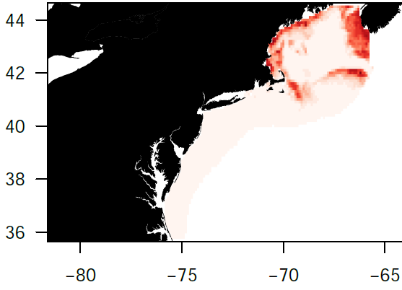
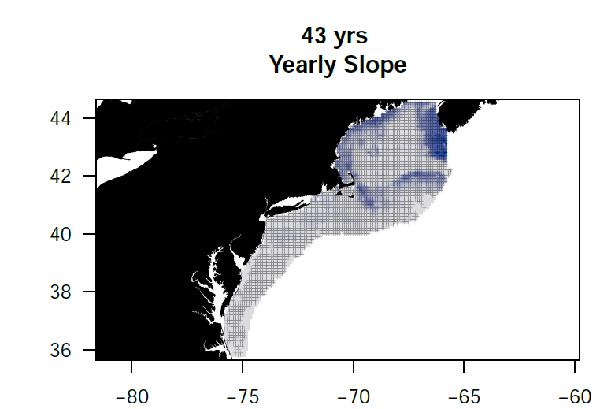
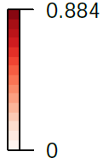
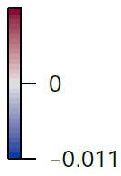
Ad cod
Ad cod
Jv cod
Jv cod
FIGURE 3
Mean habitat probability (left panels) and habitat probability trends (right panels) for cod during fall for adults (top row), and juveniles (middle row). Habitat areas with significant linear trends are shown with a crosshatched pattern.
Fall Cod GS

Slide 6
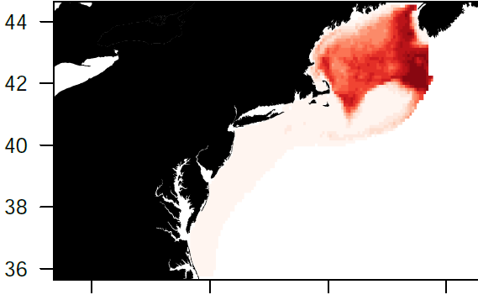
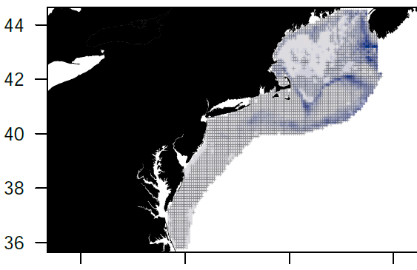
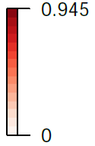
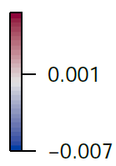
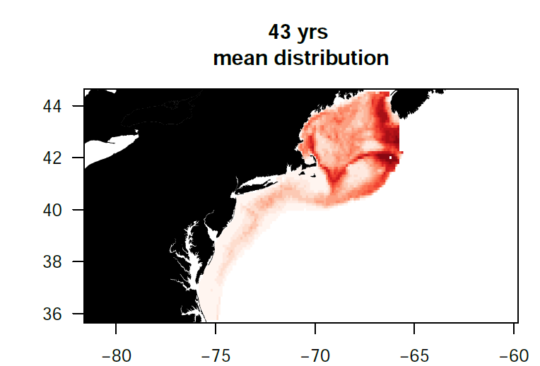
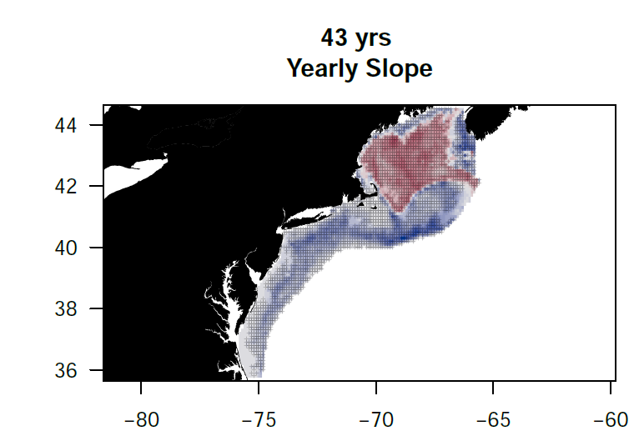
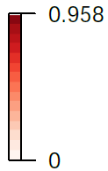
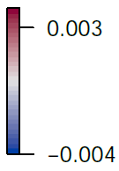
Ad had
Ad had
Ad had
Jv had
Jv had
FIGURE 4
Mean habitat probability (left panels) and habitat probability trends (right panels) for haddock during fall for adults (top row), and juveniles (middle row). Habitat areas with significant linear trends are shown with a crosshatched pattern.
Fall Haddock GS

Slide 7
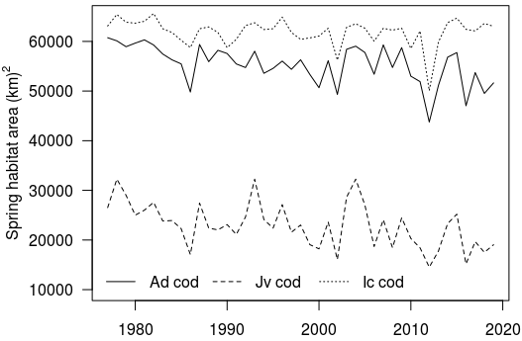
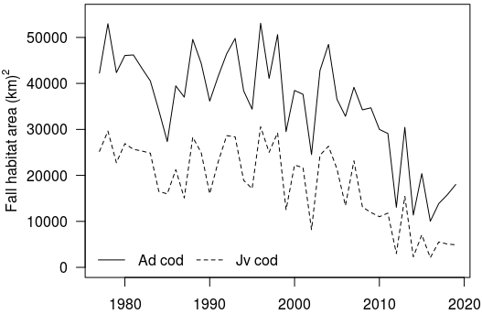
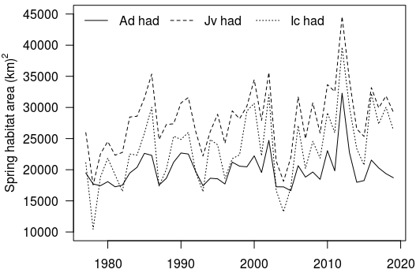
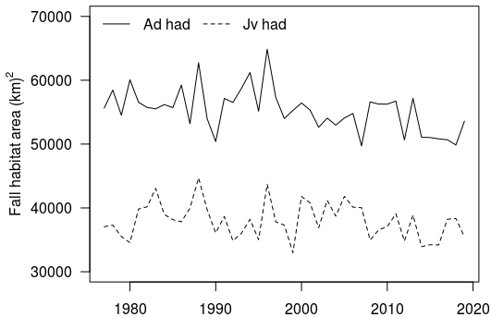
FIGURE 5
Temporal dynamics of habitat area summed by year for high probability (0.5-1) areas in spring (left panels) and fall (right panels) for haddock (top row) and cod (bottom row) for adults (solid lines), juveniles (dashed lines), and ichthyoplankton (dotted lines, spring only).
Notes:
Fig 5.

Slide 8
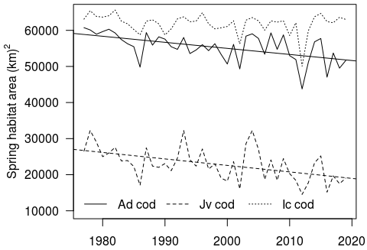
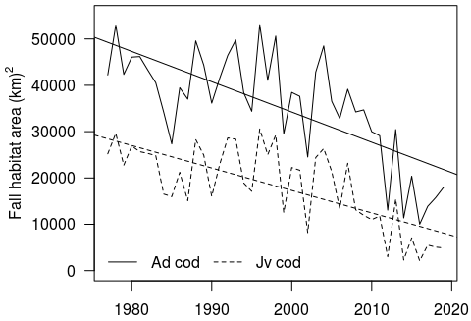


FIGURE 5
Temporal dynamics of habitat area summed by year for high probability (0.5-1) areas in spring (left panels) and fall (right panels) for haddock (top row) and cod (bottom row) for adults (solid lines), juveniles (dashed lines), and ichthyoplankton (dotted lines, spring only).
Notes:
Fig 5.

Slide 9




Surface temperature (˚C)
Bottom temperature (˚C)
FIGURE 6.
Temporal dynamics of mean surface temperature (left panels) and bottom temperature (right panels) for areas of high probability (0.5-1) habitat in spring (top row) and fall (bottom row) for haddock (red lines) and cod (black lines) for adults (solid lines), and juveniles (dashed lines).

Slide 10




Spring surface temperature (˚C)
Spring surface temperature (˚C)
Spring bottom temperature (˚C)
Spring bottom temperature (˚C)
Fall surface temperature (˚C)
Fall surface temperature (˚C)
Fall bottom temperature (˚C)
Fall bottom temperature (˚C)
FIGURE 6.
Temporal dynamics of mean surface temperature (left panels) and bottom temperature (right panels) for areas of high probability (0.5-1) habitat in spring (top row) and fall (bottom row) for haddock (red lines) and cod (black lines) for adults (solid lines), and juveniles (dashed lines).
FIGURE 6. (significant trends drawn)
Temporal dynamics of mean surface temperature (left panels) and bottom temperature (right panels) for areas of high probability (0.5-1) habitat in spring (top row) and fall (bottom row) for haddock (red lines) and cod (black lines) for adults (solid lines), and juveniles (dashed lines).

Slide 11




Log C. typicus N 100m⁻³
Log C. typicus N 100m⁻³
FIGURE 7
Temporal dynamics of Centropages typicus mean log abundance for areas of high probability (0.5-1) habitat in spring (top row) and fall (bottom row) for haddock (red lines) and cod (black lines) for adults (solid lines), and juveniles (dashed lines).

Slide 12
Log C. typicus N 100m⁻³
Spring
Log C. typicus N 100m⁻³
Fall
FIGURE 7
Temporal dynamics of Centropages typicus mean log abundance for areas of high probability (0.5-1) habitat in spring (top row) and fall (bottom row) for haddock (red lines) and cod (black lines) for adults (solid lines), and juveniles (dashed lines).

Slide 13

FIGURE 8
Potential bottom thermal habitat area for both cod and haddock north of 40°N latitude and east of 74°W longitude defined by thermal ranges extracted from high probability habitat areas in spring of (3-7°C, solid line), and fall (8-11°C, dashed line).

Slide 14




FIGURE 9
Niche overlap between cod and haddock by
stage for spring (top) and fall (bottom) seasons

Slide 15
FIGURE 9
Niche overlap between cod and haddock by
stage for spring (top) and fall (bottom) seasons

Slide 16




FIGURE 10
Niche overlap between spring and fall seasons for
haddock (top) and cod (bottom)

Slide 17
FIGURE 10
Niche overlap between spring and fall seasons for
haddock (top) and cod (bottom)

Slide 18






FIGURE 11
Niche overlap between life stages for adults and
juveniles (Ad-Jv), adults and icthyoplankton (Ad-Ic),
and juveniles and ichtyoplankton (Jv-Ic) in spring for
haddock (a) and cod (b) and in fall for both
haddock and cod (c).

Slide 19
FIGURE 11
Niche overlap between life stages for adults and
juveniles (Ad-Jv), adults and icthyoplankton (Ad-Ic),
and juveniles and ichtyoplankton (Jv-Ic) in spring for
haddock (a) and cod (b) and in fall for both
haddock and cod (c).

Slide 20




Temp variable extracted for HSI > 0.5, line added if significant < 0.05, see table in biomod_variable_importance_summary.xlsx

