Slide 1

Team SomNum’s history project

Slide 2
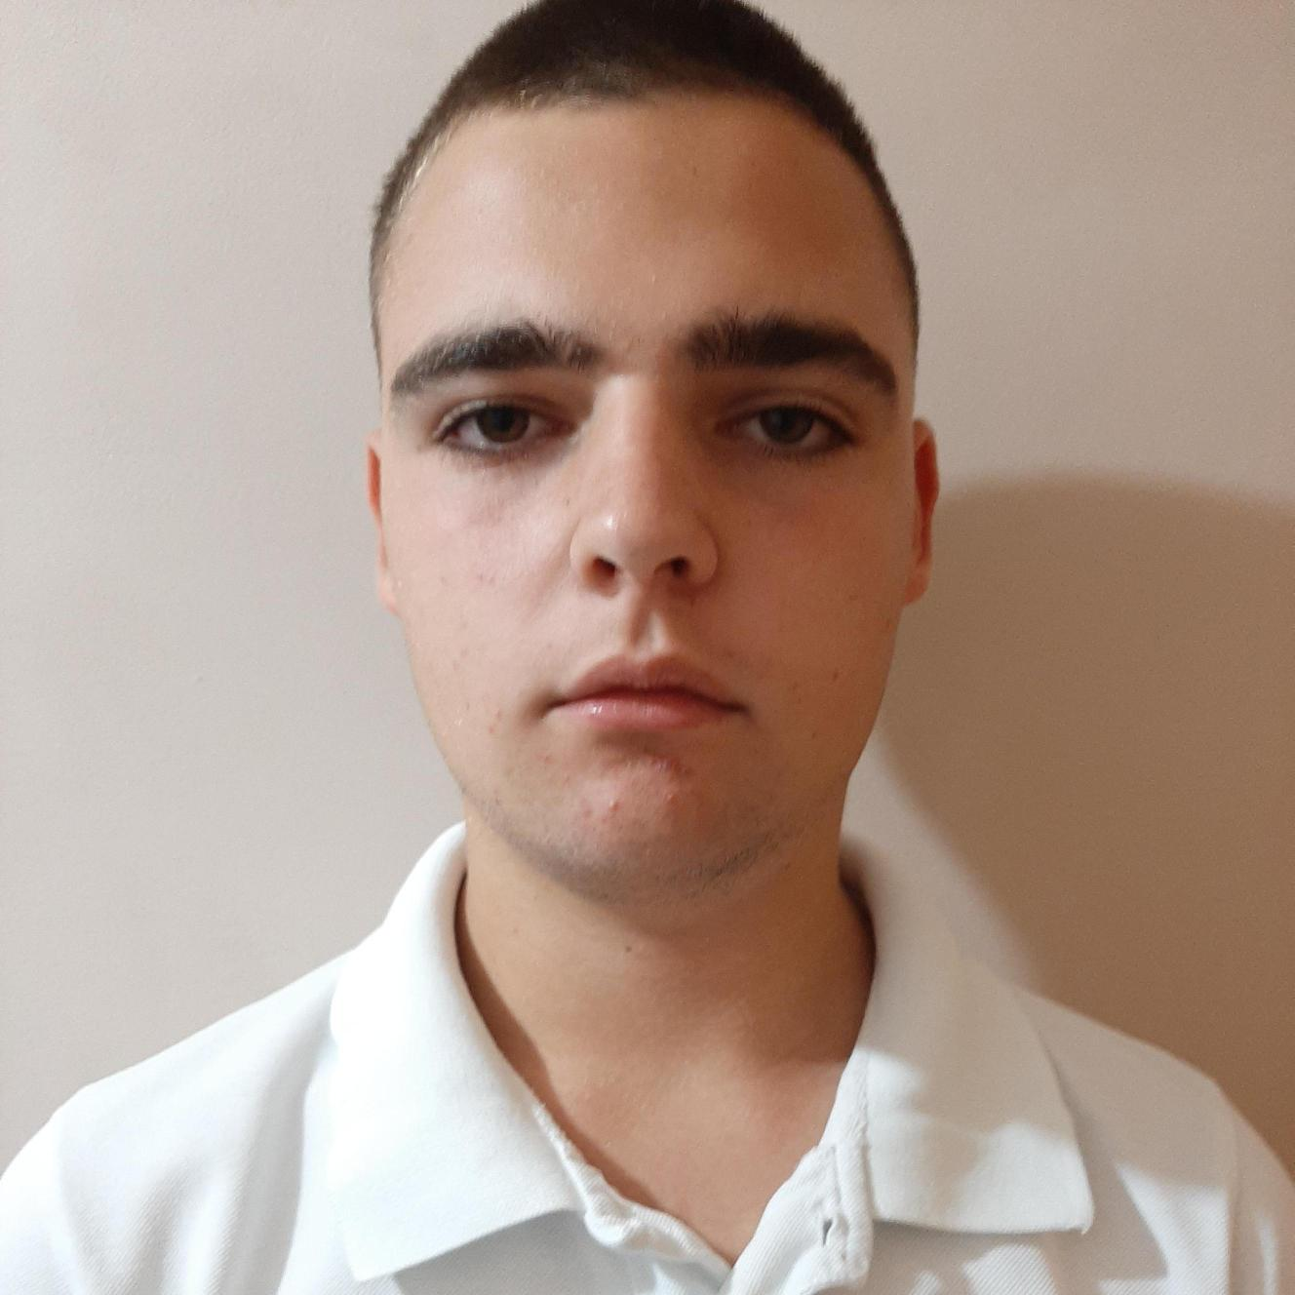
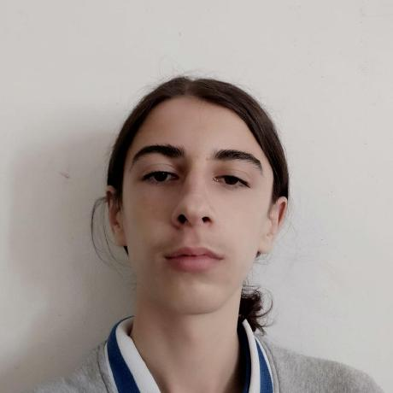
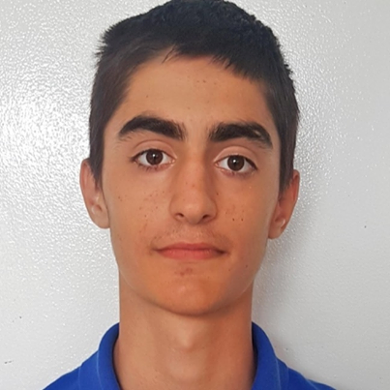
Our team
Rosen Papazov
Presian Stefanov
Zhivko Nanev
Scrum and QA engineer
Backend developer
Frontend developer

Slide 3
Stages of work
01
02
Deciding on the idea
Deciding on technologies
03
04
Working on project
Presenting

Slide 4
01
Deciding on the idea
Console utility for event management

Slide 5







2. Technologies used

Slide 6
Onto the demonstration

