Slide 1
Start
Human
Turn?
Computer
Yes
Can I win?
No
Insert Row,Col
Yes
Can I lose?
No
Calculate best movement
Add info to board
Display board
End
Yes
End?
No

Slide 2
S7 | S4 | S5 | S6 | 4
S1 | 0 | 0 | 0 | 0
S2 | 0 | 4 | 1 | 5
S3 | 0 | 0 | 0 | 0
S8 | 0 | 4 | 1 | 4
 | X | O
 | X | O

Slide 3
S7 | S4 | S5 | S6 | 5
S1 | 0 | 0 | 0 | 0
S2 | 0 | 1 | 0 | 1
S3 | 4 | 1 | 0 | 5
S8 | 4 | 2 | 0 | 1
 | X | O
 | O
X | O

Slide 4
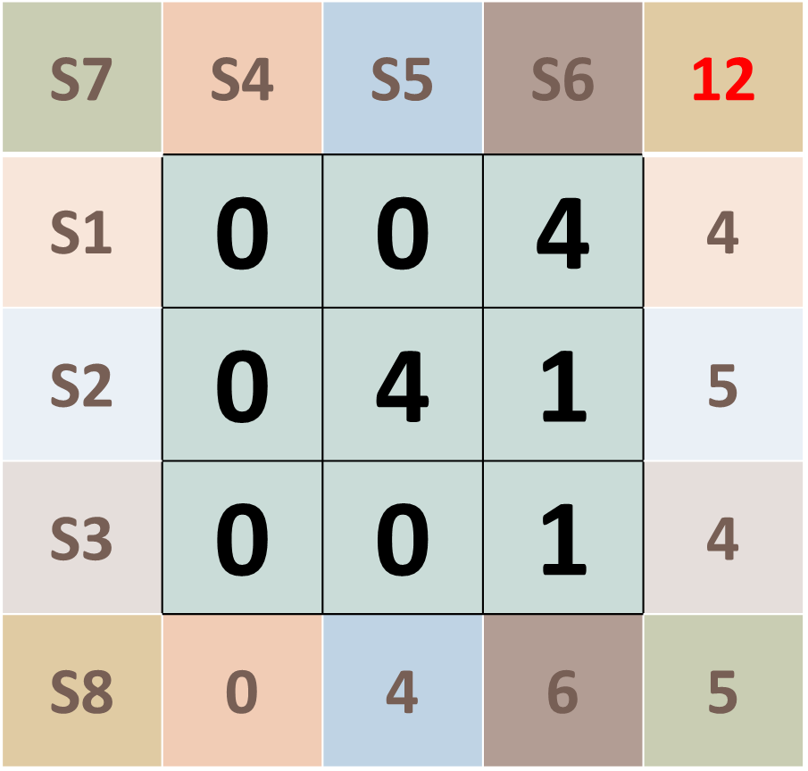
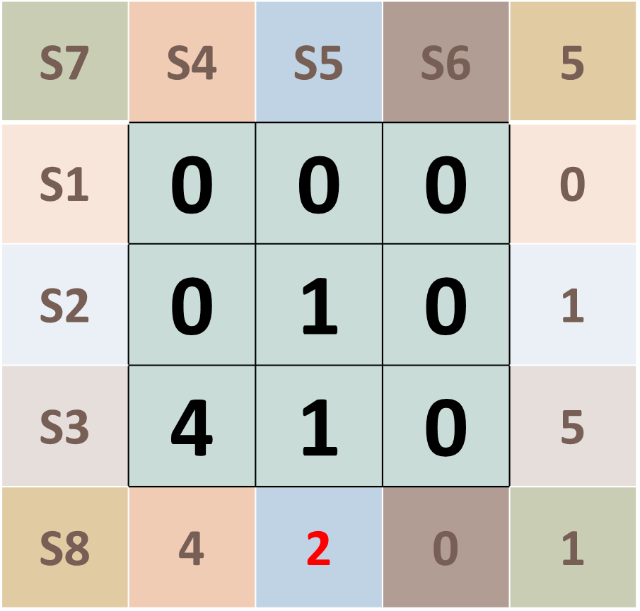
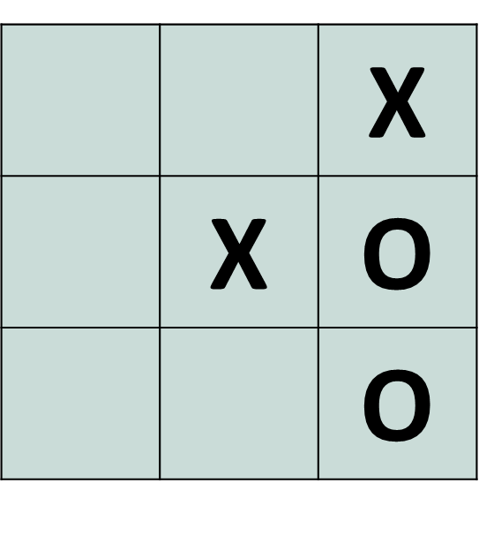
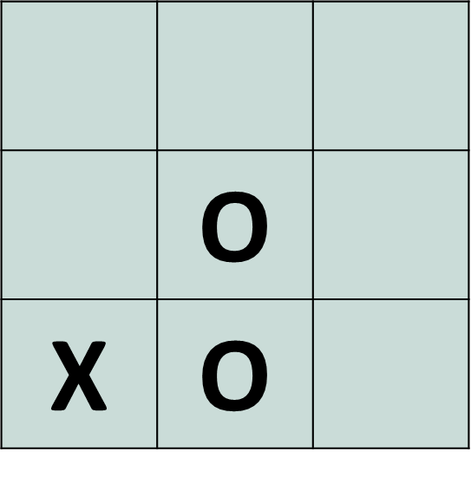
S8 diagonal shows that an
imminent win can happen.
S5 column shows that an
imminent lose can happen.

Slide 5
S7 | S4 | S5 | S6 | 12
S1 | 1 | 4 | 4 | 9
S2 | 4 | 4 | 4 | 12
S3 | 4 | 4 | 4 | 12
S8 | 9 | 12 | 12 | 9
Board game:
O
 | X
New RCD sum:
Score assigned to each cell:
0 | 1 | 2
1 | 3 | 2
2 | 2 | 2
Score of available cells to place:
-5 | 1 | 2
1 | -5 | 2
2 | 2 | 2

