Slide 1
C++ Programming
Spring Semester 2023
Shugang Zhang <zsg@ouc.edu.cn>
College of Computer Science and Technology

Slide 2
课程介绍
课程性质
  专业必修课，是信息技术类专业的基础课程
课程内容
  以面向对象的程序设计思想为主线，介绍 C++ 语言的语法和原理，将面向对象的思维方式运用到程序设计
    程序设计基础知识
    类、对象的基本概念
    继承与多态
    输入输出流

Slide 3
课程目标
掌握面向对象程序设计的基本概念和方法
  基本语法
  面向对象的分析、设计、编程、测试方法
学会使用集成开发环境，掌握程序调试方法
了解常用数据结构、经典的数值算法

Slide 4
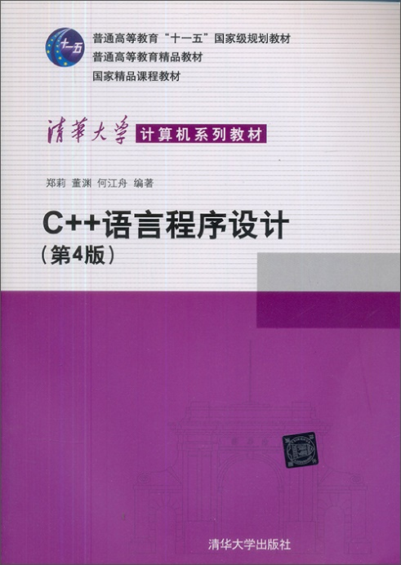
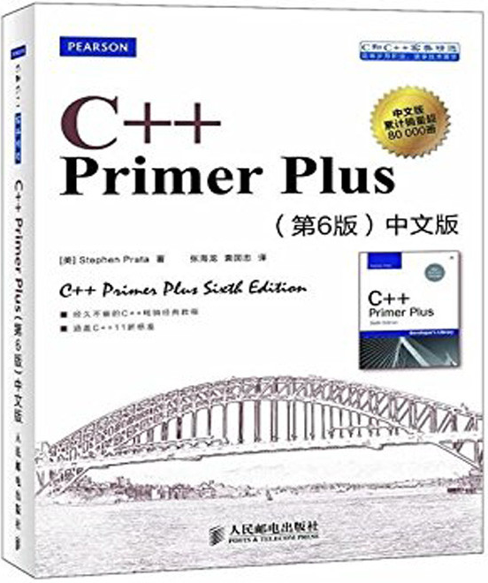
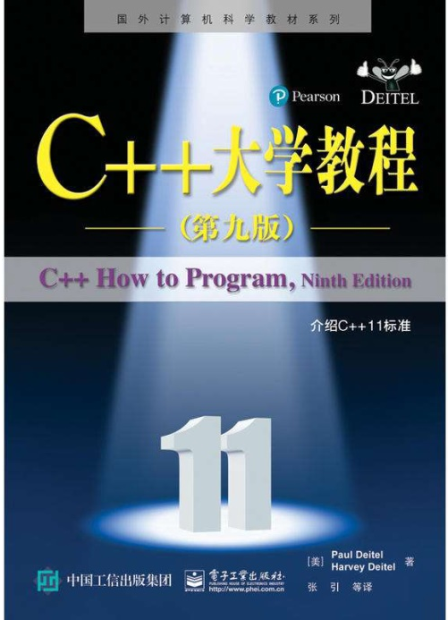
课程教材
教材
  《C++语言程序设计（第 5 版）》
    郑莉 董渊 编著，清华大学出版社
参考资料
  C++ Primer Plus（第 6 版），人民邮电出版社
  C++ 大学教程（第 9 版），电子工业出版社

Slide 5
网上资源
  cplusplus 综合网站（教程、开发手册、文章、论坛）
    http://www.cplusplus.com/
  Stackoverflow 网站
    http://stackoverflow.com/
    Stack Overflow 是程序设计领域问答网站，允许用户提出或回答问题
    用户创建的内容都使用知识共享协议授权
    最常见的主题有 C++、C#、Java、JavaScript、PHP、Android、jQuery 和Python
  Google（谷歌）、bing（必应）、百度等搜索引擎
  维基百科 C++
    https://zh.wikipedia.org/wiki/C++

Slide 6
课程考核
理论课成绩
  课堂表现：20%
    出勤，旷课一次扣 2 分，扣满为止
    上课发言积极，可获得加分
  期末考试：80%
实验课成绩
  平时 30% ，完成 11 个实验题目
    出勤，旷课一次扣 2 分，扣满为止
  上机考试 （2 小时，根据完成情况给分） 70%

Slide 7
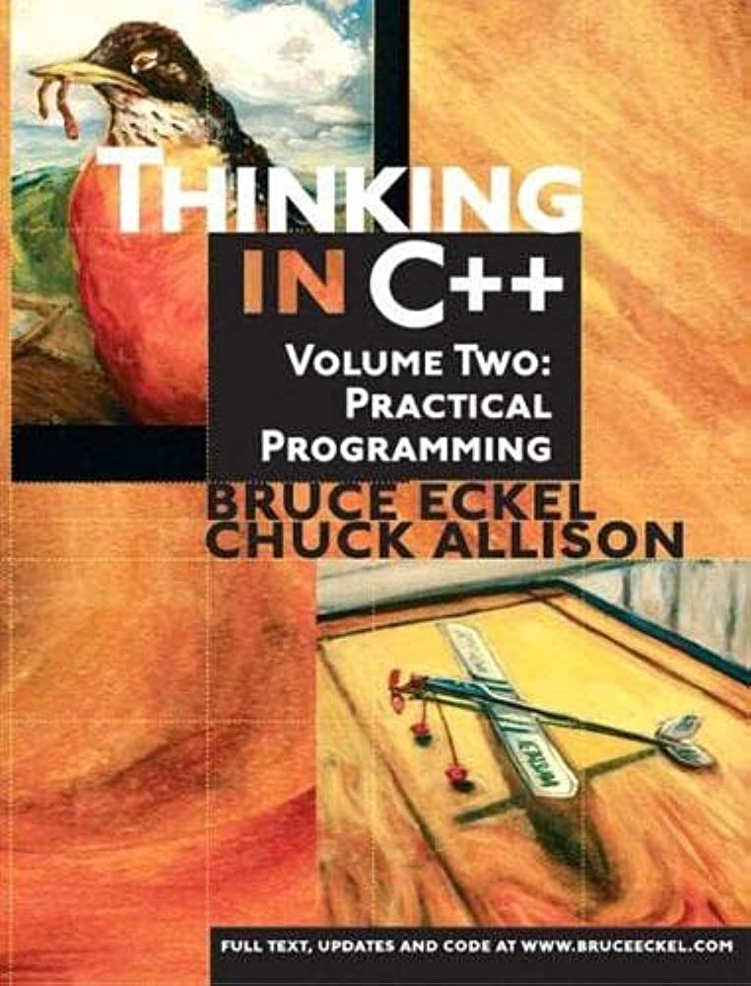
课程开始前的嘱咐
实践 > 理论！
第一，不要当成文科课来学
第二，不要当成数学课来学
第三，不要当成英语课来学
第四，不要只在课堂上学

Slide 8
Chapter 1 Introduction
Theory ~ 3 hours
Experiment ~ 2 hours

Slide 9
Overview of Chapter 1
Development of Programming Language
Object-Oriented Programming (OOP 面向对象)
Object-Oriented Software Development
Representation and Storage of Information
Basic Concept of Programming

Slide 10
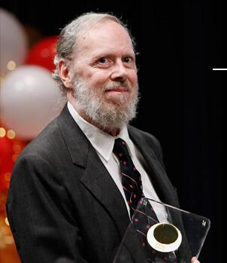
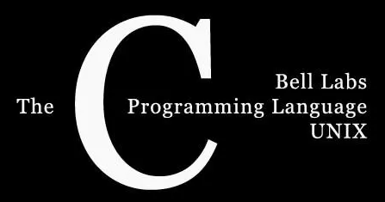
1.1 Development of Programming Language
Dennis Ritchie 1941~2011
B Programming Language
  ~1960s
  by Kenneth Thompson @ AT&T Bell Laboratories
C Programming Language
  1973
  by Dennis Ritchie @ AT&T Bell Laboratories

Slide 11

1.1 Development of Programming Language
C++ Programming Language (C with Classes)
  1979 (C with Classes)
  by Bjarne Stroustrup @ AT&T Bell Laboratories
Bjarne Stroustrup (1950~)

Slide 12

1.1 Development of Programming Language
C++ Programming Language (C with Classes)
  1979 (C with Classes)
  by Bjarne Stroustrup @ AT&T Bell Laboratories
Bjarne Stroustrup (1950~)

Slide 13
C++ v.s. C
Main Features of C++
  Compatible with C
  Supporting object-oriented programming
Drawbacks
  Not a fully object-oriented programming language (due to the compatibility with C)
  new and delete operators frequently cause memory leaks
  C++ allows multiple inheritance, leading to complex relationships

Slide 14
Computer Programming
A computer is controlled by programs.
Programs are a collection of computer instructions (指令).
Instructions are commands that the computer can recognize.

Slide 15
Machine Language and Assembly Language
Machine Language – A language consisting of binary instructions that can be recognized by a computer hardware system. Huge Gaaaaaaap!
Assembly language – It maps machine instructions into some helper characters that can be read by humans, such as ADD, SUB, etc. Still far from satisfactory!

Slide 16
High-Level Programming Language
High-level languages shield the machine from details and increase the level of abstraction of the language.
Programs can use data naming with certain meanings and execution statements that are easy to understand.
This makes it possible to write programs that relate to the concrete things that they describe.
Focusing more on the task itself.

Slide 17
Process-Oriented Programming
Process-Oriented Programming (1st generation)
  Purpose – for mathematical calculations.
  Main work – design the process of solving the problem.
  Disadvantages – difficult to develop and maintain for large, complex programs.

Slide 18
Process-Oriented Structured Programming
Structured Programming (2nd generation)
  Top-down/Step-by-step
  Divide and conquer (分治策略)
  Functional Modules forming a tree-like structure.
  Each module consists of three basic structures, i.e.,
    Sequence
    Selection (Branch)
    Loop
  Each module can be invoked as a subroutine.

Slide 19
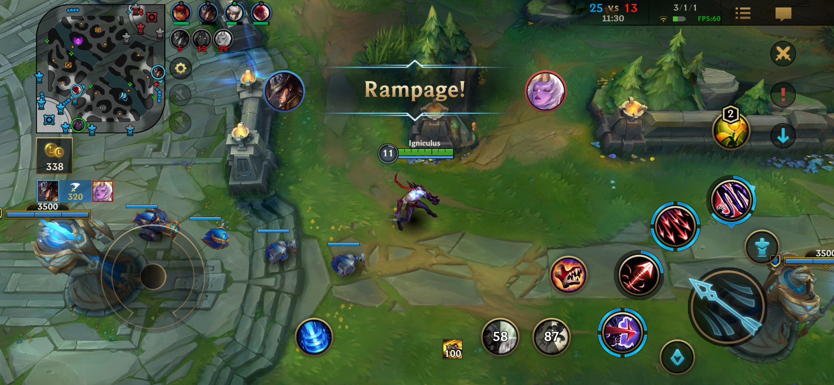
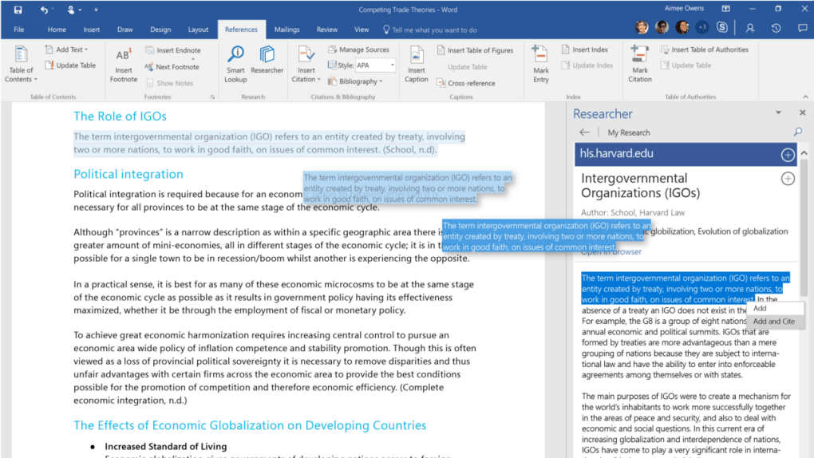
POP Advantages & Disadvantages
Advantages
  Decomposing a complex task into many easily handled subtasks.
Disadvantages
  Poor reusability
  Poor user-friendly

Slide 20
1.2 Object-Oriented Programming Language
Object-Oriented – To describe more directly the things (i.e., objects 对象) that exist in the objective world and the relationships between them.
Characteristics
  A high-level language.
  Treats objective things as objects with properties and behaviors.
  Abstraction – to find the common properties and behavior of the same class of objects and forming a class (类).
  Reusability – through class inheritance (继承) and polymorphism (多态).

Slide 21
Object-Oriented Programming Language
Advantages – It enables programs to reflect the problem domain more directly as it is, software developers are able to follow general thinking ways of humans to understand things for software development.
As you wish!

Slide 22


Some Basic Concepts in OOP
Objects
  Can be tangible (e.g., car) or intangible (e.g., proposal).
  Independent.
  Inherent properties & Outward behaviors (functions).
Properties
Color, Production,
Height, …
Properties
Theme/Topic,
Proposer, …
Functions
Drive, Brake, …
Functions
Implementation,
Expected Benefits,
…

Slide 23
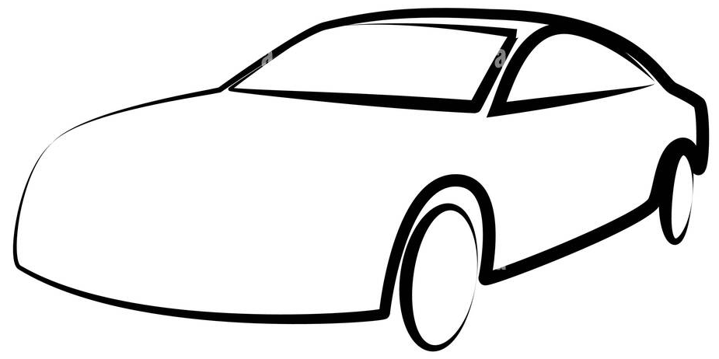

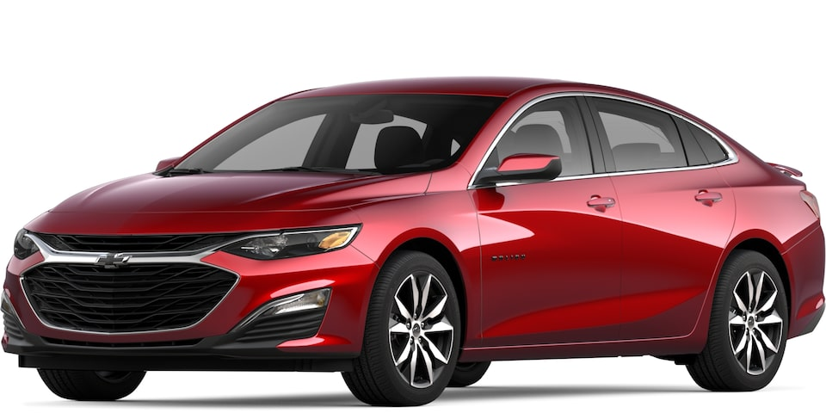
Some Basic Concepts in OOP
Class Important thinking ways – Abstraction (抽象)
  Essential characteristic with respect to the goal at hand.
  Classify things with common properties into one category.

Slide 24
Class in OOP
Class Important thinking ways – Abstraction (抽象)
  A set of objects with the same properties and services.
  It provides an abstract description of all the objects belonging to the class, especially the properties and behavior.
  Class v.s. Object: an object belonging to a class is called an instance of that class.
  p.s. Critical thinking 模具与铸件？
Notes:
OOP中更规范的定义

Slide 25
Some Basic Concepts in OOP
Encapsulation(封装)
  Combine the properties and behaviors of an object into a separate system unit.
  Conceal the internal details of the object as much as possible to form a boundary (or a barrier) to the outside, keeping only a limited number of external interfaces to the outside.

Slide 26
Some Basic Concepts in OOP
Inheritance(继承)
  Definition – A special class object has all the properties and services of its general class, which is called the inheritance of a special class from a general class (Note that Inheritance is not Instance).
  Important for software reuse!
    It is one of the major reasons why object-oriented technology can improve the efficiency of software development.
C++ Programming

Slide 27

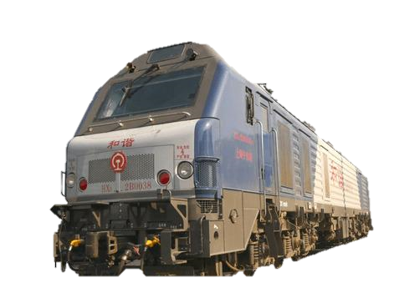

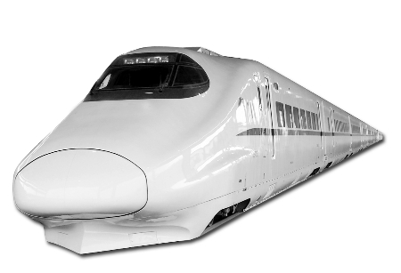

Difference between Inheritance and Instance
Instance
Inheritance
Inheritance
Abstract
Abstract
Instance
Abstract
Abstract
Inheritance
Abstract
Instance
C++ Programming

Slide 28
Some Basic Concepts in OOP
Polymorphism(多态) 该术语讨论的对象是类中的方法
  Scenario – an attribute or behavior defined in a general class, when inherited by a special class, can have different data types or exhibit different behavior.
  This allows the same property or behavior to have different semantics in the general class and its various special classes.
  Examples – The ‘Add’ operation for real numbers;
  for complex numbers;

Slide 29
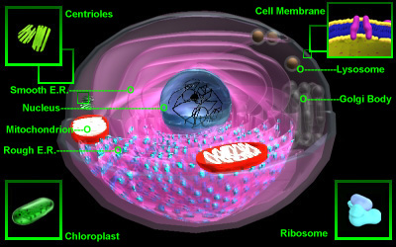
A Virtual Cell

Slide 30
1.3 Object-Oriented Software Development
Object-Oriented Analysis (OOA)
Object-Oriented Design (OOD)
Object-Oriented Programming (OOP)
Object-Oriented Test (OOT)
Object-Oriented Software Maintenance (OOSM)

Slide 31
Object-Oriented Analysis (OOA)
Task Dependent - In this phase, we should abstract precisely what the system must do, but not concerning with how to achieve it. (要注意不要事无巨细)
Defining objects directly from the existing things in the task domain, and retains the original appearance of individual things and relationships between things without transformation or recombination, and without breaking the original boundaries.
This is exactly how the world works!

Slide 32

Case Study – A Classroom
<Blackboard>
<Student>
<Teacher>

Slide 33
Object-Oriented Design (OOD)
Moving the OOA model directly to OOD.
Adding implementation-related details such as human-machine interface, data storage, and task management in the specific implementation.

Slide 34






Object-Oriented Programming (OOP)
C++/Java/C#/JavaScript
Python/TensorFlow*/PyTorch*

Slide 35
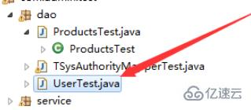
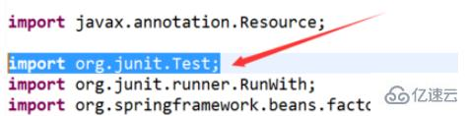
Object-Oriented Test (OOT)
Using object-oriented principles to organize tests.
  object classes as the basic test units
  The ‘test’ itself can be organized in a OOP way, e.g., the Test class in Java and JavaWeb.

Slide 36

Object-Oriented Maintenance (OOM)
Scalability
  Your BOSS asks you to add a NEW ROLE to your classroom software!

Slide 37
1.4 Representation and Storage of Information
Instruction
Control
Control Character
Information
Fixed-point
Numerical
Floating-point
Data
Characters
Non-Numerical
Logistic

Slide 38
1.4 Representation and Storage of Information
Computers use a binary (0/1) system.
Advantages
  Easy to implement
  Binary numbers are simple to operate
  High machine reliability
  Highly versatile (通用性)
Disadvantages
  poor readability for humans

Slide 39
Number Systems in Programming
 | Base | Rounding | Characters
Binary | 2 | 2→1 | 0,1
Octal | 8 | 8→1 | 0,1,2,3,4,5,6,7
Decimal | 10 | 10→1 | 0,1,2,3,4,5,6,7,8,9,
Hexadecimal | 16 | 16→1 | 0,1,2,3,4,5,6,7,8,9,A,B,C,D,E,F

Slide 40
Conversion between Number Systems
Multiplying each number by its power and adding all these results.
Examples
  (11111111.11)₂=1×2⁷+1×2⁶+1×2⁵+1×2⁴+1×2³+1×2²+1×2¹+1×2⁰+1×2⁻¹+1×2⁻² =(255.75)₁₀
  (3506.2)₈=3×8³+5×8²+0×8¹+6×8⁰+2×8⁻¹=(1862.25)₁₀
  (0.2A)₁₆=2×16⁻¹+10×16⁻²=(0.1640625)₁₀

Slide 41
Conversion between Number Systems
  2 68 余 数
  2 34 ┄┄┄┄┄┄┄┄┄ ┄┄ 0 低位
  2 17 ┄┄┄┄┄┄┄┄┄┄┄ 0
  2 8 ┄┄┄┄┄┄┄┄┄┄┄ 1
  2 4 ┄┄┄┄┄┄┄ ┄┄┄ 0
  2 2 ┄┄┄┄┄┄┄┄┄┄ 0
  2 1 ┄┄┄┄┄┄┄ ┄┄ 0
  0 ┄┄┄┄┄┄┄ ┄┄ 1 高位
  (68)₁₀＝(1000100)₂

Slide 42
Conversion between Number Systems
  0.3125 ×2 = 0 .625
  0.625 ×2 = 1 .25
  0.25 ×2 = 0 .5
  0.5 ×2 = 1 .0
  0.3125₁₀ = 0.0101₂
高位

Slide 43
Conversion between Number Systems
Interconversion among Binary, Octal, and Hexadecimal.
  Each octal digit is equivalent to three binary digits.
  Each hexadecimal digit is equivalent to four binary digits.
  Examples
    (1011010.10)₂=(001 011 010 .100)₂=(132.4)₈
    (1011010.10)₂=(0101 1010 .1000)₂=(5A.8)₁₆
    (F7)₁₆＝(1111 0111)₂＝(11110111)₂

Slide 44
Storage Units of Information
Bit (b):
  The smallest unit of metric data, representing one bit of binary information.
Byte (B):
  consists of eight binary digits (1 byte = 8 bit).
Conversion
  1 KB = 1024 B
  1 MB = 1024 K
  1 GB = 1024 M

Slide 45
Encoding the Binary Number System
— The Original Code
Symbols are represented by the first digit
  e.g.,
  X=+0101011 [X]_{ori}=0 0101011
  X=- 0101011 [X]_{ori}=1 0101011
Disadvantages：
  The representation of zero is not unique.
  [+0]_{ori} =0 00...0 [-0]_{ori} =1 00...0
  The sign bits have to be handled separately.
Symbols

Slide 46
Encoding the Binary Number System
— The Inverse Code
The inverse code of a positive number has the same representation as the original code.
The inverse code of a negative number has the following relationship with the original code.
  The sign bit is the same (still represented by 1), and the rest of the bits are inverted (0 becomes 1, 1 becomes 0).
  E.g.,
  X=-1100110 [X]original =11100110 [X]inverse =10011001
  X=+0000000 [X]original =00000000 [X]inverse =00000000
The representation of zero in the inverse code is also not unique
  i.e., X=-0000000 [X]_{ori} =10000000 [X]_{inv} =11111111
The inverse code is just an intermediate code to find the complement.
Ps. 要思考引入反码的动机

Slide 47
Encoding the Binary Number System
— The Complementary Code
A intuitive way to understand the complementary code.
  Try +3 + -3 = 0
  Check that how to represent a negative number ?

Slide 48

Encoding the Binary Number System
— The Complementary Code
Another way to understand the complementary code.
  i.e., Complement
    A – B = A + (-B) = A + B’s complement.
    E.g., 8 + (-2) = 8 + 10 ( mod 12 )
  其本质动机是要统一加减法！
  同样可以理解正数补码仍为自身（无转换需求）

Slide 49
Encoding the Binary Number System
— The Complementary Code
Modulus
  The modulus of an n-bit integer (including one sign bit) is 2^{n}.
  The modulus of a decimal number with n digits and one sign digit before the decimal point is 2.
Complement
  A – B = A + (-B) = A + B’s complement.
  E.g., 8 + (-2) = 8 + 10 ( mod 12 )
  A negative binary number can be obtained by adding its modulus to its true value (modulus minus the absolute value of the number) to find its complement.

Slide 50
Encoding the Binary Number System
— The Complementary Code
Complementary Code
  The complement of a negative number is obtained by adding 1 to the inverse code.
  The complement of a complement code returns the original code.
Rules for complement arithmetic
  The bit of sign can be used as values in operations. (与原码相比，可简化电路设计)
  Subtractive operations can be converted to additive operations.
    Adding a negative number is the same as adding the complement of that number. (对应补码的动机)
  The result of a complement operation is still the complement. [practical please!]
  The result of an operation overflows.
    The sum of a negative number yields a positive number, or the sum of a positive number yields a negative number. [try (-7) + (-7)]

Slide 51
Fixed-Point & Floating Point Numbers
1.4 信息的表示和存储
Computers usually use floating point to represent a decimal.
  i.e., N=M×2E
  E is the power of 2 and is called the factorial(阶码) of the number N. →It reflects the range of N.
  M represents all valid digits of the number N. It is called the mantissa (尾数) of the number N.
  →It reflects the precision of N.

Slide 52

The Range of Floating Numbers
1.4 信息的表示和存储
Considering an m-bit integer (one sign bit)
  Original code — -(2^{m-1} -1) ~ 2^{m-1} -1
  Inverse code — -(2^{m-1} -1) ~ 2^{m-1} -1
  Complementary code — -2^{m-1} ~ 2^{m-1} -1

Slide 53
The Range of Floating Numbers
1.4 信息的表示和存储
Considering an n-bit decimal (do not include sign bit)
  Original code — -(1-2^{-n}) ~ (1-2^{-n})
  Inverse code — -(1-2^{-n}) ~ (1-2^{-n})
  Complementary code — -1 ~ (1-2^{-n})

Slide 54
The Range of Floating Numbers
1.4 信息的表示和存储
Considering a floating number with
  r-bit factorial (阶码) integer represented by complementary code
  n mantissa (尾数) represented by original code

Slide 55
The Range of Floating Numbers
1.4 信息的表示和存储
Considering a floating number with
  r-bit factorial (阶码) integer represented by complementary code
  n mantissa (尾数) represented by original code

Slide 56
Representation of Non-Numerical Information
1.4 信息的表示和存储
Western characters.
  ASCII code: 7-bit binary number to represent a character, up to 27=128 characters
  EBCDIC code: 8-bit binary number to represent a character, up to 28 = 256 characters
Chinese characters.
  The most widely used code is the “National Standard Chinese Character Code for Information Exchange” (GB2312-80) 国标码
  It is a two-byte code, which uses two seven-bit binary numbers to represent a Chinese character.

Slide 57
1.5 Some Basic Terminology
1.5 程序的开发过程
Source Code/Program
Object Code/Program
Translation Program
Source
Code
Translator
Object
Code
#include<iostream>
int main() {}
00101011001010101101

Slide 58
The Translation Program
1.5 程序的开发过程 -> 1.5.1 基本术语
Assembly Program (汇编程序 — 特指汇编语言)
  The task is to translate the source code written in assembly language into the object code in machine language form.
Compilation Program (编译程序 — 指高级语言)
  If the source code is written in a high-level programming language and is processed by a translation program to produce the object code, then the translation program is called a compiler program.

Slide 59
The Translation Program
1.5 程序的开发过程 -> 1.5.1 基本术语
Interpreter Program (解释程序 — 指解释型高级语言)
  It translates a high-level language source program into machine instructions.
  It differs from a compiled program in that it executes as it translates.

Slide 60
The development process of the program
Edit
  Write the source program on a computer to generate a disk file with the .cpp suffix.
Compile
  Converts the source code of a program into machine language code. .obj
Concatenate
  Concatenates multiple source program files and some files in the library to produce an executable file with the .exe suffix.
Run & Debug

Slide 61
1.6 Summary
Computer programming language
  is a language that a computer can recognize to describe problem-solving methods for the computer to read and execute.
  machine languages / assembly languages /
  high-level languages / object-oriented languages.
Object-oriented software engineering.
  OOA / OOD / OOP / OOSM
Data information & Control information.
  All information is represented inside the computer as binary numbers, and the specific representation varies according to the type of information.

Slide 62
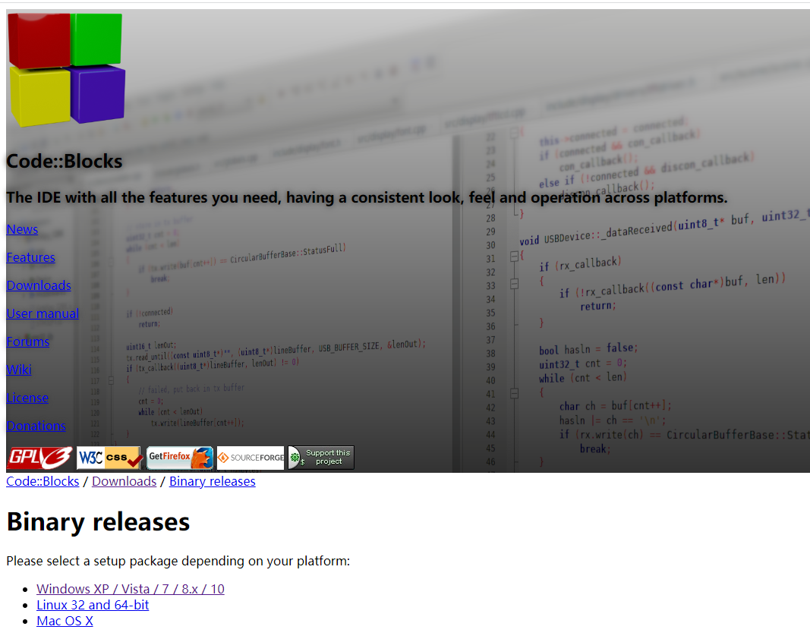
Download Code::Blocks
http://www.codeblocks.org/downloads/binaries/

Slide 63
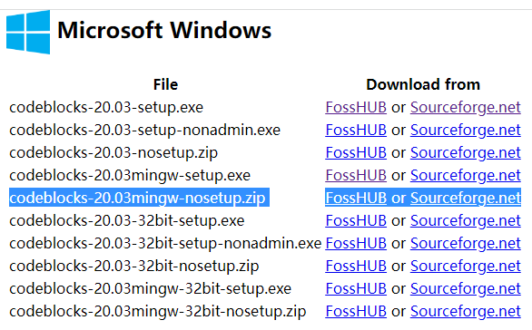
Download Code::Blocks
Pick the mingw version as it contains a default compiler.

Slide 64
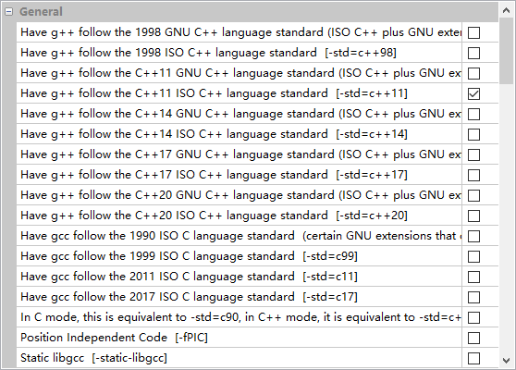
Compiler Setting
Setting > compiler > global compiler settings

Slide 65
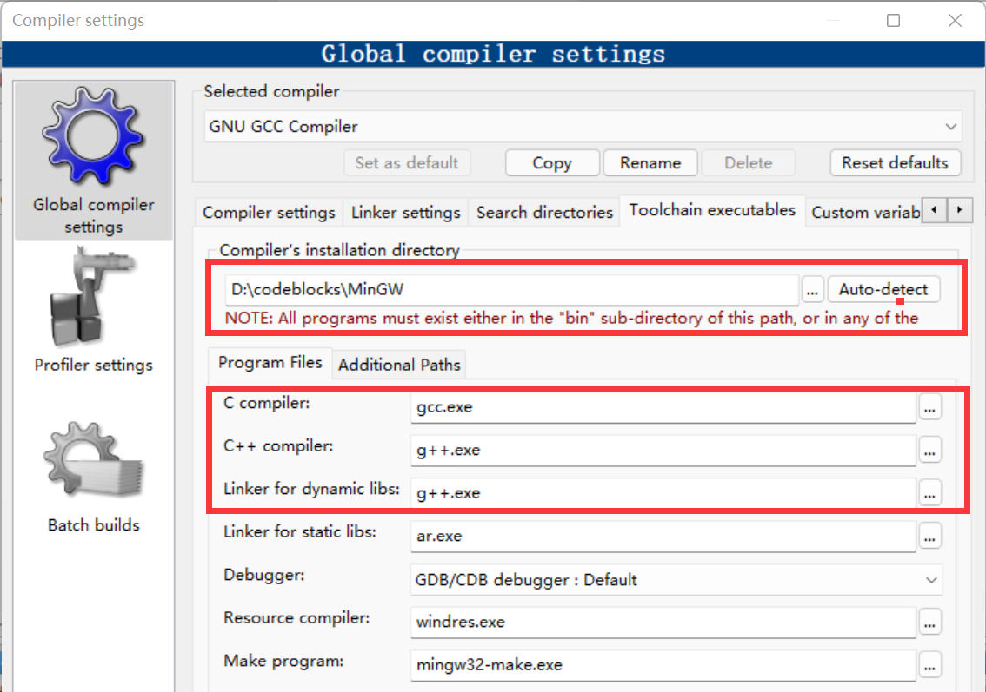
Compiler Setting
Setting > compiler > global compiler settings > toolchain executables

Slide 66
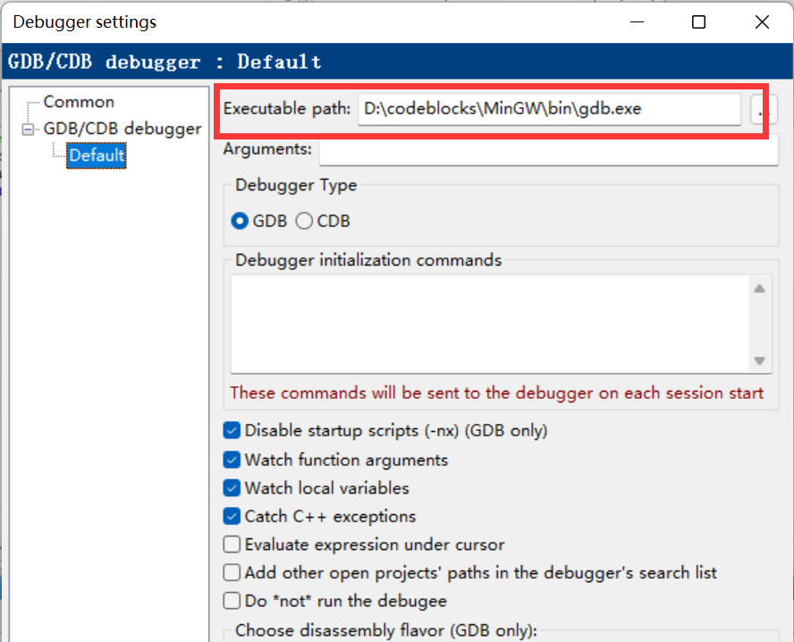
Compiler Setting
Setting > debugger setting > default

Slide 67
关于实验课及实验报告
实验课堂要求
  完成的程序需经现场审查
  独立完成、严禁抄袭，抄袭者一经发现取消本次成绩
  下次实验课前提交正式实验报告
实验报告要求
  Word电子版
  实验目的
  程序流程图/伪代码/类图 （可手绘拍照）

