Slide 1
C++ Programming
Spring Semester 2023
Shugang Zhang <zsg@ouc.edu.cn>
College of Computer Science and Technology

Slide 2
Chapter 3 Function
Theory ~ 3 hours
Experiment ~ 2 hours

Slide 3
Overview of Chapter 3
Definition and use of functions
Inline functions (内联函数)
Functions with default parameter values
Function Overloading
Using C++ System Functions
In-depth Content

Slide 4
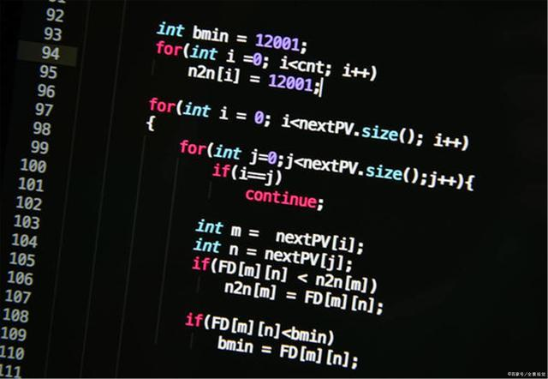
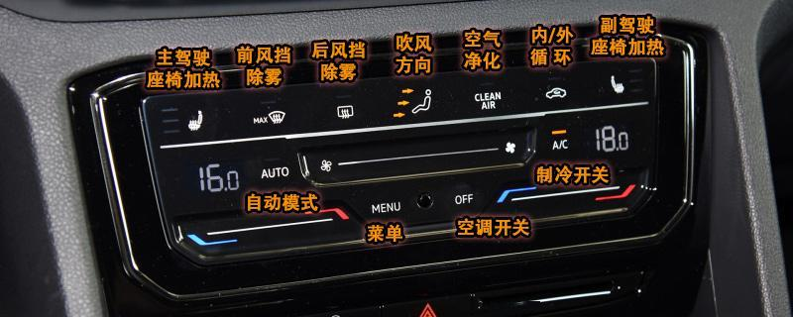
3.1.1 Definition of functions
Functions(函数) v.s. Functions(功能)
Abstraction

Slide 5
3.1.1 Definition of functions
Syntax
  Type Function Name (Formal Parameters)
  {
  Sequence of statements
  }
Formal parameters are internal variables, with lifetime and visibility limited to the scope of function.
Put ‘void’ here if there
is no return values

Slide 6
3.1.1 Definition of functions
List of Formal Parameters
  <type₁> name₁, <type₂> name₂, ..., <type_{n}> name_{n}
Return Values
  Returning values with the ‘return’ statement
  return 0
  The return statement is not necessary if the function type is void.

Slide 7
3.1.2 Calling of Functions
Declare the function before calling. (函数使用前务必先声明！)
  Function defined before the point of call.
  Function defined after the point of call.
  i.e., Type Function Name (Formal Parameters);
Call form
  Function name (Actual Arguments)
Nested calls
  Calling another function in the function body of a function.
Recursive call
  A function calls itself directly or indirectly.

Slide 8
Codes::Calling function to calculate x^{n}
#include <iostream>
using namespace std;
//计算x的n次方
double power(double x, int n) {
double val = 1.0;
while (n--) val *= x;
return val;
}
int main() {
cout << "5 to the power 2 is "
<< power(5, 2) << endl;
return 0;
}

Slide 9
Problem::Conversion between numerical systems
3.1 函数的定义与使用 —— 3.1.2 函数的调用
Entering an 8-bit binary number and converting it to a decimal number for output.
e.g., 1101₂=1(2³)+1(2²)+0(2¹)+1(2⁰)=13₁₀
Input: 1101
Output: 13

Slide 10
Codes::Conversion between numerical systems
double power (double x, int n); //declaration
int main() {
int value = 0;
cout << "Enter an 8 bit binary number ";
for (int i = 7; i >= 0; i--) {
char ch;
cin >> ch;
if (ch == '1')
value += static_cast<int>(power(2, i)); // call
}
cout << "Decimal value is " << value << endl;
return 0;
}

Slide 11
Review — Explicit conversion
Syntax forms (3 types).
  Type (expressions)
  (Type) expression
  Type conversion operator <type> (expression)
    Type conversion operators can be: const_cast, dynamic_cast, reinterpret_cast, static_cast
e.g., int(z) <=> (int)z <=> static_cast<int>(z)

Slide 12
Review & Supplementary
— Explicit conversion
何谓“安全的”类型转换？
对于简单数据类型：高级数据向低级数据转换，是不安全的
对于父子类间转换：父类向子类转换是不安全的
为什么子类向父类转换反而是安全的？
Ref. https://iask.sina.com.cn/b/1H4t9hpnUPwJ.html

Slide 13
static_cast v.s. dynamic_cast
dynamic_cast will check the safety for the downward cast.
i.e., Class D is the derived class of the base Class B.
static_cast will not check the safety for any cases.
B *pB = new B;
D *pD = new D;
D *pD = dynamic_cast<D*> (pB); //unsafe, return Null
Ref. https://www.jb51.net/article/55885.htm

Slide 14
Problem::Calculating Π
Looping until the absolute value of a term of the series is not greater than 10⁻¹⁵; both π and x are of type double.

Slide 15
Codes::Calculating Π — calling functions
#include <iostream>
using namespace std;
double arctan(double x) {
double sqr = x * x;
double e = x;
double r = 0;
int i = 1;
while (e / i > 1e-15) {
double f = e / i; // 项本身
r = (i % 4 == 1) ? r + f : r - f; // 处理符号
e = e * sqr; // 分子
i += 2; // 分母
}
return r;
}

Slide 16
Codes::Calculating Π — calling functions
int main() {
double a = 16.0 * arctan(1 / 5.0); // calling functions
double b = 4.0 * arctan(1 / 239.0); // calling functions
// 注意：因为整数相除结果取整，如果参数写1/5，1/239，结果就都是0
cout << "PI = " << a - b << endl;
return 0;
}
运行结果：
PI=3.14159

Slide 17
Example::Symmetric numbers
Looking for the number m between 11~999 that m, m², and m³ must be symmetric numbers.
E.g., 112=121, 113 = 1331.
Analysis
  Using the method of remainder (余数) to get each digit.
  The common function symm() should be extracted.

Slide 18
Codes::Symmetric Number
#include <iostream>
using namespace std;
//判断n是否为回文数
bool symm(unsigned n) {
unsigned i = n;
unsigned m = 0;
while (i > 0) {
m = m * 10 + i % 10;
i /= 10;
}
return m == n;
}

Slide 19
Codes::Symmetric Number
int main() {
for(unsigned m = 11; m < 1000; m++)
if (symm(m) && symm(m * m) &&
symm(m * m * m)) {
cout << "m = " << m;
cout << " m * m = " << m * m;
cout << " m * m * m = "
<< m * m * m << endl;
}
return 0;
}

Slide 20
Codes::Symmetric Number
运行结果：
m=11 m*m=121 m*m*m=1331
m=101 m*m=10201 m*m*m=1030301
m=111 m*m=12321 m*m*m=1367631

Slide 21
Example::Calling functions to calculate k
Calculating k as follows
r and s are entered by the user.
sinx is approximated using the following equation (precision 10⁻¹⁰)

Slide 22
Example::Calling functions to calculate k
Calculating k as follows
r and s are entered by the user.
sinx is approximated using the following equation (precision 10⁻¹⁰)
ACM：不要蛮干，而是要思考背后的考点
动手前首先要理清思路。程序只是你思路的外化！

Slide 23
Codes::Calling functions to calculate k
#include <iostream>
#include <cmath> /*对C++标准库中数学函数的说明*/
using namespace std;
const double TINY_VALUE = 1e-10; // 注意点1：const学以致用
double tsin(double x) {
double g = 0;
double t = x; // 注意点2：初值的构造
int n = 1;
do {
g += t;
n++;
t = -t * x * x / (2 * n - 1) / (2 * n - 2); // 注意点3：分子分母构造
} while (fabs(t) >= TINY_VALUE); // 注意点4：循环条件退出的判定
return g;
}

Slide 24
Codes::Calling functions to calculate k
int main() {
double k, r, s;
cout << "r = ";
cin >> r;
cout << "s = ";
cin >> s;
if (r * r <= s * s)
k=sqrt(tsin(r)*tsin(r)+tsin(s)*tsin(s));
else
k = tsin(r * s) / 2;
cout << k << endl;
return 0;
}
// 注意点4：函数调用
运行结果：
r=5
s=8
1.37781

Slide 25
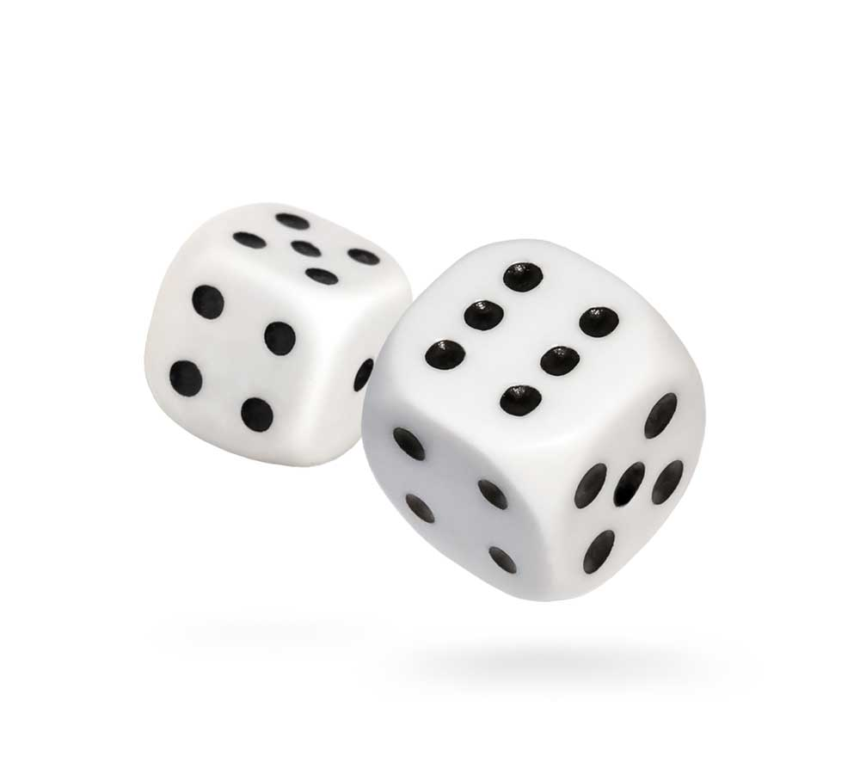
Example::Dice
每个骰子有六面，点数分别为1、2、3、4、5、6。
游戏者在程序开始时输入一个无符号整数，作为产生随机数的种子。
每轮投两次骰子，第一轮如果和数为7或11则为胜，游戏结束；和数为2、3或12则为负，游戏结束；和数为其它值则将此值作为自己的点数，继续第二轮、第三轮...直到某轮的和数等于点数则取胜，若在此前出现和数为7则为负。
由rolldice函数负责模拟投骰子、计算和数并输出和数。

Slide 26
Analysis::Functions to be used
rand
  Prototype：int rand(void);
  Header file：<cstdlib>
  Functions：Returning a pseudo-random number
srand
  Prototype：void srand(unsigned int seed);
  Parameter：a seed for generating random number
  Header file：<cstdlib>
  Functions：to set a starting point for rand(). Use srand(1) to re-initializing rand().

Slide 27
Be sure that you understand the difference between
rand() and srand()!

Slide 28
Codes::Dice
#include <iostream>
#include <cstdlib>
using namespace std;
//投骰子、计算和数、输出和数
int rollDice() {
int die1 = 1 + rand() % 6; // 注意这里随机数的使用技巧
int die2 = 1 + rand() % 6;
int sum = die1 + die2;
cout << "player rolled " << die1 << " + " << die2 << " = " << sum << endl;
return sum;
}

Slide 29
Codes::Dice
enum GameStatus { WIN, LOSE, PLAYING }; // 枚举类型
int main() {
int sum, myPoint;
GameStatus status;
unsigned seed;
cout<<"Please enter an unsigned integer: ";
cin >> seed;//输入随机数种子
srand(seed);//将种子传递给rand().注意用法，其唯一要求是在调用rand之前
sum = rollDice(); //第一轮投骰子、计算和数

Slide 30
Codes::Dice
switch (sum) {
case 7: //如果和数为7或11则为胜,状态为WIN
case 11:
status = WIN;
break; // 注意此处的case语句共享！
case 2: //和数为2、3或12则为负,状态为LOSE
case 3:
case 12:
status = LOSE;
break;
default: /*其它情况,游戏尚无结果,状态为PLAYING,记下点数,为下一轮做准备 */
status = PLAYING;
myPoint = sum;
cout << "point is " << myPoint << endl;
break;
}

Slide 31
Codes::Dice
while (status == PLAYING) { //只要状态仍为PLAYING,就继续进 行下一轮
sum = rollDice();
if (sum == myPoint) //某轮的和数等于点数则取胜
status = WIN;
else if (sum == 7) //出现和数为7则为负
status = LOSE;
}
//当状态不为PLAYING时上面的循环结束,以下程序段输出游戏结果
if (status == WIN)
cout << "player wins" << endl;
else
cout << "player loses" << endl;
return 0;
}

Slide 32
Codes::Dice
运行结果：
Please enter an unsigned integer:23
player rolled 6 + 3 = 9
point is 9
player rolled 5 + 4 = 9
player wins

Slide 33
Nested function calling
main{}
Call fun1()
END
fun1()
Call fun2()
Return
fun2()
Return
①
②
③
④
⑤
⑨
⑦
⑧
⑥

Slide 34
Codes::Adding x² + y²
#include <iostream>
using namespace std;
int fun2(int m) {
return m * m;
}
int fun1(int x,int y) {
return fun2(x) + fun2(y);
}

Slide 35
Codes::Adding x² + y²
int main() {
int a, b;
cout<<"Please enter two integers (a and b): ";
cin >> a >> b;
cout << "The sum of square of a and b: " << fun1(a, b) << endl;
return 0;
}
运行结果：
Please enter two integers(a and b): 3 4
The sum of square of a and b: 25

Slide 36
Recursive function calling
A function calls itself directly or indirectly.
Two stages
  Recursion (递推)：
  4!=4×3!→3!=3×2!→2!=2×1!→1!=1×0!→0!=1
  未知 已知
  Regression(回归)：
  4!=4×3!=24←3!=3×2!=6←2!=2×1!=2←1!=1×0!=1←0!=1
  未知 已知

Slide 37
Example::Solving n! using recursive func

Slide 38
Codes::Solving n!
#include <iostream>
using namespace std;
unsigned fac(int n){
unsigned f;
if (n == 0) // 对于递归函数来说，此处的出口非常重要
f = 1;
else
f = fac(n - 1) * n;
return f;
}
int main() {
unsigned n;
cout << "Enter a positive integer:";
cin >> n;
unsigned y = fac(n);
cout << n << "! = " << y << endl;
return 0;
}
运行结果：
Enter a positive integer:8
8! = 40320

Slide 39
Example::Picking k members from n people
用递归法计算从n个人中选择k个人组成一个委员会的不同组合数。
分析：
  由n个人里选k个人的组合数
  = 由n-1个人里选k个人的组合数 （拎出来的人未当选）
  +由n-1个人里选k-1个人的组合数 （拎出来的人当选）
  当n = k或k = 0时，组合数为1 （递归的出口）

Slide 40
Codes::Picking k members from n people
#include <iostream>
using namespace std;
int comm(int n, int k) { // 最难之处在于边界条件（递归的出口）的考虑
if (k > n) // 情况1：不讲武德
return 0;
else if (n == k || k == 0) // 情况2：常规出口
return 1;
else
return comm(n - 1, k) + comm(n - 1, k - 1); // 递归调用：理顺思路后，此步骤是最好写的！
}
int main() {
int n, k;
cout << "Please enter two integers n and k: ";
cin >> n >> k;
cout << "C(n, k) = " << comm(n, k) << endl;
return 0;
}
运行结果：
18 5
8568

Slide 41
Problem::The Hanoi Tower
Move all disks in tower A to tower C.
One disk each time.
Big disks should be always below the small disk.
A
B
C

Slide 42
Problem::The Hanoi Tower
Question: How to move n disks from A to C?
①Move n-1 disks from A to B (via C);
②Move the bottom one from A to C;
③Move n-1 disks from B to C (via A);
事实上，上面三个步骤包含两种操作：
①Move n-1 disks from src to dest (递归)。hanoi(n, src, med, dest)
②Move the bottom one from src to dest. move(src, dest)

Slide 43
Codes::The Hanoi Tower
void move(char src, char dest) {
cout << src << " --> " << dest << endl;
}
void hanoi(int n, char src, char medium, char dest) {
if (n == 1)
move(src, dest);
else {
hanoi(n - 1, src, dest, medium);
move(src, dest);
hanoi(n - 1, medium, src, dest);
}
}

Slide 44
Codes::The Hanoi Tower
int main() {
int m;
cout << "Enter the number of disks: ";
cin >> m;
cout << "the steps to moving " << m << " disks:" << endl;
hanoi(m,'A','B','C');
return 0;
}

Slide 45
Codes::The Hanoi Tower
运行结果：
Enter the number of disks:3
the steps to moving 3 disks:
A --> C
A --> B
C --> B
A --> C
B --> A
B --> C
A --> C

Slide 46
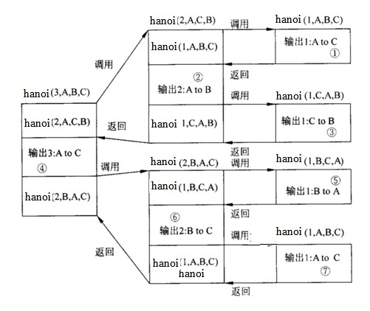

Slide 47
3.1.3 Parameter passing of functions
The storage of formal parameters are allocated only when the function is called.
Actual arguments can be constants, variables or expressions.
The type of actual arguments must match the type of the formal parameters.
Value passing is the passing of argument values, i.e., one-way passing. (有去无回)
Reference passing can achieve two-way passing. (有去有回)
Constant reference(常引用) as formal parameters, i.e., int foo (int const& a), can guarantee the safety of the actual argument.*

Slide 48
A Typical Case of “pass-by-value”
世间的纷扰已与我无关
主调函数：
D = power(A,3)
A
2.5
3
单向传递！
X
2.5
N
3
被调函数：
double power(double X, int N)

Slide 49
Codes::Swapping two integers
#include<iostream>
using namespace std;
void swap(int a, int b) {
int t = a;
a = b;
b = t;
}
int main() {
int x = 5, y = 10;
cout << "x = " << x << " y = " << y << endl;
swap(x, y);
cout << "x = " << x << " y = " << y << endl;
return 0;
}
运行结果：
x = 5 y = 10
x = 5 y = 10

Slide 50
3.1 函数的定义与使用 —— 3.1.3 函数的参数传递
1.swap(x,y);
5
10
x
y
5
10
a
b
2.Within swap()
t=a;
a=b;
b=t;
5
10
5
10
5
10
x
y
x
y
x
y
5
10
10
10
10
5
a
b
a
b
a
b
t
5
t
5
t
5
3.Back to main()
5
10
x
y

Slide 51
3.1 函数的定义与使用 —— 3.1.3 函数的参数传递
让传就传
1.swap(x,y);
5
10
x
y
5
10
a
b
2.Within swap()
尔等厮杀
与我无瓜
尔等厮杀
与我无瓜
t=a;
尔等厮杀
与我无瓜
a=b;
b=t;
5
10
5
10
5
10
x
y
x
y
x
y
5
10
10
10
10
5
a
b
a
b
a
b
t
5
t
5
t
5
3.Back to main()
尔等厮杀
与我无瓜
5
10
x
y

Slide 52
Pass-by-reference
Reference(&) is an alias for the identifier.
e.g.,
  int i, j;
  int &ri = i; //建立一个int型的引用ri,并将其初始化为变量i的一个别名
  j = 10;
  ri = j; //相当于 i = j;
A reference must be initialized to point to an existing object when declared.
Once a reference has been initialized, it cannot points to another object.
References can be used as formal parameters
e.g., void swap(int &a, int &b) {...}

Slide 53
Codes::Swap two integers
#include<iostream>
using namespace std;
void swap(int& a, int& b) {
int t = a;
a = b;
b = t;
}
int main() {
int x = 5, y = 10;
cout << "x = " << x << " y = " << y << endl;
swap(x, y);
cout << "x = " << x << " y = " << y << endl;
return 0;
}
运行结果:
x = 5 y = 10
x = 10 y = 5

Slide 54
3.1 函数的定义与使用 —— 3.1.3 函数的参数传递
swap(x,y);
t=a;
5
10
5
5
x
y
x
t
x 的引用
y 的引用
x 的引用
a
b
a
a=b
b=t;
10
10
5
5
x
y
t
y
x 的引用
y 的引用
y 的引用
a
b
b
10
5
x
y

Slide 55
Codes::Pass-by-value v.s. Pass-by-reference
#include <iostream>
#include <iomanip>
using namespace std;
void fiddle(int in1, int &in2)
{
in1 = in1 + 100;
in2 = in2 + 100;
cout<<"The values are ";
cout << setw(5) << in1;
cout << setw(5) << in2 << endl;
}
int main() {
int v1 = 7, v2 = 12;
cout << "The values are ";
cout << setw(5) << v1;
cout << setw(5) << v2 << endl;
fiddle(v1, v2);
cout << "The values are ";
cout << setw(5) << v1;
cout << setw(5) << v2 << endl;
return 0;
}

Slide 56
Pass-by-value v.s. Pass-by-reference*
Generally, a function with “pass-by-value” parameters should not be of type void.
In contrast, a function with “pass-by-reference” parameters may be type void or int indicating the state of execution.
  All operations have been done within the function body.
This may be useful in your future research.
  PyTorch, TensorFlow, etc.

Slide 57
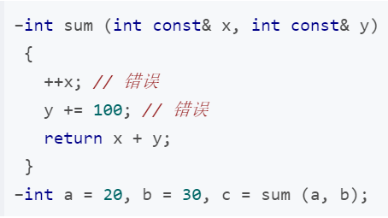
Constant reference as formal parameters*
常引用作形参的作用
一旦做出对实参的意外修改，将直接引发编译错误，从而将修改实参所带来的风险降到最低。
为何不直接用值传递？
避免了对象复制的开销。
Ref.
https://blog.csdn.net/ptonlix/article/details/76418178

Slide 58
3.2 Inline functions
Declare an inline function by adding the keyword inline.
Replacing the calling with the function body at compilation(编译时替换).
  Saving the overhead of parameter passing and control transfer (控制转移).
Tips
  No loops or switch statements are allowed inside inline functions.
  The declaration of an inline function must appear before the inline function is called for the first time.
  Advantages v.s. Disadvantages? (三要素：结构简单/语句少/调用频繁)

Slide 59
Codes::Application of inline functions
#include <iostream>
using namespace std;
const double PI = 3.14159265358979;
inline double calArea(double radius) {
return PI * radius * radius; // 结构简单，语句少
}
int main() {
double r = 3.0;
double area = calArea(r); //替换后不会增加原址开销
cout << area << endl;
return 0;
}

Slide 60
3.3 Functions with default parameter values
The function can be declared with default values of formal parameters.
The actual arguments are used if they are available, otherwise the default values will be used.
e.g.,
  int add(int x = 5,int y = 6) {
  return x + y;
  }
  int main() {
  add(10,20);//10+20
  add(10); //10+6
  add(); //5+6
  }

Slide 61
The order of parameters with default values
A formal parameter with a default argument must be at the end of the list of formal parameters,
i.e. parameters without default values cannot appear to the right of that with default values.
Reason — the rule of “left-to-right order” will cause ambiguity.
  int add(a, b=2, c=1) {return a+b+c;} → add(10,3)=?
  int add(a=3, b=2, c) {return a+b+c;} → add(10,3)=?

Slide 62
Where to set the default parameter values?
Condition 1 — In the declaration of function prototype.
Condition 2 — In the definition of function.
int add(int x = 5,int y = 6);
//原型声明在前
int main() {
add();
}
int add(int x,int y) {
//此处不能再指定默认值
return x + y;
}
int add(int x = 5,int y = 6) {
//只有定义，没有原型声明
return x + y;
}
int main() {
add();
}

Slide 63
Example::Default parameters
getVolume() is a function that calculates the volume with three formal parameters: length, width, and height, where width and height carry default values.
Analyze the results of getVolume() in different forms (see next slide).

Slide 64
Codes::Default parameters
#include <iostream>
#include <iomanip>
using namespace std;
int getVolume(int length, int width = 2, int height = 3);
int main() {
const int X = 10, Y = 12, Z = 15;
cout << "Some box data is " ;
cout << getVolume(X, Y, Z) << endl;
cout << "Some box data is " ;
cout << getVolume(X, Y) << endl;
cout << "Some box data is " ;
cout << getVolume(X) << endl;
return 0;
}
int getVolume(int length, int width/* = 2 */, int height/* = 3 */) {
cout << setw(5) << length << setw(5) << width << setw(5) << height << '\t';
return length * width * height;
}

Slide 65
3.4 Function Overload
C++ allows functions(函数) with similar functions to be declared with the same name in the same scope, i.e., overloading.
It is convenient to use and easy to remember.
Two typical kinds of overloading,
  i.e., different parameter types; different parameter numbers.
int add(int x, int y);
float add(float x, float y);
Different in parameter types.
int add(int x, int y);
int add(int x, int y, int z);
Different in parameter numbers.

Slide 66
Key points
Overloaded functions must have different formal parameters, either different numbers or different types.
The compiler will determine which function to call based on the best match between arguments and parameters.
int add(int x,int y);
int add(int a,int b);
编译器不以形参名来区分
int add(int x,int y);
void add(int x,int y);
编译器不以返回值来区分

Slide 67
Key points
Do not declare functions(函数) with different purposes as overloaded functions.
int add(int x, int y)
{ return x + y; }
float add(float x,float y)
{ return x - y; }

Slide 68
Example::x²+y² for both integers and real numbers
Write two functions with identical names to calculate x²+y² for integers and real numbers.

Slide 69
Codes::x²+y² overloads for different types
int sumOfSquare(int a, int b) {return a * a + b * b;} // 函数名相同
double sumOfSquare(double a, double b) {return a * a + b * b;} //函数名相同
int main() {
int m, n;
cout << "Enter two integer: ";
cin >> m >> n;
cout << "Their sum of square: " << sumOfSquare(m, n) << endl;
double x, y;
cout << "Enter two real number: ";
cin >> x >> y;
cout << "Their sum of square: " << sumOfSquare(x, y) << endl;
return 0;
}

Slide 70
Codes::x²+y² overloads for different types
运行结果：
Enter two integer: 3 5
Their sum of square: 34
Enter two real number: 2.3 5.8
Their sum of square: 38.93

Slide 71
3.5 C++ System Functions
C++'s system library provides hundreds of functions.
  e.g., the square root function (sprt), the absolute value function (abs).
Header files should be included before using system functions.
  e.g., cmath or math.h

Slide 72
Example — Trigonometric functions
<cmath> contains a bunch of C++ standard functions. Try it!
Input — θ
Output — sin(θ), cos(θ), tan(θ)

Slide 73
Codes::Trigonometric functions
#include <iostream>
#include <cmath>
using namespace std;
const double PI = 3.14159265358979; // 要学以致用！
int main() {
double angle;
cout << "Please enter an angle: ";
cin >> angle; //输入角度值
double radian = angle * PI / 180; // 三角函数输入要求弧度，因此需转化为弧度值
cout << "sin(" << angle << ") = " << sin(radian) <<endl;
cout << "cos(" << angle << ") = " << cos(radian) <<endl;
cout << "tan(" << angle << ") = " << tan(radian) <<endl;
return 0;
}
运行结果：
30
sin(30)=0.5
cos(30)=0.866025
tan(30)=0.57735

Slide 74
Standard and Non-standard functions
Standard C++ functions
  Definition — The functions specified in the C++ standard.
  Excellent portability due to the wide support by various compilation environments.
  Many standard C++ functions are inherited from standard C. The header files start with ‘c’ — cmath, cstdlib, cstdio, ctime ...
Non-standard C++ functions
  Depending on the particular operating system or compilation environment.
  Being used in scenarios related to OS.

Slide 75
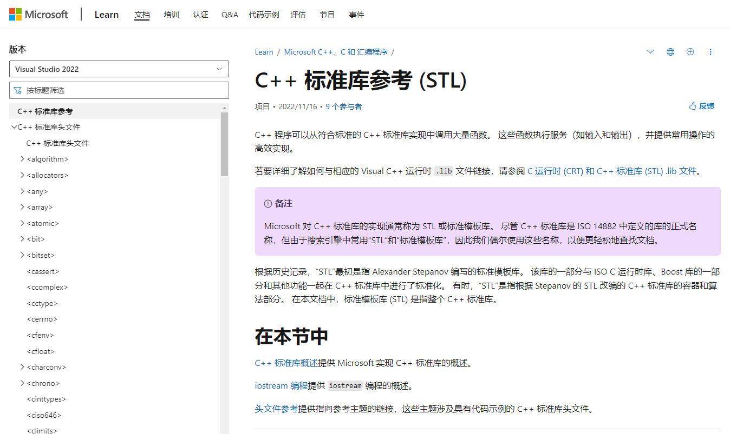
How to find system functions in STL (standard template library)?
https://learn.microsoft.com/zh-cn/cpp/standard-library/cpp-standard-library-reference?view=msvc-170

Slide 76
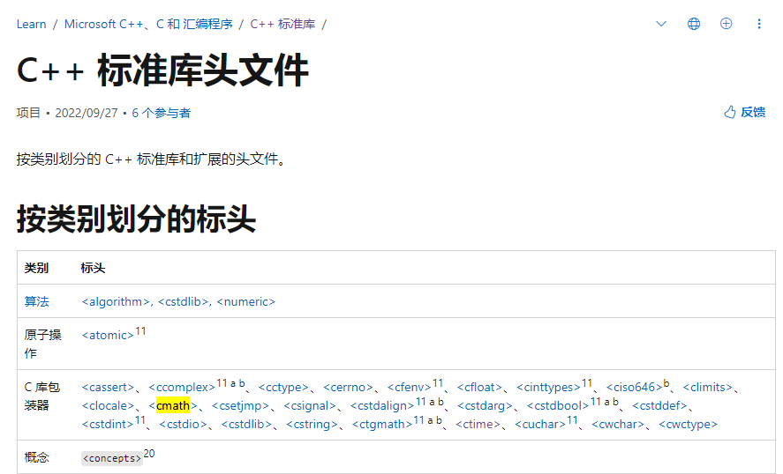
How to find system functions in STL (standard template library)?

Slide 77
Summary
Main contents
  Function declaration and invocation, parameter passing between functions, inline functions, functions with default parameter values, function overloading, C++ system functions
Objectives
  Students are required to write a relatively functionally independent program as a function.

