Slide 1
C++ Programming
Spring Semester 2023
Shugang Zhang <zsg@ouc.edu.cn>
College of Computer Science and Technology

Slide 2
Chapter 4 Class and Object
Theory ~ 3 hours
Experiment ~ 2 hours

Slide 3
Overview of Chapter 4
Basic features of object-oriented programming
Class and object
Constructor(构造函数) and destructor(析构函数)
Combination of Classes
UML diagram
Structs(结构体) and Unions(联合体)

Slide 4
4.1.1 Abstraction
Abstraction is the generalization of specific objects (problems). It extracts and describes the common properties of the class that the objects belongs to.
  Thinking first before you implement it. 针对具体问题去抽象
  Data abstraction — describing the properties or states of a certain class of objects.
  Code abstraction — describing the common behavioral features or functions that objects of a certain class have.
  Implementation — Class.

Slide 5

Example of Abstraction — Clock
Data abstraction
  int hour, int minute, int second
Code abstraction
  setTime(), showTime()

Slide 6
Codes::Abstraction of a clock
  class Clock {
  public:
  void setTime(int newH, int newM, int newS);
  void showTime();
  private:
  int hour, minute, second;
  };

Slide 7
4.1.2 Encapsulation(封装)
Combining those abstracted data members and the relevant codes, and treating them as a whole.
  The purpose is to enhance security and simplify programming.
  Users do not have to know the specific implementation details, but only need to access members via the external interface.
  Implementing encapsulation — {} in the class declaration.

Slide 8

4.1.2 Encapsulation
External Interface
  class Clock {
  public: void setTime(int newH, int newM, int newS);
  void showTime();
  private: int hour, minute, second;
  };
Access Permission
Boundary

Slide 9
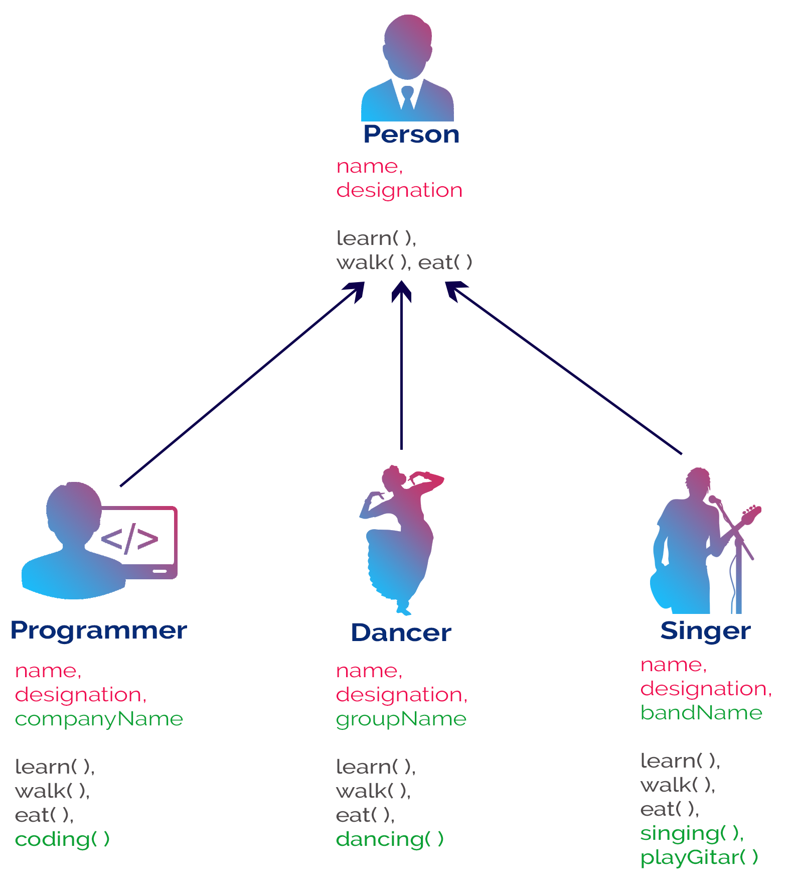
4.1.3 Inheritance
Inheritance is a mechanism in C++ that supports hierarchical classification.
It allows the programmer to be more specific while maintaining the characteristics of the original class.

Slide 10
4.1.4 Polymorphism (多态)
Polymorphism — same name, different ways of implementing functions.
Purpose — to keep a uniform behavior identification and to reduce the number of identifiers in the program.
  E.g., add_real(a, b) v.s. add_complex(a+ci, b+di) => add()
Implementation — overloaded functions and virtual functions.

Slide 11
4.2 Class and Object
Class is a collection of objects with the same properties and behaviors. It provides a unified abstract description of all the objects belonging to the class.
Class allows for encapsulation(封装), hiding(隐藏), inheritance(继承) and derivation(派生) of data.
Using classes is easy to write large and complex programs, and its modularity(模块化程度) is higher than the use of functions in C.

Slide 12

4.2.1 The definition of Class
A class is a user-defined type declared in the following form
class Cname
{
public:
// public members (external interface)
private:
// private members
protected:
// protected members
}

Slide 13
4.2.2 Public members
Definition — members declared after the keyword public.
Scope — they are the interface between the class and the outside. Any external function can access public data and functions.
Public members

Slide 14
Private members
Definition — members declared after the keyword private.
Scope — Only functions in this class are allowed to access it, and no functions outside the class can access it.
The keyword private can be omitted if the private member is declared immediately after the class name.

Slide 15
Protected members
It has similar properties with private members.
It differs from private members in the scope of derived classes.

Slide 16
4.2.3 Objects
Definition
  An object of a class is a particular entity/instance of that class,
  i.e., a variable with type of that class (对象是一个变量，其变量类型为类类型).
Declaration
  Class name Object name;
  e.g., Clock myClock;
Accessing members inside a class
  Directly use a member by its name
Accessing members outside a class
  Use "object_name.member_name" to access members of public attributes.

Slide 17
4.2.4 Member functions
4.2 类和对象
To claim a prototype in a class, the function body can be implemented outside the class. The function should be constrained by adding the class name before its name.
  e.g., void Clock::Clock(parameter list){function body;}//默认写法，可进一步拆分
It is also possible to give the function body directly in the class, forming an inline member function. (回顾：何时用内联函数？)
It is allowed to declare overloaded functions and functions with default parameter values as member functions.

Slide 18
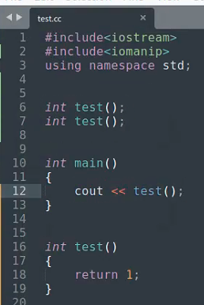
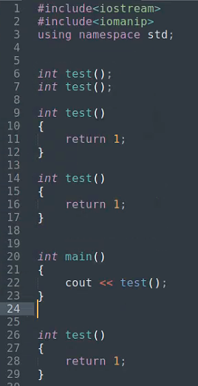
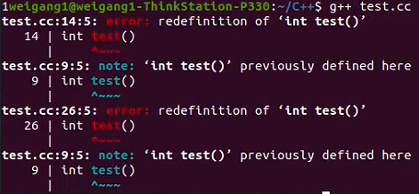

为什么C++中声明和实现要分开写*

Slide 19
Inline member functions
To improve runtime efficiency, simple functions can be declared inline.
Do not include complex structures (such as loop statements and switch statements) in inline function bodies.
Declaring inline member functi0ns in class.
  Implicit — Implementing the function body within class.
  Explicit — Using the keyword inline.

Slide 20
4.2.5 Codes::Implementing a Clock Class
#include<iostream>
using namespace std;
class Clock{
public:
void setTime(int newH = 0, int newM = 0, int newS = 0);
void showTime(); // 成员函数声明
private:
int hour, minute, second;
}; // 注意此处的“;”不要忘记！
int main() {
Clock myClock;
myClock.setTime(8, 30, 30);
myClock.showTime();
return 0;
}
运行结果：
8:30:30

Slide 21
4.2.5 Codes::Implementing a Clock Class
void Clock::setTime(int newH, int newM, int newS) {
hour = newH;
minute = newM;
second = newS;
}
inline void Clock::showTime() { // 显式声明的内联成员函数
cout << hour << ":" << minute << ":" << second;
}
运行结果：
8:30:30

Slide 22
4.3.1 Constructor
Initializing the object with pre-set values.
It is called automatically when the object is created.
If not declared in the program, a default constructor is automatically generated with an empty argument list.
Constructors can be inline functions, overloaded functions, or functions with default parameter values.

Slide 23
4.3.1 Constructor
The most apparent features of a constructor
  It has the same name as the class.
  It has no returning type. 注意这里与void区分

Slide 24
Codes::Example of Constructor
class Clock {
public:
Clock(int newH,int newM,int newS); // 构造函数声明
void setTime(int newH, int newM, int newS);
void showTime();
private:
int hour, minute, second;
};
// 构造函数定义方式之一。注意：写在函数体内也可。
Clock::Clock(int newH, int newM, int newS):hour(newH), minute(newM), second(newS) {}
int main() {
Clock c(0,0,0); // 调用构造函数
c.showTime();
return 0;
}

Slide 25
4.3.2 Default constructor
A constructor that carries parameters but receives no actual arguments.

Slide 26
Code::Default constructor
class Clock {
public:
Clock(int newH,int newM,int newS); // 有参构造函数
Clock(); //默认构造函数
private:
int hour, minute, second;
};
Clock::Clock(int newH, int newM, int newS):hour(newH), minute(newM), second(newS) {}
Clock::Clock(): hour(0), minute(0), second(0){}
int main() {
Clock c1(12,0,0); // 有参构造函数
Clock c2; // 默认构造函数
return 0;
} // 思考：可以不定义默认构造函数吗？

Slide 27
Why default constructor is recommended?
There will be no default condition if any type of constructor has been defined.
Automatically generated constructor might cause unpredicted error due to the default values. (例如除法工具类)
Automatically generated constructor is not able to initialize the member objects of class type.

Slide 28
4.3.4 Copy constructor
The copy constructor is a special constructor.
It takes a parameter of an object reference of the current class.
Its designed to initialize a new object of the same type with an existing object.
  class Cname{
  public :
  Cname (parameter list); //构造函数
  Cname (Cname &objectName); //复制构造函数
  ...
  }；
  Cname::Cname(Cname &objectName) //复制构造函数的实现
  { 函数体 }

Slide 29
4.3.4 Copy constructor
Three cases for calling copy constructor
  Initializing an object with another one.
  E.g., Point a = b; Point a(b); // 两种初始化方式均可
  Calling a function that has an object parameter.
  E.g., void foo(Point a){};
  Calling a function that has an object returning value.
  E.g., Point foo(){return a;}

Slide 30
Codes::Copy constructor
class Point{
public:
Point(int xx=0, int yy=0) {X=xx;Y=yy;} ) // inline constructor
Point(Point &p);
int GetX() {return X;}
int GetY() {return Y;}
private:
int X,Y;};
Point::Point(Point &p){ // definition of the copy constructor
X=p.X;
Y=p.Y;
cout<<"copy构造函数调用"<<endl; }

Slide 31
Codes::Copy constructor
void fun1(Point p){cout<<p.GetX()<<endl;} // 情况1：对象做参数传递
Point fun2(){ // 情况2：对象做返回值
Point a(1,2);
return a; // 注意这里的a的作用域仍然是局部范围，因此需要调用复制构造函数
}
void main(){
Point a(4,5); // 情况3：对象用于初始化
Point b(a);
cout<<b.GetX()<<endl;
fun1(b);
b=fun2();
cout<<b.GetX()<<endl;
}

Slide 32
Implicit copy constructor
If the programmer does not declare a copy constructor for the class, the compiler generates an implicit copy constructor itself.
This implicit copy constructor initializes the members of the new object with the corresponding member values of the old object.

Slide 33
When to use an explicit copy constructor?
Customized copy
  Partial copy
  User-defined content
Deep copying a member object (默认constructor也有类似问题)
  Default implicit copy constructor can only copy a pointer (shallow copy) rather than creating a new member object (deep copy).
  Shallow copy is not safe. (原指针消失？)

Slide 34
4.3.5 Destructor
Completing some cleanup work before the object is deleted.
It is automatically called by the system at the moment when the object's lifetime ends, and then the space of the object is freed.
If a destructor is not declared in the program, the compiler will automatically generate an implicit/default destructor.

Slide 35
Example of Constructor and Destructor
#include <iostream>
using namespace std;
class Point {
public:
Point(int xx,int yy);
~Point();
private:
int x, y;
};
Point::Point(int xx,int yy) {
x = xx;
y = yy;
}
Point::~Point() {
// 调用析构函数后，对象仍存在？
}

Slide 36
4.3.6 Move constructor*
Move constructor is designed to avoid redundant copy.
Left reference v.s. Right reference (临时的、值不改变的)
  Format of lr — type & reference name = left reference expression;
  Format of rr — type && reference name = right reference expression;
  float n = 6;
  float &lr_n = n;
  float &&rr_n = n;
  float &&rr_n = n*n;
  float &lr_n = n*n;

Slide 37
4.3.6 Move constructor*
Move constructor is designed to avoid redundant copy.
Left reference v.s. Right reference (临时的、值不改变的)
  Format of lr — type & reference name = left reference expression;
  Format of rr — type && reference name = right reference expression;
  float n = 6; // ok.
  float &lr_n = n; // ok.
  float &&rr_n = n; // not ok. n is a left reference.
  float &&rr_n = n*n; // ok.
  float &lr_n = n*n; // not ok. n*n returns a temp constant value.

Slide 38
4.3.6 Move constructor*
Using the right reference to avoid redundant copy.
MyStr(MyStr &&str) noexcept
:s(std::move(str.s)) {} // 承诺str.s用于初始化后不再使用
Ref. https://zhuanlan.zhihu.com/p/365412262

Slide 39
4.4.1 Combinations of classes
The member data in a class is an object of another class.
More complex abstractions can be implemented on the basis of existing abstractions.

Slide 40
The constructor for class combinations
Assigning initial values not only to the basic data-type members in this class, but also to the member objects belonging to other classes.
Declaration
Class name::Class name(parameters of member objects, parameters of this class)
:object1(parameter), object2(parameter), ......
{
//other statements of the function body
}

Slide 41
The order of initialization for combinations
The members listed in the constructor initialization list (including basic type members and member objects) are initialized first,
The initialization of this list follows the order in which the members are defined in the class body. (注意：与形参列表中的顺序无关！)
  Member object constructor call order — in the order of the declaration of member objects.
  Calling the default constructor to initialize those member objects that do not appear in the initialization list.
The function body of the constructor is executed after finishing the initialization list.

Slide 42
例4-4 类的组合，线段（Line）类
4.4 类的组合 —— 4.4.1 组合
//4_4.cpp
#include <iostream>
#include <cmath>
using namespace std;
class Point { //Point类定义
public:
Point(int xx = 0, int yy = 0) {
x = xx;
y = yy;
}
Point(Point &p);
int getX() { return x; }
int getY() { return y; }
private:
int x, y;
};
Point::Point(Point &p) { //复制构造函数的实现
x = p.x;
y = p.y;
cout << "Calling the copy constructor of Point" << endl;
}

Slide 43
例4-4（续）
4.4 类的组合 —— 4.4.1 组合
class Line {
public:
Line(Point xp1, Point xp2);
Line(Line &l);
double getLen() { return len; }
private:
Point p1, p2;
double len;
};
Line::Line(Point xp1, Point xp2) : p1(xp1), p2(xp2) {
cout << "Calling constructor of Line" << endl;
double x = static_cast<double>(p1.getX() - p2.getX());
double y = static_cast<double>(p1.getY() - p2.getY());
len = sqrt(x * x + y * y);
}
Line::Line (Line &l): p1(l.p1), p2(l.p2) {//组合类的复制构造函数
cout << "Calling the copy constructor of Line" << endl;
len = l.len;
}
int main() {
Point myp1(1, 1), myp2(4, 5); //建立Point类的对象
Line line(myp1, myp2); //建立Line类的对象
Line line2(line); //利用复制构造函数建立一个新对象
cout << "The length of the line is: ";
cout << line.getLen() << endl;
cout << "The length of the line2 is: ";
cout << line2.getLen() << endl;
return 0;
}

Slide 44
例4-4（续）
4.4 类的组合 —— 4.4.1 组合
运行结果如下：
Calling the copy constructor of Point
Calling the copy constructor of Point
Calling the copy constructor of Point
Calling the copy constructor of Point
Calling constructor of Line
Calling the copy constructor of Point
Calling the copy constructor of Point
Calling the copy constructor of Line
The length of the line is: 5
The length of the line2 is: 5

Slide 45
4.4.2 Forward reference declaration
Classes should be declared first before used.
If a class needs to be referenced before its declaration, a forward reference declaration (前向引用声明) should be made.
The forward reference declaration only introduces an identifier for the program, and the specific definition is written elsewhere.

Slide 46
Example
class B; //前向引用声明
class A {
public:
void f(B b);
};
class B {
public:
void g(A a);
};

Slide 47
Key points of forward reference declaration
Remember that when using forward reference declarations, only the identifiers being declared can be used.
Class details cannot be referred to.
要理解其本质: 只是告诉编译器有此类，但是类细节仍然一无所知

Slide 48
4.5.1 Brief introduction to UML
UML (Unified Modeling Language) is a visual object-oriented modeling language.
Three fundamental components in UML
  Things (事物)
  The most static part of the model. It represents conceptual or physical elements.
  Relationships (关系)
  Binding things together.
  Diagrams (图)
  Group of things that are related to each other.

Slide 49
4.5.2 UML Class Diagram
Clock
- hour : int
- minute : int
- second : int
+ showTime() : void
+ setTime(newH:int=0,newM:int=0,newS:int=0):void
Clock

Slide 50
4.5.2 Object Diagram
myClock : Clock
- hour : int
- minute : int
- second : int
myClock : Clock

Slide 51
Relationships
Dependence (依赖关系)
Class A uses Class B.
Class A depends on Class B.
Class A
Class B
Source
Destination

Slide 52
Relationships
Association (关联关系)
The "Multiplicity of A" in the diagram determines how many objects of class B interact with each object of class A.
Similarly, the " Multiplicity of B" determines how many objects of class A interact with each object of class B.
Multiplicity of A
Multiplicity of B
Class A
Class B

Slide 53
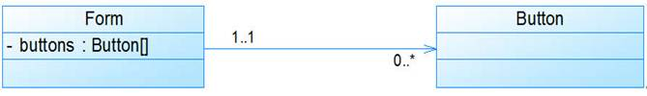
Relationships
Association (关联关系)
The "Multiplicity of A" in the diagram determines how many objects of class B interact with each object of class A.
Similarly, the " Multiplicity of B" determines how many objects of class A interact with each object of class B.

Slide 54
Relationships
Contain (包含关系)—Aggregation and Combination(聚集和组合)
  Describing the relationship between whole and part.
  Shared aggregation (共享聚集) v.s. Compositional aggregation(组成聚集)
Class A
Class A
重数A
重数A
重数B
重数B
Class B
Class B

Slide 55
Example::Line and Point in UML
Line
- len : double
+ Line(xp1 : Point, xp2 : Point)
+ Line( : Line &)
+ getLen() : double
1..*
1..*
Point
- x : int
-p1
- y : int
-p2
2
+ Point(xx : int = 0, yy : int = 0)
+ Point(p : Point &)
+ getX() : int
+ getY() : int

Slide 56
Relationships
Inheritance (继承关系) – generalization (泛化)
父类 A
父类 B
子类 1
子类 2

Slide 57
Annotation
On UML diagrams, annotations are represented as rectangles with folded corners, which are then attached to other elements of the UML with dashed lines.
注释文字

Slide 58
Example::Description of the relationship between Line and Point classes with annotations
Line
- len : double
+ Line(xp1 : Point, xp2 : Point)
+ Line( : Line &)
+ getLen() : double
单向组合：
1..*
直线段包含
1..*
端点p1、p2
Point
- x : int
-p1
- y : int
-p2
2
+ Point(xx : int = 0, yy : int = 0)
+ Point(p : Point &)
+ getX() : int
+ getY() : int

Slide 59
4.6.1 Struct (结构体)
Structs are a special form of class
  The only difference with classes — the default access to classes is private, the default access to structs is public.
  The main reason for keeping structs is to maintain compatibility with the C language.
When to use structures instead of classes?
  Holding data of different types.
  It is more convenient to use structs when all members are public.

Slide 60
Struct
Declaration
  struct name {
  public members // default
  protected:
  protected members
  private:
  private members
  };
Initialization
  Type variable_name = { init_value1, init_value2, …… };

Slide 61
Codes::<Student> struct
#include <iostream>
#include <iomanip>
#include <string>
using namespace std;
struct Student { //学生信息结构体
int num; //学号
string name; //姓名，字符串对象，将在第6章详细介绍
char sex; //性别
int age; //年龄
};

Slide 62
Codes::<Student> struct
int main() {
Student stu = { 97001, “Lin Lin”, ‘F’, 19 }; // 结构体初始化方式
cout << "Num: " << stu.num << endl;
cout << "Name: " << stu.name << endl;
cout << "Sex: " << stu.sex << endl;
cout << "Age: " << stu.age << endl;
return 0;
}
运行结果：
Num: 97001
Name: Lin Lin
Sex: F
Age: 19

Slide 63
4.6.2 Union (联合体)
Declaration
  union name {
  public members
  protected:
  protected members
  private:
  private members
  };
Features
  Union members share the same memory cells.
  Members will not be valid at the same time.

Slide 64
Memory allocation for unions
union Mark { //表示成绩的联合体
char grade; //等级制的成绩
bool pass; //只记是否通过课程的成绩
int percent; //百分制的成绩
};
Mark
grade
pass
percent

Slide 65
Summary
Main Contents
  Basic concepts in object-oriented programming
  Declarations of class and object
  Constructor & Destructor
  Inline member functions
  Copy constructors
  Class combinations

