Slide 1

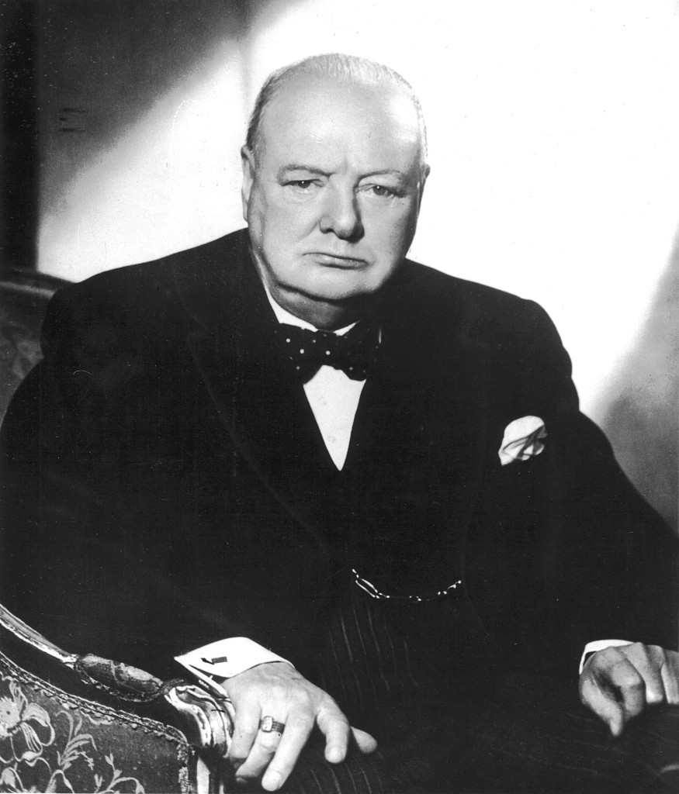

Winston Churchill
Group one
姚嫣如 周雅楠 鲁雨晨 苏锦杉

Slide 2

CONTENTS
01
Life & Contribution
02
Military ability
03
Political Career
Winston Churchill

Slide 3


Winston Churchill
鲁雨晨 周雅楠
01
life & contribution

Slide 4

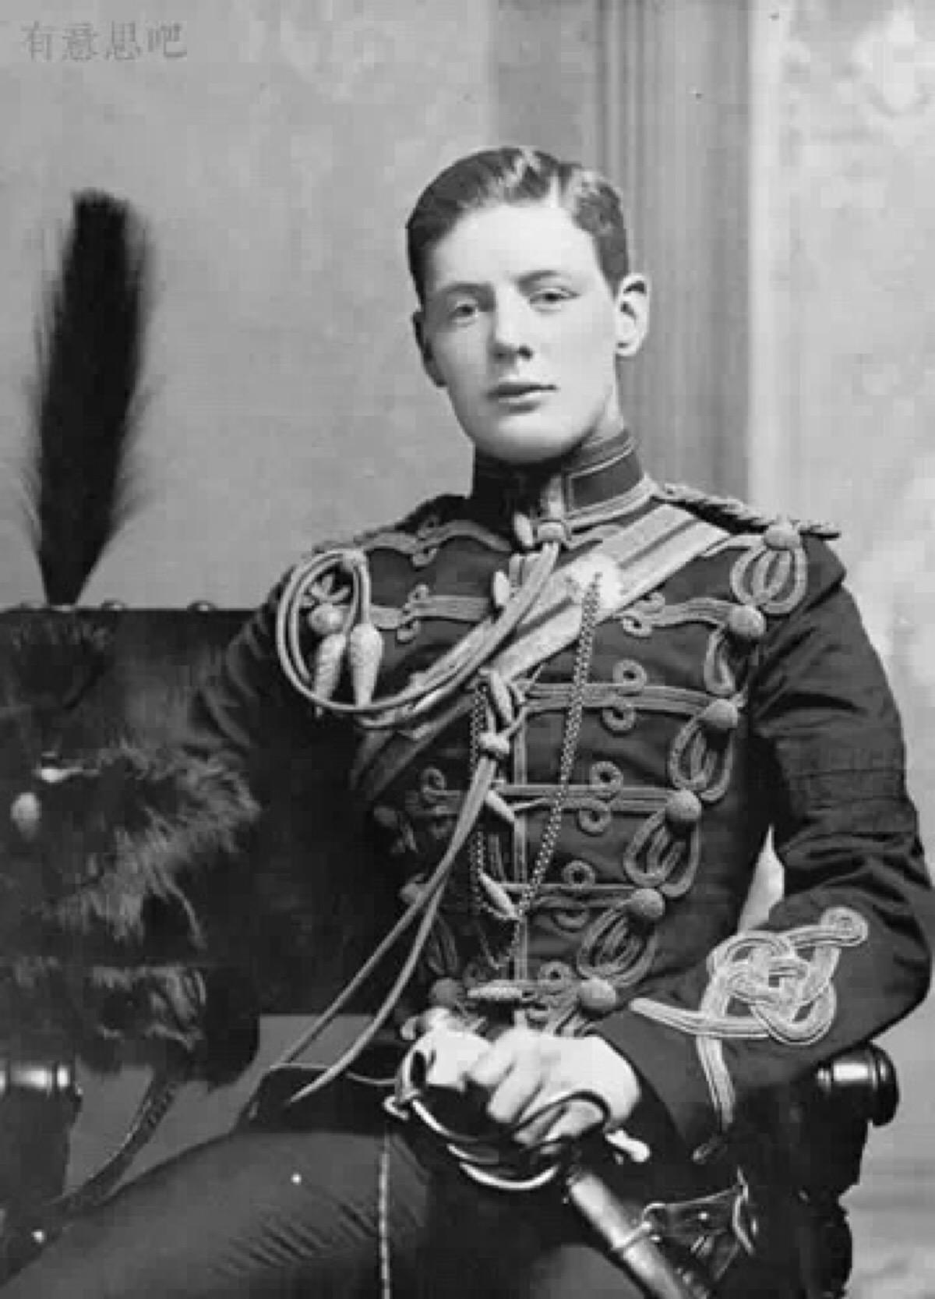
life contribution
date of birth: November 30th, 1874
date of death: January 24th , 1965
career: Politician, historian, speaker,
writer, journalist
61st and 63rd British Prime Minister

Slide 5
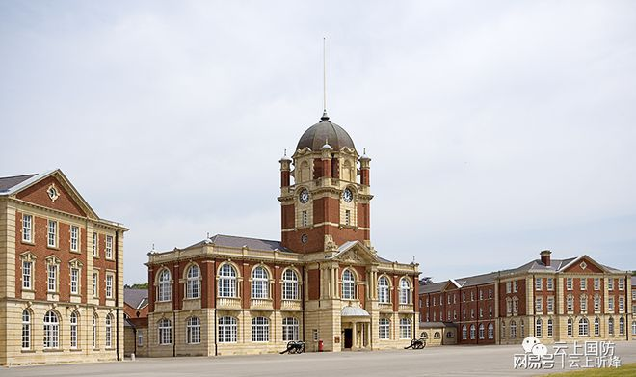
life contribution
he is of a noble birth
father:nobility
mather: Millionaire's daughter
school: Royal Military Academy Sandhurst
Royal Military Academy Sandhurst

Slide 6
life contribution
declare aid to the Soviet Union.
try to win the aid of the United States
contribute to the victory of the anti-fascist war
1895
liberal or Conservative Member of Parliamnet
colonial,naval,Treasury,and defence Secretary
join the army
1940
prime minister
1946
Iron Curtain Speech
after 1900
political career
1941
Soviet-german war
Cuban Revolution
Anglo-Boer War
open the prelude
to the Cold War

Slide 7
苏锦杉
Winston Churchill
02
Military ability
Churchill—A first-class polication,a third-rate military strategist

Slide 8
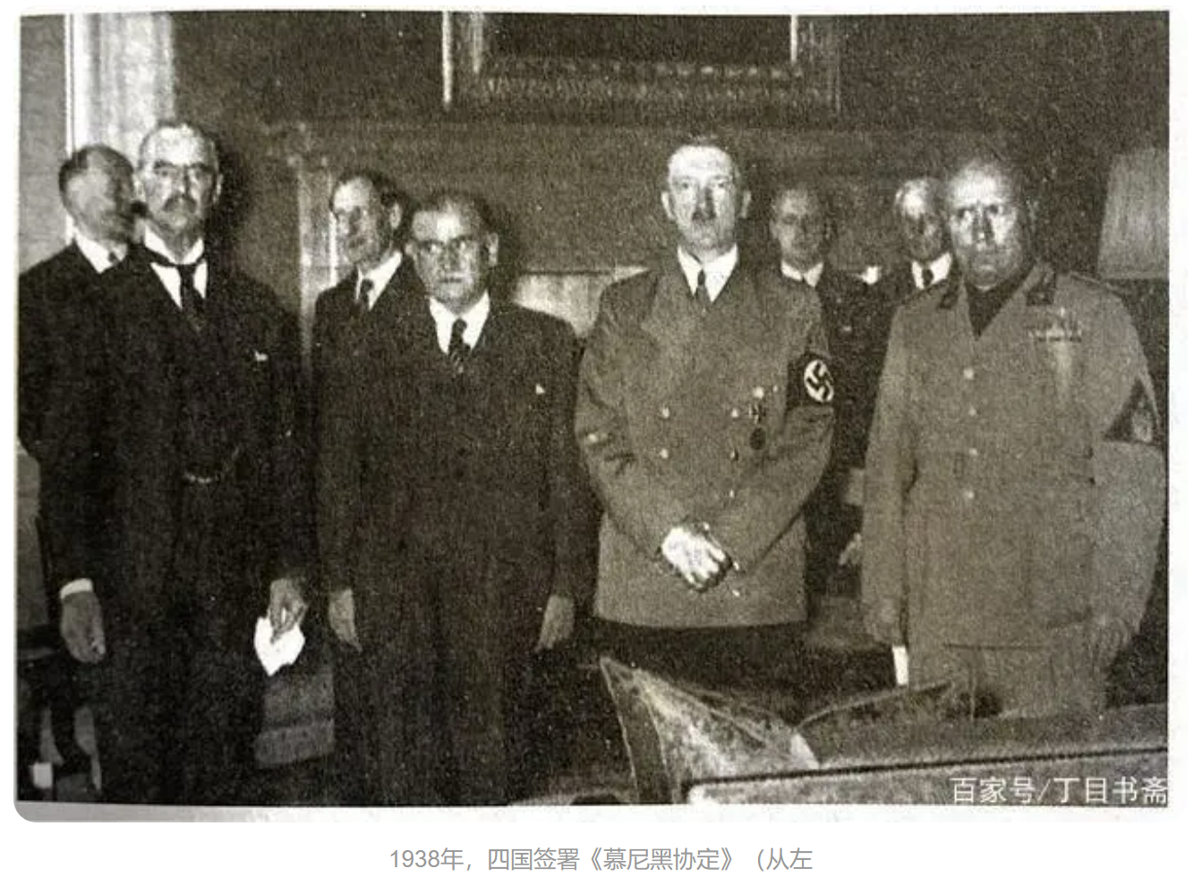
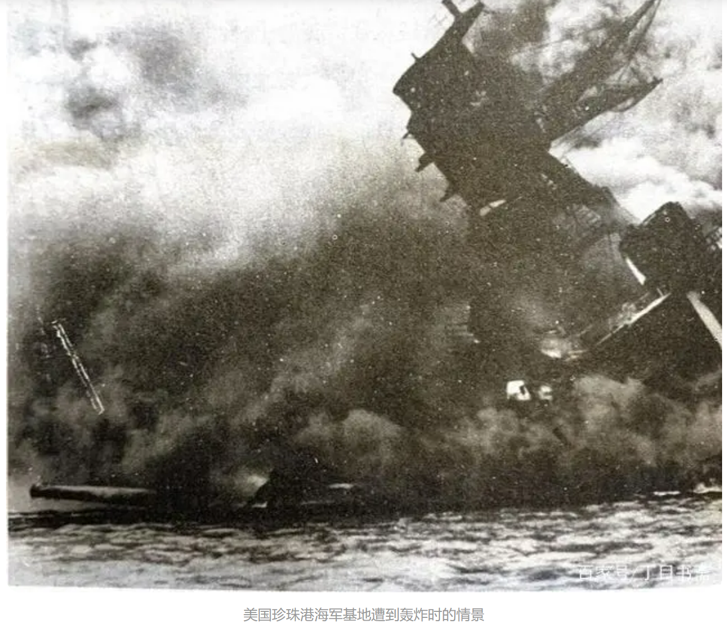
The History of the Second World War
conclusion ability
forward-looking and far-sighted

Slide 9
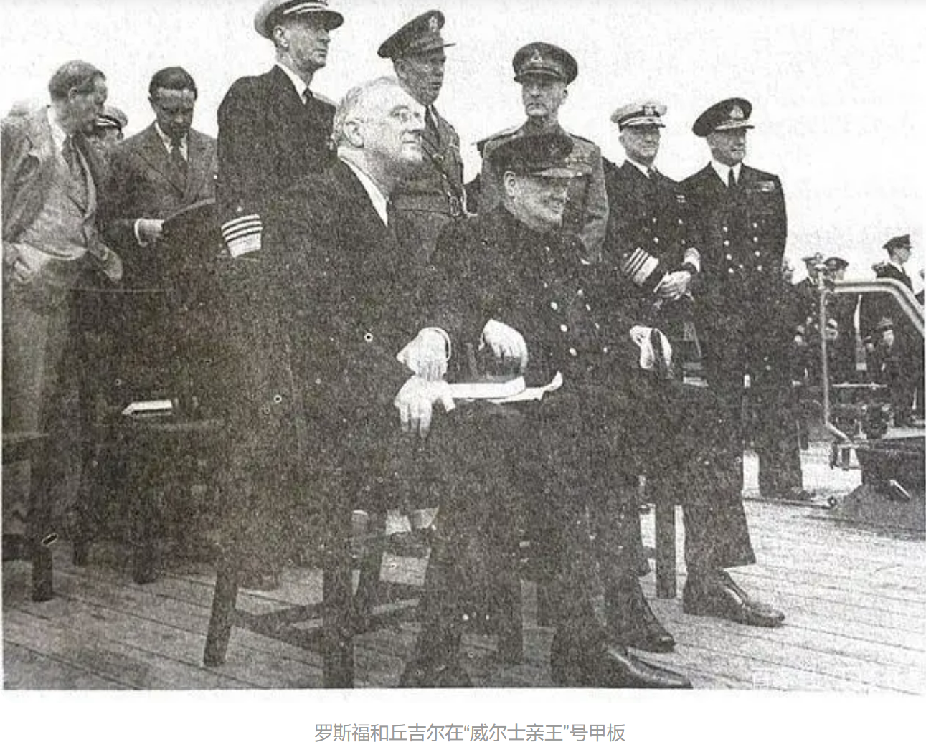
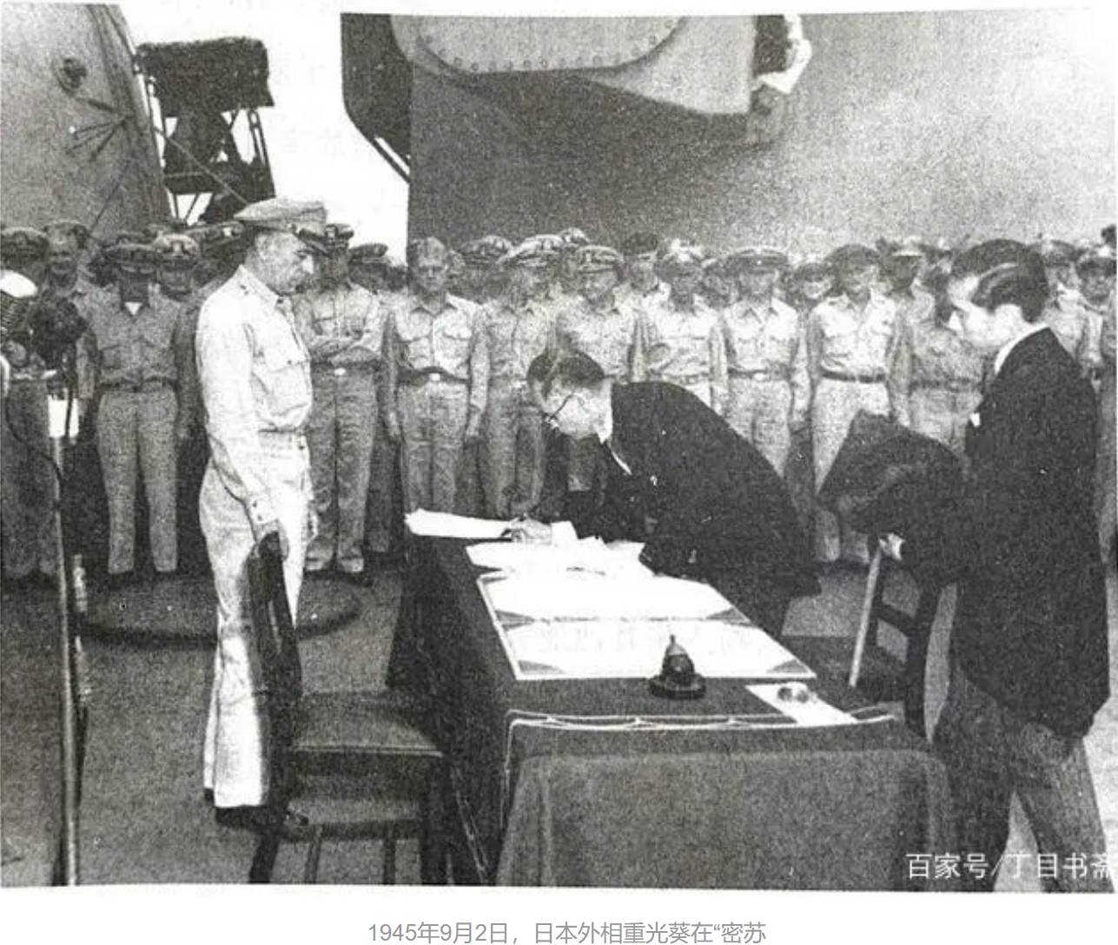
The History of the Second World War
diplomatic ability
use the mass base

Slide 10
姚嫣如
Winston Churchill
03
political career

Slide 11
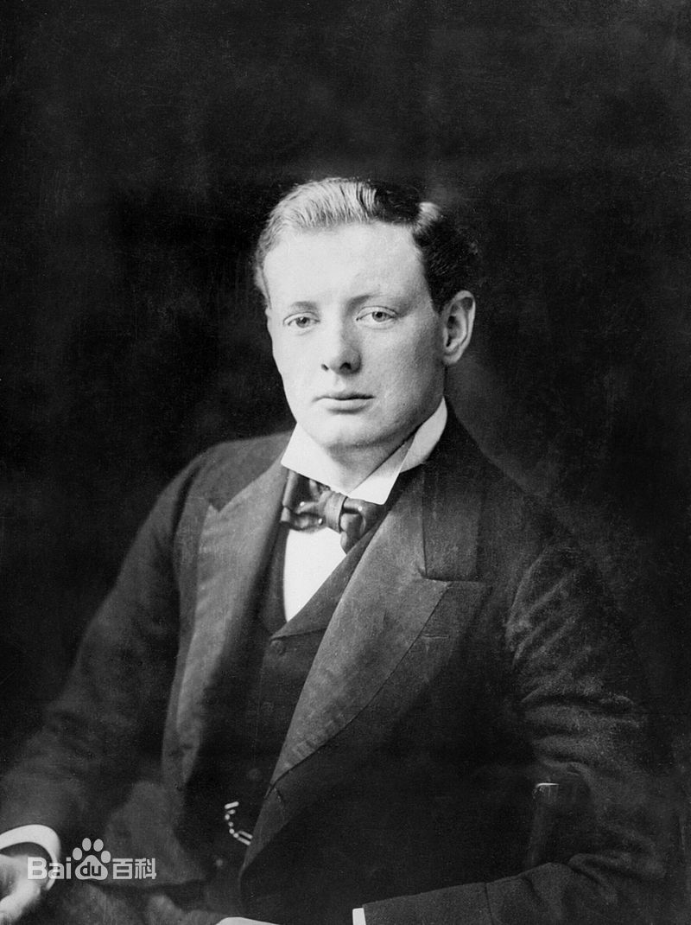
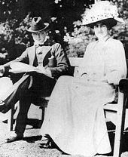
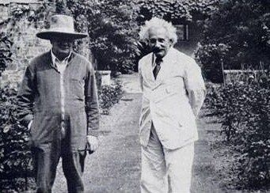
Political Career
1900
1908
1924
first entered political field after returning from the Boar War as a military hero
MP of the House of Commons
Conservative Unionist
was promoted to president of the Board of Trade
got an official seat in the cabinet
returned to the Parliament as Baldwin’s Chancellor
the return to the Gold Standard
1904
1922
crossed the floor to join the Liberals
lost the post because of the fell of coalition government

Slide 12
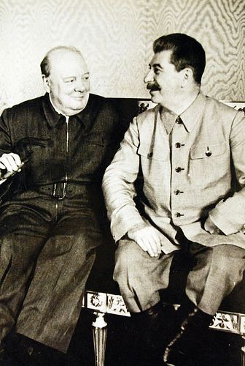
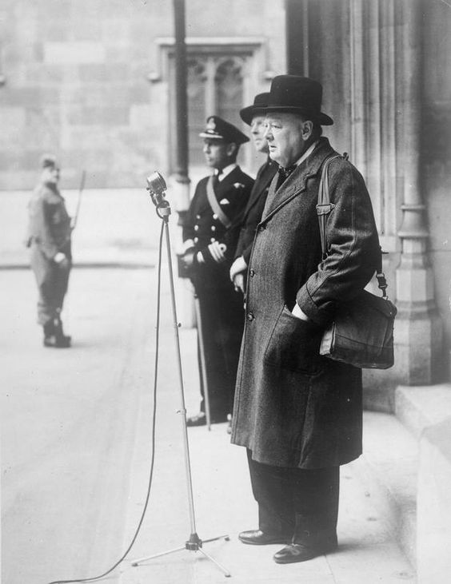
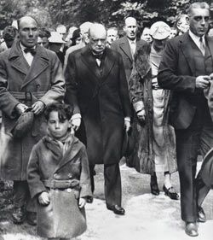
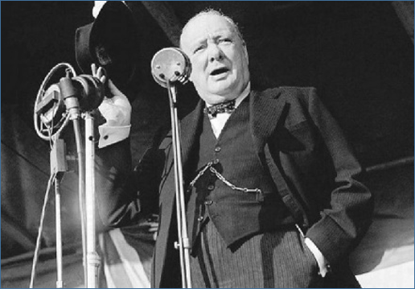
Political Career
1929
1940
1951
Baldwin’s Government fell the election
a dramatic rise in industrial conflict
was confirmed as Prime Minister
“I have nothing to offer but blood,toil,tears and sweat”
defeat the Labour in the second election
formed a more liberal Conservatives
1939
1945
Britain declared war on Germany
in charge of the Admiralty
was rejected by the voters in the general election
Labours won a landside victory to govern peacetime Britain

Slide 13
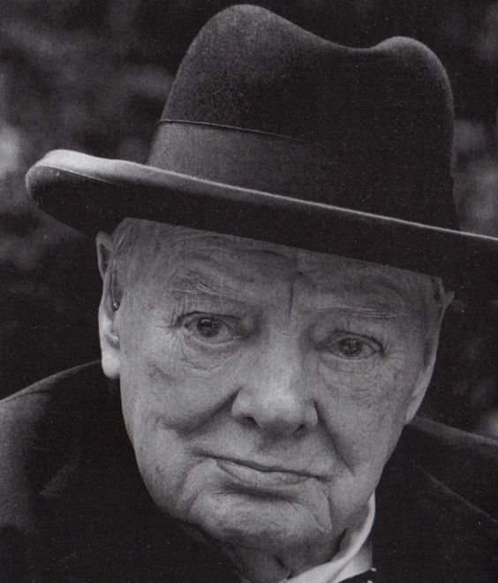
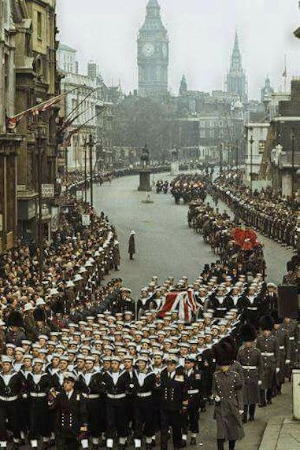
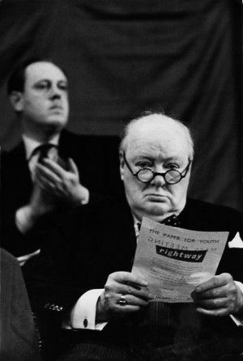
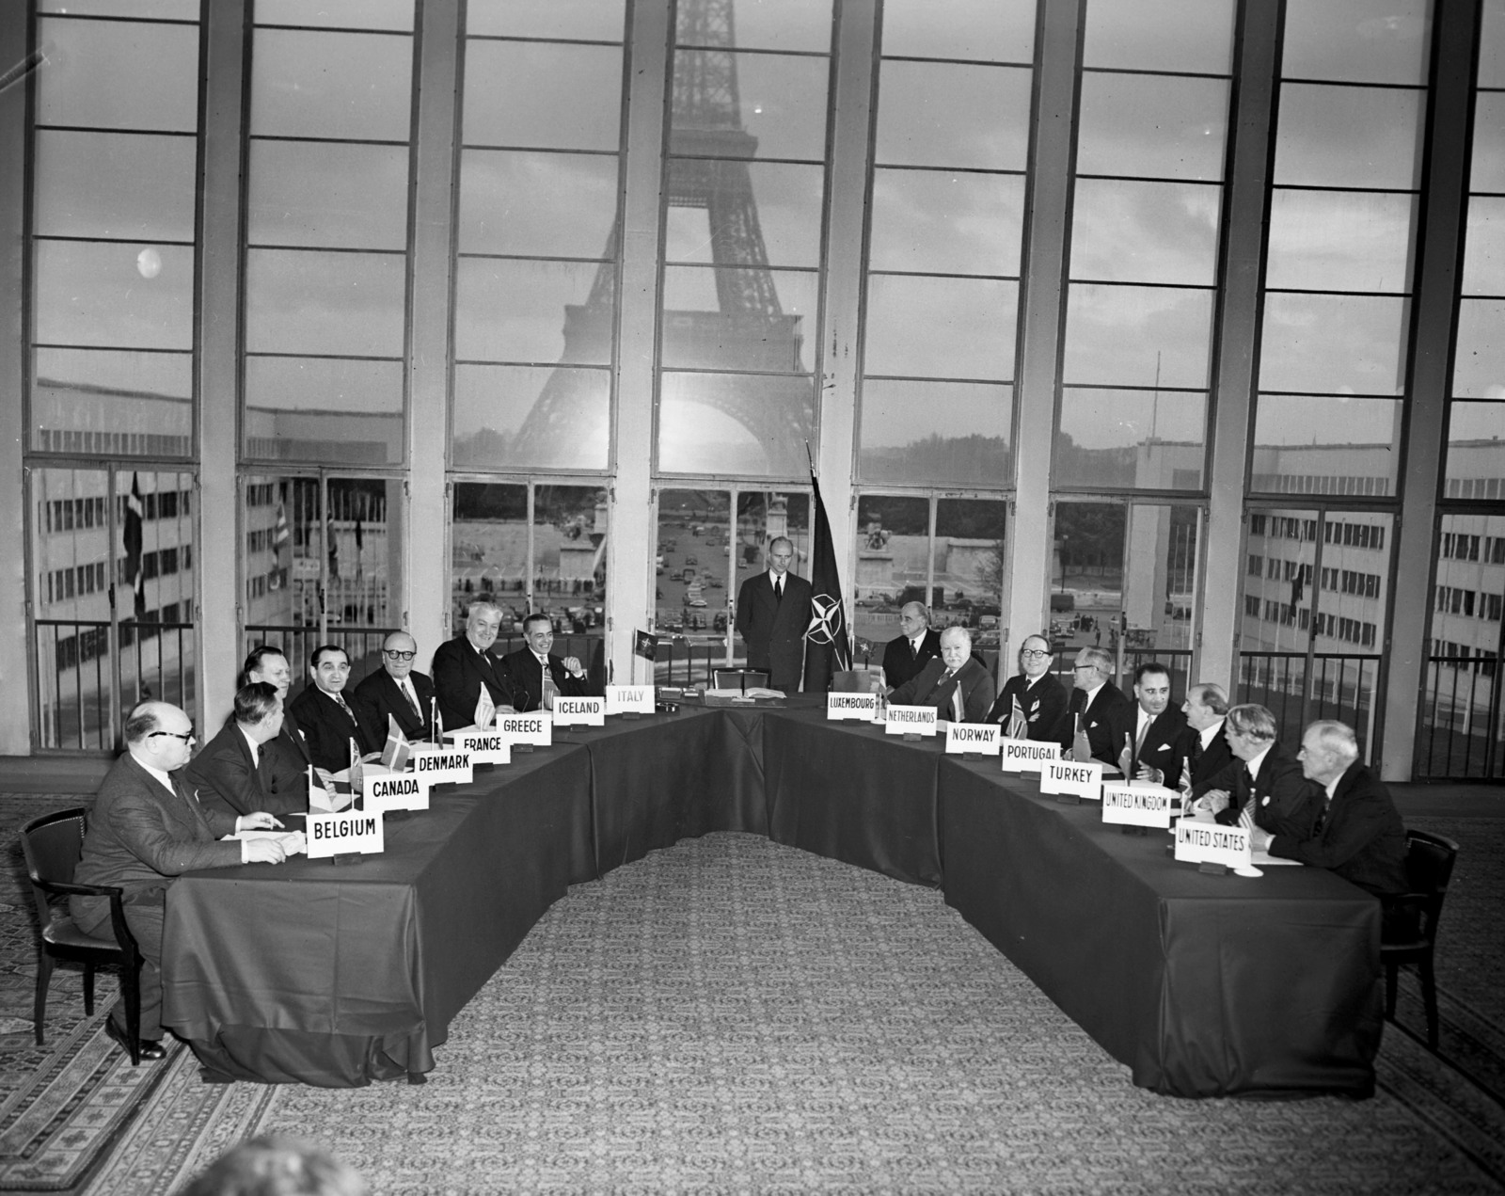
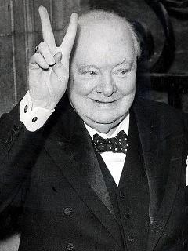
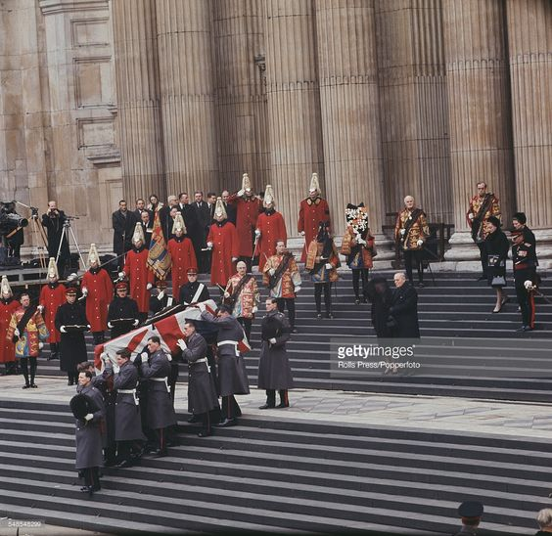
Political Career
1954
1959
London-Paris Agreement
brought West Germany to NATO
join the Southeast Asia Treaty Organization and the Central Treaty Organization
figth and win yet another election
1955
1965
announce the resignation
successor Sir Anthony Eden
father of the house
his mental and physical energy depleted by the illness

