Slide 1

CS209: Artificial Intelligence
Course Project Title: Loan Risk Prediction
Submitted by:
1. Raghuveer Verma, CS23BT041 3. Abhinandan Jain, CS23BT012
2. Shaikh Aariz, MC23BT030 4. Annavarapu Vijwal, MC23BT001
Course Instructor:
Prof. Dileep. A. D. Mentor: Ms. Neha Rudrappa Pudakalakatti

Slide 2
Outline
Date:05/05/2025
Introduction
Methodology
Experimental Setup
Results
Conclusion

Slide 3
Introduction
Date:05/05/2025
Exploration and comparison of machine learning algorithms for Classification, Regression, and Clustering.
The data set features describe the financial situation and personal attributes of individuals.
Classification: predict whether a loan is approved or not.
Regression: estimate an individual’s risk score.
Clustering: identifying clusters in the data
Elbow Method and Silhouette Analysis to get the optimal number of clusters.

Slide 4
Introduction
Date:05/05/2025
We use a synthetic dataset comprising of 20,000 records of personal and financial data.
The dataset contains thirty-six columns which can be broadly classified into:
Demographic and Employment Information
Financial and Credit Information
Credit History and Loan Information
Loan Attributes
Target Variables

Slide 5
Methodology
Date:05/05/2025
Supervised Learning:
Classification for LoanApproved:
KNN (with and without Mahalanobis Distance)
Logistic Regression
SVM (RBF + Polynomial)
Neural Networks
Supervised Learning:
Regression for RiskScore:
Linear and Polynomial Regression
Random Forest Regressor
XGBoost
Neural Networks
Unsupervised Learning:
K-Medoid
DBSCAN
Hierarchical Clustering

Slide 6
Experimental Setup
Date:05/05/2025
Columns with multiple classes: The columns with multiple classes as strings were converted to integer labels and one-hot encodings in separate datasets.
Duplicate and Missing Values: No duplicate rows or rows with missing values were found.
Train-Validation-Test Split: 60-20-20 split
Training set with 12000 examples
Validation and test sets with 4000 examples each.

Slide 7
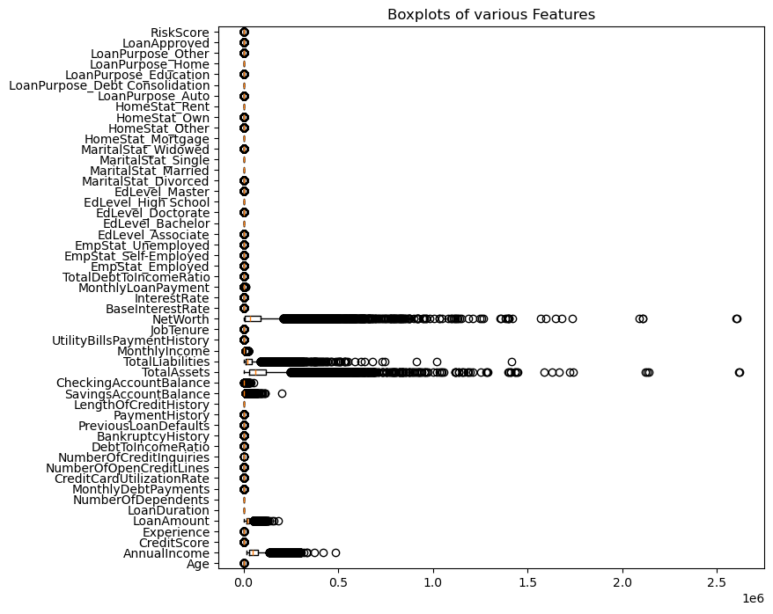

Slide 8
Experimental Setup
Date:05/05/2025
Outlier Processing:
The boxplot showed presence of many outliers
Not removed since they indicate valid data points.
Used sklearn’s RobustScaler which scales using IQR and median.
Dimensional Reduction:
The column ApplicationDate was dropped since it does not affect LoanApproved or RiskScore.
Principal Component Analysis
For data with integer labels, dimensions have been reduced from 33 to 10, 15, 20, and 25.
For data with one-hot encoding, dimensions have been reduced from 49 to 15, 20, 25, 30, and 35.

Slide 9
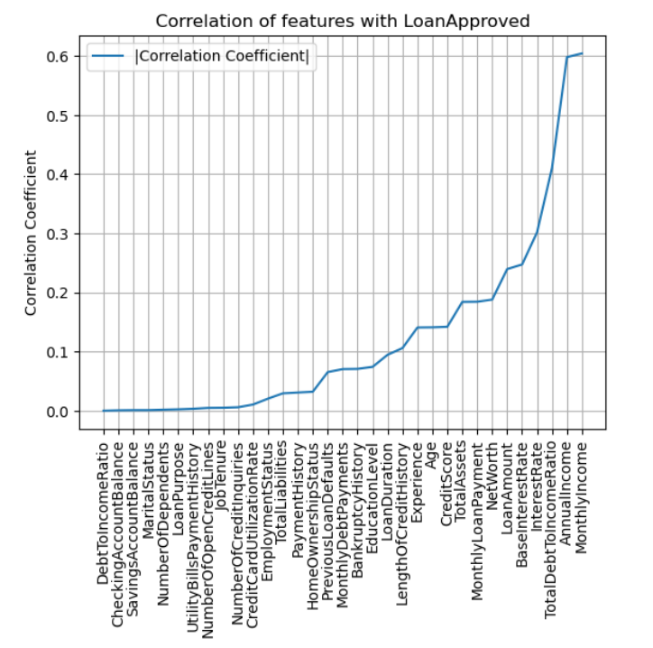
Result
Date:05/05/2025
Classification:
Analysis of correlation of features with LoanApproved.

Slide 10
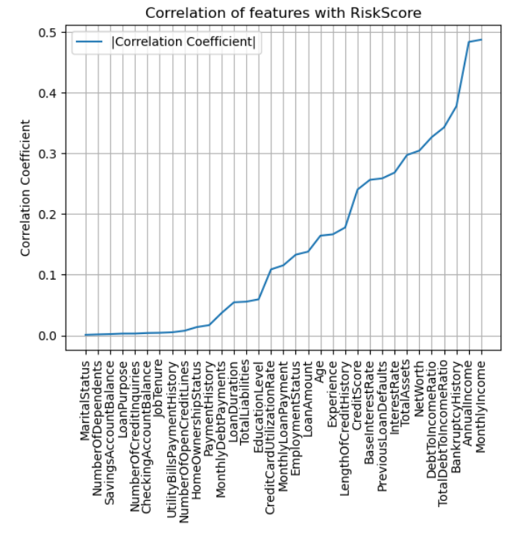
Result
Date:05/05/2025
Regression:
Analysis of correlation of features with RiskScore.

Slide 11
Result
Date:05/05/2025
Classification:
KNN
With k = 3, 5, 7, 11 and Mahalanobis Variant, we got best accuracy of 82.50% and precision of 81.84% at k = 11, best recall of 44.35% and best F1-score of 52.65% on test data.
Best Performing Dataset was with:
One-Hot Encoding
Z-score normalization
The test Performance metrics are:
Accuracy: 82.50%
Precision: 81.84%
Recall: 34.41%
F1-Score: 48.45%

Slide 12
Result
Date:05/05/2025
Classification:
Logistic Regression
We used the sklearn LogisticRegression model with max iter=1000 across different preprocessed datasets. Best precision of 93.98% was obtained on the min-max scaled data with one-hot encoding and best recall of 92.99% was obtained on RobustScaled data with one-hot encoding.
Best Performing Dataset was with:
One-Hot Encoding
Z-score normalization
The test Performance metrics are:
Accuracy: 96.70%
Precision: 93.19%
Recall: 92.99%
F1-Score: 93.09%

Slide 13
Result
Date:05/05/2025
Classification:
SVM (RBF)
The sklearn.svm’s SVC was used with kernel=’rbf’, C=0.1, 1, 10 and gamma=’scale’. Best results were obtained with C=1.
Best Performing Dataset was with:
One-Hot Encoding
Z-score normalization
The test Performance metrics are:
Accuracy: 96.20%
Precision: 93.23%
Recall: 90.69%
F1-Score: 91.94%

Slide 14
Result
Date:05/05/2025
Classification:
SVM (Polynomial)
The sklearn.svm’s SVC was used with kernel=’poly’, C=0.1, 1, 10 and gamma=’scale’. Best results were obtained with C=1.
Best Performing Dataset was with:
One-Hot Encoding
Z-score normalization
The test Performance metrics are:
Accuracy: 94.20%
Precision: 94.80%
Recall: 80.13%
F1-Score: 86.85%

Slide 15
Result
Date:05/05/2025
Classification:
Neural Network
We used torch.nn’s neural network along with loss criterion of BCELoss and optimizer Adam.
The number of hidden layers varied from 1 to 3
Number of neurons in hidden layers varied as 8, 16, 32, 64, and 128.
Best Performing Dataset was with (Triple Layer Architecture with 8, 32, 64 hidden neurons):
One-Hot Encoding
Z-score normalization
The test Performance metrics are:
Accuracy: 96.77%
Precision: 93.21%
Recall: 93.31%
F1-Score: 93.26%

Slide 16
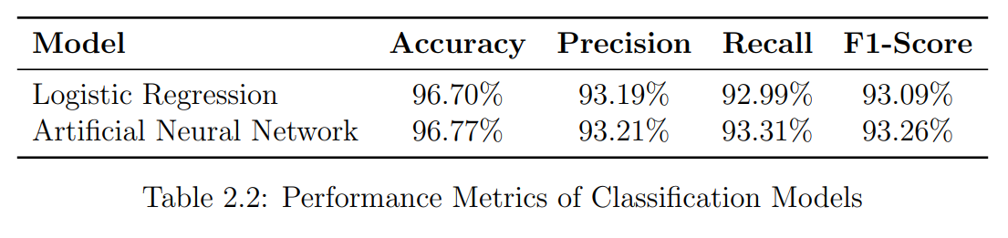
Result
Date:05/05/2025
Overall Performance:
One-Hot encoded and Z-score normalized data gave the best performance across almost all the models. Logistic Regression and Triple Layer Neural Network models gave the best performance.

Slide 17
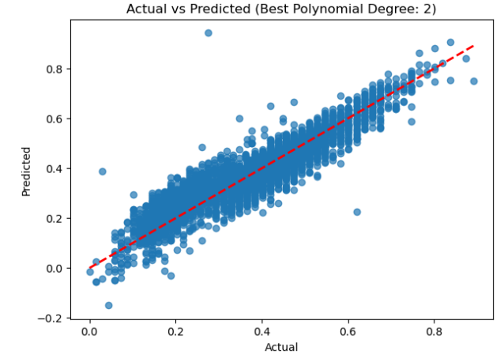
Result
Date:05/05/2025
Regression:
Polynomial Regression
The target variable RiskScore is the last column in the preprocessed datasets. The test RMSE is 0.066.
Best Performing Dataset was with:
One-Hot Encoding
Min-Max normalization

Slide 18
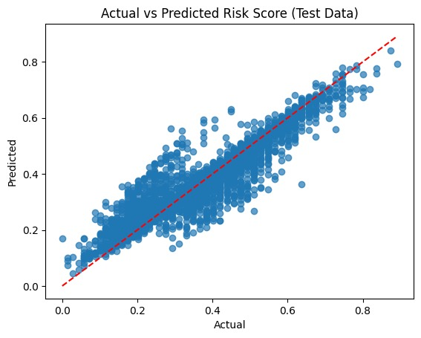
Result
Date:05/05/2025
Regression:
Random Forest Regressor
The target variable RiskScore is the last column in the preprocessed datasets. The test RMSE is 0.051.
Best Performing Dataset was with:
One-Hot Encoding
Min-Max normalization

Slide 19
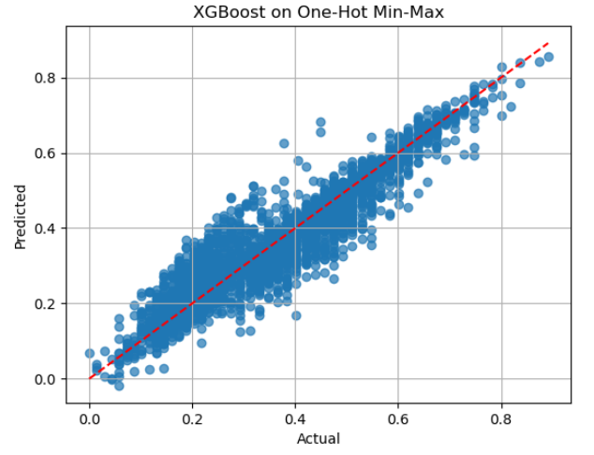
Result
Date:05/05/2025
Regression:
XGBoost
Using xgboost’s XGBRegressor with objective=’reg:squarederror’, max_depth=6, and min_child weight=10, the test RMSE is 0.046.
Best Performing Dataset was with:
One-Hot Encoding
Min-Max normalization

Slide 20
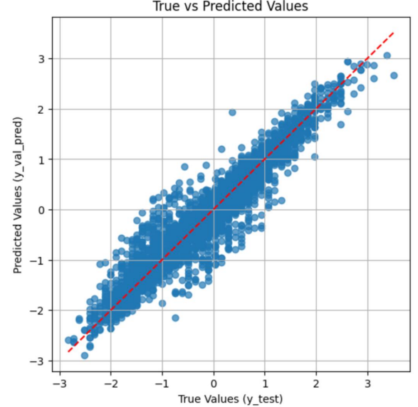
Result
Date:05/05/2025
Regression:
Neural Network
The test RMSE is 0.325 for single layer, 0.304 for double layer, and 0.313 for triple layer architecture.
Best Performing Dataset was with:
One-Hot Encoding
Z-score normalization

Slide 21
Result
Date:05/05/2025
Overall Performance:
XGBoost
For the regression task, one-hot encoded and min-max normalized data showed better results. XGBoost model was the most suitable model with RMSE of 0.046.
Best Performing Dataset was with:
One-Hot Encoding
Z-score normalization

Slide 22
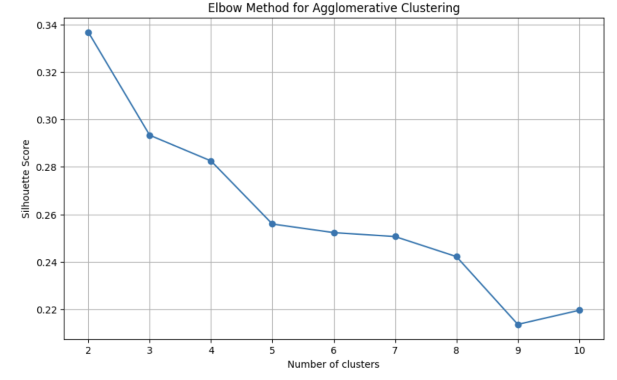
Result
Date:05/05/2025
Clustering:
Hierarchical Clustering
As seen in the figure, the elbow occurs at k = 2 indicating the optimal number of clusters for hierarchical clustering.
Best Performing Dataset was with:
One-Hot Encoding
Z-score normalization

Slide 23
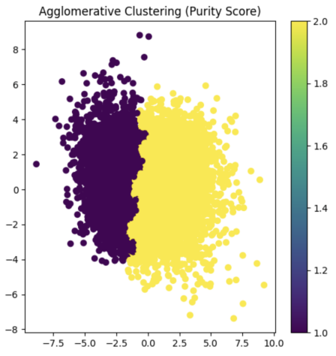
Result
Date:05/05/2025
Clustering Visualization:
Hierarchical Clustering
Based on both purity and visual coherence, the ward linkage method performed best. Clusters formed by this method were done so in PCA (l=2).
Best Performing Dataset was with:
One-Hot Encoding
Z-score normalization

Slide 24
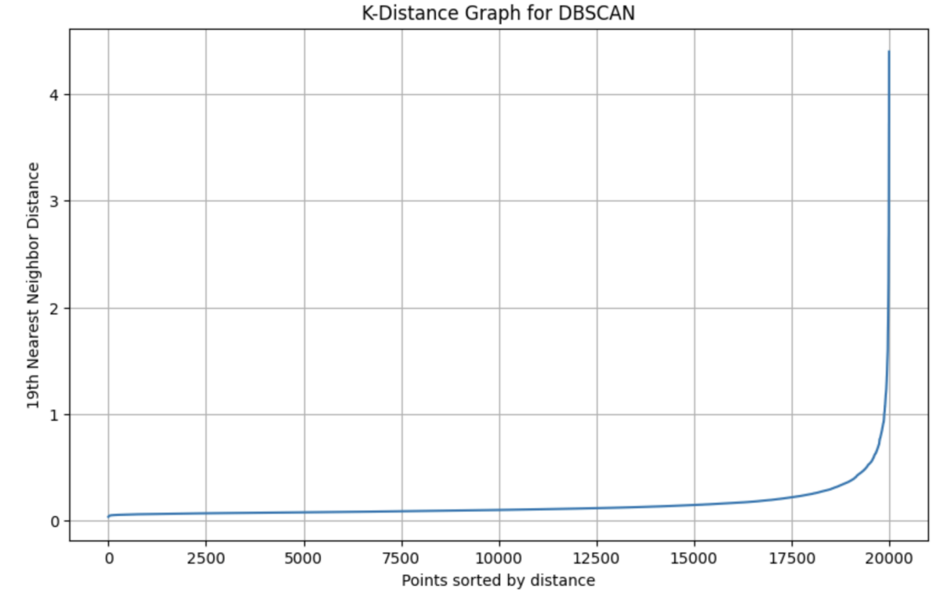
Result
Date:05/05/2025
Clustering:
DBSCAN
The ”knee” or inflection point in the curve suggests an appropriate eps value. Based on the plot, we selected eps = 0.5 and min samples = 5.
Best Performing Dataset was with:
One-Hot Encoding
Z-score normalization

Slide 25
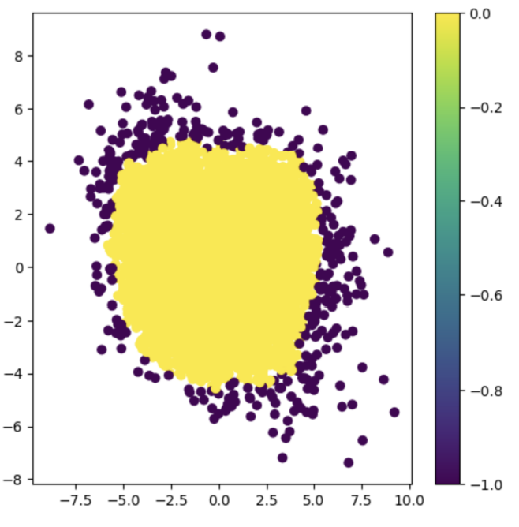
Result
Date:05/05/2025
Clustering Visualization:
DBSCAN
The ”knee” or inflection point in the curve suggests an appropriate eps value. Based on the plot, we selected eps = 0.5 and min samples = 5.
Best Performing Dataset was with:
One-Hot Encoding
Z-score normalization

Slide 26
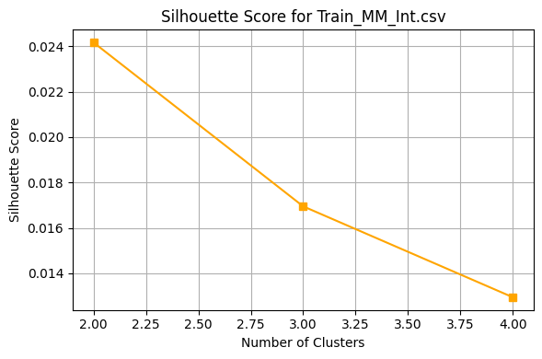
Result
Date:05/05/2025
Clustering:
K-Medoid
As seen in the figure, the elbow occurs at k = 2 indicating the optimal number of clusters for K Medoid while using method=“pam” for efficient calculation.
Best Performing Dataset was with:
Integer Encoding
MM normalization

Slide 27
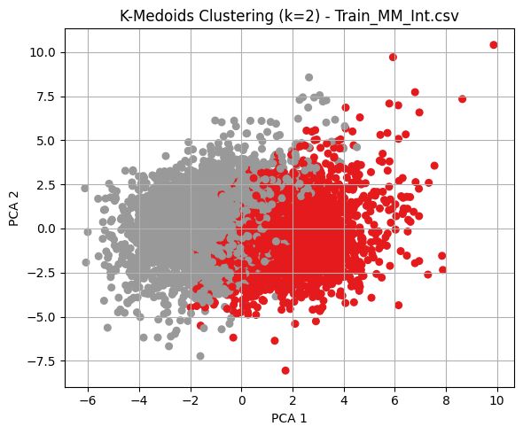
Result
Date:05/05/2025
Clustering Visualization:
K-Medoid
As seen in the figure, the elbow occurs at k = 2 indicating the optimal number of clusters. Clusters formed by this method were done so in PCA (l=2)
Best Performing Dataset was with:
Integer Encoding
MM normalization

Slide 28
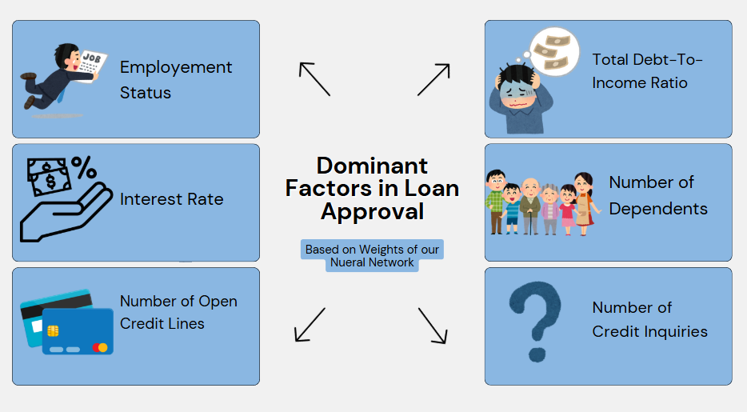
Conclusion
Date:05/05/2025
Classification:
LoanApproved
The Factors affecting LoanApproved based on the overall best model i.e. Neural Network.

Slide 29
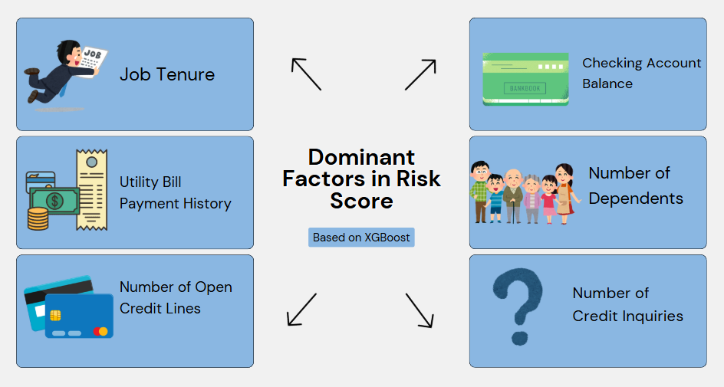
Conclusion
Date:05/05/2025
Regression:
RiskScore
The Factors affecting RiskScore based on the overall best model i.e. XGBoost.

Slide 30
Future Scopes
Date:05/05/2025
Due to our restricted computational powers, we were unable to evaluate more complex models.
With more complex models our results could improve.
Hyperparameters tuning was limited.
Expand to larger, real-world datasets for generalization and real-business impact.

Slide 31
THANK YOU
Date:05/05/2025
Now we head on to Live Demo

