Slide 1
Enviroguru
Industrial Pollution monitoring and prediction system

Slide 2
Introduction
Environmental pollution is one of the most serious problem facing humanity and other life forms on our planet today.
The Paris Agreement’s central aim is to strengthen the global response to the threat of climate change by keeping a global temperature rise this century well below 2 degrees Celsius above pre-industrial levels

Slide 3
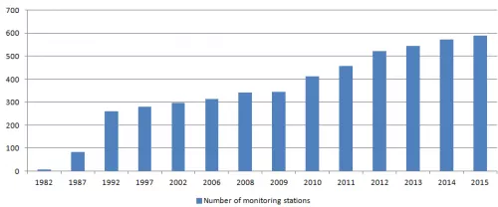
The trend so far..
the recent campaign launched by Prime Minister Modi promoting “Made in India” contributes to the growth of India, they are also partly responsible for environmental degradation.

Slide 4
Motivation
No legislation
There are no strict rules for pollution monitoring and control in industries yet
The government of India is in the midst of making industrial pollution control and monitoring laws more strict

Slide 5
Literature survey
1 | Gaganjot Kaur Kang, Jerry Zeyu Gao, Sen Chiao, Shengqiang Lu, and Gang Xie | Air Quality Prediction: Big Data and Machine Learning Approaches | This paper reports recent literature study, reviews and compares current research work on air quality evaluation based on big data analytics, machine learning models
2 | Chen Xiaojun1, Liu Xianpeng2, Xu Peng3 | IOT- Based Air Pollution Monitoring and Forecasting System | It was also observed that adding more meteorological factors, the prediction performance is greatly improved. They used past 5 years data for training the model. Which shows large sample data can improve performance and train the model well. The overall experiment used IOT and neural network for air pollution monitoring and forecasting.

Slide 6
3 | Temesegan Walelign Ayele , Rutvik Mehta | Air pollution monitoring and prediction using IoT | The proposed work on an air pollution monitoring and prediction system is enables us to monitor air quality with the help IoT devices For predicting the LSTM is implemented. It has a quick convergence and reduces the training cycles with a good accuracy
4 | Zhongshan Yang, Jian Wang | A new air quality monitoring and early warning system: Air quality assessment and air pollutant concentration prediction | In this paper, fuzzy comprehensive evaluation was used to determine the main air pollutants and evaluate the level of air pollution. The experimental results showed that the proposed model has the best accuracy and stability compared to the other five individual models and five combined models.

Slide 7
5 | Dixian Zhu 1,*, Changjie Cai 2, Tianbao Yang 1 and Xun Zhou 3 | A Machine Learning Approach for Air Quality Prediction: Model Regularization and Optimization | They have developed efficient machine learning methods for air pollutant prediction. They have formulated the problem as regularized MTL and employed advanced optimization algorithms for solving different formulations.
6 | Mahmoud Reza Delavar 1,* , Amin Gholami 2, Gholam Reza Shiran 3, Yousef Rashidi 4 , Gholam Reza Nakhaeizadeh 5, Kurt Fedra 6 and Smaeil Hatefi Afshar 2 | A Novel Method for Improving Air Pollution Prediction Based on Machine Learning Approaches: A Case Study Applied to the Capital City of Tehran | A comparative study of machine learning methods including NARX, ANN and SVR has been employed for air pollution prediction and the NARX finally selected as the optimum one.

Slide 8
7 | Xiuwen Yi1,2, Junbo Zhang2,1,+, Zhaoyuan Wang1,2, Tianrui Li1, Yu Zheng2,1,3 | Deep Distributed Fusion Network for Air Quality Prediction | They proposed a DNN-based approach to predict air quality. This approach achieves a higher accuracy in both general cases and sudden changes.

Slide 9
GAP analysis
The above papers that we have referred to predict pollution concentration with respect to time .
Our proposed model will predict the pollution concentration in the stack and using Gaussian model it will calculate the distribution(spread) of pollutants in a given area.

Slide 10
OBJECTIVES
To make a gadget/series of gadgets which will collect the data of environmental parameters using different sensors and process the data using machine learning algorithm.
The output of the processes will be in the form of graphs, charts, tables etc.

Slide 11
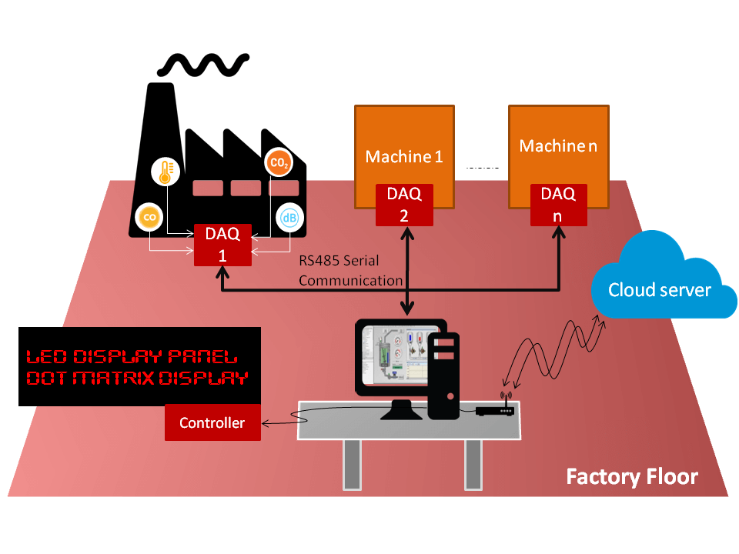
METHODOLOGY

Slide 12
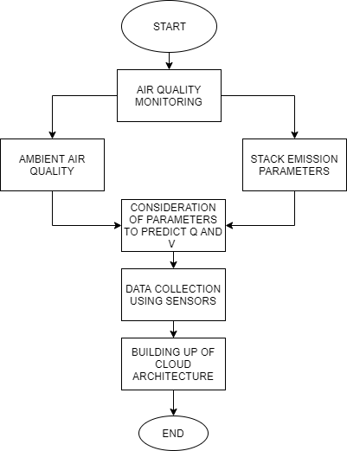
IOT PROCESS FLOW

Slide 13
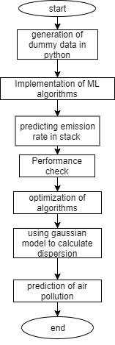
MACHINE LEARNING PROCESS FLOW

Slide 14
Feature space
Emission rate(Q):
Time, date
Size of industry
Output
Type of product
Wind speed(v):
Temperature
Pressure
Surrounding wind speed
Time/season
Wind direction

Slide 15
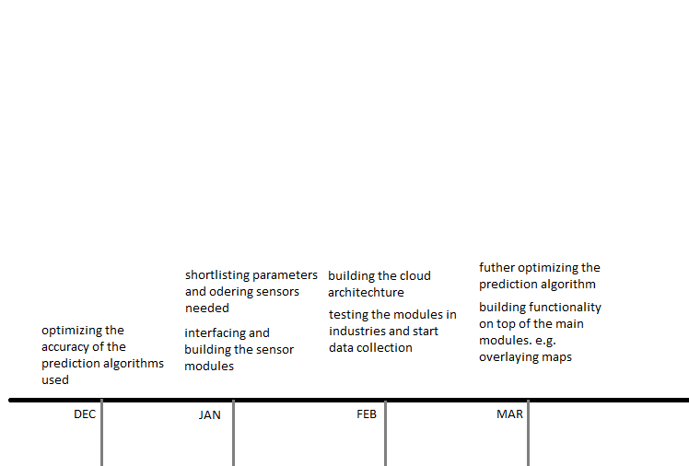
TIMELINE

