Slide 1


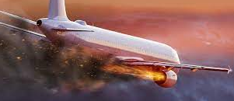
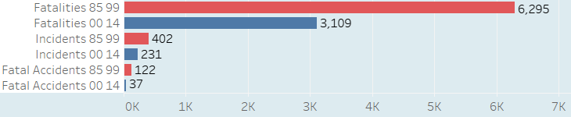
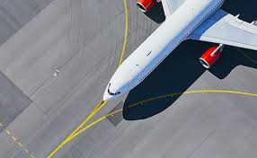
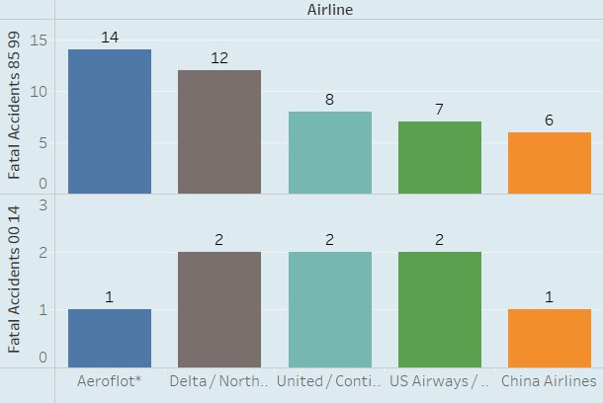
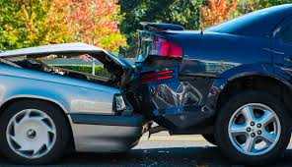
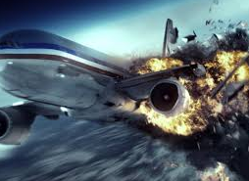
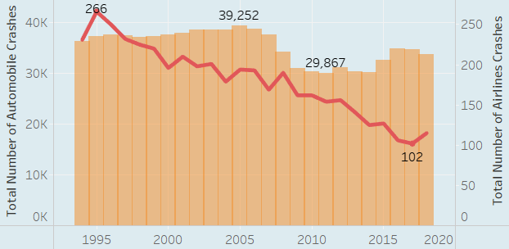
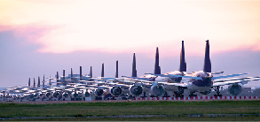
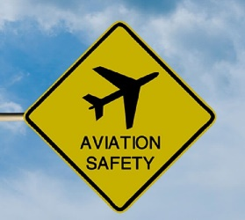



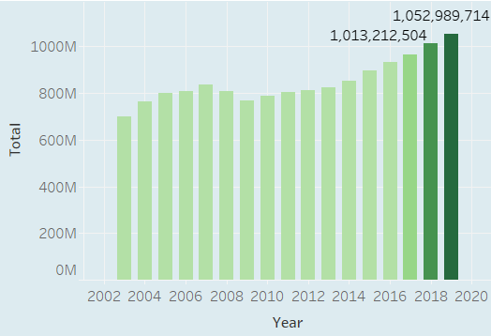
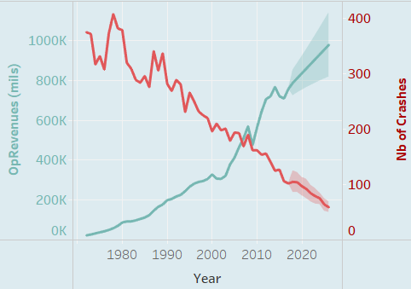
Is Air travel the safest form of Transportation?
50.61% Reduction in Fatalities
42.53% Reduction in Incidents
69.67% Reduction in Fatal Accidents.
In the years 2000-2014, fatal accidents has reduced dramatically in major airlines.
Automobile crashes are in 30K vs airline crashes are 300
45,000 Average daily flights handled.
5,400 Aircrafts in the sky at peak operation times
OpRevenues(mils) is expected to cross 900K (mils) in coming years.
Number of Crashes has reduced lesser than 100
The number of passengers have cross 1000M. Indicating people prefer airlines

