Slide 1
Question Answering that requires reasoning, common-sense and deeper understanding of the world
Chitta Baral
Arizona State University
January 28, 2019
Notes:
Question Answering that requires reasoning, common-sense and deeper understanding of the world
Abstract:
In recent years several Question answering challenges have been proposed to benchmark progress in specific AI disciplines (such as nature language understanding and image understanding) as well as general AI. This includes the Winograd Schema Challenge that has been proposed as an alternative to the Turing test. It seems many of these challenges require reasoning, common-sense, and deeper understanding of the world. In this talk we will discuss some of these challenges and point out aspects of these challenges that necessitate reasoning and common-sense knowledge. We will also discuss our thoughts on common-sense knowledge acquisition and various kinds of reasoning needed for various different forms of knowledge.

Slide 2
Focus of the talk
Answer some central questions about this workshop (“Reasoning and Complex QA”)
Relationship between KR&R (major focus of AI during its initial 50 years) and QA
Role of Machine Commonsense in QA

Slide 3
Evaluation of AI components and systems: QA plays an important role
Evaluation of AI components
ML, NLP, Vision modules have a long tradition of evaluation (correctness, efficiency)
KR, Reasoning, Planning
Theoretical results (correctness)
Efficiency evaluations of reasoning and planning systems
Evaluation of general AI
Turing Test
Question Answering
Project halo
Winograd Challenge
Standardized Tests as benchmarks for Artificial Intelligence
Lots of new QA datasets are being proposed

Slide 4
Question Answering
Going beyond querying databases
Lots of QA datasets/challenges in recent years, recent months
This talk: Some analysis and observations about QA datasets/challenges (existing and ones that can be constructed)
What makes some questions harder than others?
For humans? For computers?
When do we need reasoning, commonsense, deeper understanding of the world during answering questions?
Creating QA datasets that emphasize reasoning …

Slide 5
Before reinventing/redesigning the wheels: Bloom’s Taxonomy
Next few slides are from http://www.bloomstaxonomy.org/Blooms%20Taxonomy%20questions.pdf
Bloom’s Taxonomy provides an important framework for teachers to use to focus on higher order thinking. By providing a hierarchy of levels, this taxonomy can assist teachers in designing performance tasks, crafting questions for conferring with students, and providing feedback on student work.
Six levels:
Level I Knowledge
Level II Comprehension
Level III Application
Level IV Analysis
Level V Synthesis
Level VI Evaluation

Slide 6
Bloom’s Level I: Knowledge
Exhibits memory of previously learned material by recalling fundamental facts, terms, basic concepts and answers about the selection.
Keywords: who, what, why, when, omit, where, which, choose, find, how, define, label, show, spell, list, match, name, relate, tell, recall, select
Questions: What is...? Can you select? Where is...? When did ____ happen? Who were the main...? Which one...? Why did...? How would you describe...? When did...? Can you recall...? Who was...? How would you explain...? How did ___happen...? Can you list the three..? How is...? How would you show...?
Assessment:
Match character names with pictures of the characters.
Match statements with the character who said them.
List the main characteristics of one of the main characters in a WANTED poster.
Arrange scrambled story pictures and/or scrambled story sentences in sequential order.
Recall details about the setting by creating a picture of where a part of the story took place.
Many of the QA data sets are at this level.

Slide 7
Bloom’s Level II: Comprehension
Demonstrate understanding of facts and ideas by organizing, comparing, translating, interpreting, giving descriptors and stating main ideas.
Keywords: compare, contrast, demonstrate, interpret, explain, extend, illustrate, infer, outline, relate, rephrase, translate, summarize, show, classify
Questions: How would you classify the type of...? How would you compare...? Will you state or interpret in your own words...? How would you rephrase the meaning? What facts or ideas show...? What is the main idea of ......? Which statements support...? Which is the best answer...? What can you say about ...? How would you summarize... ? Can you explain what is happening...? What is meant by...?
Assessment:
Interpret pictures of scenes from the story or art print.
Explain selected ideas or parts from the story in his or her own words. contrast...?
Draw a picture and/or write a sentence showing what happened before and after a passage or illustration found in the book. (visualizing)
Predict what could happen next in the story before the reading of the entire book is completed.
Construct a pictorial time-line that summarizes what happens in the story.
Explain how the main character felt at the beginning, middle, and /or end of the story.
Some QA data sets have some of these types of questions

Slide 8
Bloom’s Level III: Application
Solve problems in new situations by applying acquired knowledge, facts, techniques and rules in a different, or new way.
Keywords: apply, build, choose, construct, develop, interview, make use of, organize, experiment with, plan, select, solve, utilize, model, identify
Questions: How would you use...? How would you solve ___ using what you’ve learned...? What examples can you find to...? How would you show your understanding of...? How would you organize _______ to show...? How would you apply what you learned to develop...? What approach would you use to...? What other way would you plan to...? What would result if...? Can you make use of the facts to...? What elements would you use to change...? What facts would you select to show...? What questions would you ask during an interview?
Assessment:
Classify the characters as human, animal, or thing.
Transfer a main character to a new setting.
Make finger puppets and act out a part of the story.
Select a meal that one of the main characters would enjoy eating: plan a menu, and a method of serving it.
Think of a situation that occurred to a character in the story and write about how he or she would have handled the situation differently.
Give examples of people the student knows who have the same problems as the characters in the story.

Slide 9
Blooms Level IV: Analysis
Examine and break information into parts by identifying motives or causes. Make inferences and find evidence to support generalizations.
Keywords: analyze, categorize, classify, compare, contrast, discover, dissect, divide, examine, inspect, simplify, survey, test for, distinguish, list, distinction, theme, relationships, function, motive, inference, assumption, conclusion, take part in
Questions: What are the parts or features of...? How is______ related to...? Why do you think . . . ? What is the theme . . . ? What motive is there . . . ? Can you list the parts . . . ? What inference can you make . . . ? What conclusions can you draw . . . ? How would you classify . . . ? How would you categorize . . . ? Can you identify the different parts . . . ? What evidence can you find . . . ? What is the relationship between . . . ? Can you make a distinction between . . . ? What is the function of . . . ? What ideas justify . . . ?
Assessment:
Identify general characteristics (stated and/or implied) of the main characters. Distinguish what could happen from what couldn't happen in the story in real life. Select parts of the story that were the funniest, saddest, happiest, and most unbelievable. Differentiate fact from opinion.
Compare and/or contrast two of the main characters.
Select an action of a main character that was exactly the same as something the student would have done.

Slide 10
Bloom’s Level V: Synthesis
Compile information together in a different way by combining elements in a new pattern or proposing alternative solutions.
Keywords: build, choose, combine, compile, compose, construct, create, design, develop, estimate, formulate, imagine, invent, make up, originate, plan, predict, propose, solve, solution, suppose, discuss, modify, change, original, improve, adapt, minimize, maximize, theorize, elaborate, test, happen, delete
Questions: What changes would you make to solve...? How would you improve...? What would happen if...? Can you elaborate on the reason...? Can you propose an alternative...? Can you invent...? How would you adapt ___ to create a different...? How could you change (modify) the plot (plan)...? What facts can you compile...? What way would you design...? What could be combined to improve (change)...? Suppose you could ___what would you do...? How would you test...? Can you formulate a theory for...? Can you predict the outcome if...? How would you estimate the results for...? What could be done to minimize (maximize)...? Can you construct a model that would change...? How is __ related to...? Can you think for an original way for the...? What are the parts or features of...? Why do you think...? What is the theme...? What motive is there...? Can you list the parts...? What inference can you make...? ...? What ideas justify...? What conclusions can you draw...? How would you classify...? How would you categorize...? Can you identify the different parts...? What evidence can you find...? What is the relationship between...?Can you make the distinction between...? What is the function of …?
Assessment:
Create a story from just the title before the story is read (pre-story exercise).
Write three new titles for the story that would give a good idea what it was about.
Create a poster to advertise the story so people will want to read it.
Use your imagination to draw a picture about the story.
Create a new product related to the story.
Restructure the roles of the main characters to create new outcomes in the story.
Compose and perform a dialogue or monologue that will communicate the thoughts of the main character(s) at a given point in the story.
Imagine that you are the main character. Write a diary account of daily thoughts and activities. Create an original character and tell how the character would fit into the story.
Write the lyrics and music to a song that one of the main characters would sing if he/she/it became a rock star and perform it.

Slide 11
Bloom’s Level VI: Evaluation
Present and defend opinions by making judgments about information, validity of ideas or quality of work based on a set of criteria.
Keywords: award, choose, conclude, criticize, decide, defend, determine, dispute, evaluate, judge, justify, measure, compare, mark, rate, recommend, rule on, select, agree, appraise, prioritize, opinion, interpret, explain, support importance, criteria, prove, disprove, assess, influence, perceive, value, estimate, deduct
Questions: Do you agree with the actions/outcome...? What is your opinion of...? How would you prove/ disprove...? Can you assess the value or importance of...? Would it be better if...? Why did they (the character) choose...? What would you recommend...? How would you rate the...? How would you evaluate...? How would you compare the ideas...? the people...? How could you determine...? What choice would you have made...? What would you select...? How would you prioritize...? How would you justify...? What judgment would you make about...? Why was it better that...?How would you prioritize the facts...? What would you cite to defend the actions...? What data was used to make the conclusion...? What information would you use to support the view...? Based on what you know, how would you explain...?
Assessment:
Decide which character in the selection he or she would most like to spend a day with and why.
Judge whether or not a character should have acted in a particular way and why.
Decide if the story really could have happened and justify reasons for the decision.

Slide 12
Bloom’s taxonomy – human versus computers
Some of QA that is hard for humans is also hard for computers
But some of the QA (some specific classification tasks) that is hard for humans may be less hard for computers
Perhaps because computers can be trained with huge data
Many of the key words used in the Bloom’s hierarchy classification require hand-coding and are hard to learn.
Consider a question with “classify” in a specific domain where computers are better
The training that we provide for a system to classify is a form of hand-coding.
Notes:
Babe movie – Pigs

Slide 13
QA needing deeper understanding
The question contains terms/concepts that has a deeper meaning; the answer is not based on direct correspondence of such a term in the question and a similar term in the background text (and MCQ tricks fail).
commonsense concepts; other concepts
The question may be simple but the answer
requires reasoning over multiple facts in the text
some of them may be commonsense facts
may need commonsense reasoning
requires reasoning using external knowledge
some of that may be commonsense knowledge
may need commonsense reasoning
grounding requires reasoning
may need commonsense reasoning
Notes:
To correctly answer a question; not accidentally getting it right.
But how do we know if something is accidental?
Opaque methods using embeddings may get it right, and it is not easy to figure out when it is accidental and when it is based on knowledge that goes into when creating the embedding.

Slide 14
Aside: Note on Commonsense
Commonsense facts: Although in recent months the focus has been on Commonsense facts (such as Effect of actions; precondition of actions) , commonsense involves several other aspects.
Commonsense concepts
Examples: indicates
Commonsense knowledge (facts, concepts, rules, defaults, modules)
Examples: normally birds fly.
Commonsense reasoning
Examples: reasoning with defaults; reasoning about actions (frame problem); reasoning about inheritance hierarchies.

Slide 15
Terms/concepts that have a deeper meaning
Plan, diagnosis, cause (what is the cause, what is the reason, why), belief/believes, knows, explains (explanation), indicates, exception, regular/periodic (time interval), best explanation, most appropriate, how, primary/main (role), alike because, similar, helped …
One can painstakingly train systems about each such term, but an easier approach may be to write definitions of these terms in a declarative language (like Answer Set Programing)
Some of these concepts that is “commonly” understood by can be thought of as commonsense concepts.
Some others are defined after a lot of research: diagnosis, cause, explanation, believes, knows
Some of these concepts may have a simpler meaning (understood by the mass) that can be used with respect to many of the questions.

Slide 16
QA examples where the questions have concepts with deeper meaning
What best indicates that a frog has reached the adult stage? (A) When it has lungs (B) When its tail has been absorbed by the body
Which of the following distinguishes the organisms in the kingdom Fungi from other eukaryotic organisms? (A) Fungi are unicellular. (B) Fungi reproduce sexually. (C) Fungi obtain nutrients by absorption. (D) Fungi make food through photosynthesis.
Stars are often classified by their apparent brightness in the nighttime sky. Stars can also be classified in many other ways. Which of these is least useful in classifying stars? (A) visible color (B) composition (C) surface texture (D) temperature
Notes:
Which statement best compares single-celled and multi-celled organisms?

Slide 17
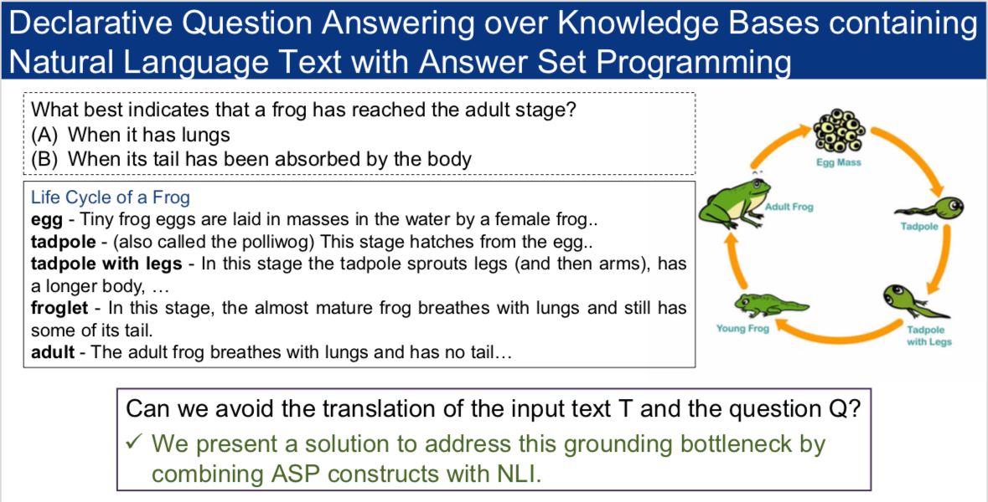

Slide 18
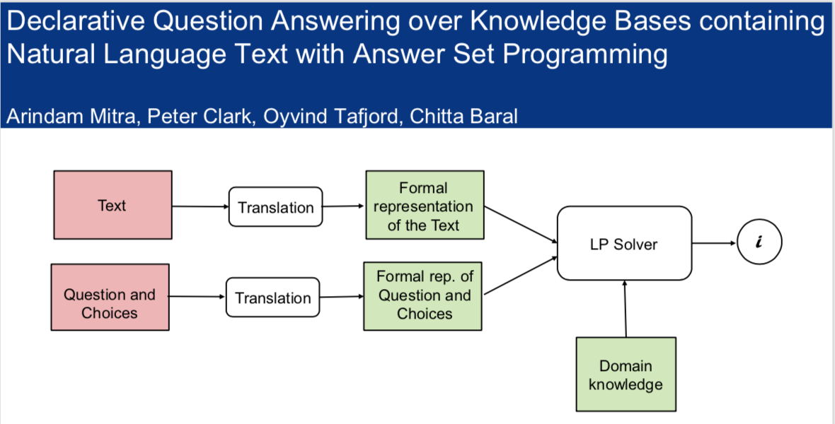

Slide 19
QA examples where the questions have concepts with deeper meaning (cont.)
Acid rain has a pH below 5.6. This rain can damage soil, lakes, crops, and buildings. Acid rain is caused by all of the following except (A) industrial emissions from factories. (B) coal that is burned to produce heat and power. (C) automobile exhaust. (D) nuclear power plants that produce radiation.
All of these are examples of the ways Earth and the Moon interact except (A) the phases of the Moon. (B) the tides on Earth. (C) seasons on Earth. (D) lunar eclipses.
Felicia noticed how air temperatures were cooler and there were fewer hours of daylight during some of the seasons. Which of the following contributes to these seasonal changes? (A) Earth rotates on its axis. (B) Earth revolves around the Sun. (C) The Sun has less energy in winter. (D) The Sun moves further from Earth in winter.

Slide 20
QA needing deeper understanding (cont.)
Where to find such QA schemas
AI2’s ARC challenge on elementary science questions: the best performance to date is only 53.84%. https://leaderboard.allenai.org/arc/submissions/public [On an earlier ARC dataset a combination of methods based on retrieval, statistics and inference upped the result from 60.7% (of the best single solver) to the ensemble result of 71.3%.]
Some were presented in previous invited talks
Some more need to be compiled (to be discussed in later slides)

Slide 21
Answers requiring reasoning over multiple facts in the text
Relational reasoning: Natural language query over a database that can be answered by simple database (say relational algebra) operations
Could involve a complicated sequence of such operations (for example: For all queries)
Reasoning that involves more complicated forms (if most people can do it then we can consider it as commonsense reasoning)
Transitive closure queries (eg., ancestor), indirect effect of actions through a sequence of effects (eg. An intervention in a circuit or in a biological cell signaling network)
Reasoning about actions, events
Reasoning about inheritance hierarchies
Reasoning about causality
Reasoning about counterfactuals
Diagnostic reasoning
Reasoning about interactions (say drug-drug interactions)
Reasoning about beliefs and knowledge
Math Word Problems

Slide 22
QA examples where question are simple, but answering them requires reasoning
[Beliefs] X observe two agents, Sally and Anne, with their containers, a basket and a box. After putting a marble in her basket, Sally leaves the room (and is not able to observe the events anymore). After Sally’s departure, Anne moves the marble to her box. Then Sally returns to the room. X is asked:
Where will Sally look for the marble?
Where is the marble really?
Where was the marble in the beginning?
[Inheritance hierarchy] Normally birds fly. Penguins do not fly. Penguins and birds. Tweety is a bird. Skippy is a penguin.
Is Skippy a bird?
Does skippy fly?
Does Tweety fly?
[Causality and Counterfactual] The season determines whether the sprinkler is on and whether it may rain. It does not rain in the summer or spring. But rains in the Fall and winter. The sprinkler being on as well as if it rained will make the grass wet.
The grass is observed to be wet. What are its possible causes.
The grass is observed to be wet and the sprinkler was on. Knowing it is Fall, is there a possibility that the grass would be wet if the Sprinkler was turned off.
Notes:
These are KR based examples.

Slide 23
Answer needs external knowledge: some pointers
Science QA datasets: http://data.allenai.org/arc/challenge-train/
George wants to warm his hands quickly by rubbing them. Which skin surface will produce the most heat? (A) dry palms (B) wet palms (C) palms covered with oil (D) palms covered with lotion
What best indicates that a frog has reached the adult stage? (A) When it has lungs (B) When its tail has been absorbed by the body
Winograd Schema Challenge examples
The man couldn’t lift his son because he was so weak/heavy. Who was so weak/heavy?
The fish ate the worm because it was tasty/hungry. What was tasty/hungry?
The trophy doesn’t fit into the brown suitcase because it’s too large/small. What was too large/small?
AI2 Commonsense Datasets: https://leaderboard.allenai.org/coming-soon

Slide 24
Grounding requires reasoning
Words in the questions, do not always match with phrases in the text, and may need to be derived through reasoning
Does drug X interact with drug Y?

Slide 25
Inferring Drug-Drug Interaction
S-warfarin, predominantly responsible for the anticoagulation effect, is metabolized mostly by the CYP2C9 enzyme. [PMID: 19799531]
CYP2C9 is subject to induction by rifampin, phenobarbital, and dexamethasone. [PMID: 19515014]
metabolize
induce
Phenobarbital
Warfarin
Rifampin
CYP2C9
Dexamethasone
Notes:
Consequence:
CYP2C9 enzyme activity is increased.
Rate of metabolism of warfarin by CYP2C9 is increased.
Bioavailability of warfarin is decreased.

Slide 26
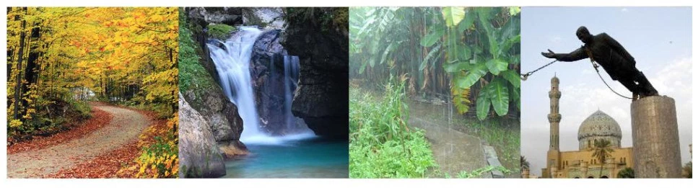
Image Riddles: What words connect these? (Aditya et al. UAI 2018)

Slide 27
Challenges with complex reasoning
Solving Puzzles, QA based on them: https://en.wikipedia.org/wiki/Zebra_Puzzle
1. There are five houses.
2. The Englishman lives in the red house.
3. The Spaniard owns the dog.
4. Coffee is drunk in the green house.
5. The Ukrainian drinks tea.
6. The green house is immediately to the right of the ivory house.
7. The Old Gold smoker owns snails.
8. Kools are smoked in the yellow house.
9. Milk is drunk in the middle house.
10. The Norwegian lives in the first house.
11. The man who smokes Chesterfields lives in the house next to the man with the fox.
12. Kools are smoked in the house next to the house where the horse is kept.
13. The Lucky Strike smoker drinks orange juice.
14. The Japanese smokes Parliaments.
15. The Norwegian lives next to the blue house.
Now, who drinks water? Who owns the zebra?
We mentioned about the difficulty in solving such puzzles: Arindam Mitra and Chitta Baral. Learning to automatically solve logic grid puzzles. EMNLP 2015. (Must have been mentioned before)
A formal analysis in a recent paper: On the Capabilities and Limitations of Reasoning for Natural Language Understanding. Daniel Khashabi, Erfan Sadeqi Azer, Tushar Khot, Ashish Sabharwal, Dan Roth. 8th Jan 2019.

Slide 28
KR & R Research over the years
Languages for expressing common sense knowledge and doing commonsense reasoning
Non-monotonic reasoning: various logics proposed and some systems built
Logics: Circumscription, Default Logic, Auto-epistemic logic, NM Modal logics, Answer Set Programming
Systems: DeRes (old), ASP systems (Smodels, DLV, Clingo suite), Prolog
Expressing specific commonsense concepts, such as
Inheritance hierarchies
Actions, events and their effects
Belief and knowledge
Causality and Counterfactuals
Preferences
Argument theory
Did not focus much on
Obtaining commonsense knowledge
Doing QA where Q, A or Background Knowledge are given in natural language
Additional Challenges when moving on to Natural language as a source
Scalable reasoning with large knowledge bases that may have inconsistencies

Slide 29
Conclusion
The early research in AI (a lot of it focused on KR & R) is not in vain and are still very much relevant.
They address (and will continue to address) many important aspects of AI
QA needing deep understanding and KR&R are intimately connected
Many existing QA datasets need KR&R to answer questions (at least 2 papers in this conference by people here)
Past KR & R research, especially on concept formulation, can be used to create many more new QA datasets.
KR & R research can get some new challenges and directions from the QA datasets
Such as formalizing new concepts and developing reasoning modules for them
More KR & R research should pay attention to QA challenges and its aspects (eg. understanding NL, knowledge acquisition, dealing with uncertainty and inconsistencies).

Slide 30
Thanks
To my students and co-authors: Especially Arindam Mitra
To Peter and AI2

Slide 31
Use of rich encodings, textual entailments and various MCQ heuristics
Given some text T, a question Q and answers A₁, … A_{n}, to find which one of A₁, … A_{n} is the most appropriate answer for Q, one may use various methods that may work in many cases but does not involve full understanding. For example:
Compute the entailment of each of A₁ to A_{n} with respect to T using an NLI that in turn uses a good embedding method and see which one has the highest entailment measure (This ignores the question, but works in many cases)
Create statements S₁, … S_{n} where S_{i} is obtained by combining Q with A_{i}. Compute the entailment of each of S₁ to S_{n} with respect to T using an NLI that in turn uses a good embedding method and see which one has the highest entailment measure.
Direct use of encodings: (Say in the absence of T or) where T and Q can be merged to say T’ then determining the weight of A_{i} follows T using an encoding such as BERT.

