Slide 1
Exploring Coordinated Attacks on ML-Enabled IoT Devices
Raine Morrigan
Dr. Hasan
June 16, 2025

Slide 2
This project attempts to show remaining vulnerabilities in IOT systems trained with Machine Learning Models

Slide 3
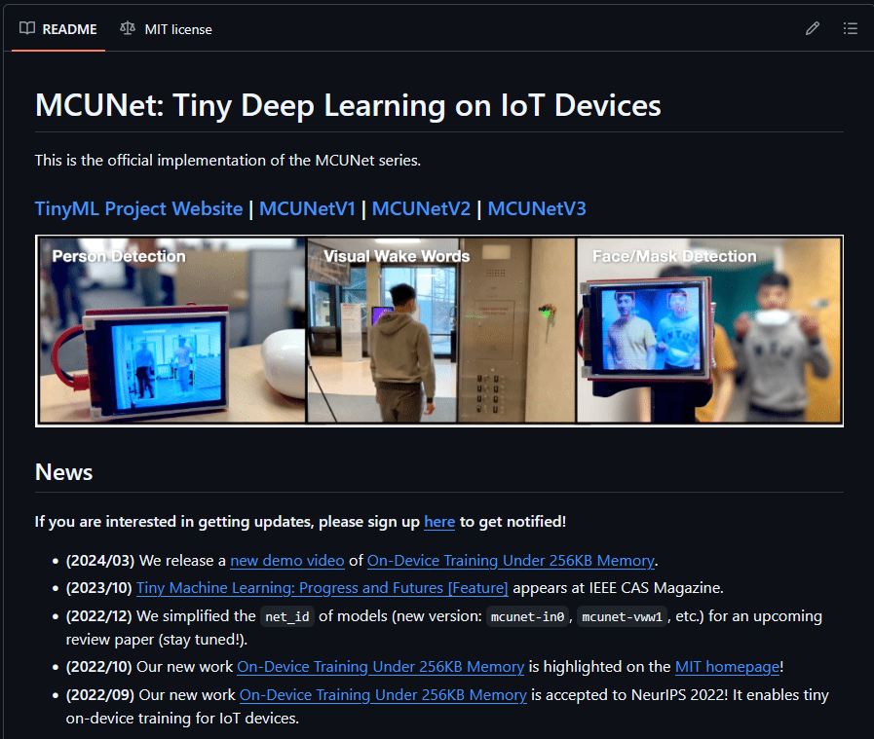
Background
What is TinyML?
8-bit computations (MIT)
What is IoT?
How is it Vulnerable?
Data poisoning (FairGuard)
Minimal Model Replacement
What is Transfer Learning?

Slide 4
AI Methods & Related Research
MCUNet: Tiny Deep Learning on IoT Devices
FairGuard: A Fairness Attack and Defense Framework in Federated Learning
Federated Learning Minimal Model Replacement Attack Using Optimal Transport: An Attacker Perspective
Harvard University Fundamentals of TinyML Course
Securing IoT-Enabled Smart Cities and Detecting Cyber Attacks in Smart Homes for a Greener Future

Slide 5
Tools & Current Challenges
Arduino IDE
Tensorflow
LFW dataset
Face Detections and Re-identification dataset
Currently, I have not been able to successfully connect the ESP32-Cam to my Arduino IDE. Additionally, I am still designing the model to attack.

Slide 6

Next Steps
Flash ESP32-Cam
Connect Arduino and ESP32-Cam
Utilize bigger dataset (lfw)

Slide 7
References
https://github.com/mit-han-lab/mcunet
X. Sheng, Z. Yang and W. Bao, "FairGuard: A Fairness Attack and Defense Framework in Federated Learning," in IEEE Transactions on Dependable and Secure Computing, vol. 22, no. 3, pp. 2519-2532, May-June 2025
K. Naveen Kumar, C. Krishna Mohan and L. Reddy Cenkeramaddi, "Federated Learning Minimal Model Replacement Attack Using Optimal Transport: An Attacker Perspective," in IEEE Transactions on Information Forensics and Security, vol. 20, pp. 478-487, 2025
Harvard University Fundamentals of TinyML Course, Vijay Janapa Reddi, and Laurence Moroney | Available April 2025 – April 2026 https://pll.harvard.edu/course/fundamentals-tinyml
L. Zhou, A. Gaurav, R. W. Attar, V. Arya, A. Alhomoud and K. T. Chui, "Securing IoT-Enabled Smart Cities and Detecting Cyber Attacks in Smart Homes for a Greener Future," in IEEE Internet of Things Magazine, doi: 10.1109/MIOT.2025.3575924.keywords: {Smart homes;Internet of Things;Accuracy;Feature extraction;Security;Machine learning;Support vector machines;Smart cities;Scalability;Authentication;IoT;Security;DDoS Attack},

Slide 8
Thank you
Raine Morrigan

