Slide 1
LIVE BLOOD DONOR SUPPORT SYSTEM
Submitted by :
Mounika Rimmalapudi (15JN1A05D4)
Sravani Maddukuri (15JN1A0586)
Geetha Sri Alluri (15JN1A05C5)
Sushmitha Grandhi (15JN1A0582)
Sivajyothi Polisetti (16JN5A0501)
Under the Guidence of :
J.Lavanya

Slide 2
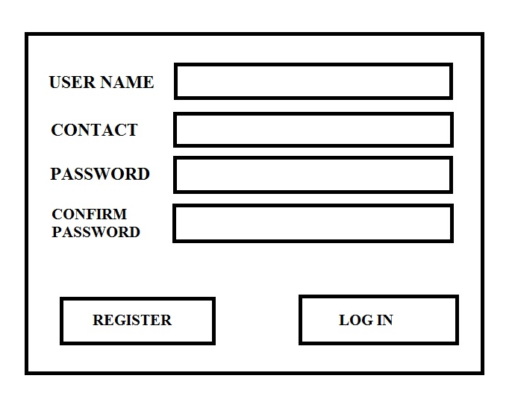
REGISTRATION

Slide 3
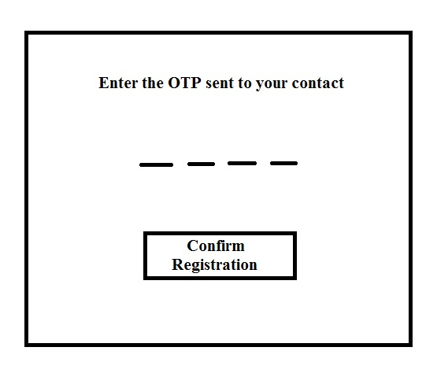
OTP

Slide 4
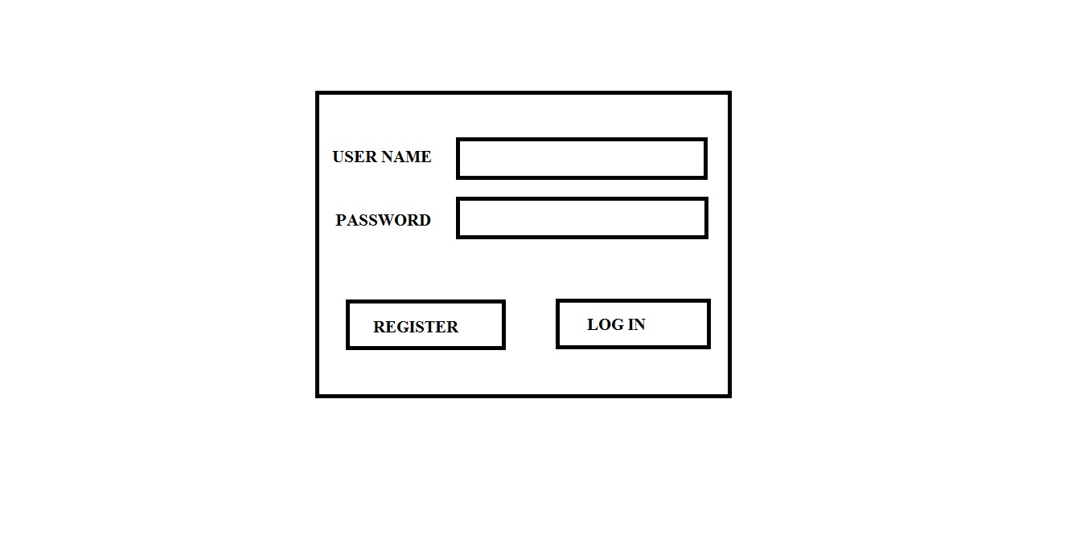
LOGIN

Slide 5
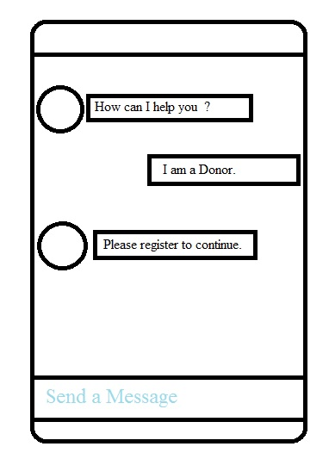
BOT

