Slide 1
Data Analytics - Capstone Project
Dixie Peralta
Neeraja Jayaraman
Richelle Long
Nisha Bharakhada

Slide 2




The Team
Dixie Perlata
Richelle Long
Neeraja Jayaraman
Nisha Bharakhada
Github
Database
Dashboard
Database
Presentation
Dashboard
Machine Learning Model
Presentation
Dashboard
Machine Learning Model
Presentation
Dashboard

Slide 3
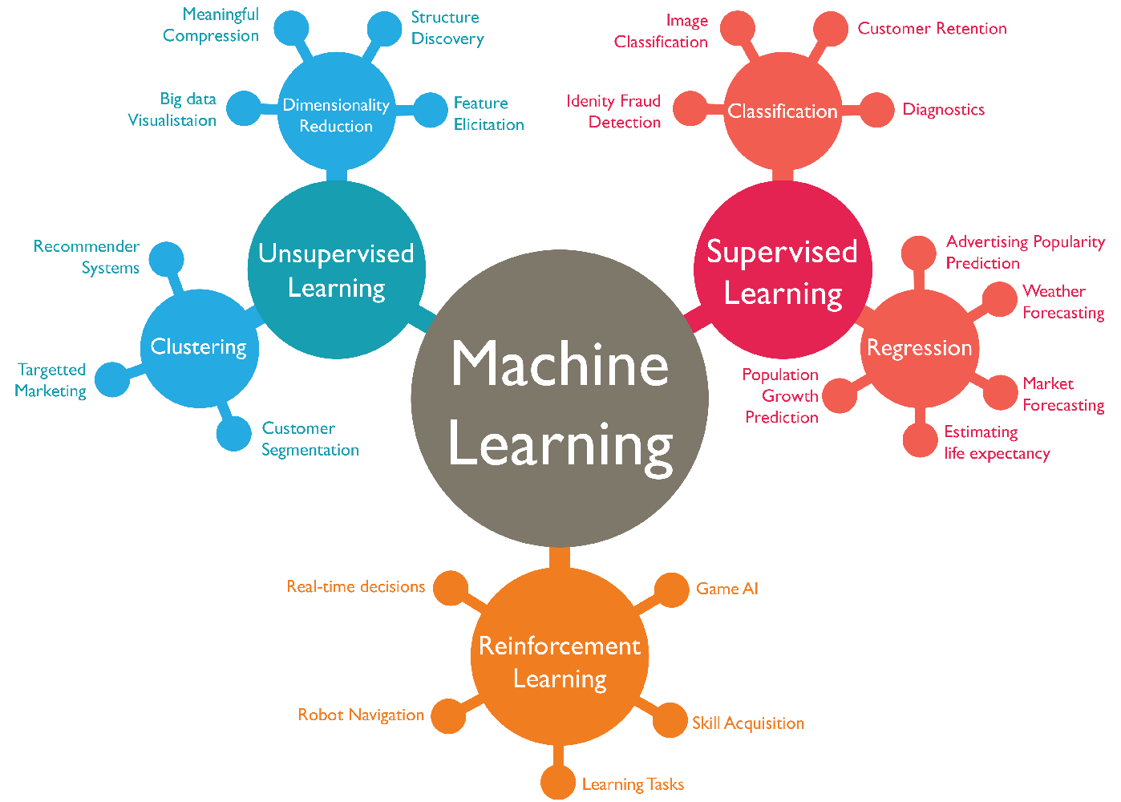



Project Details
Selection of dataset
Reasons for selection
Description of the data source
ML Model for prediction

Slide 4


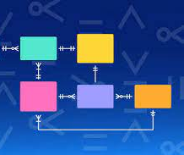




Tools/ Technologies Used

Slide 5
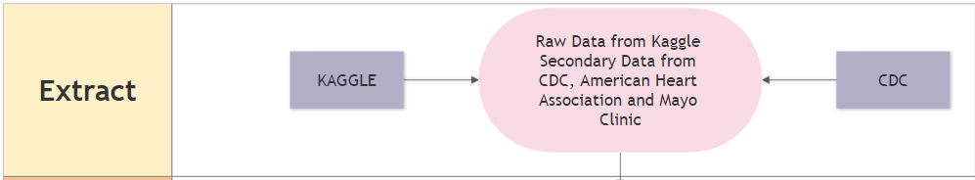
Primary Dataset - Kaggle
Heart Disease Dataset
438 Rows/16 Columns
Secondary Dataset - CDC
Blood Sugar Level Category (3 Rows/ 2 Columns)
BMI Category (4 Rows/ 2 Columns)
Secondary Dataset – American Heart Association
Blood Pressure Category (4 Rows/ 5 Columns)
Secondary Dataset – Mayo Clinic
Cholesterol Category (3 Rows/ 3 Columns)

Slide 6
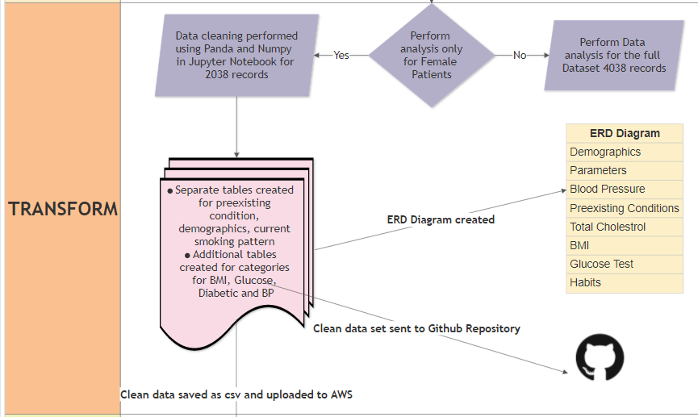

Slide 7
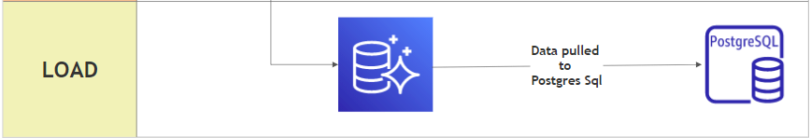
Current Dataset
Contains data for Female Patients
2034 Rows
20 Columns
Join query performed to map categories from Secondary Dataset to Primary Dataset values

Slide 8
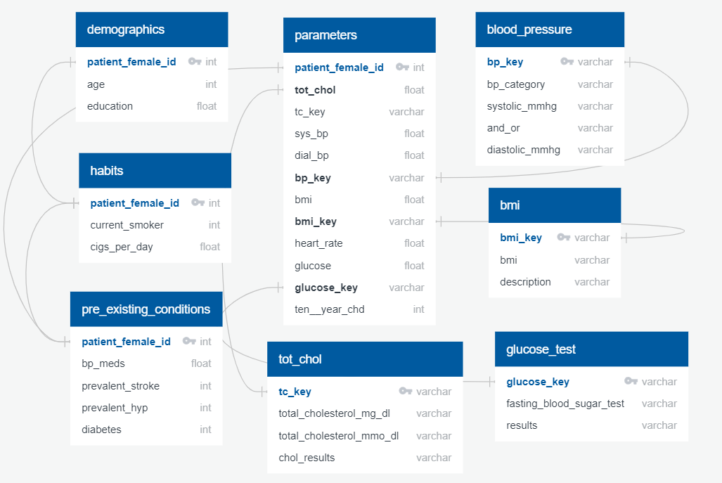
ERD Diagram
Notes:
Add ML+ ERD

Slide 9
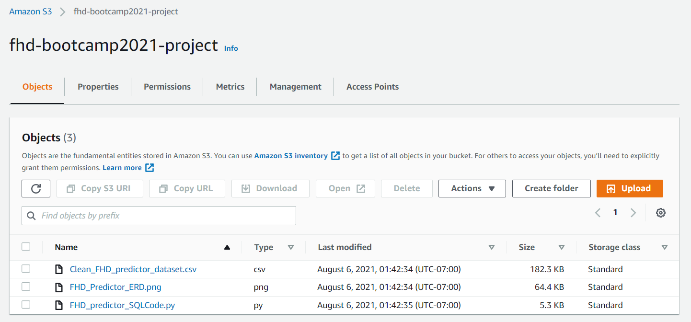
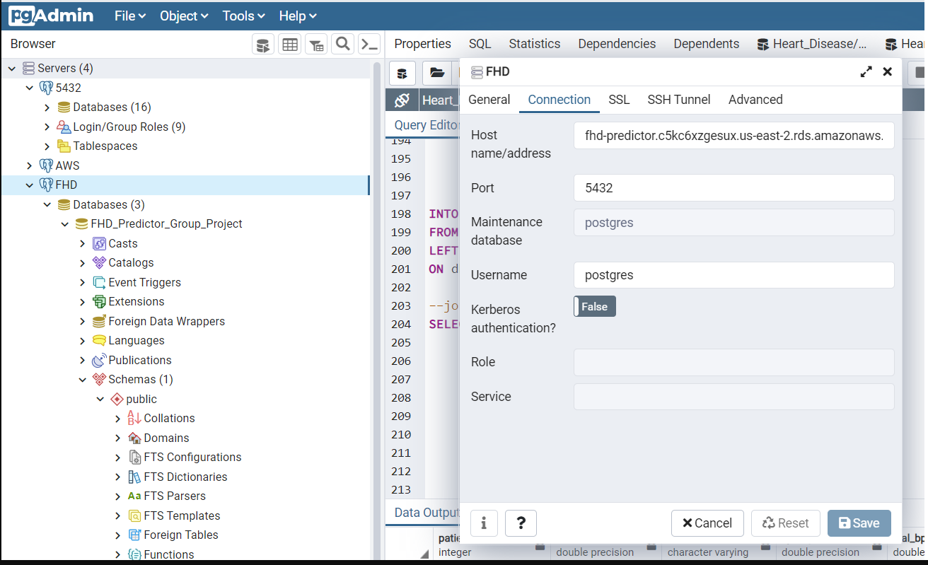
AWS - Postgres
Notes:
Add ML+ ERD

Slide 10
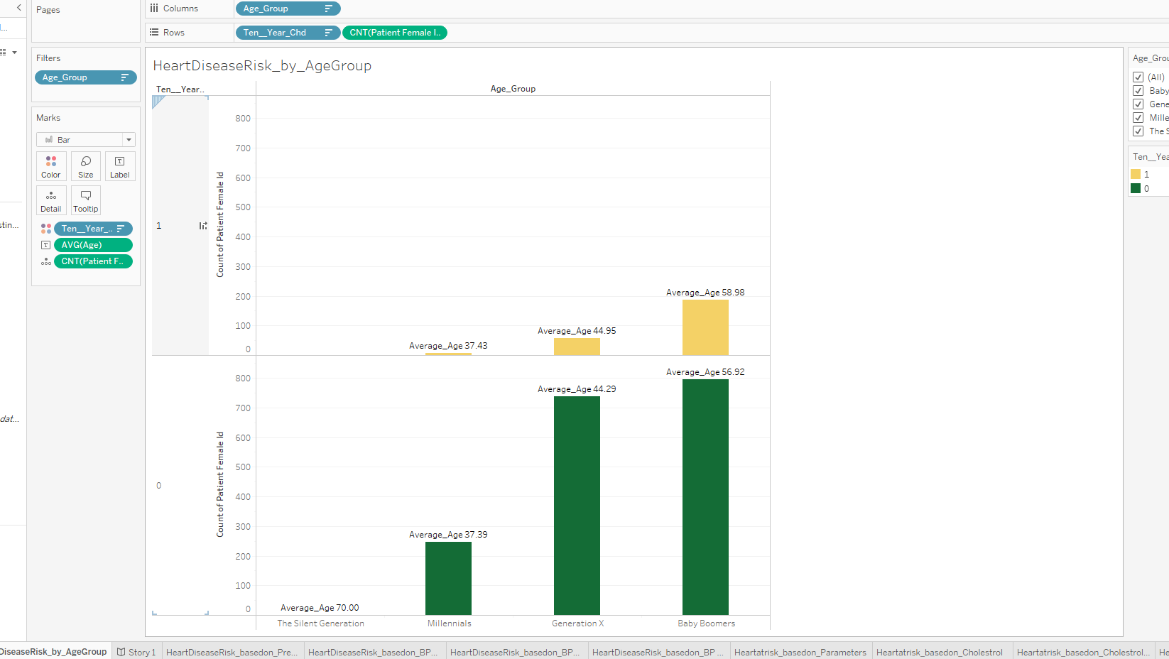
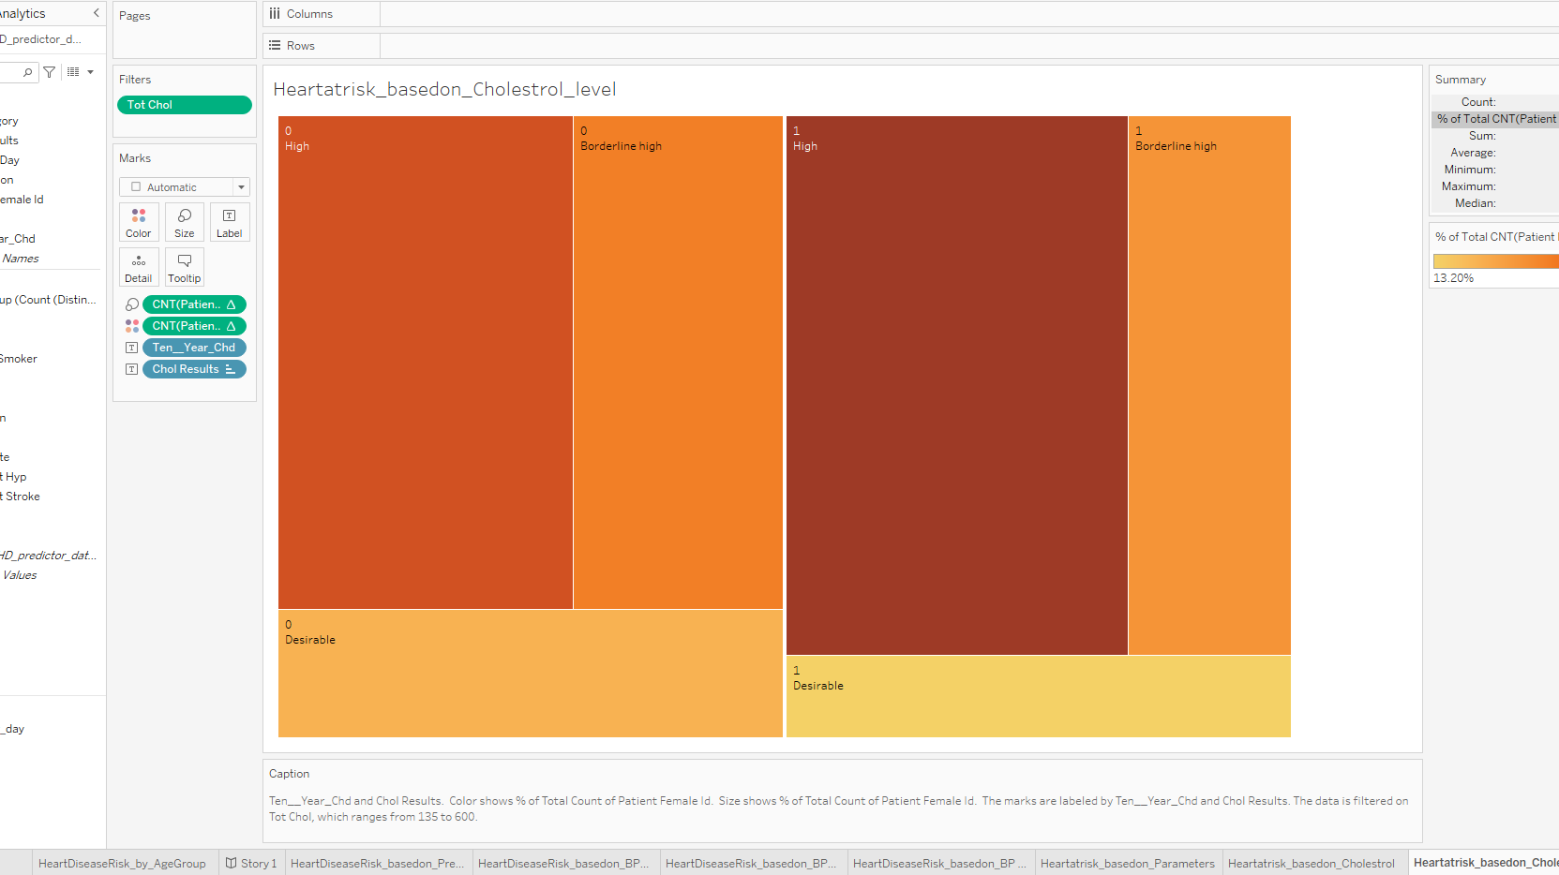
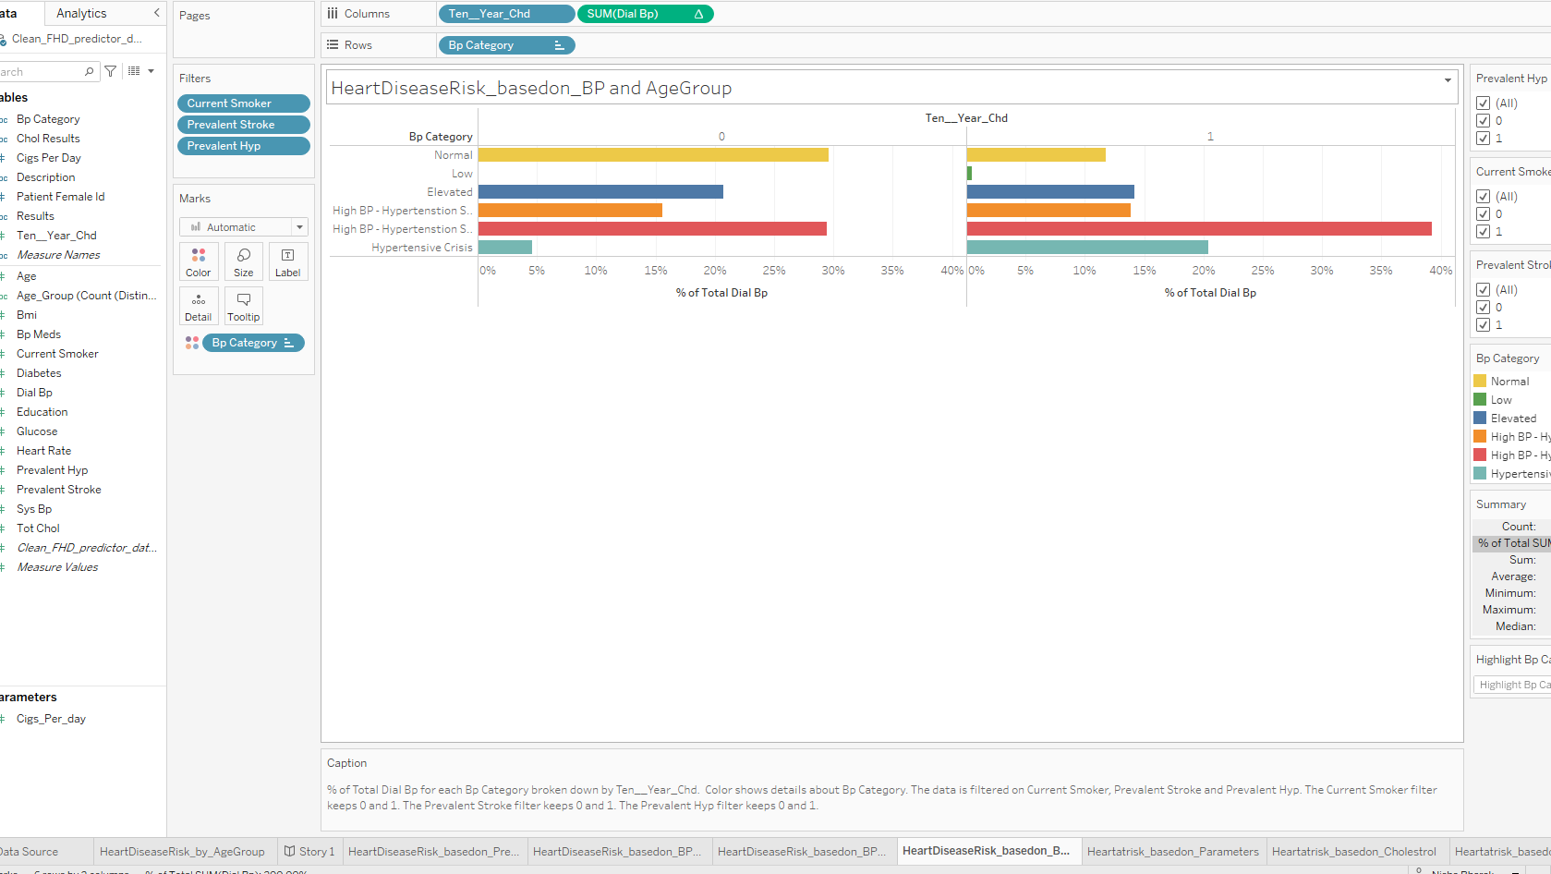
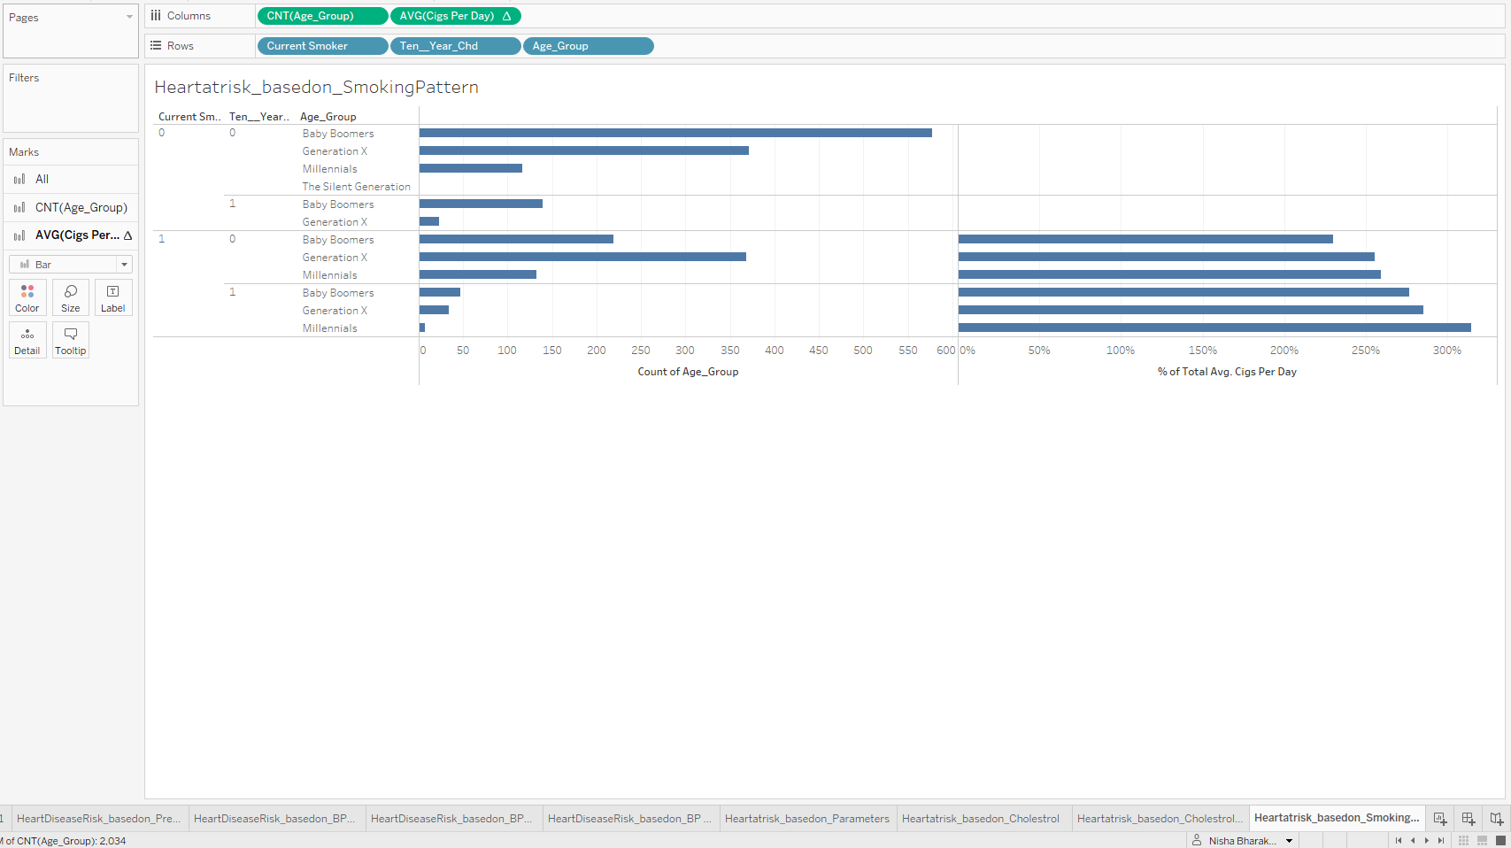
Dashboard
(Data Analysis and results of Analysis)
Notes:
https://public.tableau.com/authoring/girl_power/DashboardNisha_TrialLayout_1#1
https://public.tableau.com/authoring/girl_power/Dashboard2v_2_1#1
https://public.tableau.com/authoring/girl_power/MLMDashboard#1

Slide 11
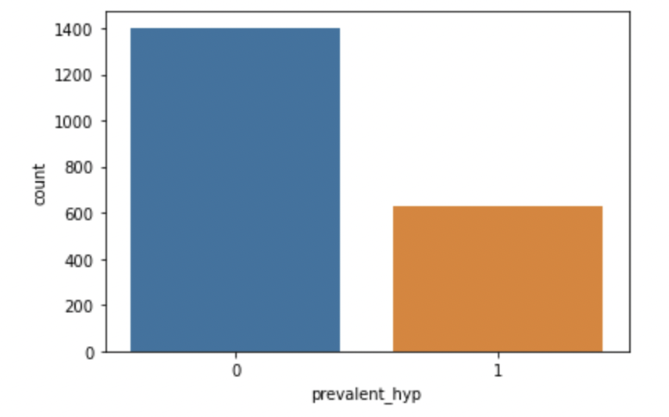
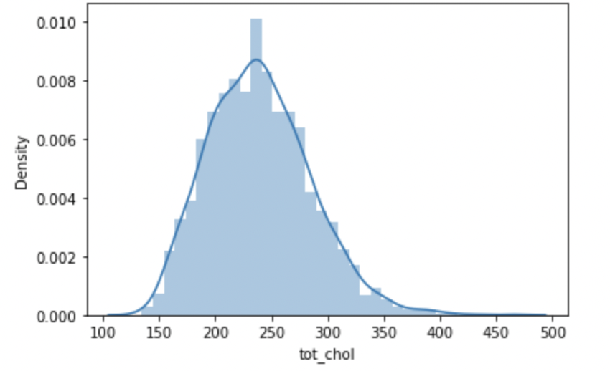
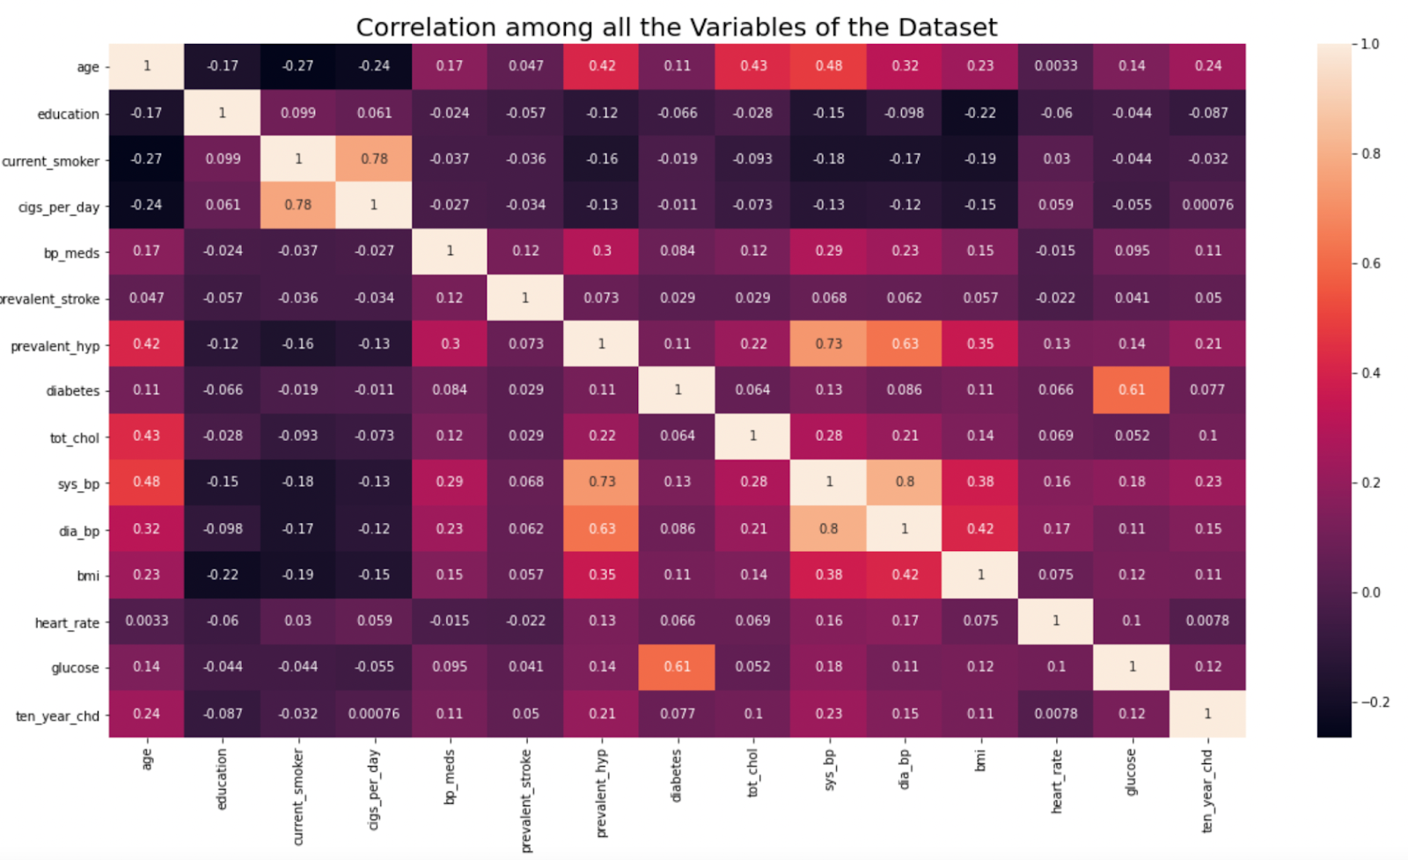
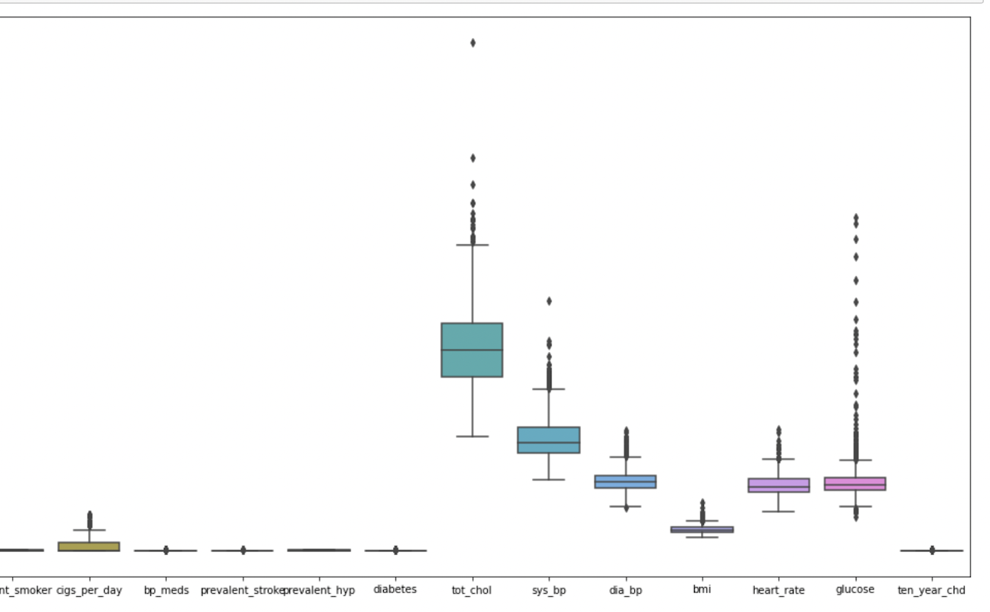
Exploratory Data Analysis
Data Cleaning
Data Distributions
Notes:
Data Cleaning
Data Distributions
Relationships

Slide 12

MLM Model
Input Data
Supervised Models
- Application of Machine Learning Classification Models
- Gradient Boosting Model
Output Optimum Model
- Logistic Regression
- Support Vector Machine
- Decision Tree Model
- Random Forest Classifier
Criteria
- Accuracy Score
- Precision
- Recall
- Features and Target Identified
- Exploratory Data Analysis
- Feature Selection
- Feature Scaling
- Best Performing Model recommended

Slide 13
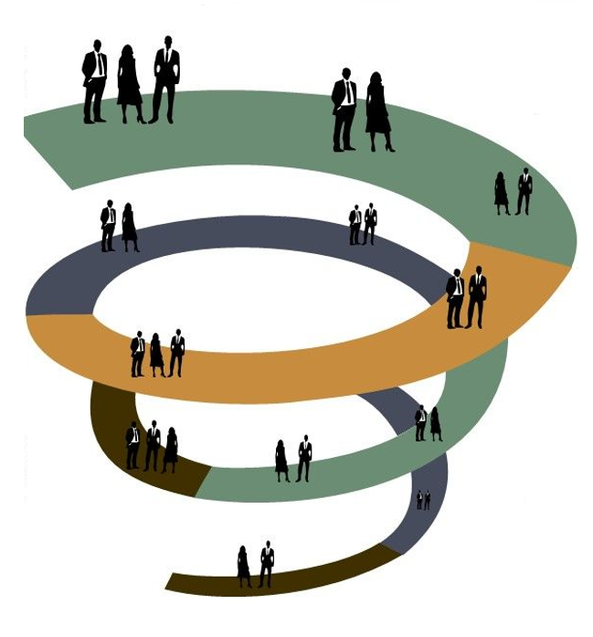
Project Lessons Learned and Challenges
Understanding Dataset
Knowledge of Domain/Subject Matter
Identifying the problem/question to resolve
Incorrect selection of dataset
Incomplete data to support the model

Slide 14
Recommendations
Database
Connecting to cloud Database
Maintaining a backup of data
Git hub
Knowledge of basic functions of Git hub
Maintain a clean repository
Machine Learning
Decision for selecting Model
Dashboard
Accuracy in reading the value of each data point in the graph
Comparison to achieve outcome
Understanding datapoint value significance based on domain of dataset
Addressing Class Imbalance issues
Attempt to get a better Recall score along with Accuracy
Consider other machine learning Models such as simple Neural networks
Understanding correct datatype
Weightage for each feature
Active link in the repository
Commit and Merge task/subtask
Data cleaning based on key feature requirement
Understanding Input Data
Understanding Pros and Cons for different ML model
Adding more dimension to the analysis
Understanding statistical significance for each data point
Data analysis and visualization correlation with prediction models

Slide 15


