Slide 1
Data Analytics - Capstone Project
Dixie Peralta
Neeraja Jayaraman
Richelle Long
Nisha Bharakhada

Slide 2








The Team
Dixie Perlata
Richelle Long
Neeraja Jayaraman
Nisha Bharakhada
Github / Database/Presentation
Github / Database/Presentation
Machine Learning Model/Presentation/Dashboard
Machine Learning Model/Presentation/Dashboard

Slide 3
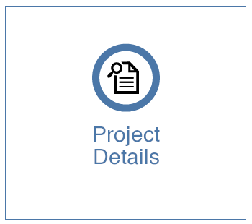
List of dataset reviewed
Selection of dataset
Reasons for selection
Description of the of data source
ML Model for prediction

Slide 4
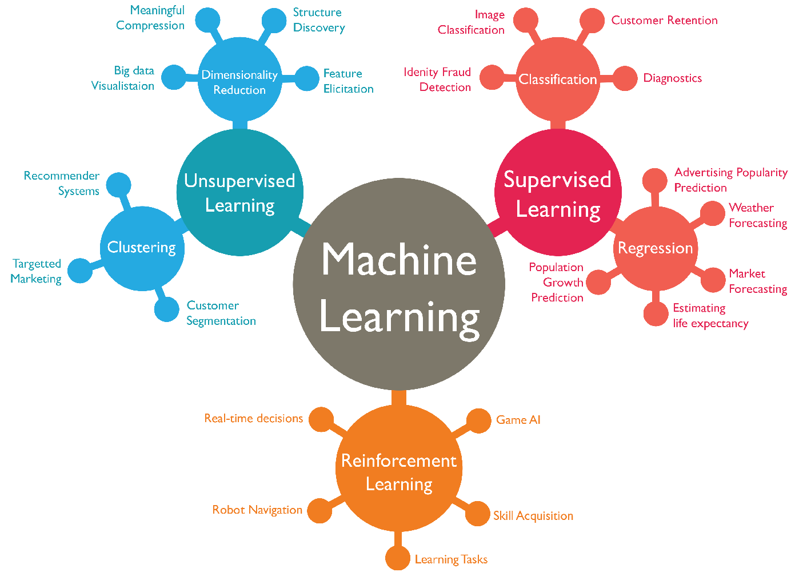
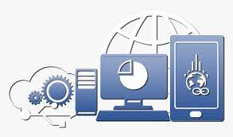


Data Analysis & Prediction using Machine Learning
Selection of Dataset
Tools and Technologies for Data Analysis
Machine Learning Model for Prediction
Communication Protocols

Slide 5




Communication Protocol
Notes:
Microsoft Excel - To view the data once csv file is downloaded
Postgres SQL - To create a database
Python (Jupyter Notebook)
QBD - To create ERD diagram
Github
Google Drive - To keep all the documents at one central location

Slide 6


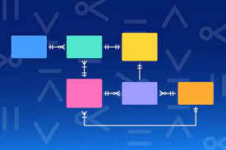

Tools/ Technologies Used
Notes:
Microsoft Excel - To view the data once csv file is downloaded
Postgres SQL - To create a database
Python (Jupyter Notebook)
QBD - To create ERD diagram
Github
Google Drive - To keep all the documents at one central location

Slide 7
Prediction of YouTube Trending videos
Topic Selection
Reasons for Selection
Description of Data source
Total 6 Datasets originally reviewed
Youtube Trending Videos - Selected
Travel Insurance
Reading Habits
Walmart Retail
House Sales Price
Vehicle Fuel Type
General Reason
A useful topic for Youtube content creators
Youtube is a global platform with over 2 billion users
Project specific reason
Availability of more recent dataset
Number of records available
Applicability of tools and technologies learnt during the course to meet the deliverables.
Dataset is extracted from Kaggle for top trending videos on YouTube
It contains details such as video title, channel title, publish time, tags, views, likes and dislikes, description, and comment count.

