Slide 1

Capstone Project Female Patients - Heart Disease Risk Predictor

Slide 2


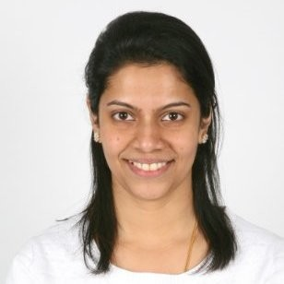
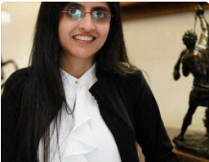
The Team
Dixie Perlata
Richelle Long
Neeraja Jayaraman
Nisha Bharakhada
Github
Database
Dashboard
Database
Presentation
Dashboard
Machine Learning Model
Presentation
Dashboard
Machine Learning Model
Presentation
Dashboard

Slide 3





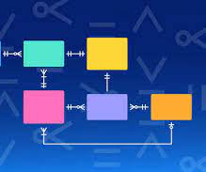
Tools/Technologies Used

Slide 4

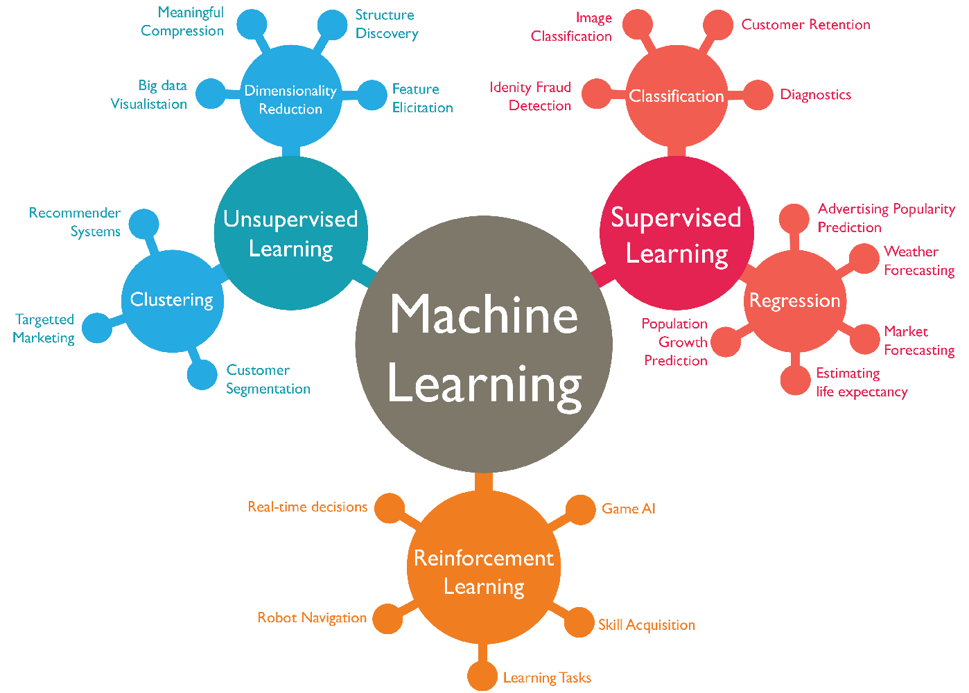

Project Details
Selection of dataset
Heart Disease Risk Predictor for female
Reasons for selection
Availability of number of records required
Applicability of tools/technologies
Useful for wider audience female group and healthcare systems

Slide 5
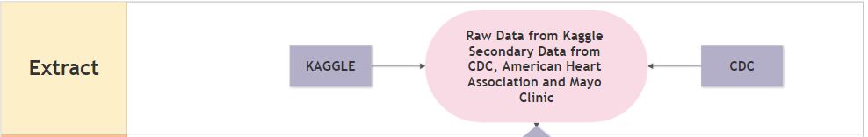
Primary Dataset - Kaggle
Heart Disease Dataset
4238 Rows/16 Columns
Secondary Dataset - CDC
Blood Sugar Level Category (3 Rows/ 2 Columns)
BMI Category (4 Rows/ 2 Columns)
Secondary Dataset – American Heart Association
Blood Pressure Category (4 Rows/ 5 Columns)
Secondary Dataset – Mayo Clinic
Cholesterol Category (3 Rows/ 3 Columns)

Slide 6
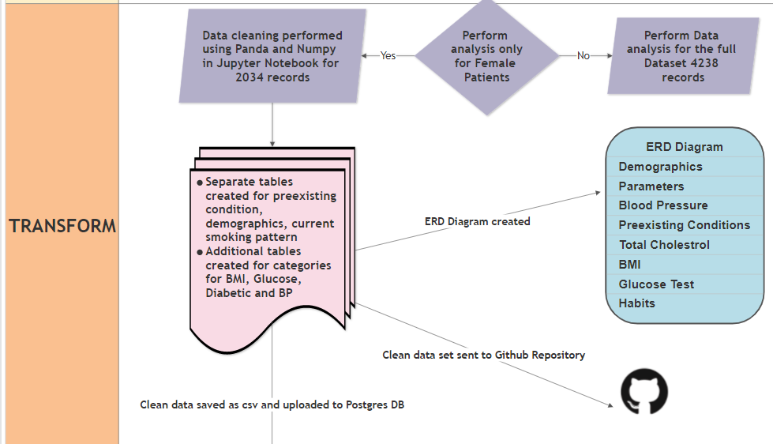

Slide 7
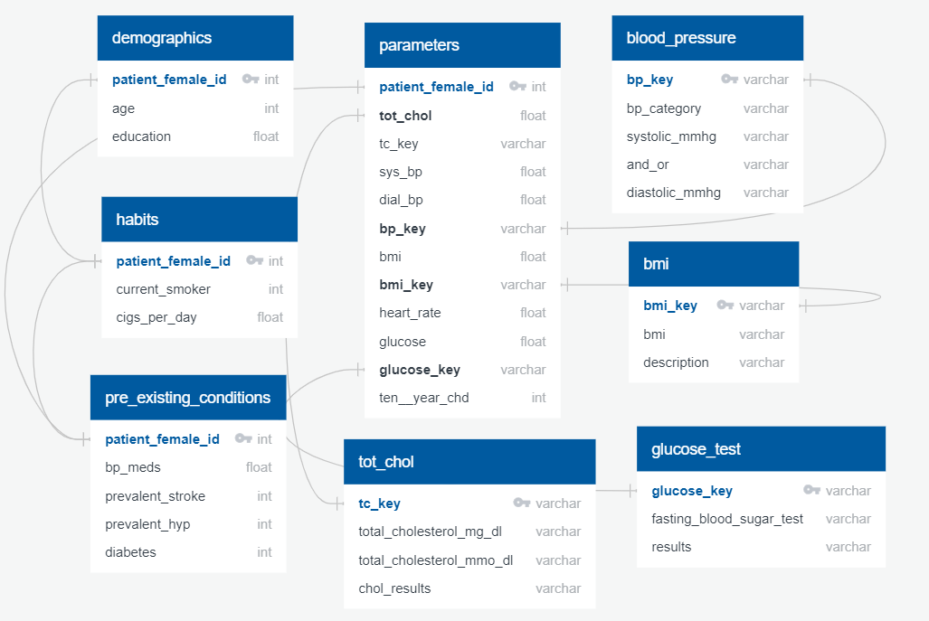
ERD Diagram
Notes:
SQL_Code_Table_Creation.png
Pgadmin connection string – Jupyter notebook

Slide 8
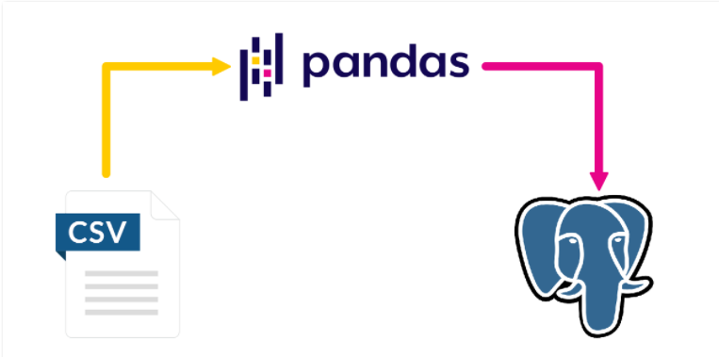
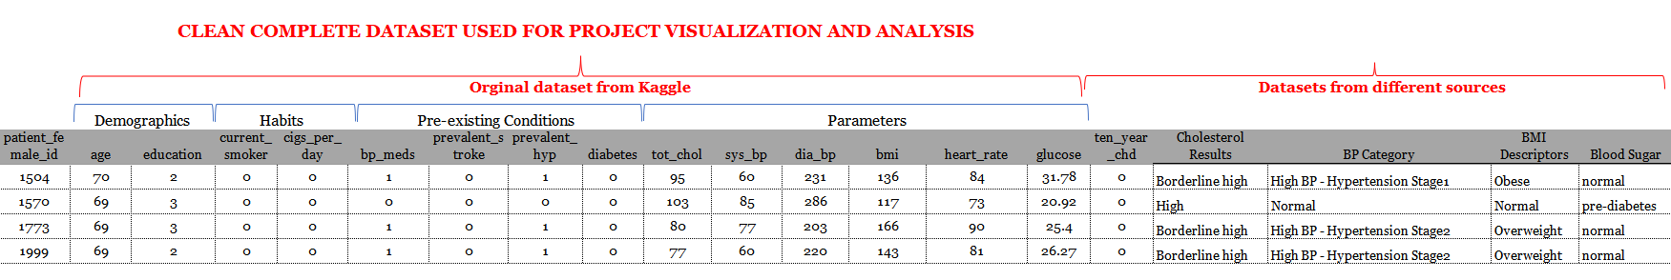
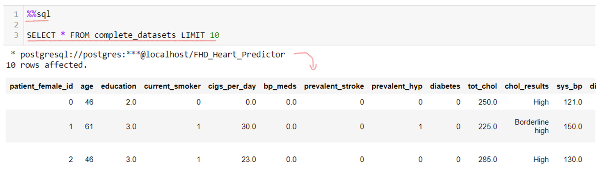
Python - PostgreSQL
Notes:
Contains data for Female Patients
2034 Rows
20 Columns
Join query performed to map categories from Secondary Dataset to Primary Dataset values

Slide 9
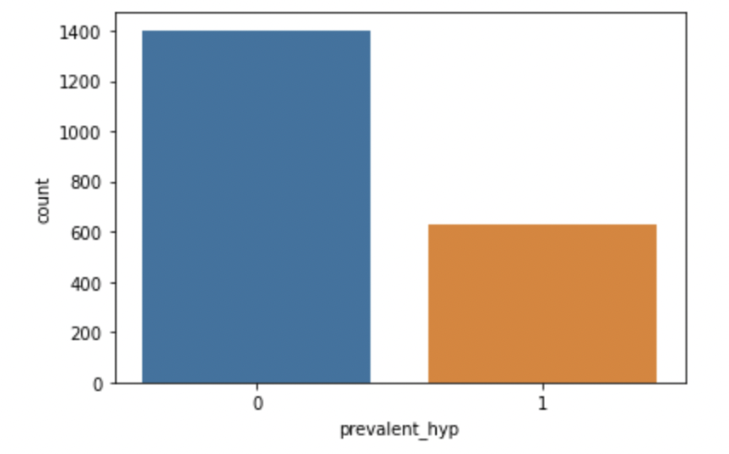
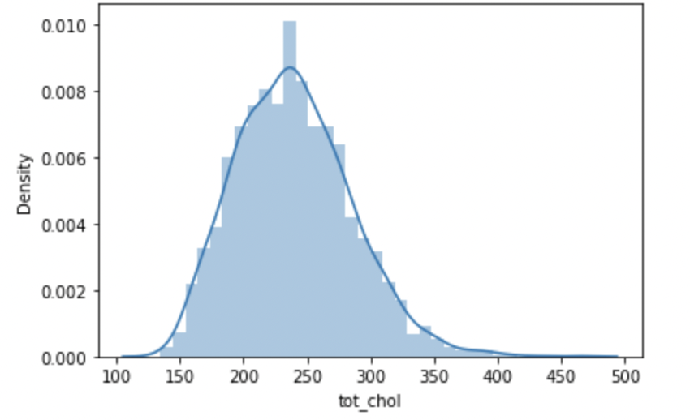
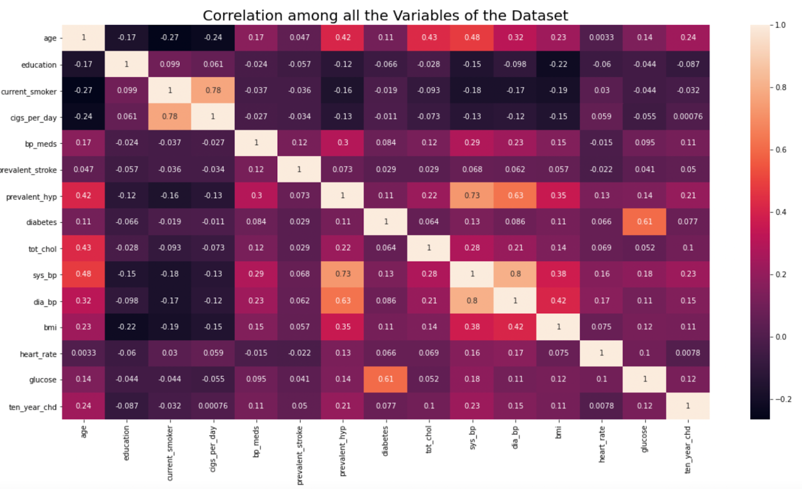
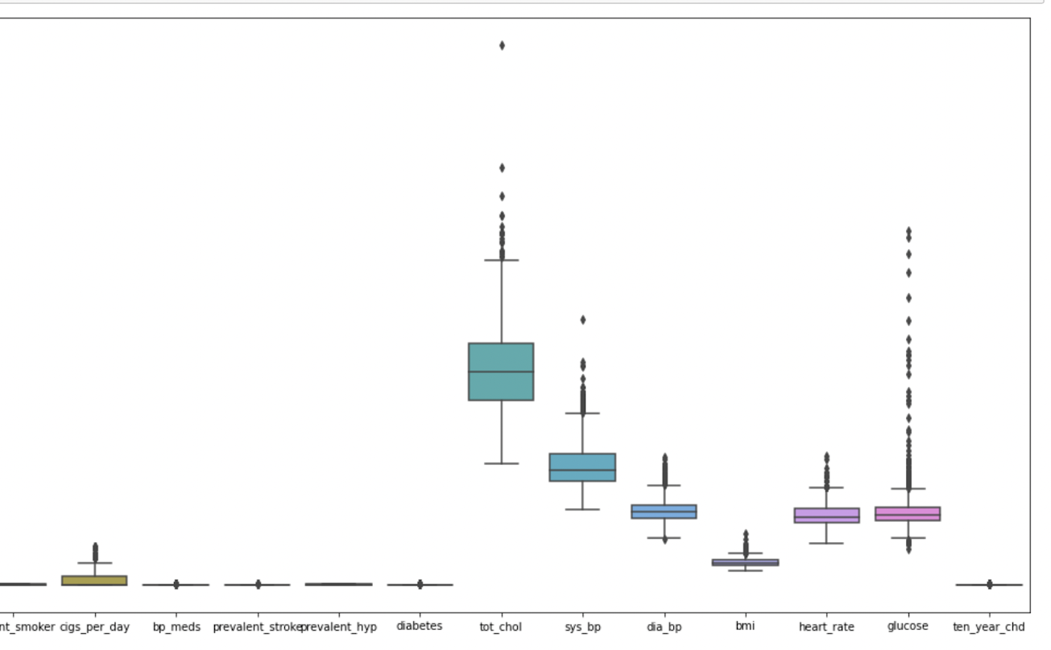
Exploratory Data Analysis
Data Cleaning
Data Distributions
Data Correlation
Notes:
Data Cleaning
Data Distributions
Relationships

Slide 10

MLM Model
Input Data
Supervised Models
- Application of Machine Learning Classification Models
- Gradient Boosting Model
Output Optimum Model
- Logistic Regression
- Support Vector Machine
- Decision Tree Model
- Random Forest Classifier
Criteria
- Accuracy Score
- Precision
- Recall
- Features and Target Identified
- Exploratory Data Analysis
- Feature Selection
- Feature Scaling
- Best Performing Model recommended

Slide 11
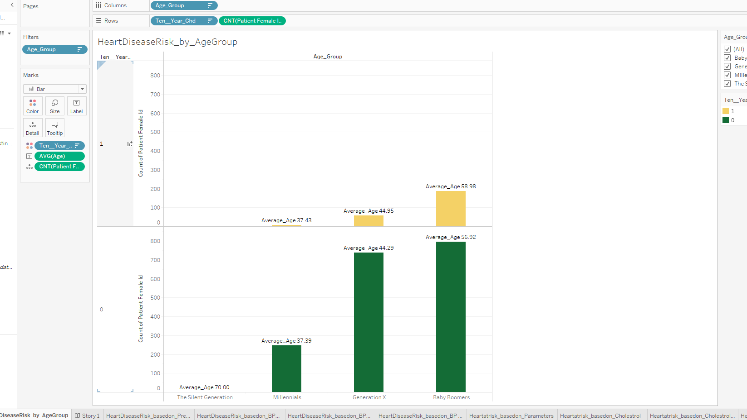
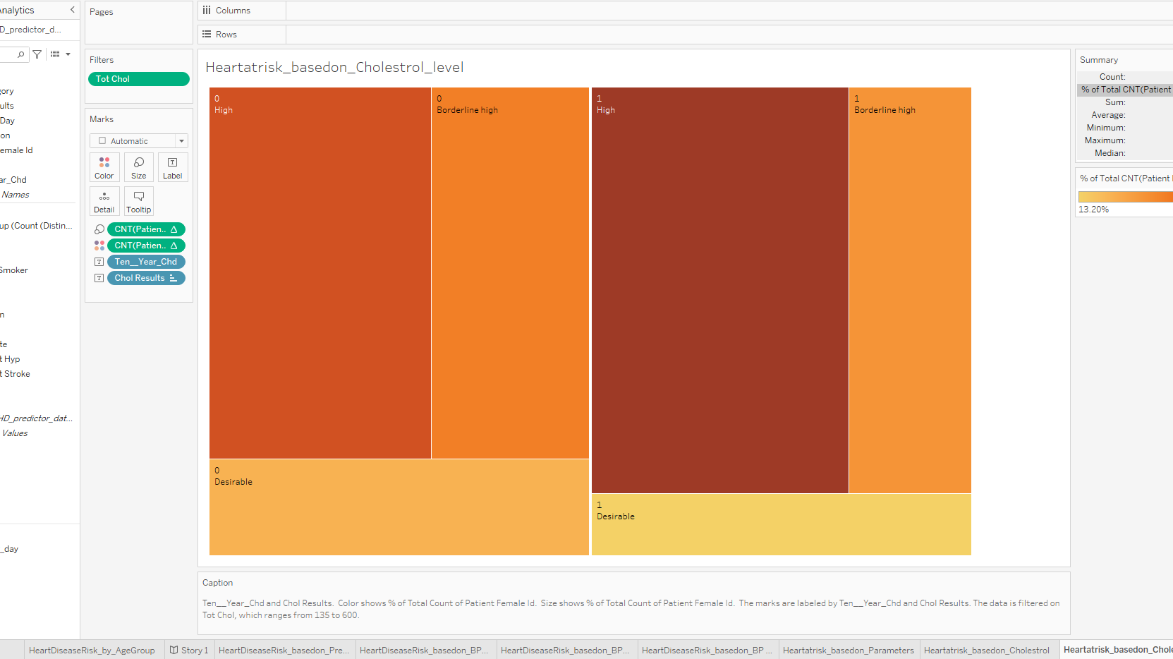
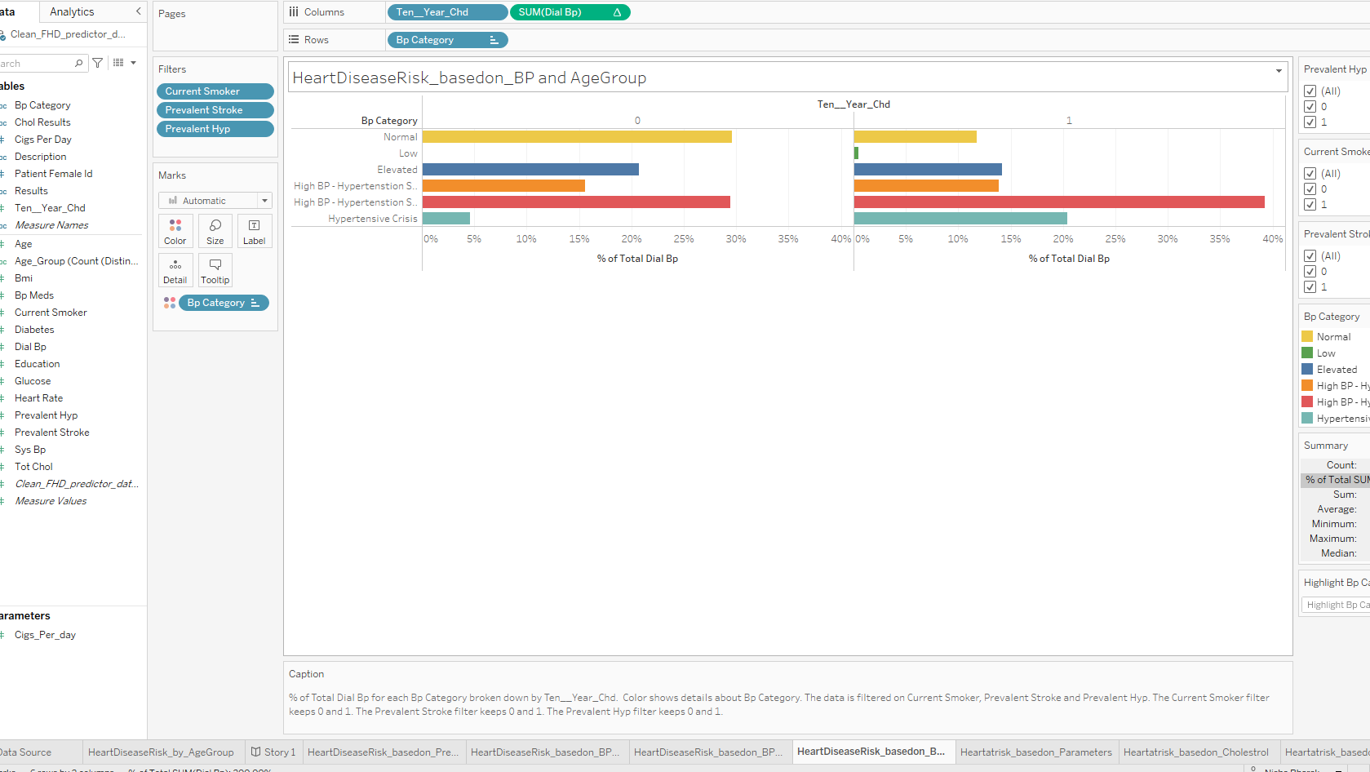
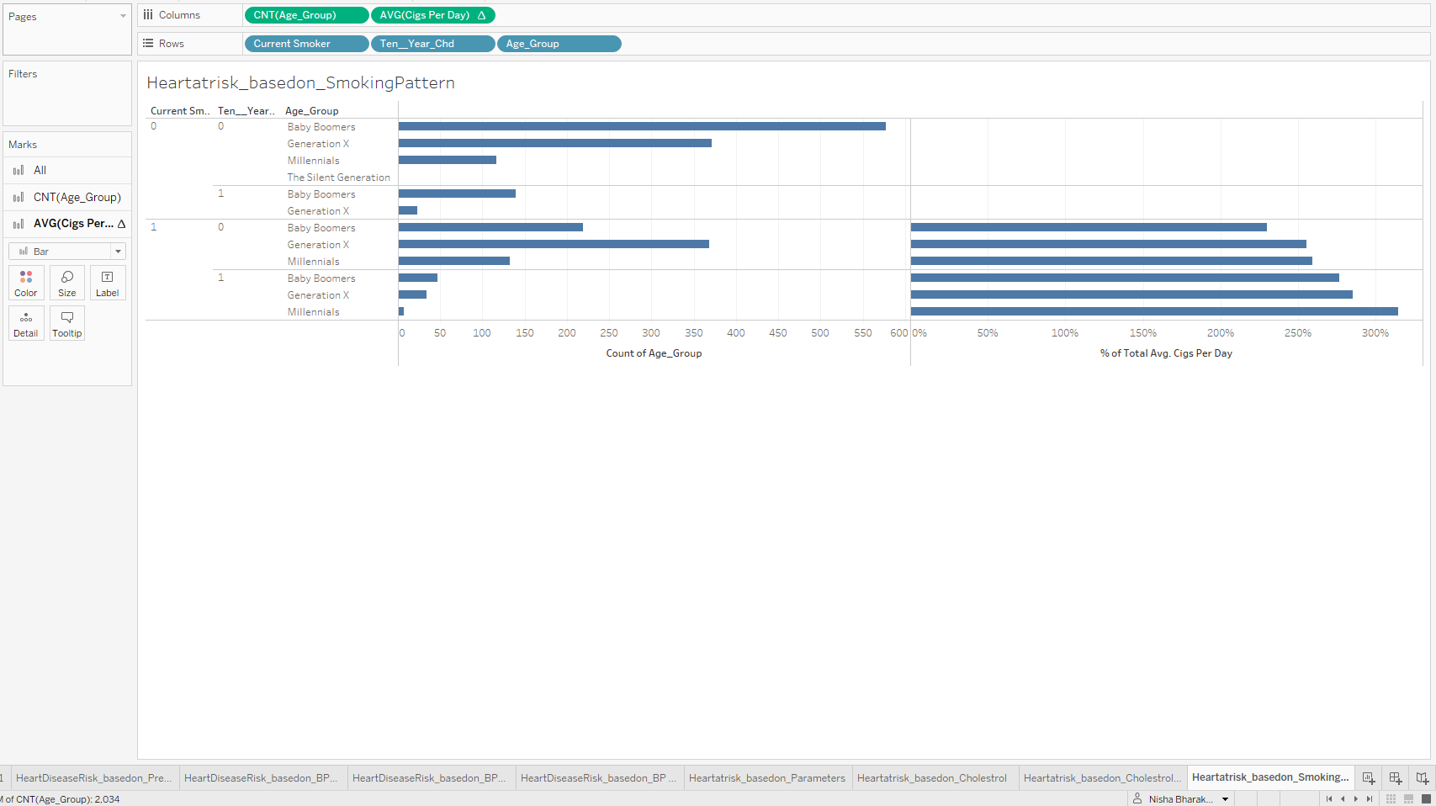
Dashboard
Notes:
https://public.tableau.com/authoring/FemaleHeartDiseasePredictor/Story12/Female_HeartDisease_Predictor#1

Slide 12
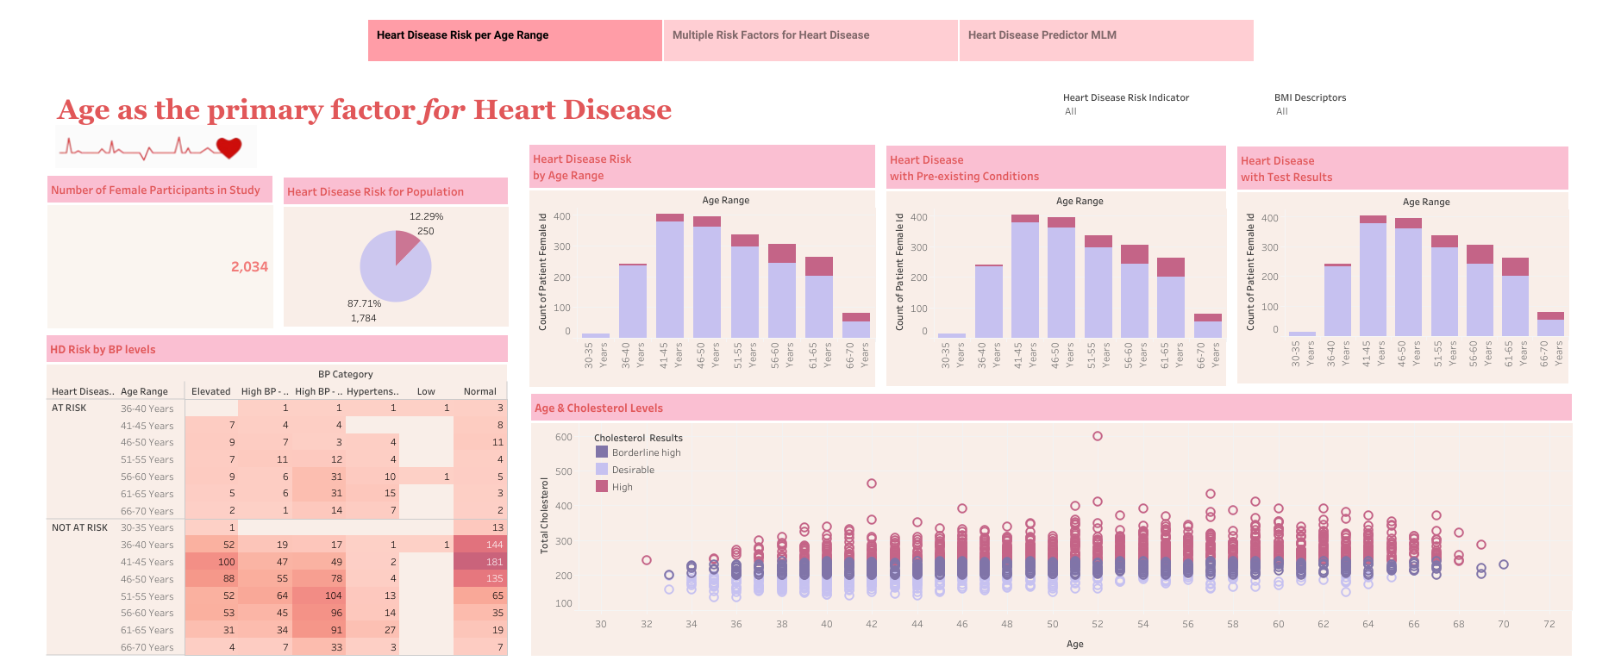
Notes:
https://public.tableau.com/app/profile/fhd.ucb2021/viz/FemaleHeartDiseasePredictor/Story_Board#1

Slide 13
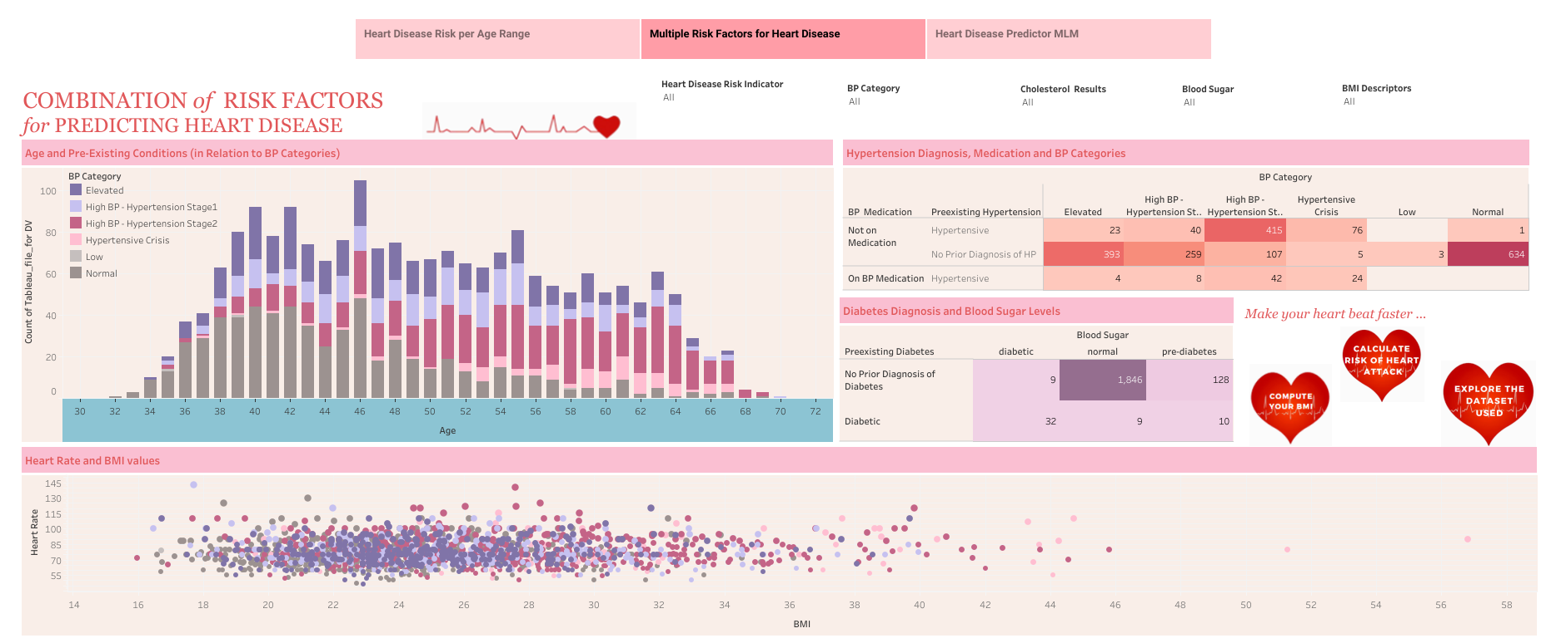

Slide 14
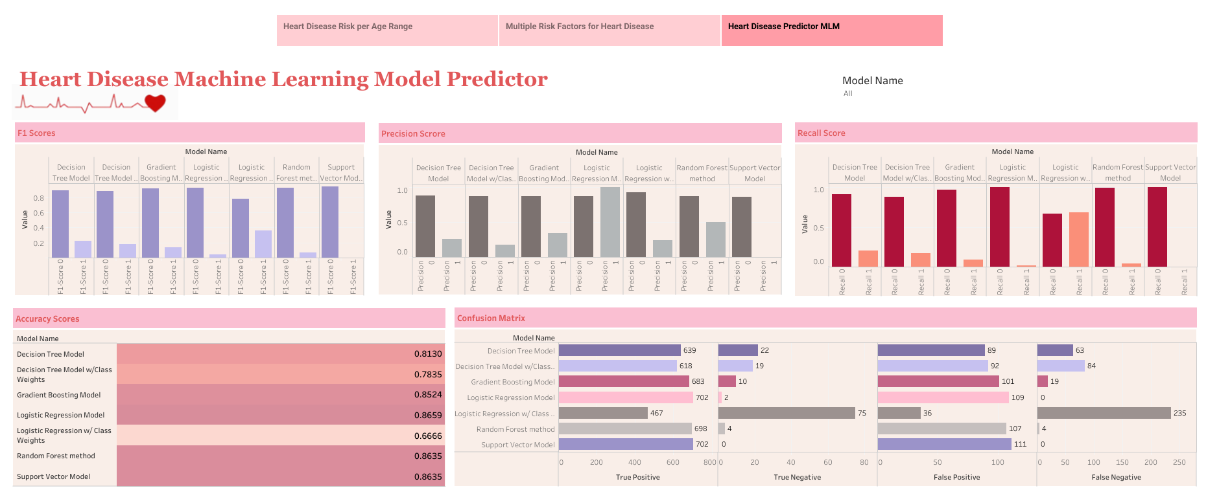

Slide 15
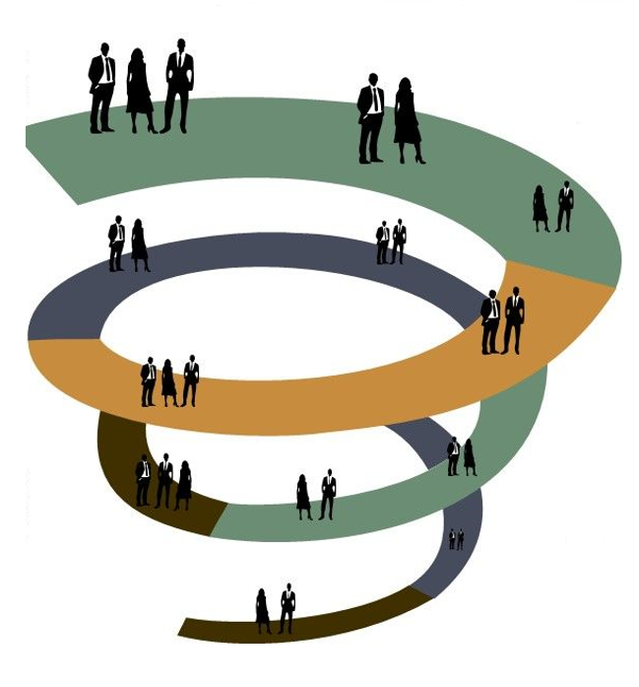
Recommendation for Future Analysis
Adding more dimensions to the dataset and identify relevant secondary dataset
Attempting new machine learning model for optimal result
Accessing the recent dataset
Comparative analysis with new contributing factors
Knowledge of Domain/Subject Matter to understand the data

Slide 16
Lessons Learned
Database
Connecting to cloud Database
Maintaining a backup of original and clean data
Git hub
Knowledge of basic functions of Git hub
Maintain a clean repository
Machine Learning
Addressing Class Imbalance issues
Dashboard
Accuracy in reading the value of each data point in the graph
Understanding datapoint value significance based on domain of dataset
Understanding correct datatype
Weightage for each feature
Active link in the repository
Commit and Merge task/subtask
Data cleaning based on key feature requirement
Understanding statistical significance for each data point
Data analysis and visualization correlation with prediction models
Attempt to get an optimal balance between Recall scores and Accuracy.
Consider other Machine Learning Algorithms.
Notes:
https://public.tableau.com/app/profile/fhd.ucb2021/viz/FemaleHeartDiseasePredictor/Story_Board#1

Slide 17
Thank You
What are your questions?

