Slide 1


Project 1 Group 3
Introduction to the Data-Related Job Market
Amanda Pesch, Chloe Lee, John Burke, David Mueller, Rna Babikar

Slide 2
Introduction & Objectives
What is the job market currently and what is the job market in recent years for data-related jobs? We’ll be heading into this market soon and what better time to start looking, while utilizing our coding skills!
Our objective: explore the job market for data-related jobs within the U.S., by analyzing current and recent data sources.
See our README.md file for details on data sources, questions asked, and analysis

Slide 3
Our focus was to have an overview to the employment number per sector in the United State of America per state.
And find answers to:
Q1. What are the top 15 sector
Q2. What are the employment and projection for computer system design and related services for (2029).
Q3. What are the number of graduates by major for top 8 states graduates.
Q4.Comparing the degrees in computers, mathematics and statistics by region

Slide 4
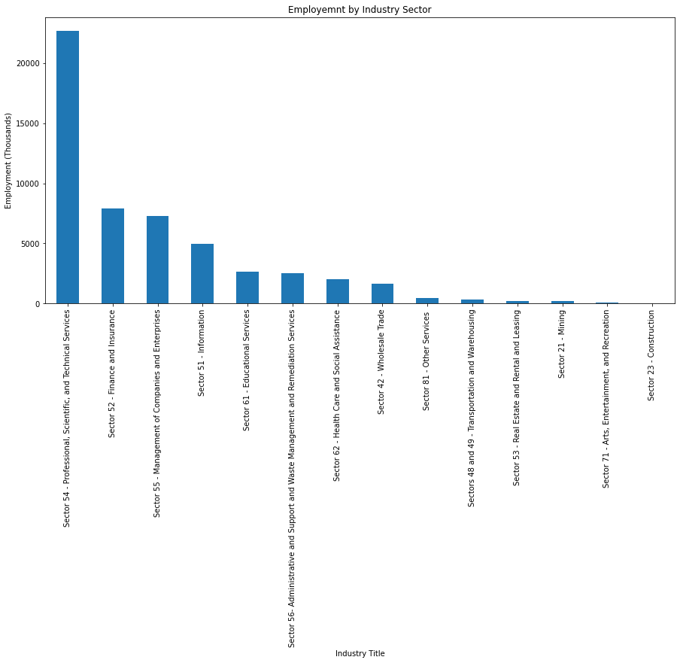
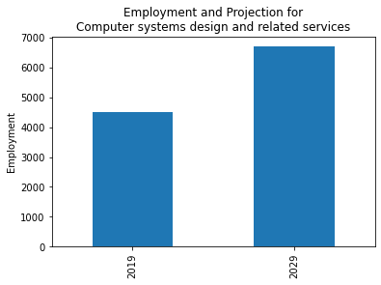
May 2020 National Industry Specific Occupational Employment and Wage Estimates(OEWS)
Fig (1): Employment by Industry Sector. Shows top 15 sector in the united state, per employment.
sectors were classified according to the north american industry classification system(NAICS).
Data source U.S. Bureau of Statistics.
Fig (2): Employment and projection for computer system design and related services
Data source U. S. Bureau of Statistics.

Slide 5
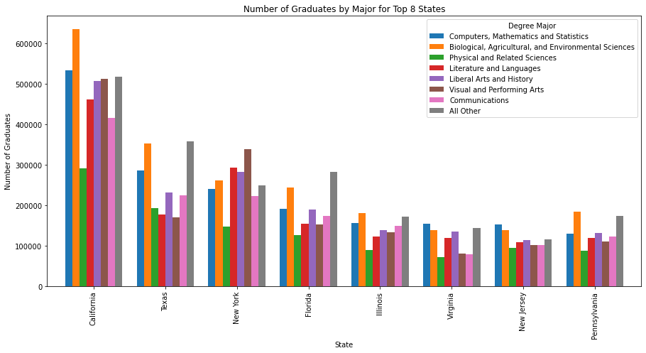
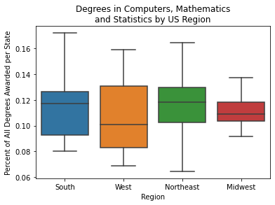
Graduates in the united state
Fig (3): Number of graduates by major for top 8 states graduates
Data source U.S. Bureau of Statistics.
Fig (4): Degree in computers, mathematics and statistics by region
Data source https://raw.githubusercontent.com/cphalpert/census-regions/master/us%20census%20bureau%20regions%20and%20divisions.csv

Slide 6
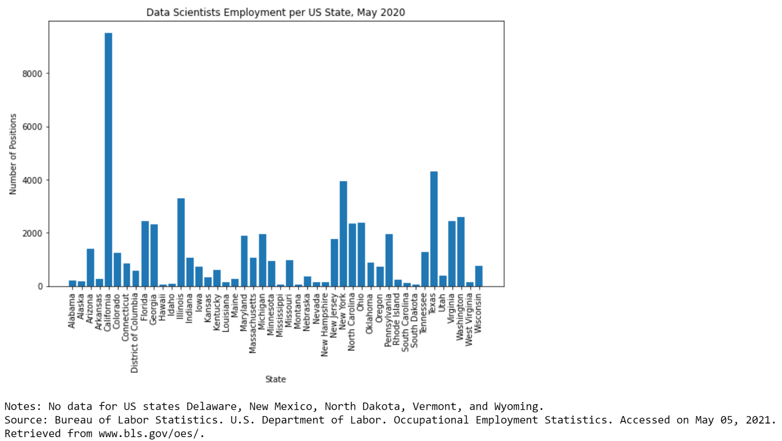
Dave’s Analysis

Slide 7
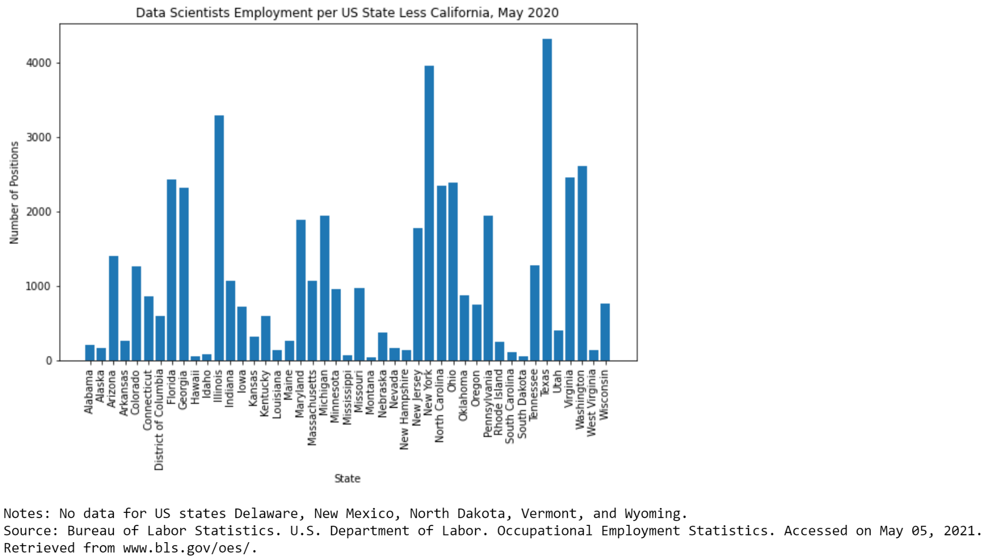
Dave’s Analysis

Slide 8
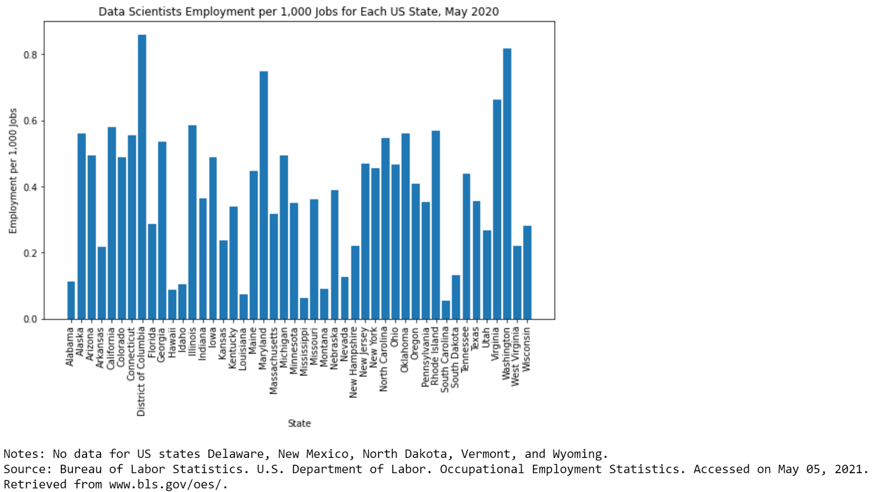
Dave’s Analysis

Slide 9
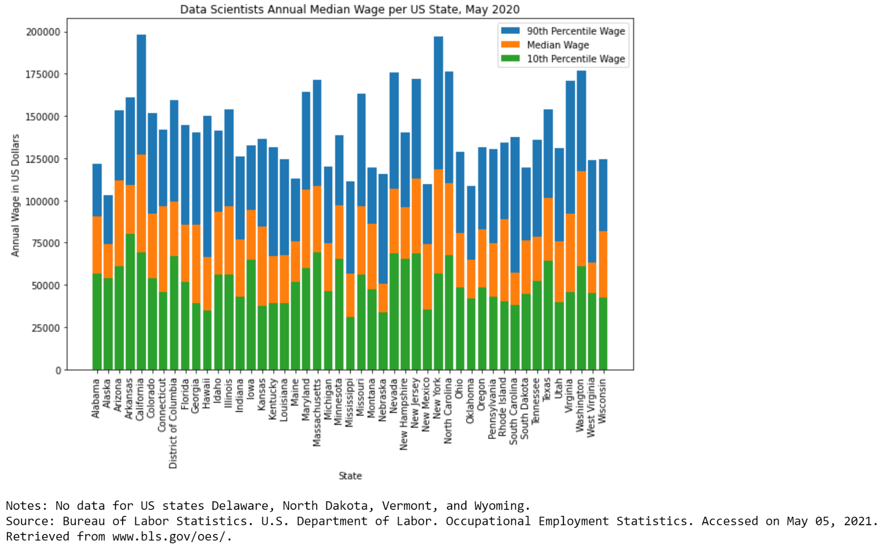
Dave’s Analysis

Slide 10
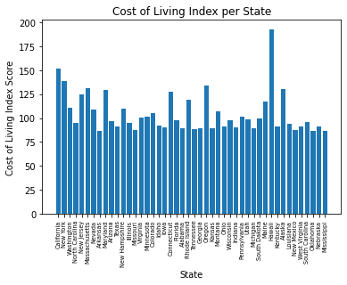
John’s Analysis - Cost of Living Index
Graph below shows cost of living per state. Calculation is based on the amount of money needed to sustain a certain standard of living based on the costs of housing, food, healthcare, and more.
Data Source - https://worldpopulationreview.com/state-rankings/cost-of-living-index-by-state

Slide 11
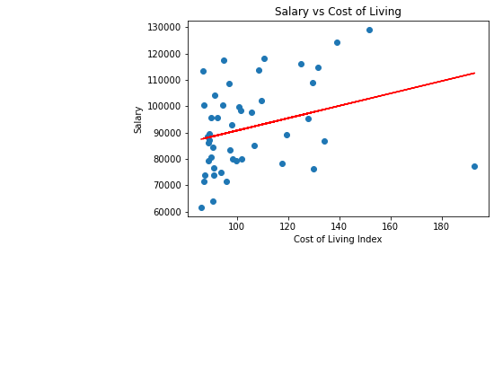
John’s Analysis - Salary vs Cost of Living per State
Based on the average salaries per state for Data Scientist jobs and the cost of living index per state, the scatter plot below compares states having salaries vs the cost of living. Points above the linear regression lines are the states that would be best to apply for Data Scientist positions.

Slide 12
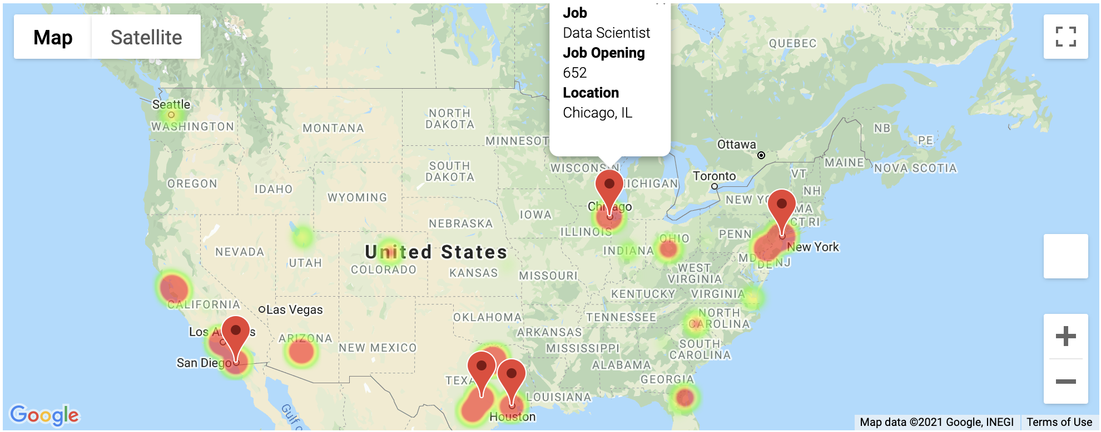
Chloe’s Analysis
My exploration focused to find out and visualize which industries are currently looking for data-related job in the United States, which companies are there, and which states are looking for the most by using ‘glassdoor’ information.
Q1. Which states are looking for the most data-related job?
A1. Cleaning up data from glassdoor and by using geopy, retrieved latitude and longitude for each state.
Layered heatmap and marked only Top 5 state that has largest job openings.
1. New York, NY (800) 2. Chicago, IL (652) 3. Austin, TX (625) 4. San Diego, CA (561) 5. Houston, TX (490)

Slide 13
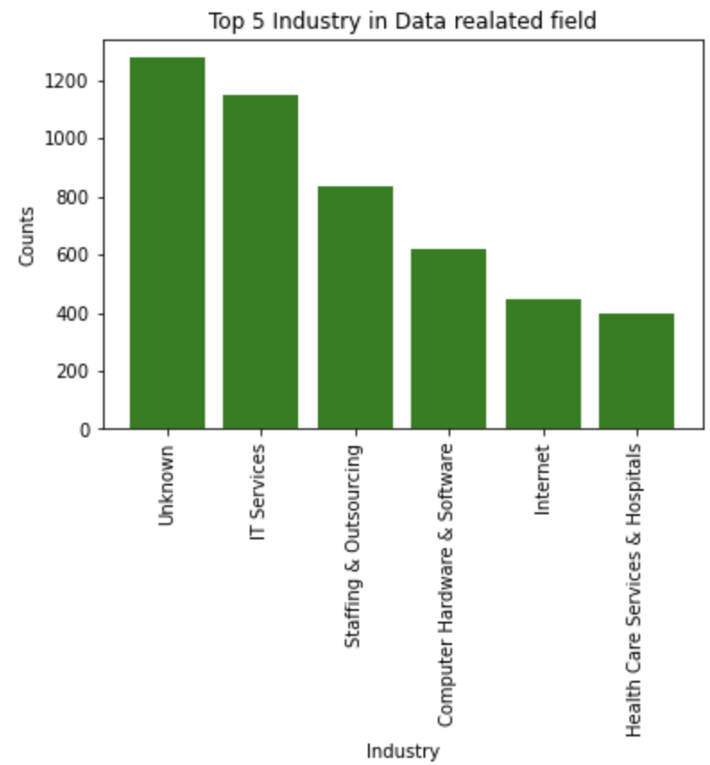
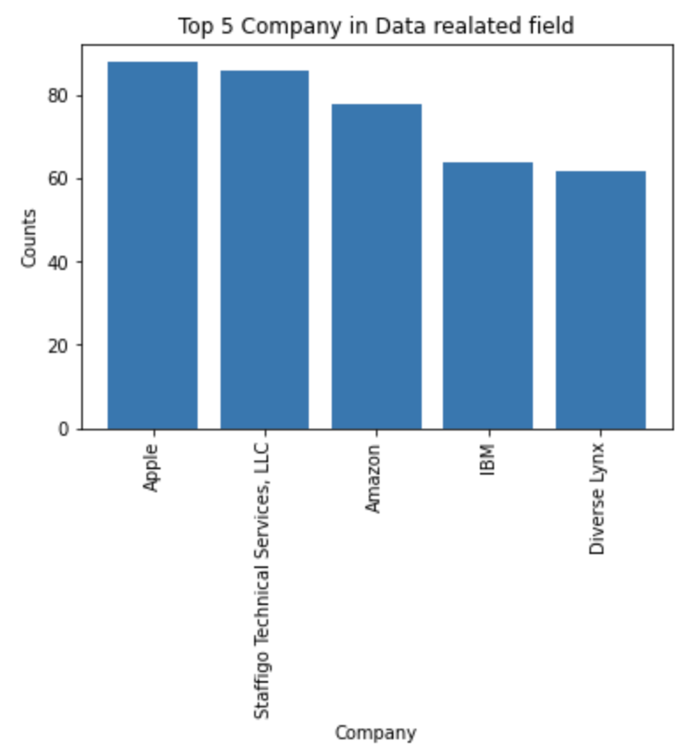
Chloe’s Analysis
Top 5 Industry in Data related job based on Job openings from Glassdoor.
IT Services (13.3%)
Staffing & Outsourcing (9.6%)
Computer Hardware & Software (7.1%)
Internet (5.2%)
Health Care Services & Hospitals (4.6%)
Top 5 Company in Data related job based on Job openings from Glassdoor.
Apple (1.0%)
Staffigo Technical Services, LLC (1.0%)
Amazon (0.9%)
IBM (0.7%)
Diverse Lynx (0.7%)

Slide 14
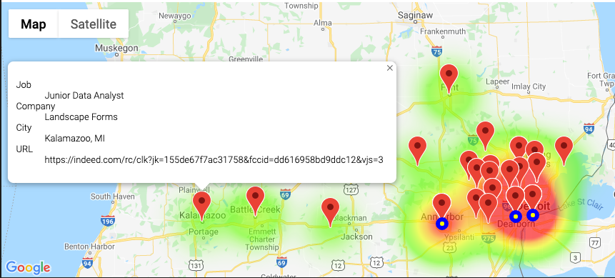
Amanda’s Analysis
If we were to visualize the hotspots for data-related jobs on a map of Michigan, where would those geographical hotspots be? Within that map, can we pinpoint the job locations and company? What are the top three locations with the most data-related jobs posted?
I obtained .csv datasets from an open-source Indeed web-scraping tool found on GitHub
Below visualizes the count & descriptions of data-related jobs (pulled 4/30/21 from Indeed) within Michigan
geolocator = GoogleV3(g_key) to obtain coordinates
gmaps to obtain a map of Michigan, with a heatmap layer, marker layer (job details), and symbol layer (top 3 cities with most jobs)
The number of jobs from the top 3 cities by job count (Detroit (20), Ann Arbor (10), and Dearborn (7)) account for 51% of the data-related jobs in Michigan
Notes:
My exploration focused on understanding the current data-related job market in Michigan and the U.S.
See google map with heatmap layer, marker layer, and symbol layer. The heatmap is showing that most data-related jobs exist on the East side of Michigan (metro Detroit to Ann Arbor region). The markers depict a sample job from each city with the job title, company, city, and URL. The three yellow symbols highlight the three cities with the most job postings (Detroit, Ann Arbor, and Dearborn).
"Data-related" meaning Data Analyst, Data Scientist, Data Engineer, Business Intelligence Analyst, etc. using the keyword "data" in the job title.

Slide 15
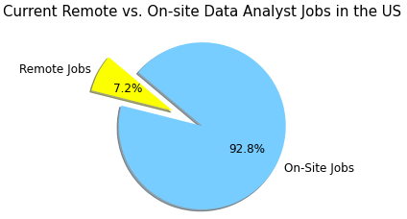
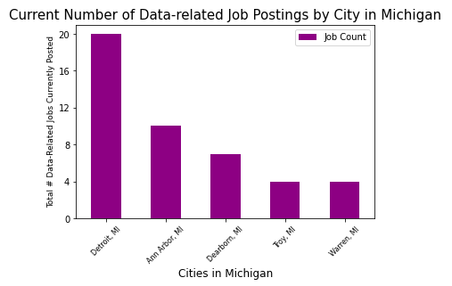
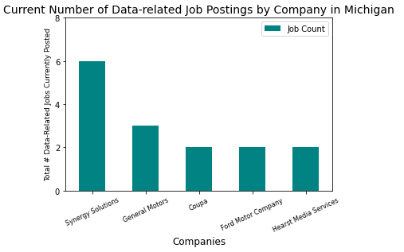
Amanda’s Analysis
Michigan Analysis (continued):
Q: In Michigan, what are the top five cities in Michigan with the most data-related job postings currently?
Account for 63% of the overall data-related jobs in Michigan
Q: In Michigan, what are the top five companies in Michigan with the most data-related job postings currently?
Account for 21% of the overall data-related jobs in Michigan
U.S. dataset (same Indeed web scraping tool - just “Data Analyst” and “Remote” keywords in job title)
Q: With today's evolving work environment, what percentage of the Data Analyst jobs posted in the U.S. right now are remote?
Notes:
Used pandas to clean the data & Matplotlib to visualize

Slide 16
Questions or Comments?

