Slide 1
Influenza and Clinical Visits
Andrew Patterson
IDS 702 Final Project Presentation

Slide 2

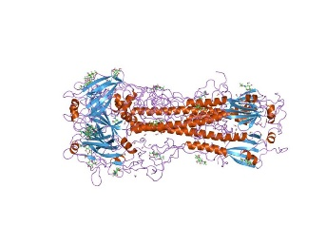
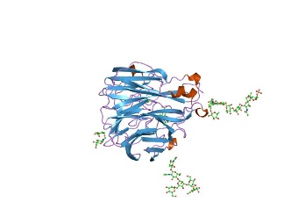

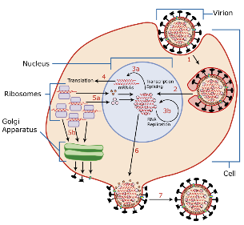
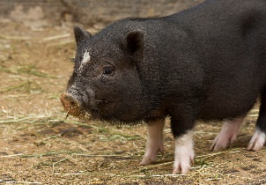
Influenza Background
Influenza A
Hemagglutinin
Neuraminidase
H5N1
H7N7
Influenza B
Example: H1
Example: N1
H1N1
2009 H1N1
For this project, will analyze the effects of the different strains on clinical visits by state.

Slide 3
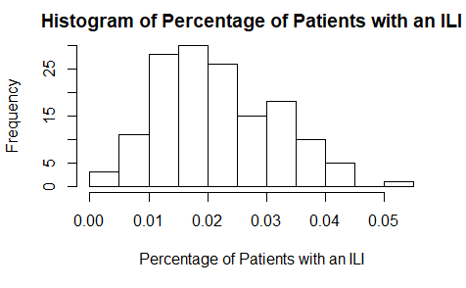

Data and EDA
CDC Data on Influenza Like Illnesses (ILI) and total patients
Contains on information of several common strains of influenza
Divided by week, year, or season- changed data to be only by season
For this presentation, only look at public health labs past 2015-16 season

Slide 4
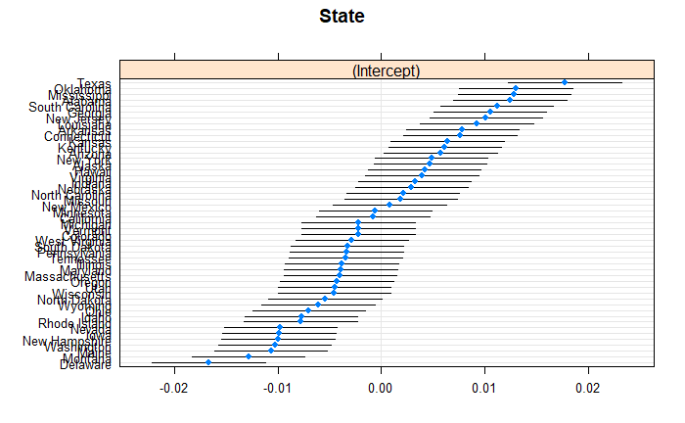
Model And Results

Slide 5
Conclusions
Influenza B Yamagata Strain has an increasing effect on ILI clinical presentation
Influenza A H3 has a negative effect on ILI clinical presentation
Southeastern states tend to have higher percentage of ILI visits

Slide 6
Future Research and Confounding Variables
Constant Evolutionary, Technological, and Adaptive Immune System Warfare
Investigate Vaccination’s Effect on this Data
More Strains and Other Countries

Slide 7
Thank you!

Slide 8

https://en.wikipedia.org/wiki/Duck
https://en.wikipedia.org/wiki/Hemagglutinin
https://en.wikipedia.org/wiki/Viral_neuraminidase
https://www.cdc.gov/flu/index.htm
https://en.wikipedia.org/wiki/Influenza
https://gis.cdc.gov/grasp/fluview/fluportaldashboard.html

