Slide 1
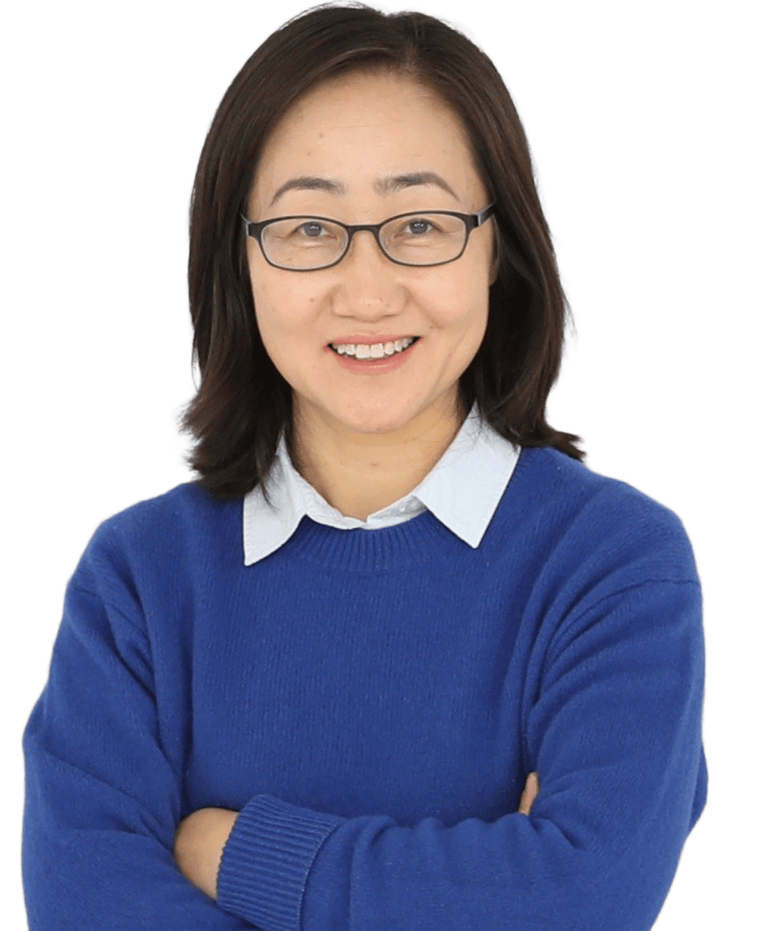



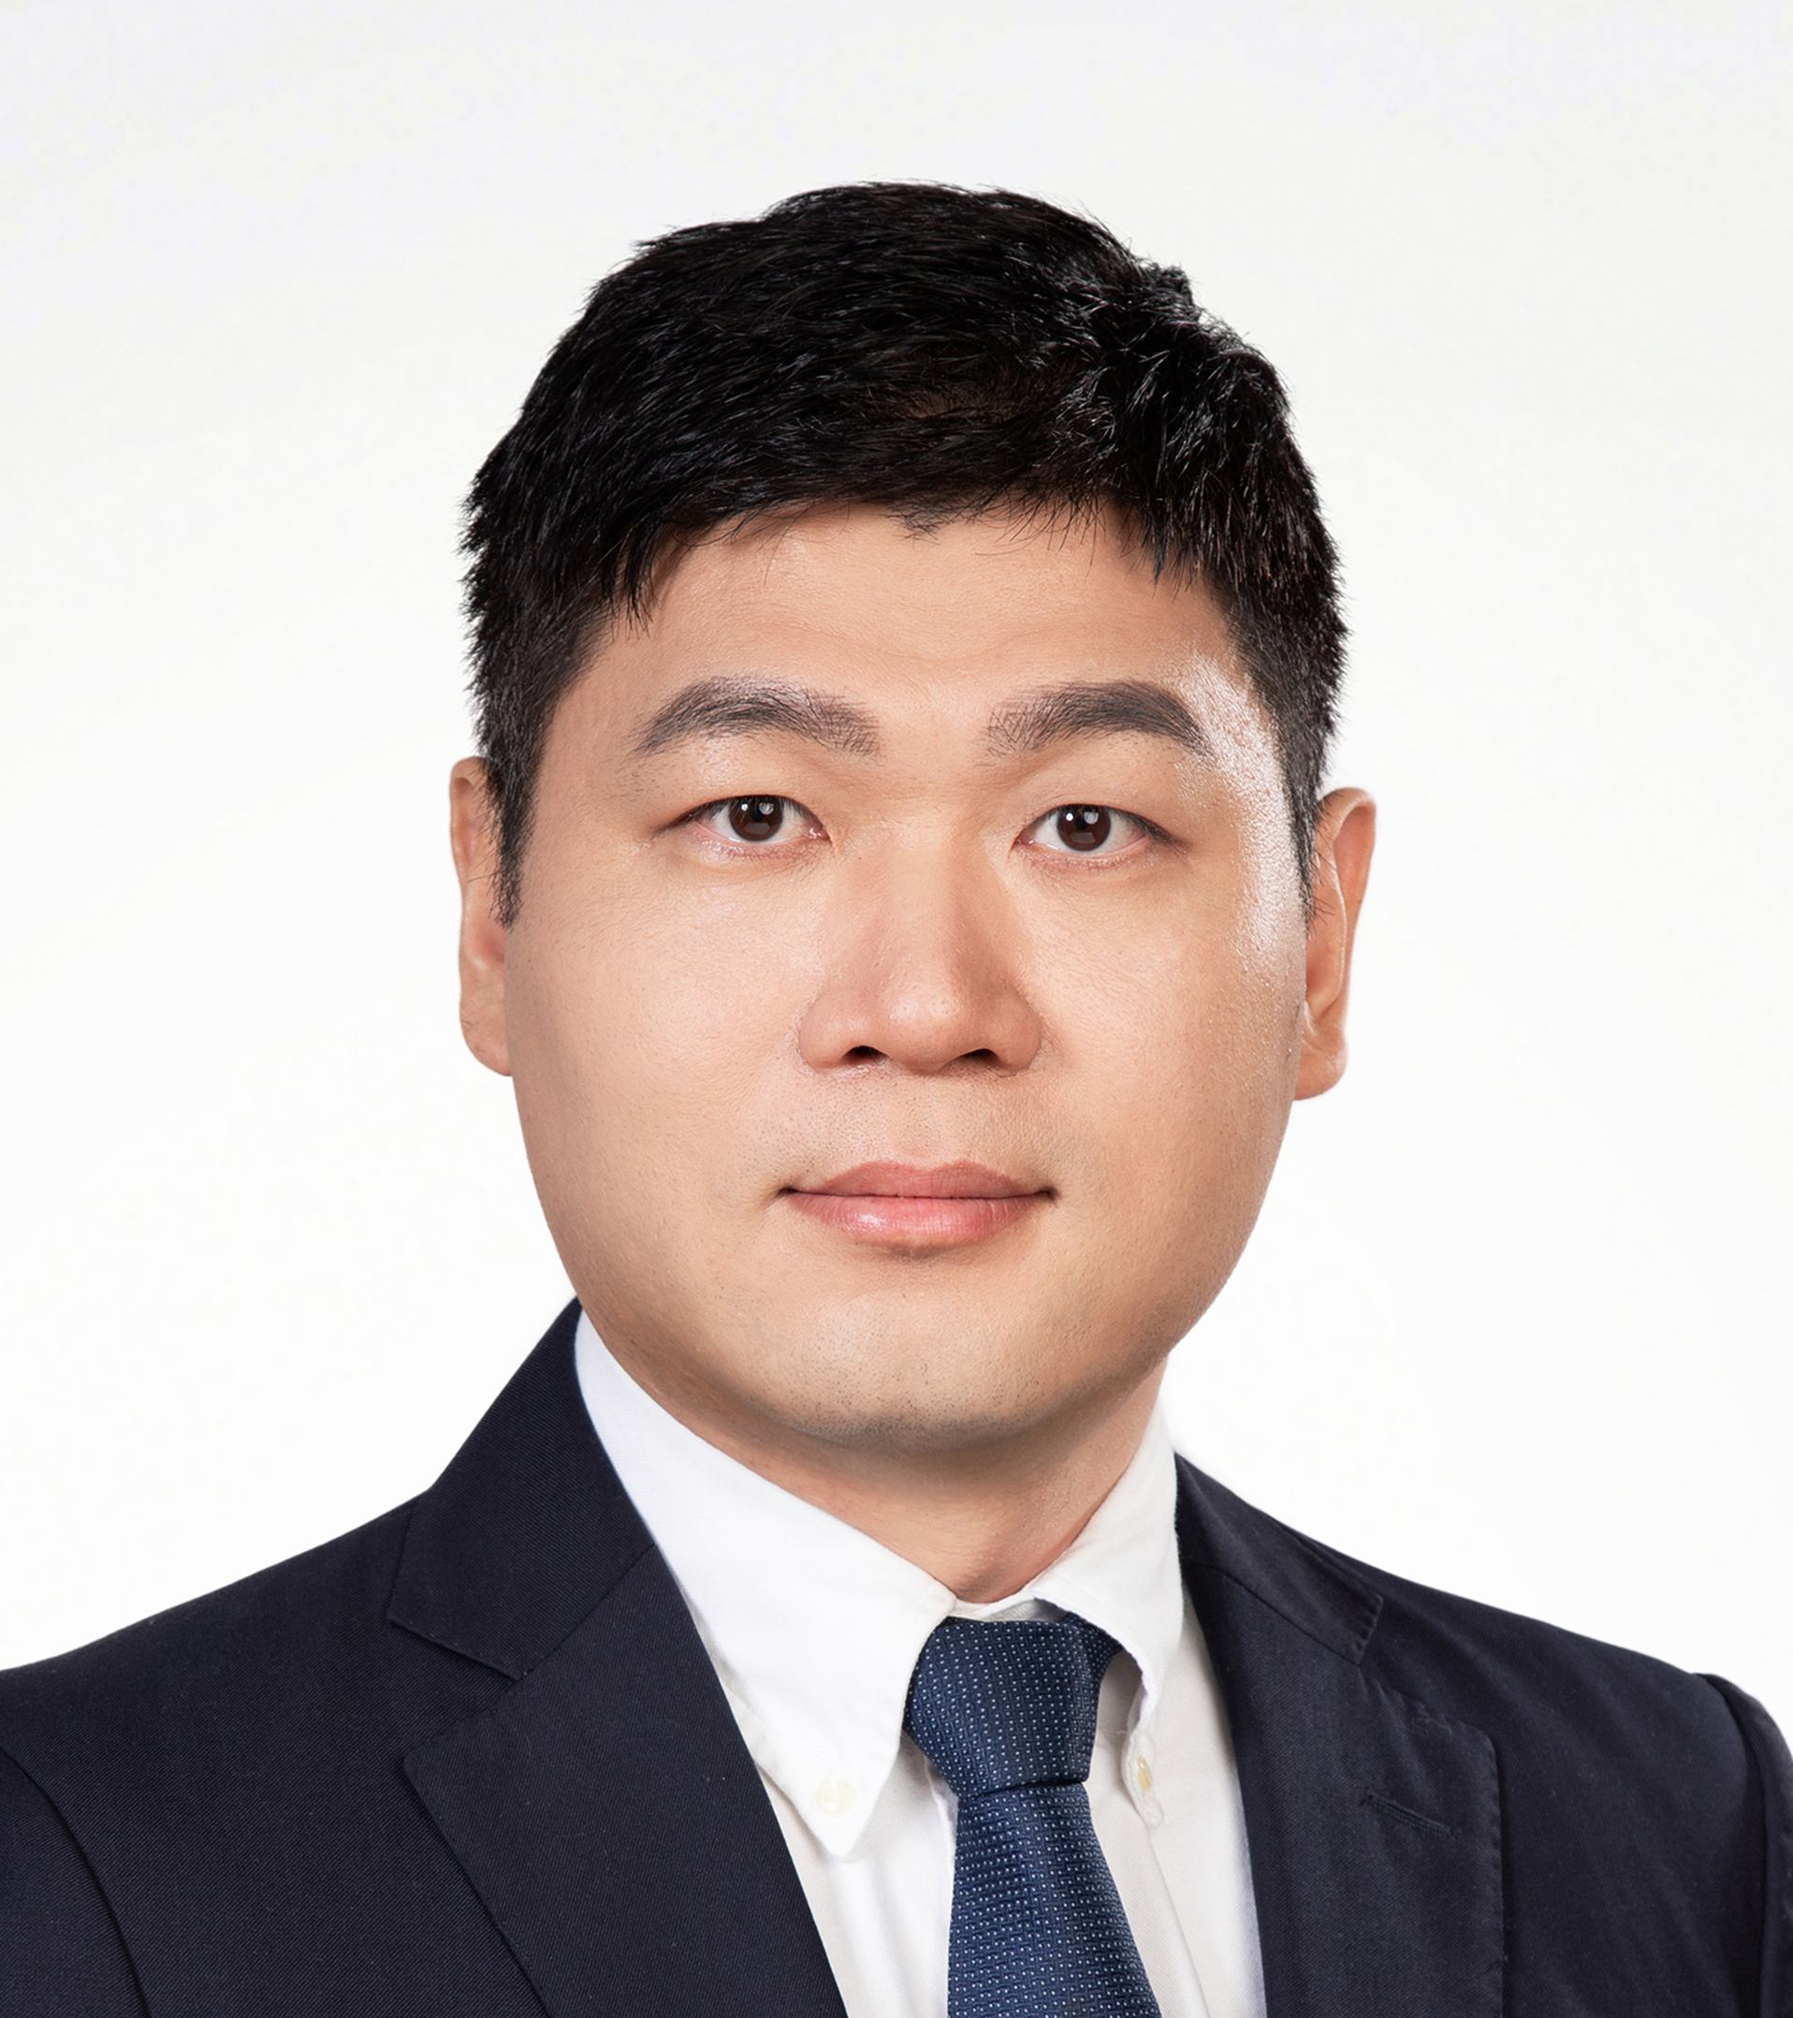
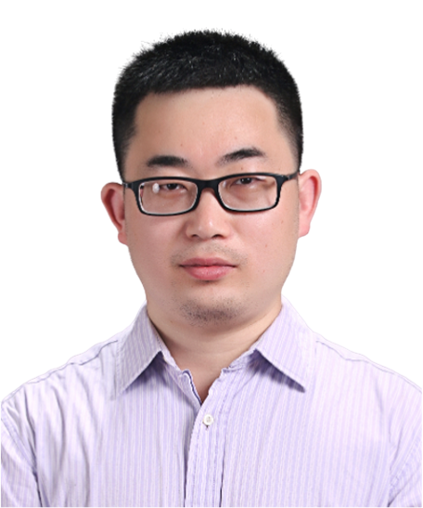
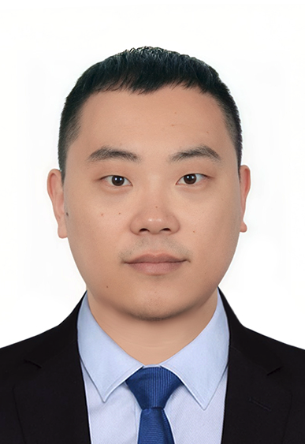
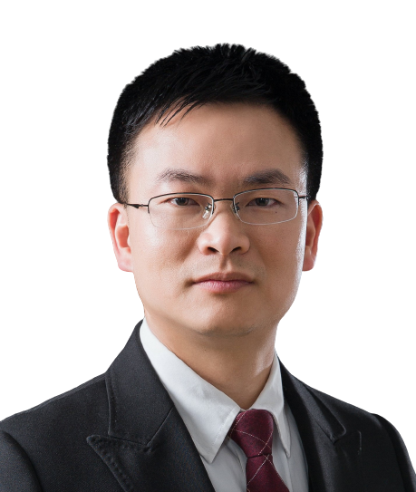
骨骼肌干细胞中G四联体结构的功能解析
北京时间: 2026-5-15 15:00
腾讯会议ID: 806-215-157
腾讯会议链接: https://meeting.tencent.com/dm/OwFnL4g17hPB
B站：https://live.bilibili.com/26427894
王华婷 教授
香港中文大学李嘉诚健康科学学院教授
香港中文大学骨科及创伤外科系教授
摘要：
G-四链体（G4s）是由富含鸟嘌呤的DNA或RNA形成的非经典二级结构，通过Hoogsteen氢键维持稳定。我们团队重点研究RNA G4s（rG4s）和DNA G4s（dG4s）如何在成年肌肉干细胞（MuSCs，即卫星细胞）中发挥内在调控作用。MuSCs对肌肉稳态与再生至关重要：平时保持静息状态，损伤后迅速激活、增殖为成肌细胞，进而分化修复肌肉，或通过自我更新补充干细胞池。该过程受到严格的调控，一旦失调会导致肌肉疾病及年龄相关的肌肉衰退。我将介绍我们近期关于rG4s和dG4s在再生与衰老过程中调控MuSC活性的研究。
主持人＆嘉宾
主持人：苗智超
广州实验室
广州医科大学
王金凯
中山大学
于福龙
广州实验室
黄林
中山大学
赞助商

Slide 2
Functional elucidation of
G-quadruplexes in skeletal muscle stem cells
Time (China): 2026-5-15 15:00
Tencent meeting: 806-215-157
Tencent meeting link: https://meeting.tencent.com/dm/OwFnL4g17hPB
Bilibili：https://live.bilibili.com/26427894
Huating Wang (Professor) Professor at Li Ka Shing Institute of Health Sciences, The Chinese University of Hong Kong
Professor at Department of Orthopaedics and Traumatology, The Chinese University of Hong Kong
Abstract:
G-quadruplexes (G4s) are non-canonical secondary structures formed in guanine-rich DNA or RNA, stabilized by Hoogsteen hydrogen bonding. Our group studies how both RNA G4s (rG4s) and DNA G4s (dG4s) intrinsically regulate adult muscle stem cells (MuSCs, satellite cells). MuSCs are essential for muscle homeostasis and regeneration: they normally remain quiescent, but upon injury activate, proliferate as myoblasts, and either differentiate to repair muscle or self-renew to maintain the stem cell pool. This process is tightly controlled, and its dysregulation contributes to muscle diseases and age-related muscle decline. I will discuss our recent work on the roles of rG4s and dG4s in modulating MuSC activity during regeneration and aging.
HOST＆PANELISTS
Host: Zhichao Miao
Guangzhou Laboratory
Guangzhou Medical University
Jinkai Wang
Sun Yat-sen University
Fulong Yu
Guangzhou Laboratory
Lin Huang
Sun Yat-sen University
Sponsors

