Slide 1
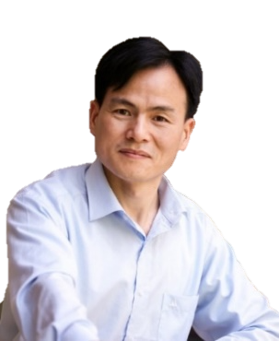



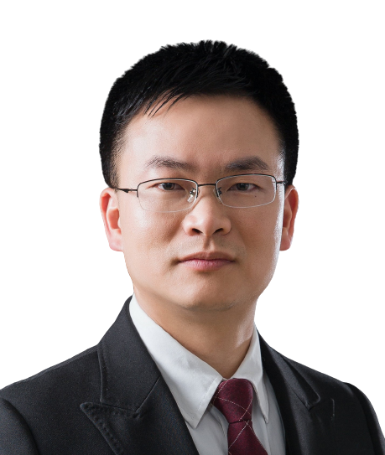
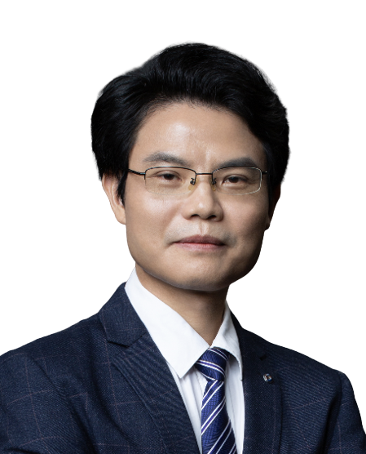
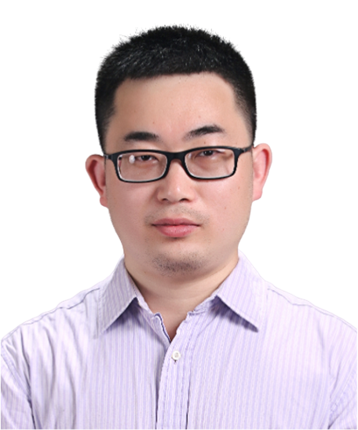
基于人工智能的冷冻电镜RNA三维结构建模
报告时间: 2024-5-17 14:00
地址: B2栋, 201会议室, 广州实验室
腾讯会议：399-6661-4494 Bilibili：https://live.bilibili.com/26427894
黄胜友
华中科技大学教授
汇报人简介:
华中科技大学物理学院教授、博导，1998年获武汉大学物理学学士学位，2003年获武汉大学理学博士学位。长期从事蛋白质/核酸相互作用计算及其复合物结构预测研究，共发表论文120余篇，其中近5年以通讯作者在Nature Biotechnology、Nature Machine Intelligence、Nature Protocols、Nature Communications等杂志发表论文40余篇。发展的HDOCK等蛋白质/核酸分子对接算法在国际蛋白质相互作用预测CAPRI竞赛中多次排名第一，已为全球 120 余个国家用户完成超过100万个结构预测任务。曾入选国家高层次青年人才计划，获全国百篇优秀博士学位论文。现任中国生物学信息学学会(筹)“生物分子结构预测与模拟专业委员会”秘书长。
实验室网页：http://huanglab.phys.hust.edu.cn/
摘要:
RNA作为遗传信息的载体，在蛋白质合成、基因调控、免疫调节等许多生命活动中发挥重要作用，“结构决定功能”，因此，确定RNA的三维结构对于理解其功能及相关药物开发至关重要。然而，与蛋白质相比，RNA结构更加复杂，柔性更大，导致冷冻电镜密度图中RNA区域的分辨率通常比蛋白质要低得多，因此，冷冻电镜的RNA结构建模一直是冷冻电镜结构解析领域的一个难题。在本报告中，我将介绍一种基于人工智能的冷冻电镜RNA三维结构建模方法，通过深度学习从冷冻电镜实验密度图中挖掘RNA主链原子，有机整合RNA的一维序列、二维二级结构以及三维主链信息，构建RNA的全原子三维结构。该方法有效解决了RNA冷冻电镜密度图的低分辨率难题，大大提高了RNA建模精度，结果显著优于其它基于冷冻电镜密度图的RNA结构建模算法，实现了冷冻电镜密度图的自动、快速、准确RNA结构建模。
主持人&特邀嘉宾
主持人：苗智超
广州国家实验室
广州医科大学
黄林
中山大学孙逸仙医院
杨建华
中山大学
王金凯
中山大学

Slide 2

3D structure modeling of RNA by cryo-electron microscopy based on artificial intelligence
Time (China): 2024-5-17 14:00
Address: Building B2, 201 room, Guangzhou Laboratory
Tencent Meeting: 399-6661-4494 Bilibili：https://live.bilibili.com/26427894
Prof. Shengyou Huang
Huazhong University of Science and Technology
Abstract:
RNA, as a carrier of genetic information, plays an important role in protein synthesis, gene regulation, immune regulation and many other life activities. "Structure determines function", therefore, determining the three-dimensional structure of RNA is crucial for understanding its function and related drug development. However, RNA structure is more complex and more flexible than protein, resulting in the resolution of RNA region in cryo-electron microscope density map is usually much lower than that of protein. Therefore, RNA structure modeling in cryo-electron microscope has been a difficult problem in the field of cryo-electron microscope structure analysis. In this report, I will introduce an AI-based 3D structure modeling method for RNA cryo-electron microscopy. Through deep learning, RNA main strand atoms are mined from the experimental density map of cryo-electron microscopy, and the one-dimensional sequence, two-dimensional secondary structure and three-dimensional main strand information of RNA are organically integrated to construct the all-atomic 3D structure of RNA. This method effectively solves the problem of low resolution of RNA cryo-electron microscope density map, greatly improves the accuracy of RNA modeling, and the results are significantly superior to other RNA structure modeling algorithms based on cryo-electron microscope density map, realizing automatic, rapid and accurate RNA structure modeling of cryo-electron microscope density map.
HOST＆PANELISTS
Host：Zhichao Miao
Guangzhou Laboratory
Guangzhou Medical University
Lin Huang
Sun Yat-sen University
Jianhua Yang
Sun Yat-sen University
Jinkai Wang
Sun Yat-sen University

