Slide 1
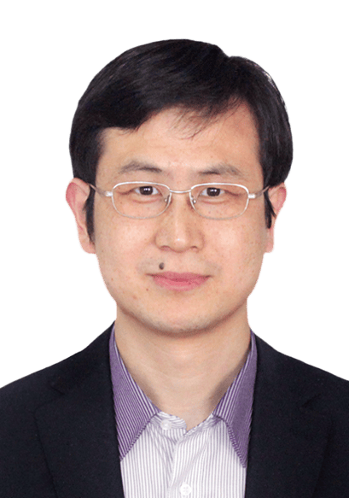


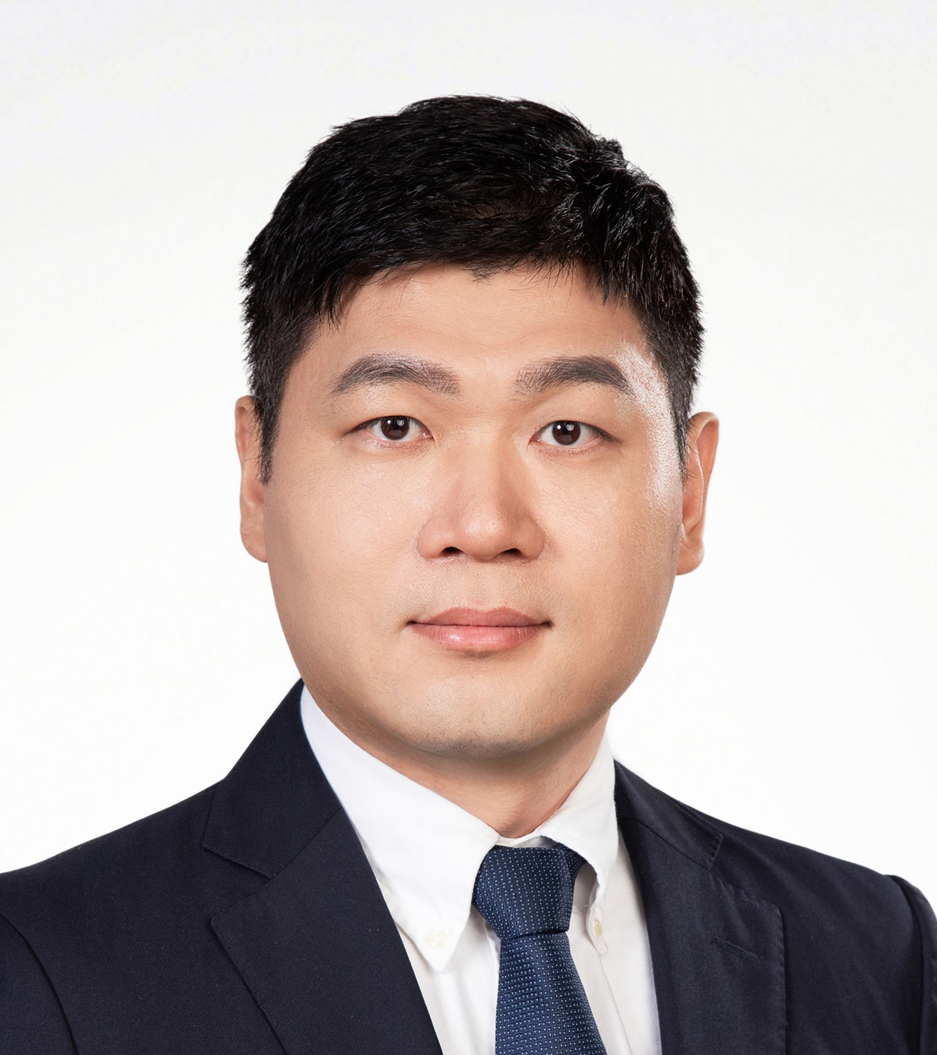
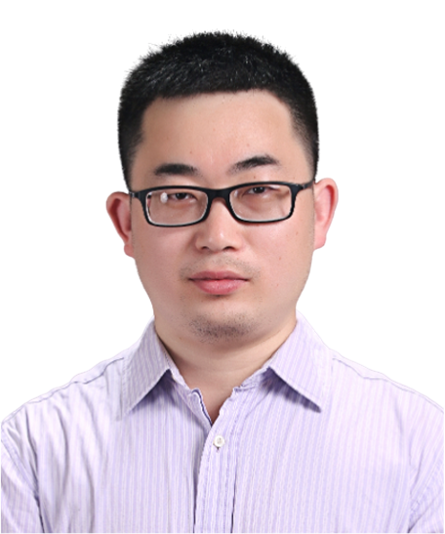
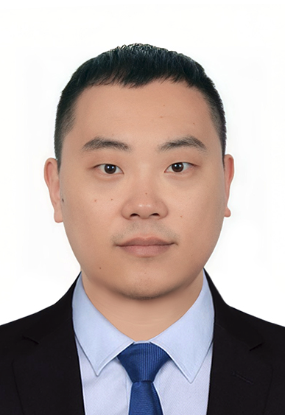
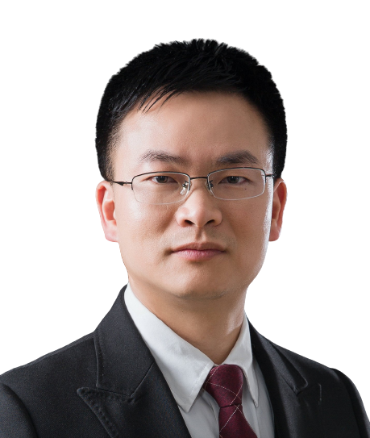
Intelligent decoding of spatial biology
Time (China): 2025-8-1 15:00
Tencent meeting: 638-172-196
Tencent meeting link: https://meeting.tencent.com/dm/tNuxLGkp8EAO
Bilibili：https://live.bilibili.com/26427894
Shihua Zhang (Professor) Academy of Mathematics and Systems Science, Chinese Academy of Sciences
Section Editor of PLOS Computational Biology
Editorial Board Member of Genomics, Proteomics & Bioinformatics
Abstract:
Technological advances in spatial transcriptomics are critical for better understanding the structures and functions of tissues in biological research. The combination of intelligent or statistical algorithms and spatial transcriptomics has emerged to pave the way for deciphering tissue architecture. We have made great efforts to advance intelligent spatial transcriptomics and developed a group of STA-tools such as STAGATE, STAligner, STAMarker, STAGE, STASCAN, STALocaor, and STAMapper. In this talk, I will take these tools as examples to introduce how to utilize deep learning to model spatial transcriptomics data effectively. Moreover, I will shed light on some recent progress in spatial multi-omics integration with STAMO, directionally or temporally variable gene detection with STAVAG, and high-fidelity simulation and full-view 3D modeling of spatial transcriptomics with STADiffuser.
HOST＆PANELISTS
Host: Zhichao Miao
Guangzhou Laboratory
Guangzhou Medical University
Jinkai Wang
Sun Yat-sen University
Fulong Yu
Guangzhou Laboratory
Lin Huang
Sun Yat-sen University
Sponsors

Slide 2
空间生物学的智能解码
北京时间: 2025-8-1 15:00
腾讯会议ID: 638-172-196
腾讯会议链接: https://meeting.tencent.com/dm/tNuxLGkp8EAO
B站：https://live.bilibili.com/26427894
张世华 教授
中国科学院数学与系统科学研究院
PLOS Computational Biology 栏目主编
GPB Genomics, Proteomics & Bioinformatics编委
摘要：
空间转录组学的技术进步对于更好地理解生物研究中组织的结构和功能至关重要。智能或统计算法与空间转录组学的结合已经出现，为破译组织结构铺平了道路。本团队在智能空间转录组学研究方面做出了巨大的努力，开发了STAGATE、STAligner、STAMarker、STAGE、STASCAN、STALocaor、STAMapper等一系列空间转录组学工具。在这次演讲中，我将以这些工具为例，介绍如何利用深度学习来有效地建模空间转录组学数据。此外，我还将介绍利用STAMO进行空间多组学整合、利用STAVAG进行定向或时变基因检测以及利用STADiffuser进行空间转录组学的高保真模拟和全视图3D建模等方面的最新进展。
主持人＆嘉宾
主持人：苗智超
广州实验室
广州医科大学
王金凯
中山大学
于福龙
广州实验室
黄林
中山大学
赞助商

