Slide 1
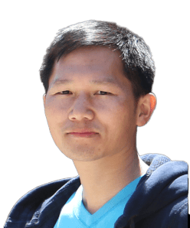


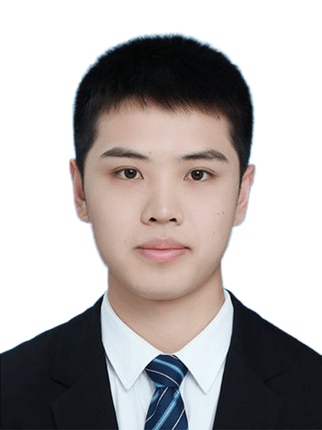
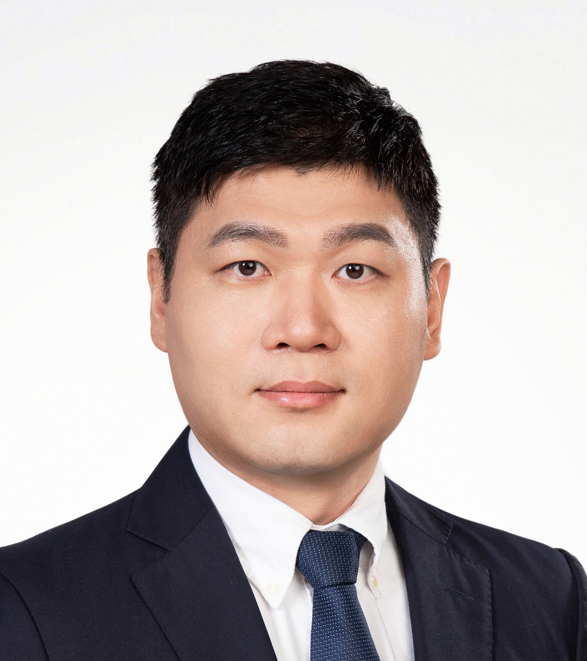
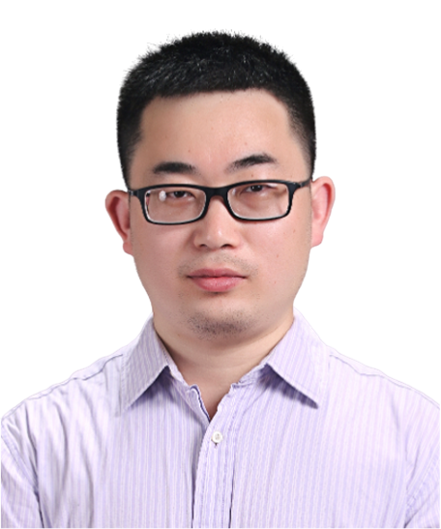
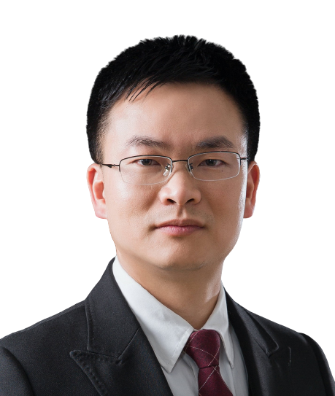
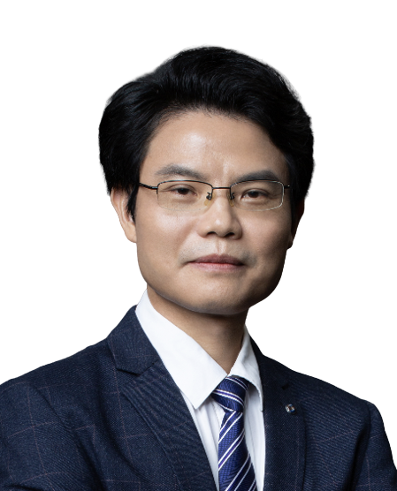
AI empowers RNA structure prediction
Beijing Time: 2025-05-30 19:30
Tencent meeting: 870-187-080
Tencent meeting link: https://meeting.tencent.com/dm/cyzDbKXpOwJs
Bilibili：https://live.bilibili.com/26427894
Prof. Jianyi Yang
Recipient of the National Natural Science Foundation of China's Distinguished Young Scientist Fund
Research Center for Mathematics and Interdisciplinary Sciences, Shandong University
Dr. Wenkai Wang
Outstanding Postdoctoral Fellow at Shandong University
Research Center for Mathematics and Interdisciplinary Sciences, Shandong University
Abstract:
Compared to protein structures, RNA structures exhibit greater complexity and flexibility, making their experimental determination and theoretical prediction significantly more challenging than those of proteins. Inspired by advances in protein structure prediction, our research group has developed AI-based methods for RNA structure prediction, namely trRosettaRNA and its improved version trRosettaRNA2. In this report, we will present the recent progress in this area.
HOST＆PANELISTS
Host: Zhichao Miao
Guangzhou Laboratory
Guangzhou Medical University
Jinkai Wang
Sun Yat-sen University
Lin Huang
Sun Yat-sen University
Jianhua Yang
Sun Yat-sen University
Sponsors

Slide 2
AI赋能RNA结构预测
北京时间: 2025-05-30 19:30
腾讯会议号: 870-187-080
腾讯会议链接:
https://meeting.tencent.com/dm/cyzDbKXpOwJs
B站：https://live.bilibili.com/26427894
杨建益 教授
国家“杰出青年科学基金”获得者
主持国家杰青、重点等项目，享受国务院政府特殊津贴
山东大学，数学与交叉科学研究中心
王文恺 研究员
山东大学卓优博士后
入选国家“博新计划”，曾获南开十杰等荣誉
山东大学，数学与交叉科学研究中心
摘要：
与蛋白质类似，为了执行转录、翻译等生物学功能，tRNA、rRNA等大量非编码RNA往往折叠成空间三维结构。然而，与蛋白结构相比，RNA结构更复杂、柔性更大，导致RNA结构的实验解析和理论预测均比蛋白难。受蛋白质结构预测的启发，课题组开发了基于AI的RNA结构预测方法trRosettaRNA及trRosettaRNA2。本报告中，我们将介绍相关进展。
主持人＆嘉宾
主持人：苗智超
广州实验室
广州医科大学
王金凯
中山大学
黄林
中山大学
杨建华
中山大学
赞助商

