Slide 1

WIPRO NGA Program – LSP Batch
Capstone Project Presentation – 26 Aug 2024
Project Title Here – Inventory Management System
Presented by – CPPE Group - 2
Ramisetti Naga Bhavani Prasad
Mansi Dilip Bhoi
pappu Satya Swaroopa
praveen kumar D
Mayank Bisht
www.rpsconsulting.in

Slide 2

Agenda
Introduction
Login
Home page
CRUD operations on inventory
Low inventory Alarm System
Technology Stack
Conclusion
Q&A
2024 - RPS Consulting all rights reserved

Slide 3
Introduction
An Inventory Management System (IMS) is a software solution designed to oversee and control the inventory of a business. It tracks product quantities, manages stock levels, and facilitates the smooth operation of inventory-related tasks.
2024 - RPS Consulting all rights reserved

Slide 4

Login
Secure Access Management: Ensure that only authorized admin users can access the Inventory Management System (IMS) by securely managing authentication. And also we used Authgaurds to avoid access for unauthorized users via browser's link
2024 - RPS Consulting all rights reserved

Slide 5
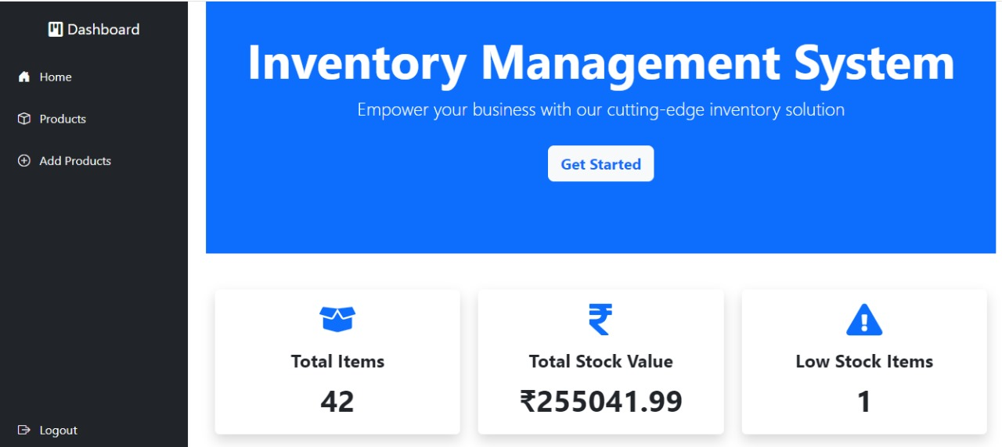
Home Page
The home page of our Inventory Management System serves as a comprehensive dashboard that provides key insights into the current status of the inventory. It is designed to give users a quick overview of important metrics and highlight areas that need attention
2024 - RPS Consulting all rights reserved

Slide 6
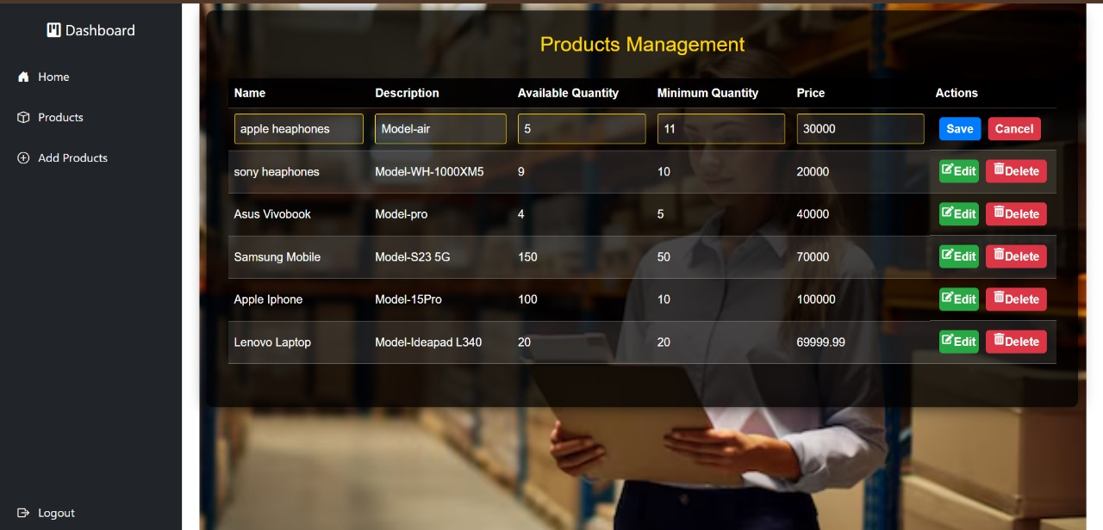
CRUD operation on Inventory
Enable administrators to manage inventory items effectively by providing a comprehensive set of CRUD (Create, Read, Update, Delete) operations.
2024 - RPS Consulting all rights reserved

Slide 7
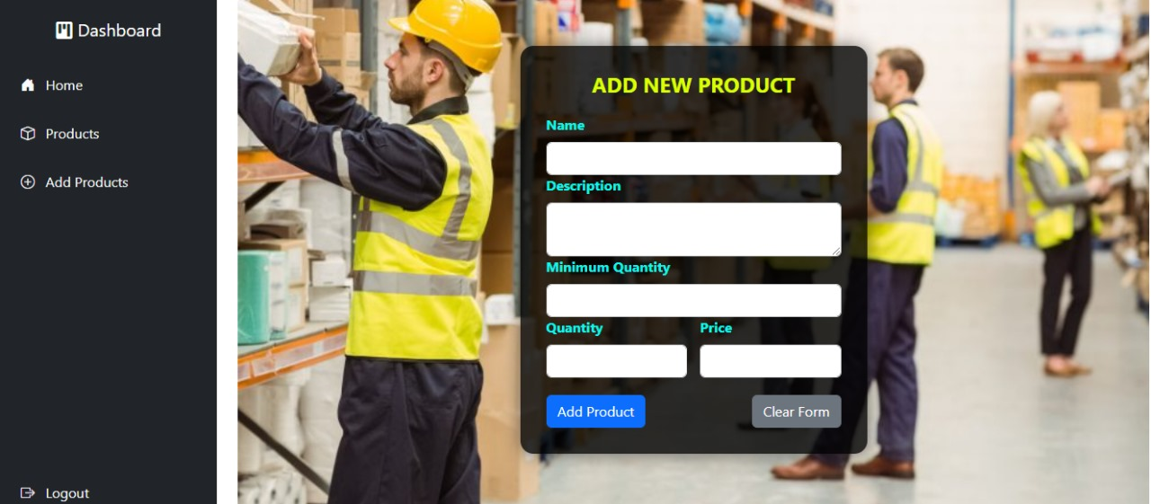
Add Product Page
Here, we are adding products using CRUD operations at the backend," we are referring to the backend functionality that supports the addition of new products to the inventory.
2024 - RPS Consulting all rights reserved

Slide 8
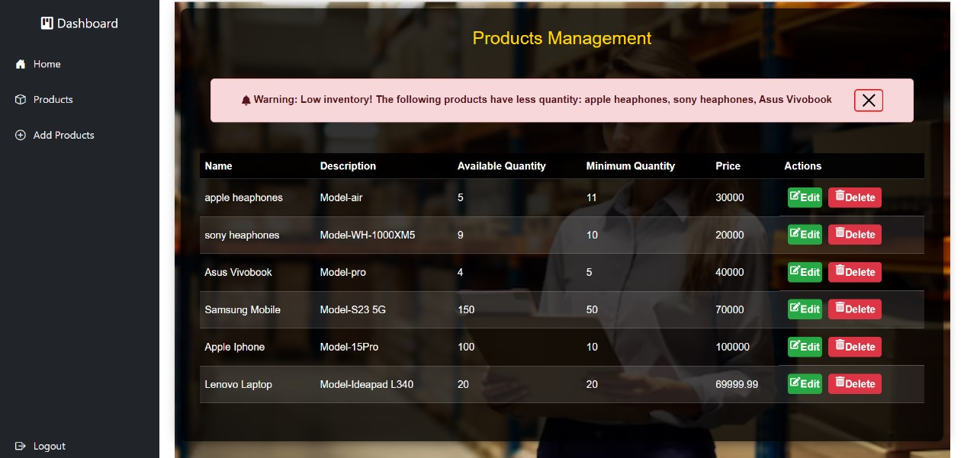
Low inventory Alert System
Monitor and Alert: Automatically track inventory levels and alert administrators when stock falls below predefined thresholds to ensure timely replenishment. Compare current stock levels against set minimum thresholds to detect potential shortages.
2024 - RPS Consulting all rights reserved

Slide 9
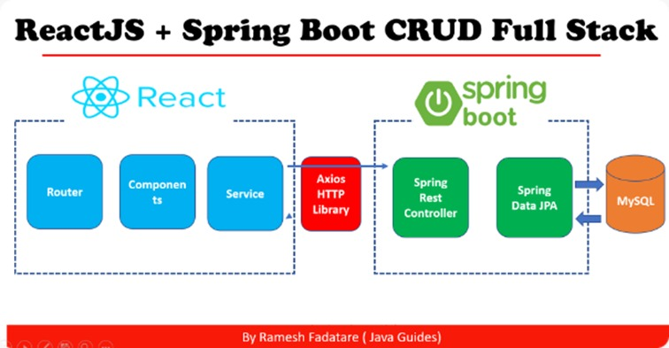
Technology Stack
2024 - RPS Consulting all rights reserved

Slide 10
Tools Used
Visual Studio Code: Used for developing and managing the frontend.
Spring Tool Suite (STS): Primary tool for developing the backend Spring Boot application.
MySQL 8.0: Database system to manage user and appointment records.
Postman: Tool for API testing during development to ensure proper interaction between the frontend and backend.
2024 - RPS Consulting all rights reserved

Slide 11
Conclusion
This presentation outlined the key features and benefits of our new inventory management system. It secure access management ensures only authorized admin users can enter the system. Comprehensive management of inventory items through Create, Read, Update, and Delete functions. And proactively monitors inventory levels and triggers alerts for low stock. Moving forward, we will continue to enhance the system with new features and functionalities to further optimize your inventory management processes.
2024 - RPS Consulting all rights reserved

Slide 12
References
React reference : Quick Start – React
Spring Boot reference : https://docs.spring.io/spring-boot/index.html
Spring JPA reference : https://spring.io/projects/spring-data-jpa
MySQL reference: MySQL :: MySQL Documentation
2024 - RPS Consulting all rights reserved

Slide 13
Thank you !
2024 - RPS Consulting all rights reserved

