Slide 1
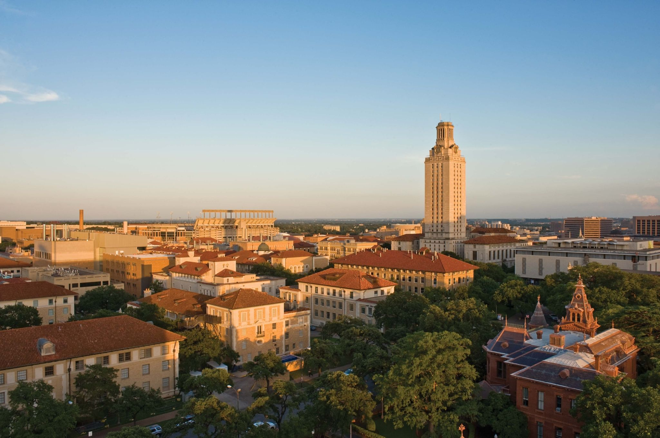

How Physical, BEHAVIORAL, & Geographic factors can affect Medical costs
Introduction to Machine Learning – Group Project
Bindu Raghu Naga
Mayank Gupta
Pratyush Sharma
Rathil Madihalli
Jordan Ehlinger
July 2023

Slide 2

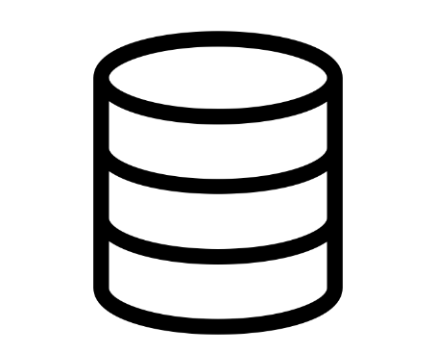

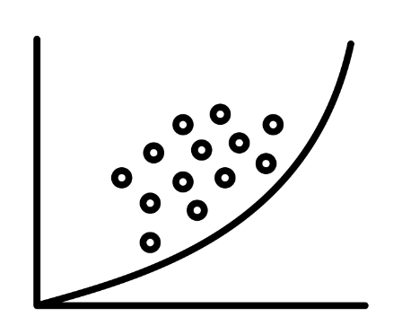
Outline
Background Dataset EDA Modeling

Slide 3
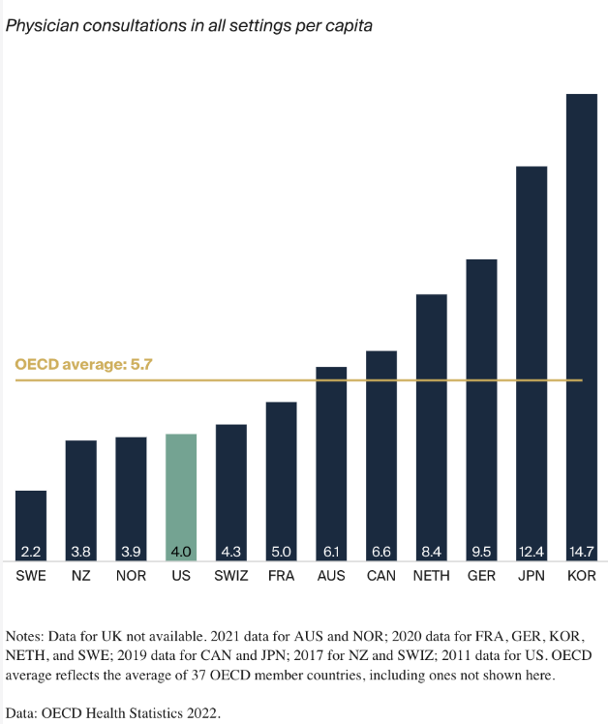
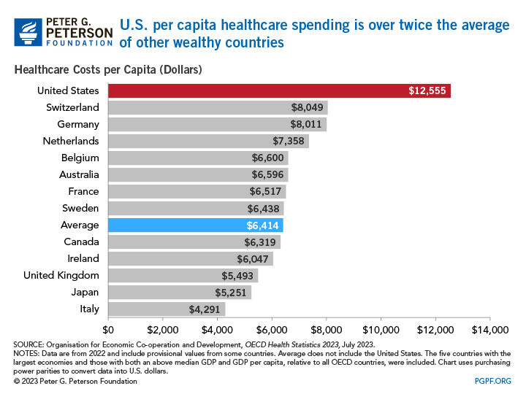
State of U.S. Health Care
Usage₃
U.S. Health Insurance Market Size: $1.6 Trillion₁
Cost₄

Slide 4





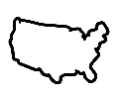
Objective
The main objective of this analysis is to explore the interconnections between various health-related factors and individual medical costs billed by health insurance. By understanding these relationships, we aim to build predictive models that can accurately estimate medical charges based on demographic and health variables.
Dataset
Dataset includes 1,338 examples of beneficiaries currently enrolled in the insurance plan, with features indicating characteristics of the patient as well as the total medical expenses charged to the plan for the calendar year
Age: Older individuals may have higher insurance charges due to increased health risks.
Gender: Gender can influence healthcare utilization and costs.
BMI: Higher BMI values are associated with higher health risks and potential higher medical costs.
Children: The number of dependents can impact insurance charges.
Smoker: Smoking is a significant risk factor that may lead to higher health insurance costs.
Region: Different regions may have varying healthcare costs and behaviors.
Methodology
We employ various models, including Linear Regressor, Gradient Boost, Decision Tree, and Random Forest. These models are trained and fine-tuned using cross-validation to achieve accurate predictions. By applying machine learning models, we can predict individual medical costs based on demographic and health factors with reasonable accuracy.
Significance
This analysis provides valuable insights into the complex relationships between health-related variables and medical charges. Understanding these interactions can inform insurance policy design and improve healthcare outcomes. The predictive models developed can assist in cost estimation and support decision-making in the healthcare industry.

Slide 5
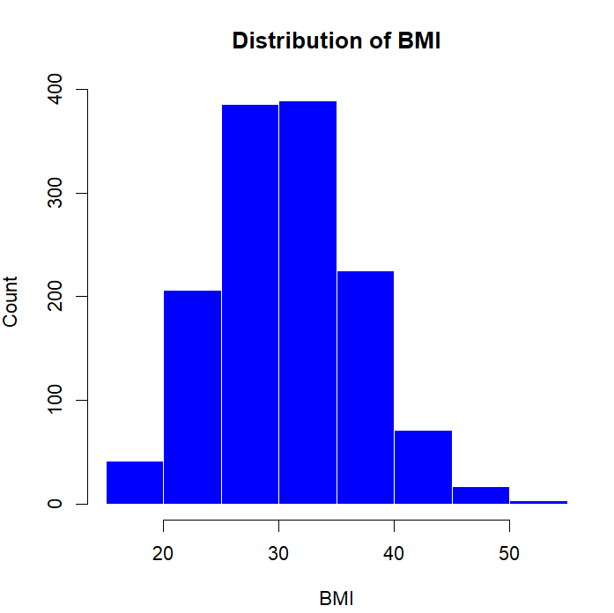
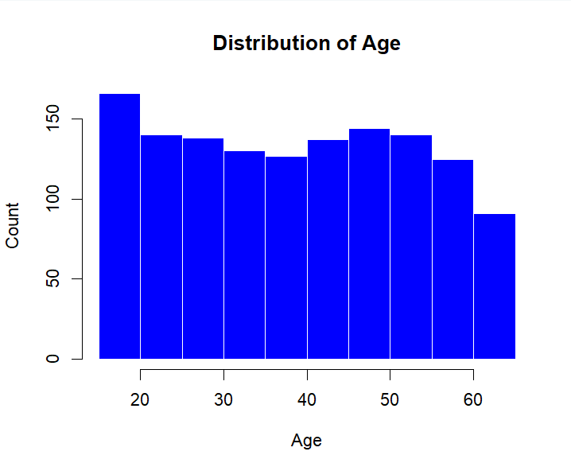
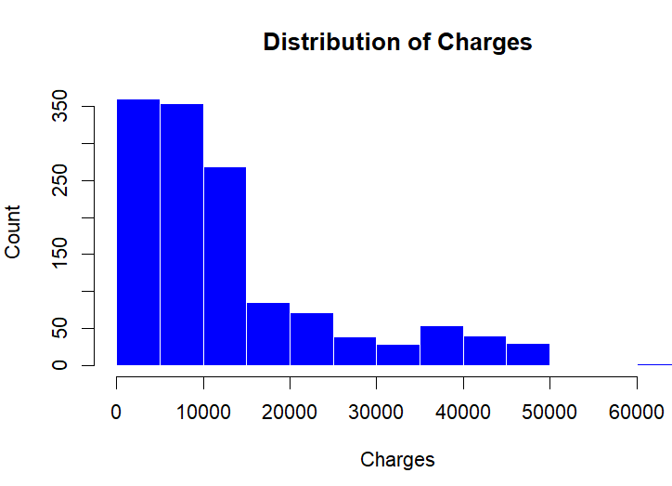
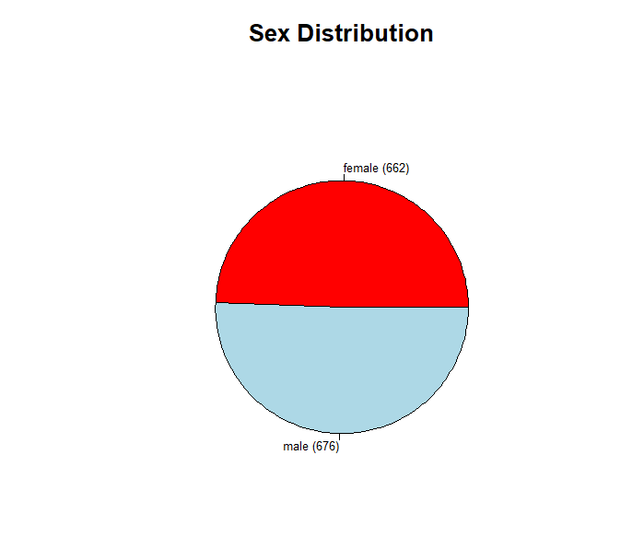
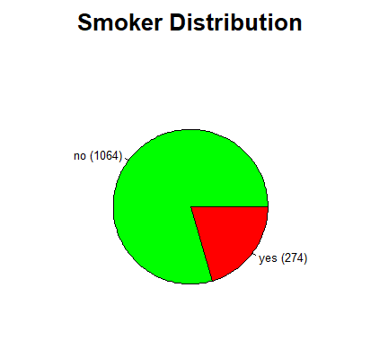
Feature Distributions
Target Variable

Slide 6
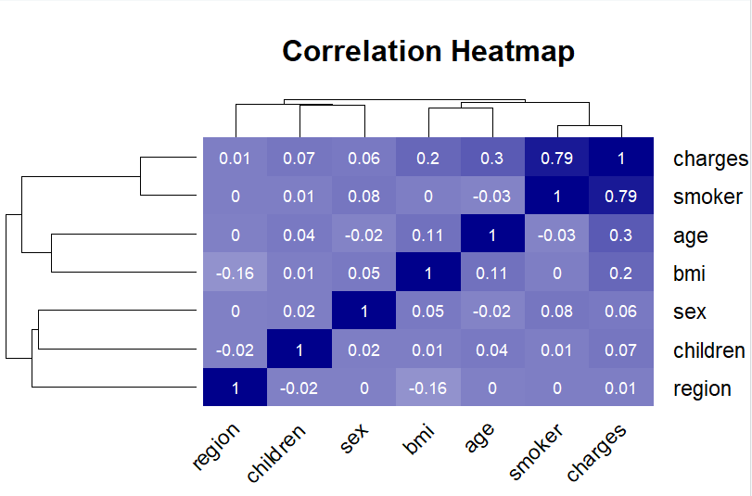
Observations
Smoking status shows the highest correlation(0.79) with insurance charges
Age and BMI also depict a significant positive correlation
Let’s look at the relation between (Smoking status, age, BMI) vs Insurance charges more closely……

Slide 7
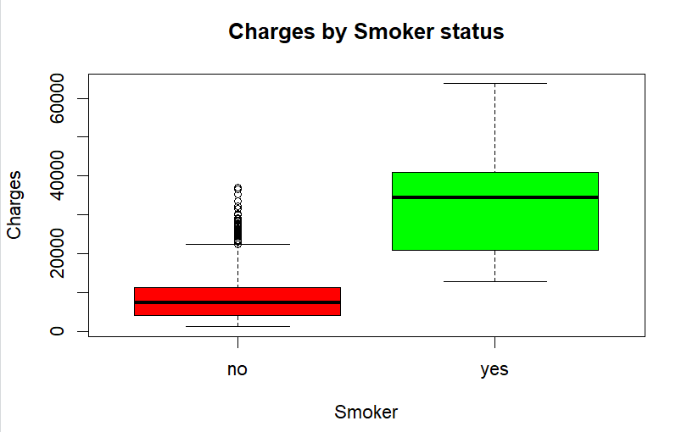
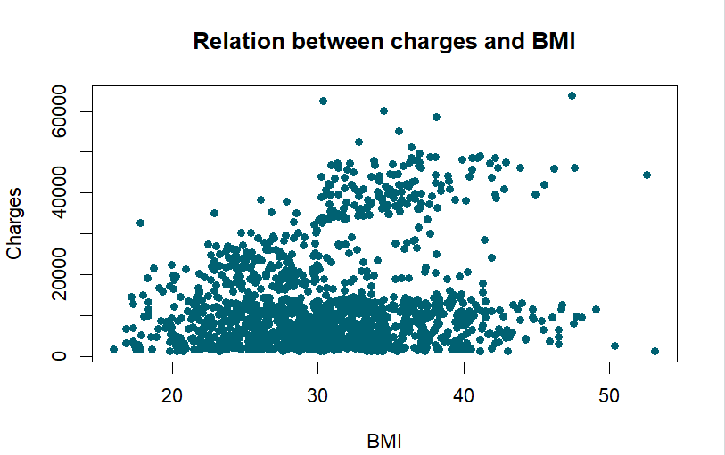
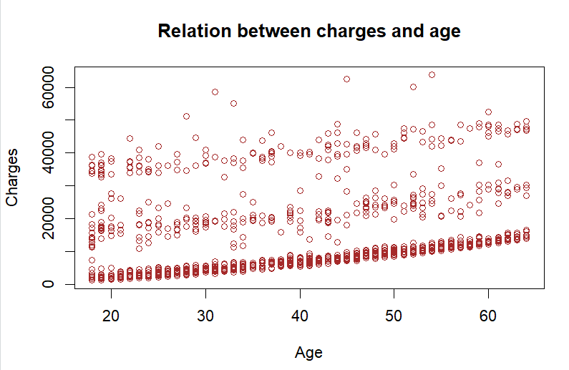
Observations
Smokers usually get charged more than double the premium on average than non-smokers
Charges increase with the age of a person
Charges increase dramatically for a person having BMI > 30

Slide 8
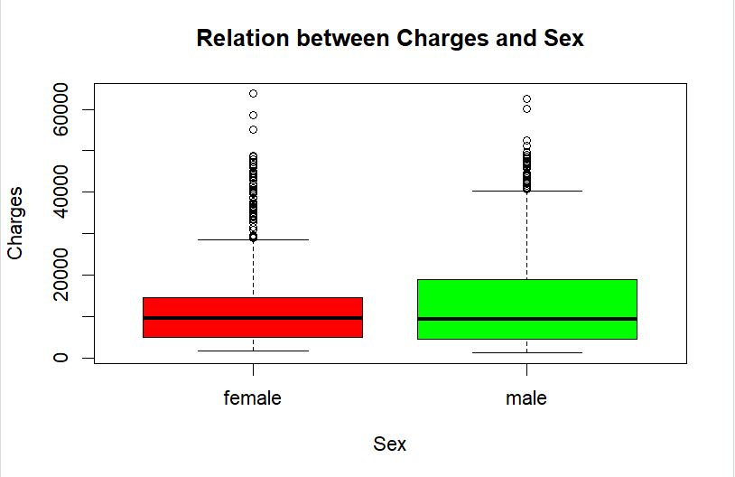
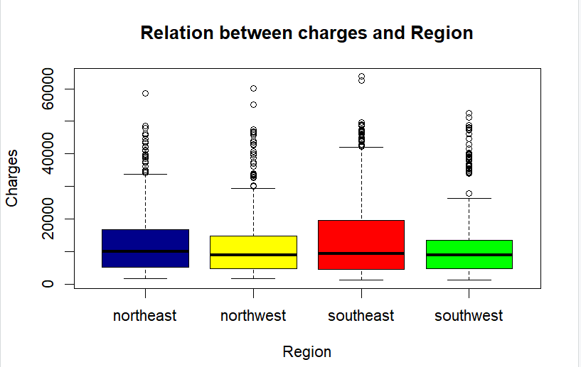
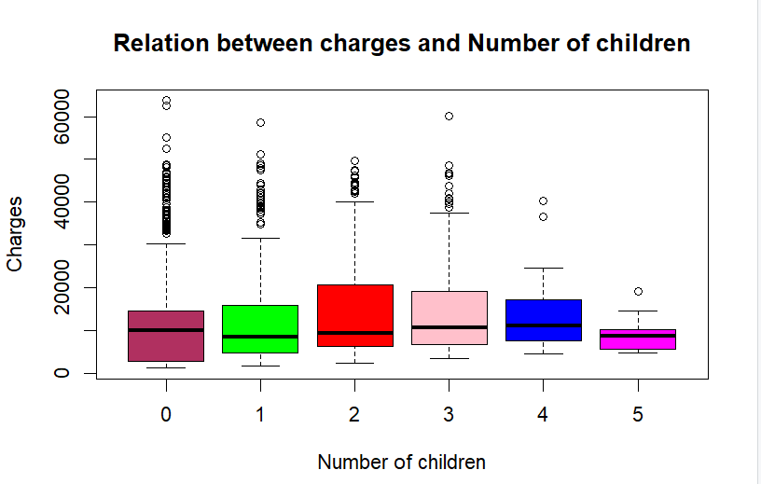
Observations
Males tend to pay a little higher charges than women
Interestingly, a person with 5 children pays the least charges
The Southeast appears to incur more charges than the other regions, followed by the Northeast

Slide 9
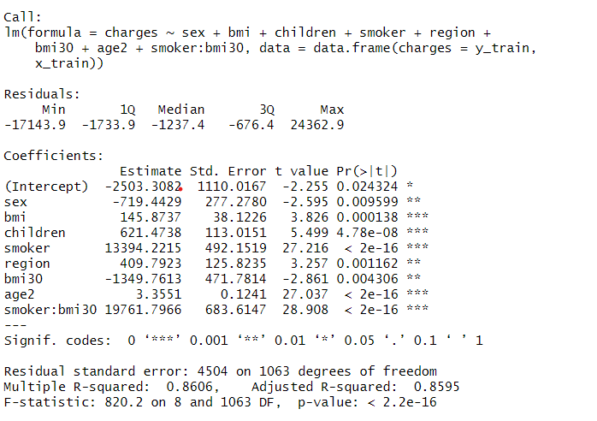
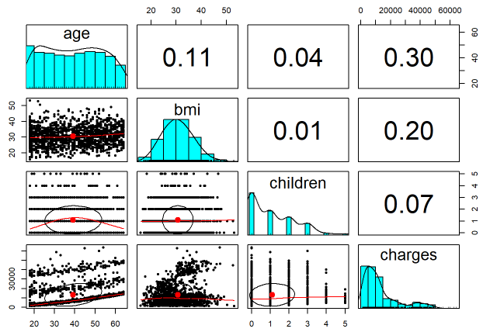
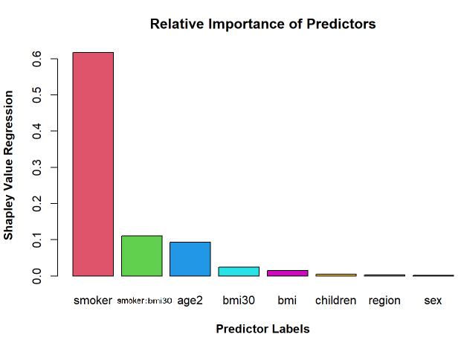
Linear Regression
Algorithm
Suspecting a non-linear relationship between ‘age’ and ‘charges’ a higher order term ‘age2’ = age² is added. Considering smoking and obesity may have detrimental effect an interaction term is added. Having a hunch that effect of ‘bmi’ is non-cumulative; added an additional binary term ‘bmi30’ encoding it via threshold >30. Independent variables considered: age, age², sex, bmi, children, bmi30 (0 and 1 for >30), region, bmi30:smoker.
In sample and out of sample split: 80:20 respectively
Stepwise regression - Backward Elimination process
Most significant variables: sex, bmi, children, smoker, region, age², bmi30 and smoker: bmi30
Adjusted R-squared:
RMSE: 4194.57
Results

Slide 10
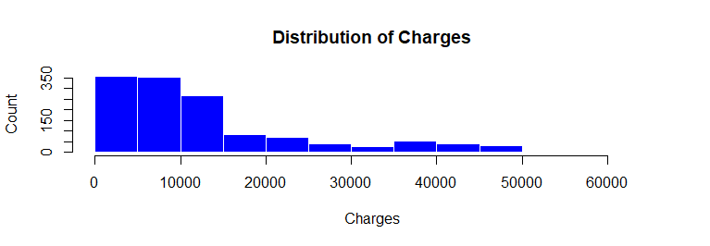
Log Transformation
Reasoning
Log transformation can lead to a lower Root Mean Squared Error (RMSE) in a Random Forest (RF) or any other machine learning model for several reasons, especially when dealing with data that exhibits heteroscedasticity (non-constant variance) or has a skewed distribution.

Slide 11
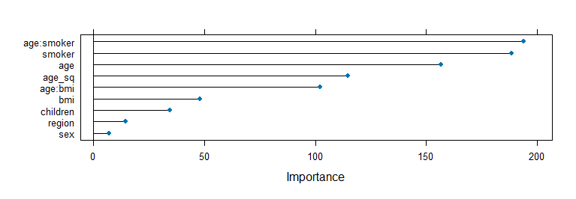
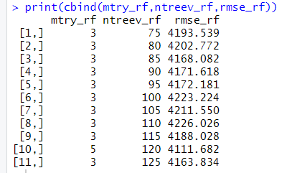
Random Forest
Algorithm
Random Forest is a powerful machine learning algorithm used for both classification and regression tasks. It belongs to the ensemble learning family, which means it combines multiple individual decision trees to create a more robust and accurate model.
Independent variables considered: Age , Age², BMI , BMI*Age, Children, Region, Sex, Smoker, Smoker*Age
Results
RMSE : 4111
Most Important Features:
Smoker*Age
Smoker
Age
Age²

Slide 12
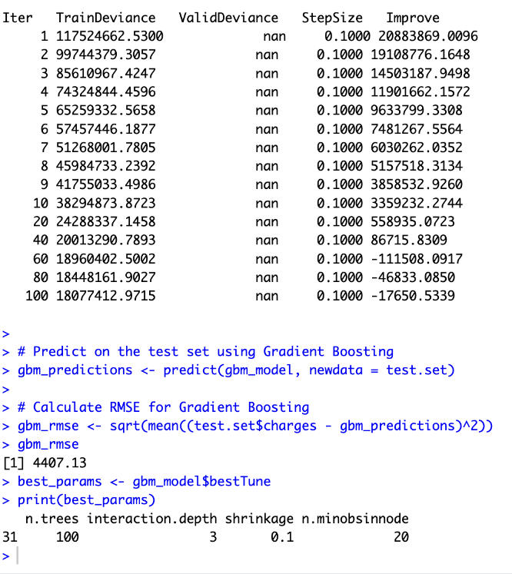
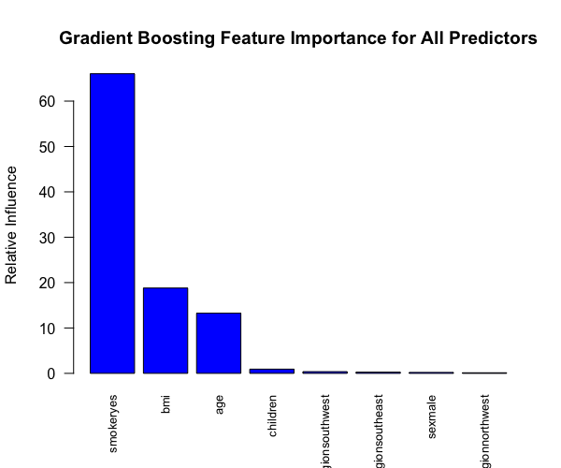
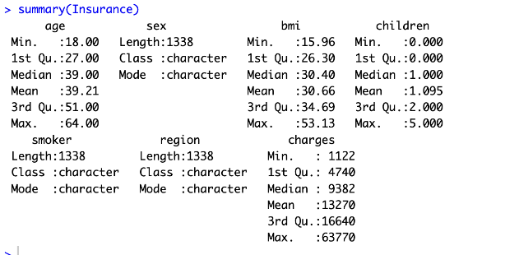
Gradient Boosting
Code
Algorithm
Gradient Boosting is an ensemble machine learning technique that combines weak learners (e.g., decision trees) to create a powerful predictive model. Each subsequent weak learner corrects the errors of the previous ones, leading to improved performance.
The 'train' function fits the Gradient Boosting model with hyperparameter tuning using the training set. The 7-fold cross-validation is used to evaluate model performance. Hyperparameter grid defines the combinations of hyperparameters to be tried. –n.trees: 100, 200, 300 –interaction.depth: 3, 5, 7 –shrinkage: 0.01, 0.1, 0.2 –n.minobsinnode: 10, 20, 30 Iterative Learning: During each iteration, the model is updated to minimize the deviance, representing the discrepancy between observed data and predictions. Convergence: The iterative process continues until convergence, resulting in the best-fit model.
Results
RMSE : 4407.13

Slide 13
Comparison of Models
Linear Regression
Random Forest
RMSE: 4111
Boosting
RMSE : 4407
Important Features: Smoker, BMI, Age, Children
RMSE: 4194
Important Features: Sex, BMI, Children, Smoker, Region, Age², BMI30, Smoker:BMI30
Important Features: Smoker*Age, Smoker, Age, Age²
Adjusted R-Squared: 0.8595
R-Squared: 0.8978
R-Squared: 0.8813
Base Model
RMSE: 12838
Features: Age, Sex, BMI, Children, Smoker, Region

Slide 14
Appendix
Models tested that did not improve fit
KNN
Boosting

Slide 15
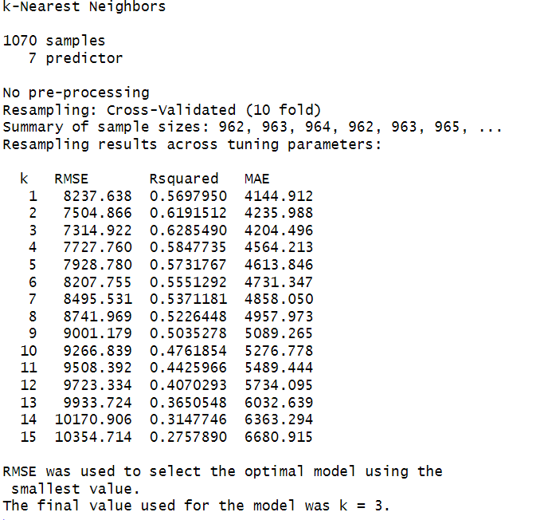
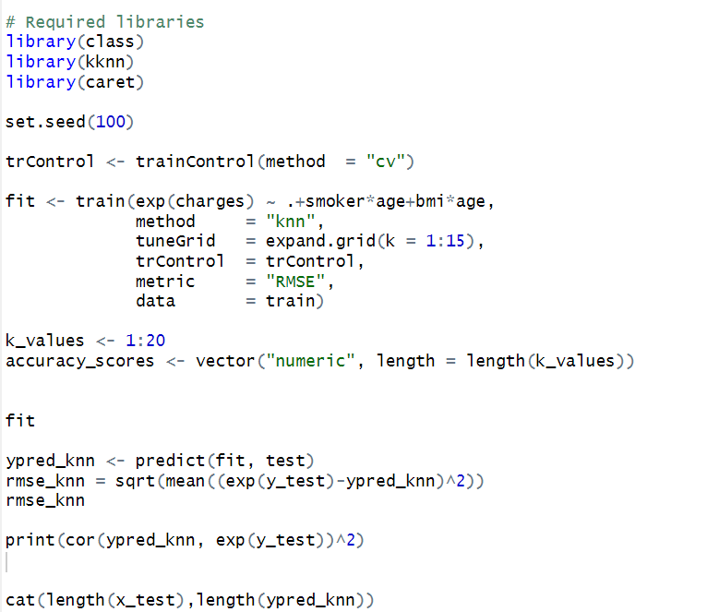
KNN Algorithm
Code
Algorithm
K-nearest neighbors (KNN) algorithm is a non-parametric, supervised machine learning algorithm used for classification and regression tasks. It assigns a new data point's class or value based on the majority class or average of its K nearest neighbors in the feature space.
K-nearest neighbors (KNN) does not inherently provide feature importance. KNN is a distance-based algorithm that does not involve explicit feature selection or extraction. It makes predictions based on the proximity of data points in the feature space without considering the importance of individual features.
Results

Slide 16
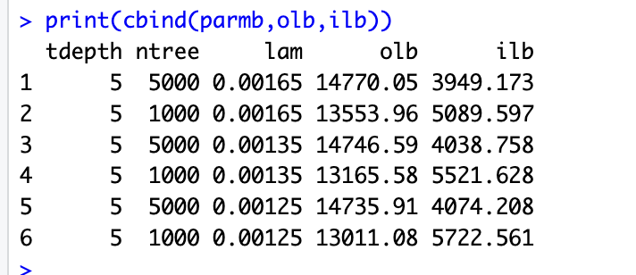
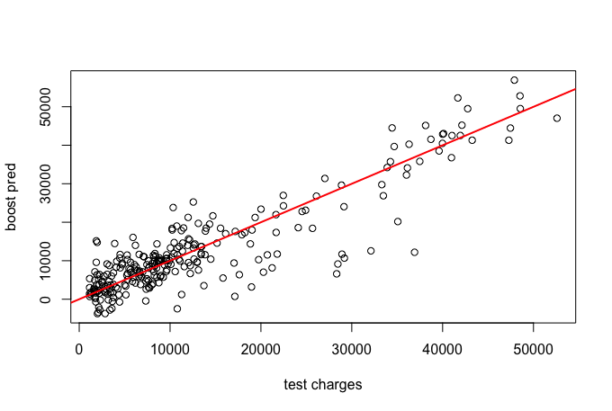
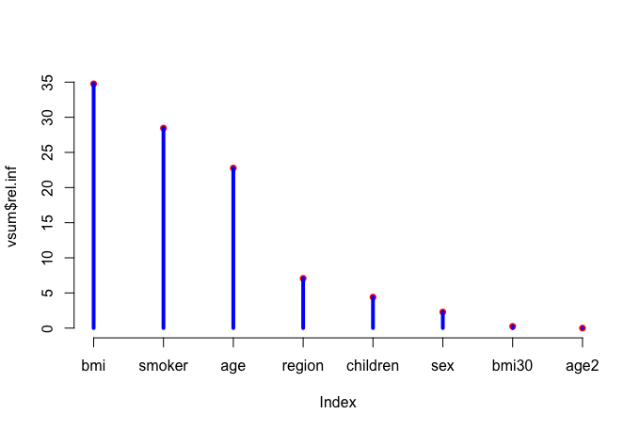
Boosting
Code
Fitting Process
We ran a second Boosting model that divided the data set into a training, testing, and validation set. By shrinking tree depth and increasing the number of trees we saw more success with lowering both out-of-sample and in-sample RMSE. To find the best fit, adjusting the lambda was about finding the right balance because as we lowered the lambda out-of-sample RMSE decreased, but in-sample RMSE rose in response. After running many different iterations, we discovered that a lambda of 0.00135 would allow us to optimally minimize both RMSEs. The biggest predictors of health care costs were BMI, whether the patient was a smoker, and age.
Results
Accuracy of Charges Predictions
Predictor Impact

Slide 17
Conclusion
Important Predictors
Possible Improvements
Working with only 1,388 observations and having to subset the data into different samples for testing and cross-validation limited the ability of our models to provide a great fit. Increasing the size of the data set would allow our models to improve their fit.
The data set only contained 6 predictor variables for our models to predict price. Adding more predictor variables would mostly likely help predict charges more accurately.
Region and sex were not important variables for predicting insurance charges.
Age
Children
Smoker
BMI

Slide 18
References
https://www.grandviewresearch.com/industry-analysis/us-individual-health-insurance-market-report#:~:text=The%20U.S.%20individual%20health%20insurance,6.08%25%20from%202023%20to%202030
https://content.naic.org/sites/default/files/inline-files/2020-Annual-Health-Insurance-Industry-Analysis-Report.pdf
https://www.pgpf.org/blog/2023/07/how-does-the-us-healthcare-system-compare-to-other-countries#:~:text=In%202022%2C%20the%20United%20States,capita%20across%20the%20OECD%20countries
https://www.commonwealthfund.org/publications/issue-briefs/2023/jan/us-health-care-global-perspective-2022
https://www2.deloitte.com/content/dam/insights/articles/US164650_CFS-Insurance-industry-outlook/DI_Insurance-industry-outlook.pdf
Age Icon: age by Adrien Coquet from <a href="https://thenounproject.com/browse/icons/term/age/" target="_blank" title="age Icons">Noun Project</a> (CC BY 3.0)
Gender Icon: gender by Evgeny Filatov from <a href="https://thenounproject.com/browse/icons/term/gender/" target="_blank" title="gender Icons">Noun Project</a> (CC BY 3.0)
BMI Icon: BMI by Amethyst Studio from <a href="https://thenounproject.com/browse/icons/term/bmi/" target="_blank" title="BMI Icons">Noun Project</a> (CC BY 3.0)
Children Icon: Family by The Icon Z from <a href="https://thenounproject.com/browse/icons/term/family/" target="_blank" title="Family Icons">Noun Project</a> (CC BY 3.0)
Smoker Icon: Cigarette by Jørgen Eidem from <a href="https://thenounproject.com/browse/icons/term/cigarette/" target="_blank" title="Cigarette Icons">Noun Project</a> (CC BY 3.0)
Region Icon: us by WEBTECHOPS LLP from <a href="https://thenounproject.com/browse/icons/term/us/" target="_blank" title="us Icons">Noun Project</a> (CC BY 3.0)
Background Icon: Research by Maan Icons from <a href="https://thenounproject.com/browse/icons/term/research/" target="_blank" title="Research Icons">Noun Project</a> (CC BY 3.0)
Dataset Icon: dataset by Chenyu Wang from <a href="https://thenounproject.com/browse/icons/term/dataset/" target="_blank" title="dataset Icons">Noun Project</a> (CC BY 3.0)
EDA Icon: Data Analysis by Happy Girl from <a href="https://thenounproject.com/browse/icons/term/data-analysis/" target="_blank" title="Data Analysis Icons">Noun Project</a> (CC BY 3.0)
Modeling Icon: Machine Learning by Abd Majd from <a href="https://thenounproject.com/browse/icons/term/machine-learning/" target="_blank" title="Machine Learning Icons">Noun Project</a> (CC BY 3.0)

