Slide 1
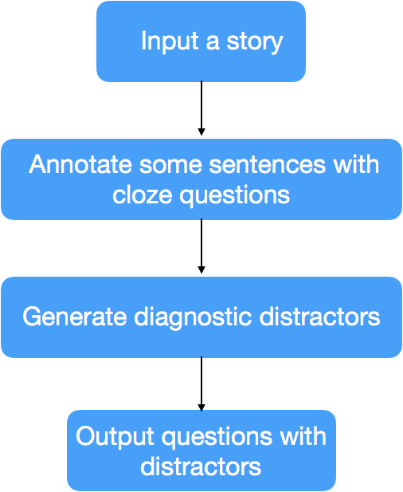
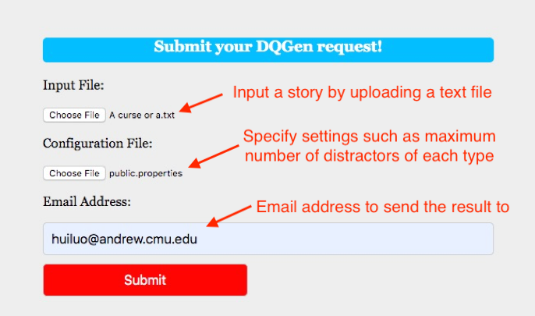
DQGen generates diagnostic comprehension questions
Hui Luo and Jack Mostow
How DQGen works
Example: A Very Tall Man, by Cornelius Gulere (minus pictures)
Given a text, DQGen (2017) inserts questions to diagnose deficits in reading comprehension by using ungrammatical, nonsensical, and plausible distractors to reveal failures in syntactic, semantic, and contextual processing.
Input story | Output distractors
His hoe was too short. | Nonsensical: special, major, whole, little
His doorway was too low. | Ungrammatical: hoe
 | Nonsensical: white, whole, single, large
His bed was too short. | Ungrammatical: hoe, doorway
 | Nonsensical: cheap
His bicycle was too short. | Ungrammatical: bed, doorway
 | Nonsensical: total, old, white, general
This man was too tall! | Ungrammatical: bicycle, bed
 | Nonsensical: stable, tiny, innocent, brown
He made a very long hoe handle. | Ungrammatical: tall
 | Nonsensical: echo, fill, happen, appear
He made very high door frames. | Ungrammatical: made, long
 | Nonsensical: fans, bits, practices, tries
He made a very long bed. | Ungrammatical: made, long
 | Nonsensical: none, boy, east, copy
He bought a very high bicycle. | Ungrammatical: made, long
 | Nonsensical: hurricane, crop, arena, crisp
He sat on a very high chair.
He ate with a very long fork. | Ungrammatical: sat
 | Nonsensical: hurricane, smell, pioneer, cheek
 | Plausible: delay, string, tail
He left his house and lived in a big forest. | Ungrammatical: ate, long, sat
 | Nonsensical: east, boy, bottle, ear
 | Plausible: family
He lived for many years. | Ungrammatical: ate, big, long, lived
Mostow, J., Huang, Y.-T., Jang, H., Weinstein, A., Valeri, J.,
& Gates, D. (2017). Developing, evaluating and refining an
automatic generator of diagnostic multiple choice cloze
questions to assess comprehension while reading. Journal
of Natural Language Engineering 23(2), 245-294.
What's new
DQGen is now a web service (URL to be announced).

