Slide 1










MediPredict – AI-IoT Predictive Maintenance for Autoclaves & Ventilators
Team : MediPredict
Membership no.: 1122022403 - Rahul Patil
1122022422 - Shivendu Khanke
1122022405 - Mrunmayee Talokar

Slide 2


Problem statement
A Journey from reactive to predictive
In Indian hospitals, biomedical equipments such as Ventilators and Steam Sterilizers are critical for sustaining patient lives. However, these devices often suffer from unexpected breakdowns due to wear-and-tear, improper calibration, or delayed servicing. Currently, maintenance is largely reactive, where issues are addressed only after the device fails
Hospital biomedical devices often break down unexpectedly.
Current maintenance is reactive, not predictive.
Leads to delayed treatments and patient risk.
Causes high hospital costs due to emergency repairs.
Unplanned downtime disrupts critical patient care.

Slide 3

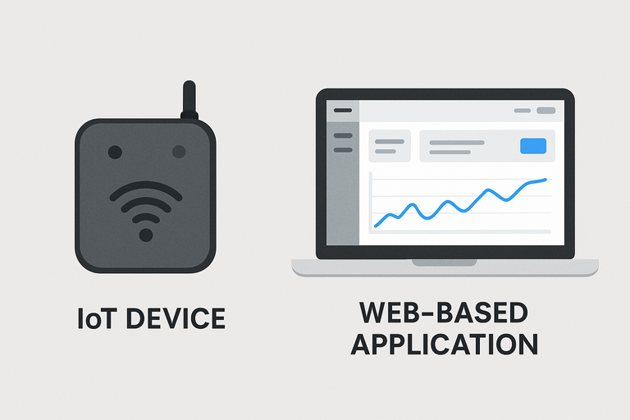

Objective
Our objective is to make hospital equipment smarter, safer, and always ready when lives depend on it
To develop an AI-Powered predictive maintenance IoT Device for biomedical equipments that will :
Predicts failures before they occur using machine learning models.
Ensures uninterrupted patient care by reducing device downtime.
Optimizes hospital costs through smarter servicing and resource allocation.

Slide 4

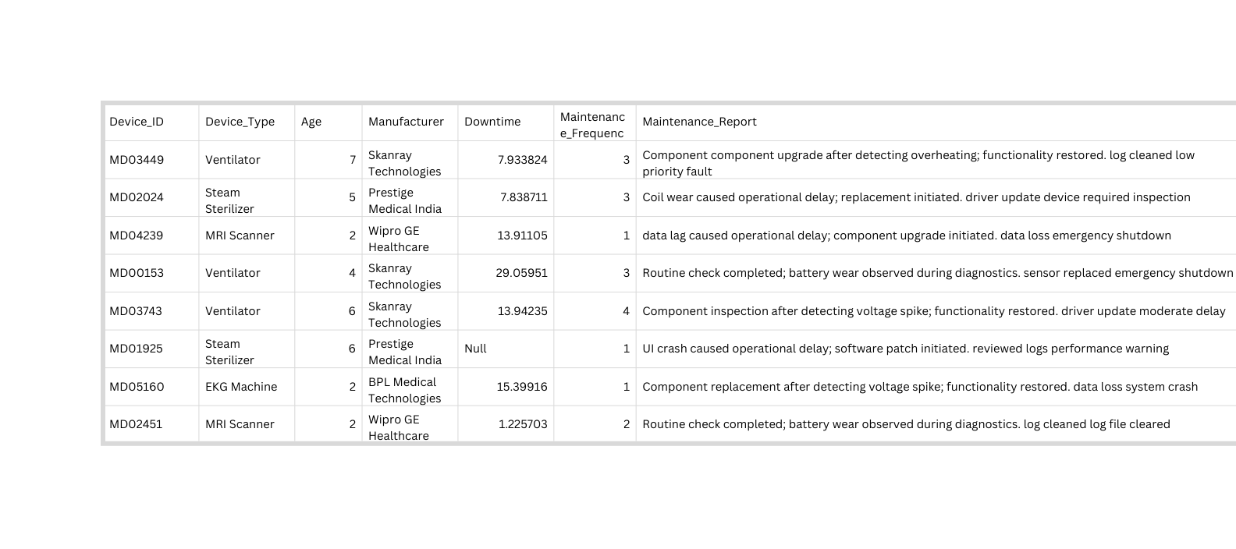
MOTIVATION
Smart cities are built on smart healthcare. And smart healthcare begins with reliable machines
Our inspiration began at Summer Internship where we saw the need for smarter, safer, and more reliable medical machines.
The data below shows that current device breakdowns cost us money, waste time, erode trust, and reduce efficiency.
This data was collected from the hospital where we completed our internship.

Slide 5
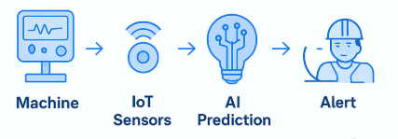
PROPOSED SOLUTION
Smart Predictive Maintenance for Biomedical Equipment
An AI-powered predictive maintenance system that continuously monitors biomedical equipment, detects early signs of failure, and alerts staff before breakdowns occur.
Machine Selected are two critical, common, high-impact machines
1) Ventilator
2) Steam Sterilizer
Data Collection → Sensors + IoT modules on equipment collect real-time usage, temperature, vibration, and performance data.
AI Prediction → ML detects anomalies & forecasts failures.
Early Alerts → Web Dashboards notify staff.
Preventive Action → Engineers service before breakdown.
Continuous Learning → AI gets smarter with more data.

Slide 6
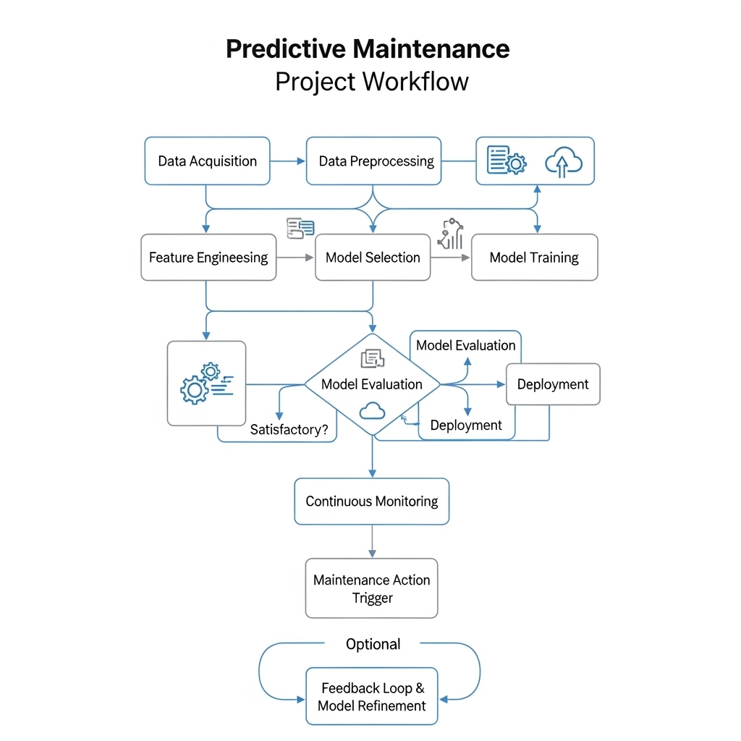
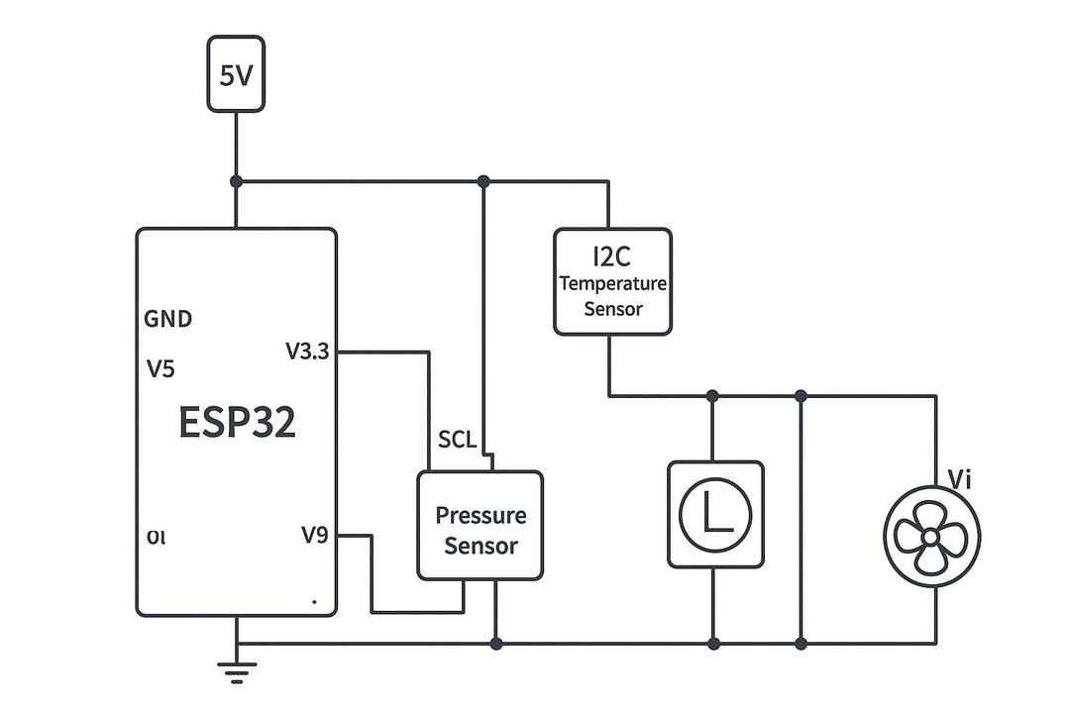
ML learning And Circuit Diagram For Prototype
🔹Sensors used for Steam Sterilizer
Temperature Sensor (DS18B20 / PT100 RTD)
Pressure Sensor (0–30 psi transducer, analog)
🔹 Sensors used for Ventilator
Pressure Sensor (BMP180 / MPX5010DP)
Vibration Sensor (MPU6050)

Slide 7
IMPLEMENTATION PLAN:
Step 1 – Data Simulation & Sensors
Use ESP32 with basic sensors (temperature + pressure for autoclave, airflow + pressure for ventilator) or run a simulator to generate live equipment signals.
Step 2 – Data Transmission
Send sensor data as JSON via HTTP to a Python backend (FastAPI/Flask) and log it into SQLite for quick access.
Step 3 – Machine Learning Model
Train a small ML classifier (Random Forest) on sample/simulated datasets to predict Healthy, Warning, Critical. Save model as .pkl.
Step 4 – Streamlit Dashboard
Build a simple UI with tabs:
Autoclave Monitor → temp/pressure cycle + prediction.
Ventilator Monitor → airflow/pressure stability + prediction.
Alerts Panel → highlights risky devices.
Step 5 – Live Demo Prep
Run IoT board or simulator feeding data → backend → ML → Streamlit. Show real-time predictions and an alert popping up.

Slide 8
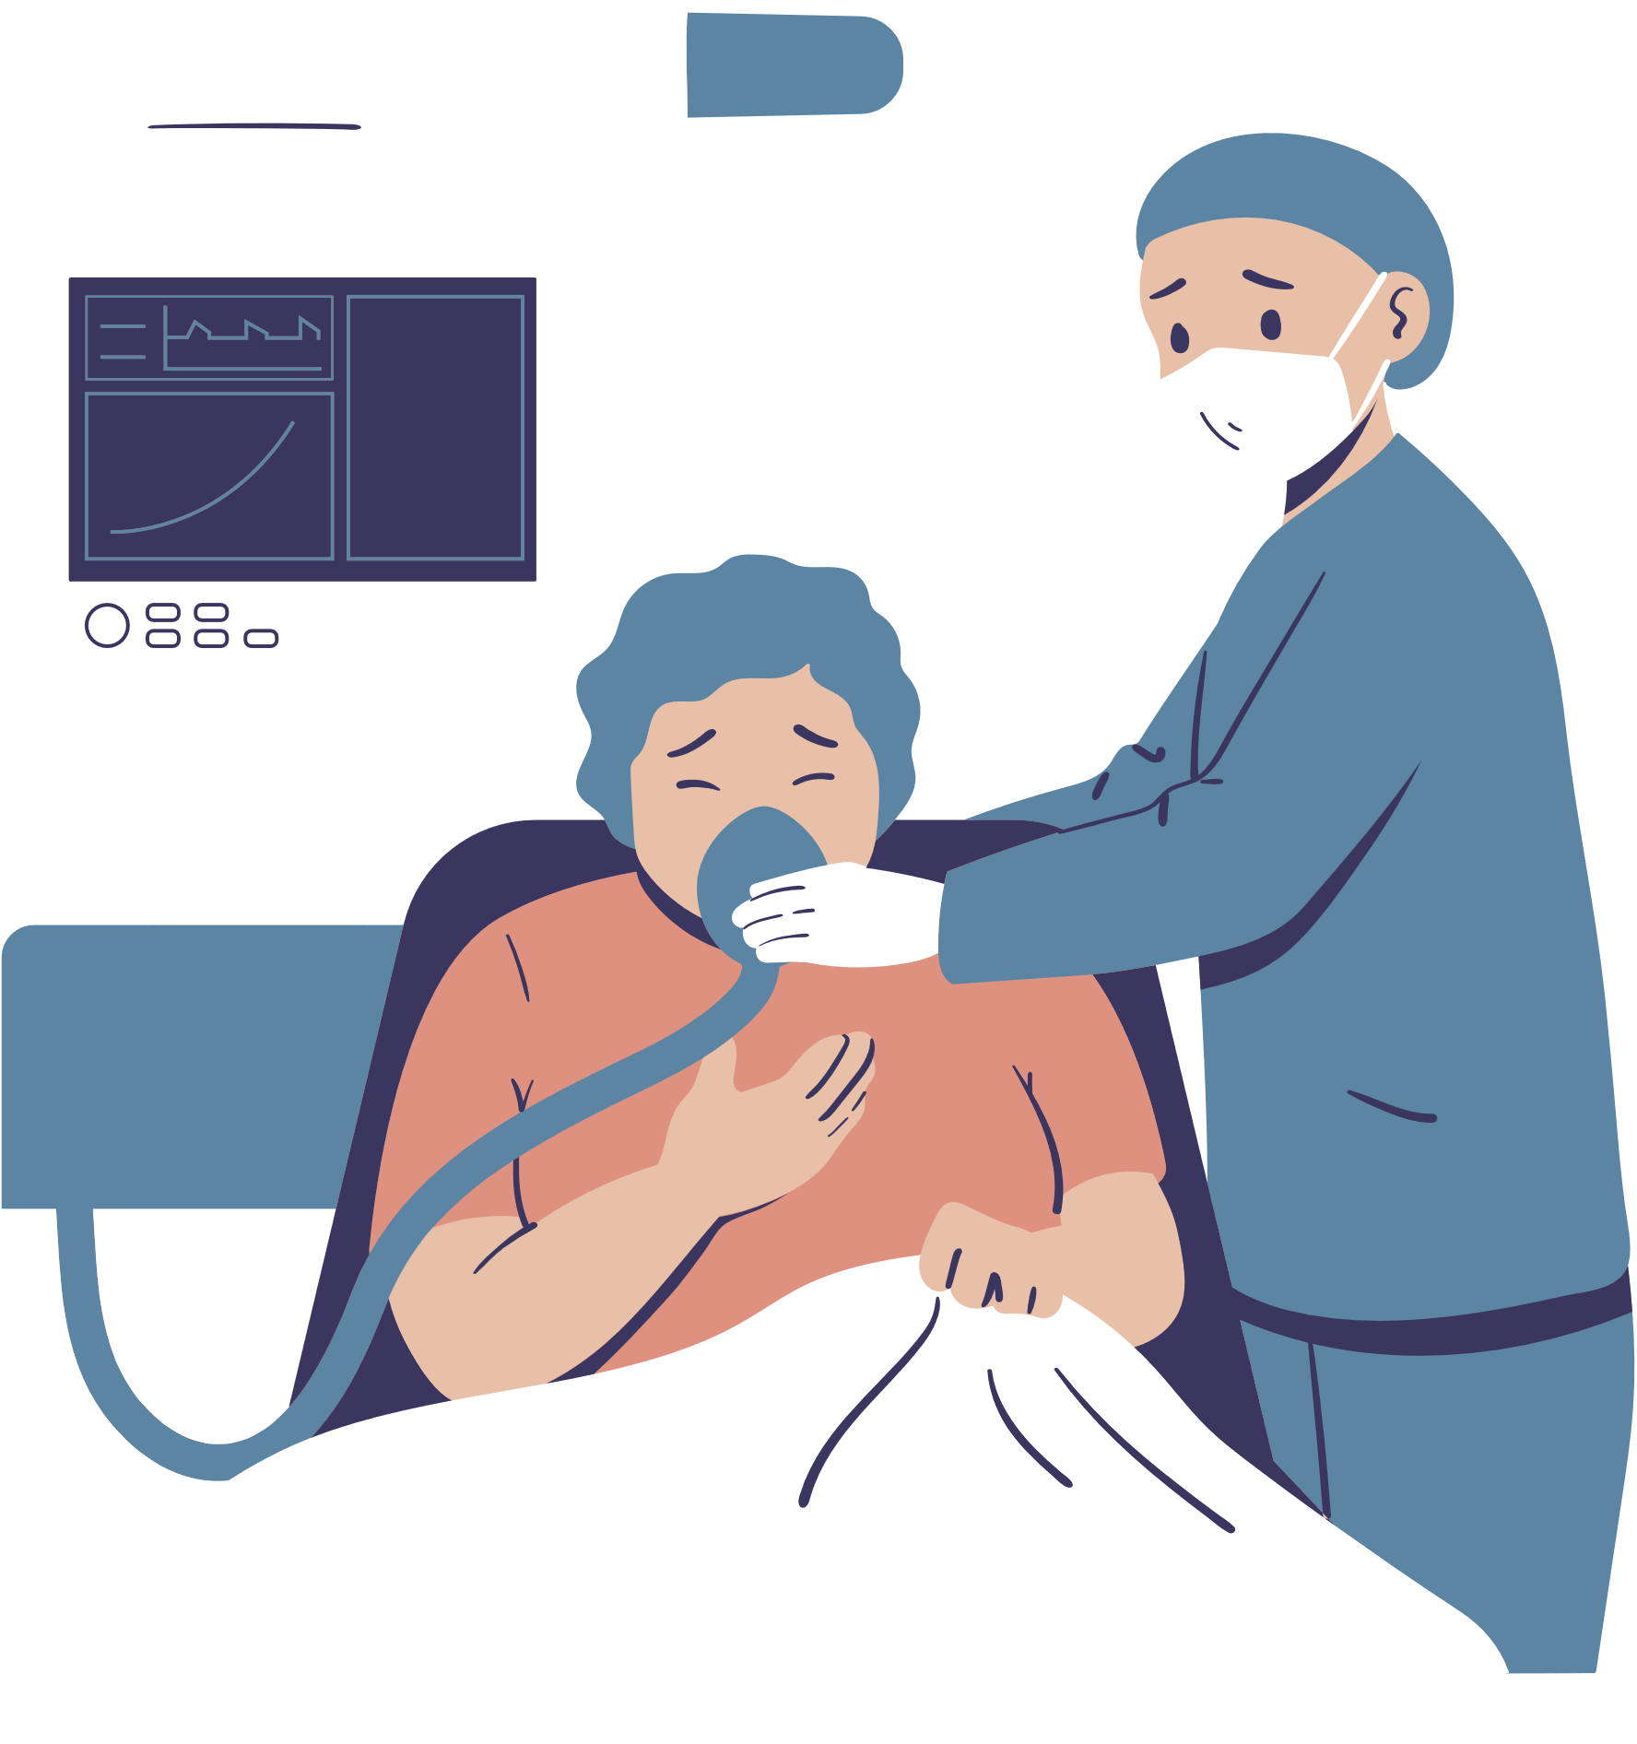
INNOVATION FACTOR
AI + IoT Fusion → Real-time predictive maintenance for critical hospital equipment.
Device-Specific Models → Separate ML models for Autoclaves & Ventilators (not generic).
Low-Cost IoT Sensors → Retrofit on existing machines, no need for new equipment.
Early Failure Prediction → Detects heater/valve wear (autoclave) & airflow/pressure drift (ventilator) before breakdown.
FUTURE SCOPE
Integration with Hospital IoT Network – connect multiple devices (autoclaves, ventilators, monitors) into one predictive platform.
Edge AI Deployment – run lightweight ML models directly on devices (ESP32/TinyML) for faster, offline predictions.

Slide 9
THANKYOU

