Slide 1

FIELD PILOT PROPOSAL
Counting footfall with 2D LiDAR
A one-week, low-cost people-counting pilot for the festival entrance
Budget ≤ 3,000 DKK
Edge-processed on-site
No cameras — privacy by design
Prepared for supervisor review · June 2026

Slide 2

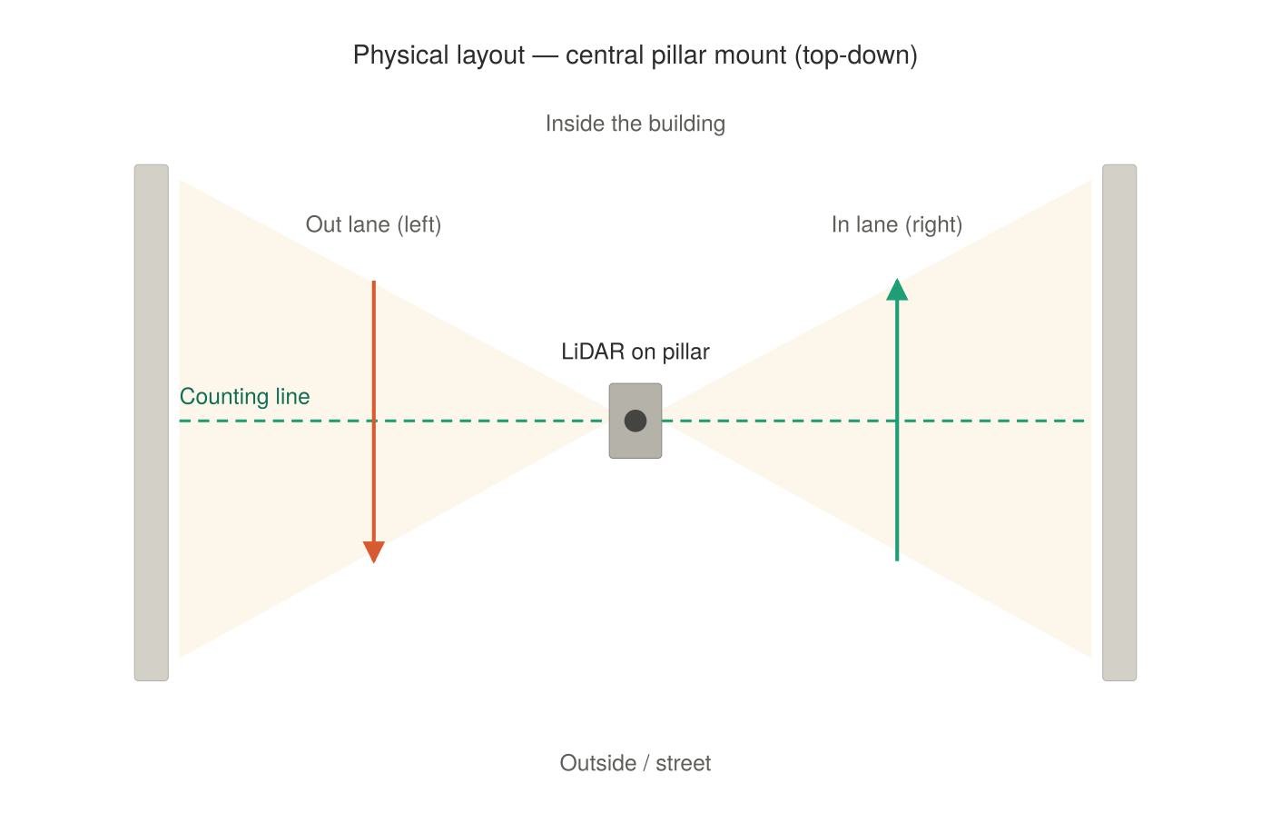



OBJECTIVE
What we’re building
Count people entering and leaving the main entrance, continuously.
Two lanes — in on the right, out on the left — covered by one sensor on the central pillar.
All detection and counting runs on-site on a small computer.
Output: live in/out counts and crowd occupancy across the week.
Top-down view: one LiDAR on the pillar scans both lanes.

Slide 3


WHY THIS APPROACH
Why 2D LiDAR, not cameras
Private by design
Works in any light
Cheap & self-contained
No images or faces are ever captured — only anonymous counts. GDPR-friendly for a public event.
A time-of-flight sensor handles daylight and darkness alike. Nothing to blind or backlight.
Runs on a ~500 DKK Raspberry Pi, with all counting done locally at the entrance.

Slide 4




HOW IT WORKS
From laser sweep to a count
1 · Scan
2 · Track
3 · Count
4 · Log
The LiDAR sweeps a plane across the entrance, ~40× a second.
Each person shows up as a moving blob; we follow them frame to frame.
Direction across the line decides in vs. out, per lane.
Counts are saved locally and pushed to a dashboard.
All of this runs on the Pi at the entrance — no video ever leaves the site.

Slide 5





COST
Hardware & budget
RPLIDAR C1 — time-of-flight LiDAR
~600 DKK
~1,900 DKK
Raspberry Pi 5 (2 GB) + microSD
~570 DKK
estimated build cost
27 W PSU + power-bank buffer
~440 DKK
of a 3,000 DKK budget
IP-rated enclosure + pillar clamp
~300 DKK
≈ 1,100 DKK headroom for spares
4G dongle / phone hotspot
~0–300 DKK
A higher-resolution sensor is available within budget if the entrance is covered.

Slide 6



PLAN
Deployment plan
Timeline
Field-readiness
1
Build & test
T-2 weeks — assemble, code, validate on recorded scans
Power buffer
Inline power-bank/UPS rides through brief outages and generator switchovers.
2
Dry run
T-1 week — 24 h soak; confirm logging + store-and-forward
Weatherproofing
Sheltered under the canopy with the electronics in an IP-rated box.
3
On-site setup
Setup day — mount, define lanes, calibrate, verify counts
Local-first logging
4
Run & validate
Everything is saved on the Pi first — no reliance on festival Wi-Fi.
Festival week — monitor; spot-check vs. manual tally

Slide 7



RISK & VALUE
What we’re managing — and what you get
Risks we’re managing
What you’ll get
Crowd-surge undercount
Live in/out counts and crowd occupancy across the week.
2D can’t see people hidden behind others — we validate against a manual tally and report trends + normal-flow counts.
Peak-time and flow analysis for the entrance.
Weather & power
Sheltered enclosure plus an inline power buffer.
A privacy-compliant method we can reuse at future events.
Network dropouts
All counts are logged locally first, then uploaded when possible.
Cheap, low-risk, and entirely off-the-shelf hardware.

Slide 8


THE ASK
Approve a one-week pilot
Go-ahead to run the pilot at the entrance
~2,000 DKK in hardware (within the 3,000 DKK budget)
Permission to mount on the central entrance pillar
Low cost, low risk, reusable — and nothing identifying is ever recorded.

