Slide 1


Twitter Mining &
Sentiment Analysis
Rosie Hamilton
@Rosicadia

Slide 2
Trump’s Tweets
David Robinson, a Data Scientist at Stack Overflow, mined some of Donald Trump’s Tweets from Twitter.
He noticed that Trump’s tweets originated from either Android or iPhone.
He applied sentiment analysis and found Trump’s Android tweets used approx 40-80% more words related to disgust, sadness, fear, anger, and other “negative” sentiments than his iPhone tweets.
Why might that be?

Slide 3
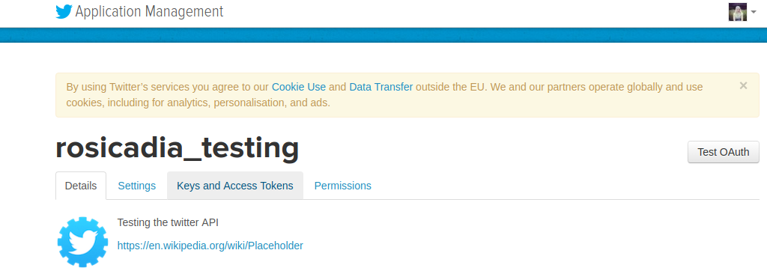
Mining Twitter Data
Use the twitteR package to access Twitter API
Create an app at apps.twitter.com
Get Keys and Access Tokens

Slide 4
Mining with R
Don’t commit your secrets in plain text to Github. Use environment variables
#install.packages("twitteR")
library(twitteR)
TWITAPISECRET <- Sys.getenv("TWITAPISECRET")
TWITTOKENSECRET <- Sys.getenv("TWITTOKENSECRET")
# Set API Keys
api_key <- "aVXP1fw3fyxFFYfSDsAKje3vy"
api_secret <- TWITAPISECRET
access_token <- "69366834-DdbmXBAxgxybC27MSBK3gaojj26Qcdr5Mi1rSzGpd"
access_token_secret <- TWITTOKENSECRET
setup_twitter_oauth(api_key, api_secret, access_token, access_token_secret)
latest_tweets <- searchTwitter("#cat", n=100)
# The twListDF() function converts from list format to a dataframe
df <- twListToDF(latest_tweets)

Slide 5
Tweet Data Fields
text: The text of the status
favorited: Whether this status has been favorited by the authenticated user
favouritedCount: Approximately how many times this tweet was liked
replyToSN: Screen name of the user this is in reply to
created: When this status was created
truncated: Whether this status was truncated
replyToSID: Status ID this was in reply to
id: ID of this status
replyToUID: ID of the user this was in reply to
statusSource: Source user agent for this tweet
screenName: Screen name of the user who posted this status
retweetCount: The number of times this status has been retweeted
isRetweet: TRUE if this status is a retweet
retweeted: TRUE if this status has been retweeted
longitude: If user has opted in to “Tweeting with Location” shows longitude
latitude: If user has opted in to “Tweeting with Location” shows latitude

Slide 6
Saving Twitter Data
Twitter API only holds tweets for about 10 days
Mine tweets then convert to a data frame
Store data frame in Github as .Rda file
# Once we have a data frame named df containing tweet data
# save the data frame object containing tweets as a .Rda file
saveRDS(df,file="tweets.Rda")
# load data frame object containing tweets
mytweets <- readRDS("tweets.Rda")

Slide 7
Some Useful Clean Up Snippets
Select only tweets on a certain day
Clean up encoding
tweets <- readRDS("mytweets.Rda")
index <- which(as.Date(tweets$created) == "2016-11-03")
datetweets <- tweets[index,]
# extract just the tweet text
textdata <- tweets$text
#check encoding
Encoding(textdata) # mixture of all kinds of encoding
#Apply Native encoding on the vector
textdata <- enc2native(textdata)
#Apply UTF-8 encoding on the vector
textdata <- enc2utf8(textdata)
# This deals with unicode characters and emoji
# Changes characters like & < > to &amp; &lt; &gt;

Slide 8
gsub() and regex
For powerful cleaning, level up your regex skills
# strip out punctuation
textdata = gsub("[[:punct:]]", "", textdata)
# strip out control characters, like \n or \r
textdata = gsub("[[:cntrl:]]", " ", textdata)
# strip out numbers
textdata = gsub("\\d+", "", textdata)
# Any '&' are now '&amp;', replace them with the word 'and'
textdata = gsub("\\&amp;", "and", textdata)
# ????
textdata = gsub("(^|[^@\\w])@(\\w{1,15})\\b", " ", textdata)

Slide 9
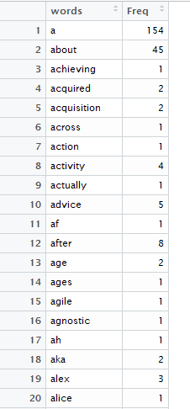
Word Frequency
#convert all text to lowercase
textdata <- tolower(textdata)
# extract the words with strsplit()
words <- unlist(strsplit(textdata, " "))
# remove any blank ""'s in the vector
words <- words[words != ""]
#total up the words in a table
wordtable <- table(words)
#store totals in a data frame
worddf <- as.data.frame(wordtable, stringsAsFactors=FALSE)

Slide 10
Helpful Word Lists
List of positive and negative words
for a starting point, use the Hu and Liu Opinion Lexicon from: http://www.cs.uic.edu/~liub/FBS/opinion-lexicon-English.rar
List of stop words
Various lists both long and short found at:
http://www.ranks.nl/stopwords
Store word list as .txt files
Use the readr package to read them into R
Use stringr package to split them into word vectors

Slide 11
Remove Stop Words
#read in a list of stop words
stopwords <- read_file("stop-words.txt", locale = default_locale())
# replace control characters, like \n or \r with a space
stopwords = gsub("[[:cntrl:]]", " ",stopwords)
# split the stopwords up into a vector of words
stopwords <- unlist(strsplit(stopwords, " "))
# remove blank ""'s
stopwords <- stopwords[stopwords != ""]
#make an index of stopwords which are in the words dataframe
index <- which(worddf[,1] %in% stopwords)
#remove the stopwords from the words dataframe
worddf <- worddf[-index,]
#re-index
row.names(worddf) <- 1:nrow(worddf)

Slide 12
Score words by Sentiment
# Now score each word on whether it is positive or negative.
library(plyr)
# ddply() takes a dataframe, does stuff, returns a dataframe
# Score all the words and output as dataframe
scoredwords <- ddply(worddf, "words", function(x) {
wordtocheck <- x$words
# compare the word to check to wordlists
pos.match = match(wordtocheck, good_text)
neg.match = match(wordtocheck, bad_text)
# match() returns the position of the matched term or NA
# convert matches to TRUE/FALSE instead
pos.match = !is.na(pos.match)
neg.match = !is.na(neg.match)
# TRUE/FALSE is treated as 1/0 by sum(), so add up the score
score = sum(pos.match) – sum(neg.match)
})

Slide 13
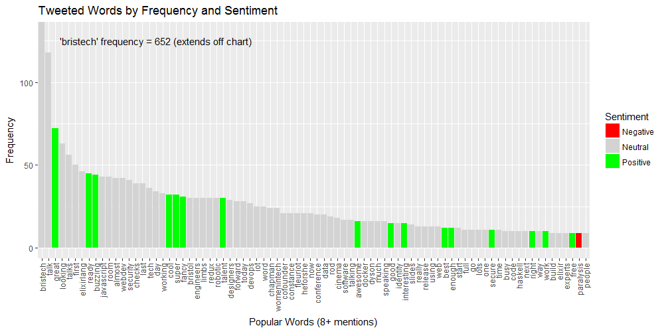
Visualise Vocabulary

Slide 14
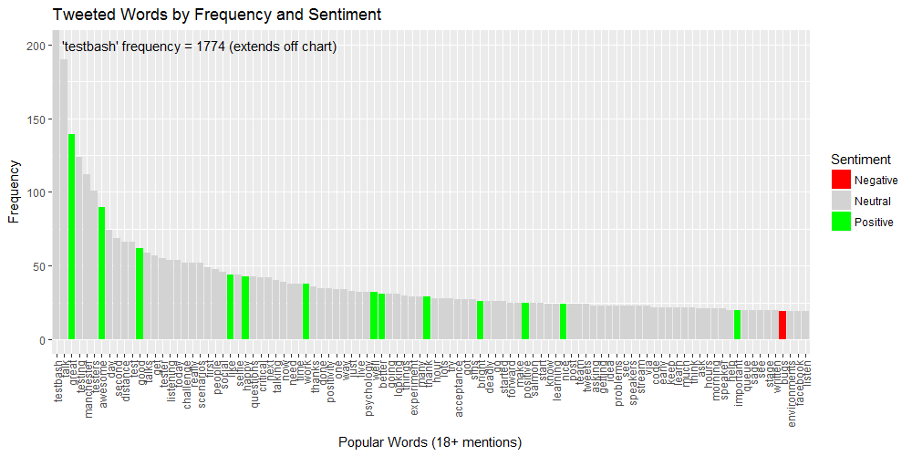
R = Reproducible!

Slide 15
Score Tweets
Use a function to compare each word in each tweet to list of good and bad words
Score +1 for each good word and -1 for each bad word
Add up the score for each tweet
Each time a positive word is identified append it to a positive list.
Each time a negative word is identified, append it to a negative list.
Cbind the score of each tweet onto the data frame

Slide 16
Word Clouds
Use two packages
The main structure for managing text in tm package is a corpus.
A corpus represents a collection of text documents.
# The tm package is a framework for text mining within R
# The wordcloud package lets you make pretty word clouds
# install.packages("tm", dependencies = TRUE)
# install.packages("wordcloud", dependencies = TRUE)
library(wordcloud)
library(tm)

Slide 17
Creating a Corpus
There are two kinds of corpus
Vcorpus is a volatile corpus, held in R memory.
If you delete a vcorpus your text is gone forever
Pcorpus is a permanent corpus, text stored outside of R usually in a database.
# To get your text into a corpus there are three main source
# functions that can help:
# DirSource() uses a path to a file to get text
# VectorSource() gets text from a vector
# DataframeSource() gets text from a data frame
# to make a corpus, use Corpus() on one of the above functions
# make a corpus for positive and negative words
pcorp = Corpus(VectorSource(positivity))
ncorp = Corpus(VectorSource(negativity))

Slide 18
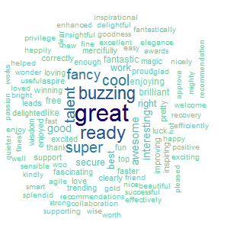
Generating Word Clouds
wordcloud(words,
scale=c(2,0.6),
max.words=200,
min.freq=-1,
random.order=FALSE,
rot.per=0.2,
use.r.layout=FALSE,
# blue to green colours
colors = c(
"#63CDA4",
"#50BFAE",
"#3FA7B1",
"#307EA2",
"#235594",
"#172F86",
"#100E78",
"#200569"))

Slide 19
Beware!
If people swear in their tweets, your word clouds can fill up with swear words!
For a sensitive audience, you may want to do the following:
# add * to swear words so word clouds are less offensive
index <- which(negativity =="fuck")
negativity[index] <- "f*ck"
index <- which(negativity =="fucking")
negativity[index] <- "f*cking"
index <- which(negativity =="shit")
negativity[index] <- "sh*t"

Slide 20
Completed Analysis
Used Twitter mining to analyse two conferences
Test Bash, a single track software testing conference https://github.com/Rosalita/test_twit
Bristech, a multi-track developer conference https://github.com/Rosalita/bristech_twit
Blog post explaining Tesh Bash analysis http://testingfuntime.blogspot.co.uk/

