Slide 1

SMART MOVE
“Public Bus Live Tracking for Smart City”
TEAM APEX
Aashish Maharjan
Prayag Raj Ghimire
Roshan Nyaupane
Rushma Singh

Slide 2
TABLE OF CONTENTS
01
02
03
04
INTRODUCTION AND PROBLEM STATEMENT
SOLUTION OVERVIEW
IMPLEMENTATION AND BENEFITS
FUTURE ENHANCEMENTS AND CONCLUSION

Slide 3
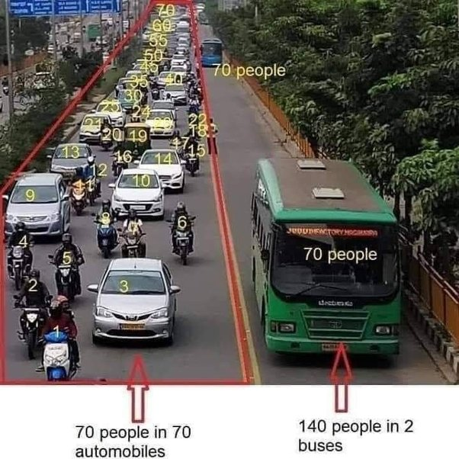

Slide 4
PROBLEM
Traffic congestion in the Kathmandu Valley is primarily attributed to the widespread preference for private vehicles due to unmanaged public transportation and information deficiencies.
"Unlocking Urban Flow: Tackling Traffic Jams, Transport Hassles, and Info Gaps for Seamless City Living!"

Slide 5
PROBLEM
Traffic Congestion
Preference of private vehicle over public vehicle
Unmanaged Public Transport
Information Deficiency

Slide 6
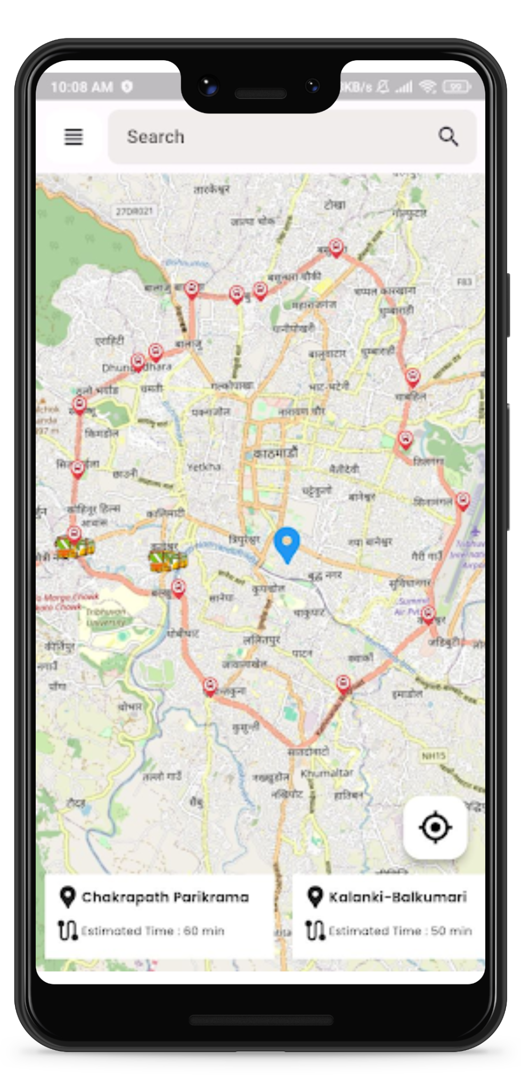
WHAT IS SMART MOVE?
Public Transportation Information Systems
Tracks Live Bus Location
Smart Bus Routes and Bus Stations.
Initiate to Revolutionize Urban Transportation.
Reduces Passenger Waiting Time.

Slide 7
SMART MOVE: FEATURES
LIVE BUS TRACKING
BUS ROUTES & STATIONS
PUBLIC AMENITIES LOCATOR
ADMINISTRATIVE DASHBOARD

Slide 8
SMART MOVE: FEATURES
LIVE BUS TRACKING
BUS ROUTES & STATIONS
PUBLIC AMENITIES LOCATOR
ADMINISTRATIVE DASHBOARD
TRAFFIC CONGESTION ANALYTICS
BUS DRIVER PORTAL

Slide 9



SMART MOVE: REVENUE MODEL
ADVERTISEMENTS
SAAS MODEL
B2G

Slide 10
UPCOMING GOALS
Smart Move Enhance Passenger Bus Waiting Experience
GOAL 1
Smart Move has Advance Integrated Tracking System
GOAL 2
Enlarge User Engagement and seamless Integration with Payment Portal
GOAL 3
GOAL 4
Smart Move forecast Traffic Congestion

Slide 11
DEMO
Web App Demo
Mobile App Demo
Note: Playing Demonstration Video.

Slide 12
MILESTONES
Integrate all major transport service provider into the system
1
Integration of Notification System
2
Integration of payment portal
3
4
Traffic congestion Forecast and tracker using AI

Slide 13



OUTCOMES
Reliable Bus Arrival Real Timing,
And Nearby Routes
TRACK
Embedded Bus Routes, Bus Stops,
Public Amenities
ROUTES
Traffic Monitoring & Reduce Traffic Congestion
OPTIMIZATION

Slide 14
THANK YOU
Open floor for questions, feedbacks and discussions.

