Slide 1
Multichannel Acoustic Echo Cancellation Using Digital Processing Algorithm BY Nithin Raj Anantha 14BEC1164 Yashaswi Peta 14BEC1120 Phani Sandeep Somu 14BEC1060 GUIDE: Dr. MohanaPrasad

Slide 2
Motivation
Acoustic Echo Cancellation (AEC) plays a vital role in the hands free communication environment.
All the existing adaptive algorithms like NLMS,RLS,LMS fail to work in a double talk scenario without the use of a double talk detector.
This compelled us to develop an algorithm that can work in double talk scenario without the use of double talk detector.

Slide 3
Introduction
Today people are more interested in hands-free communication . In this situation the regular loudspeaker and high-gain microphone in place of telephone receiver would be appropriate.
The presence of large acoustic coupling between loud speaker and microphone would produce echo that would make conversation difficult.
In Hands free conversation undesired acoustic echo is a major problem

Slide 4
What is an echo?
Echo is a reflection of sound that arrives at the listener with a delay after the direct sound. The delay is proportional to the distance of the reflecting surface from the source and the listener.
Echo occurs if
– Any reflecting object placed more than 11.3 m far from the sound source produce echo
• Reverberation
-prolongation of a sound; resonance.

Slide 5
Echo is of two types
Acoustic echo
Hybrid echo

Slide 6
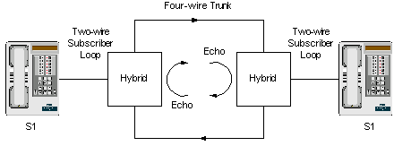
Hybrid echo
The vast majority of the public telephone system local loop wiring is done using two-wire connections whereby the same pair of wires carries voice signals in both directions.
In the telephone company's central office or in an office PBX, a two-to-four wire conversion is done using a hybrid circuit.
Hybrid circuits do not perform perfect impedance matches. The imperfection results in echo.

Slide 7
Acoustic Echo
Sound from a loudspeaker is picked up by the microphone in the same room
Problem exists in any communications where there is a speaker and a microphone
Examples:
– Hands-free car phone systems
– A standard telephone or cell phone in speakerphone

Slide 8
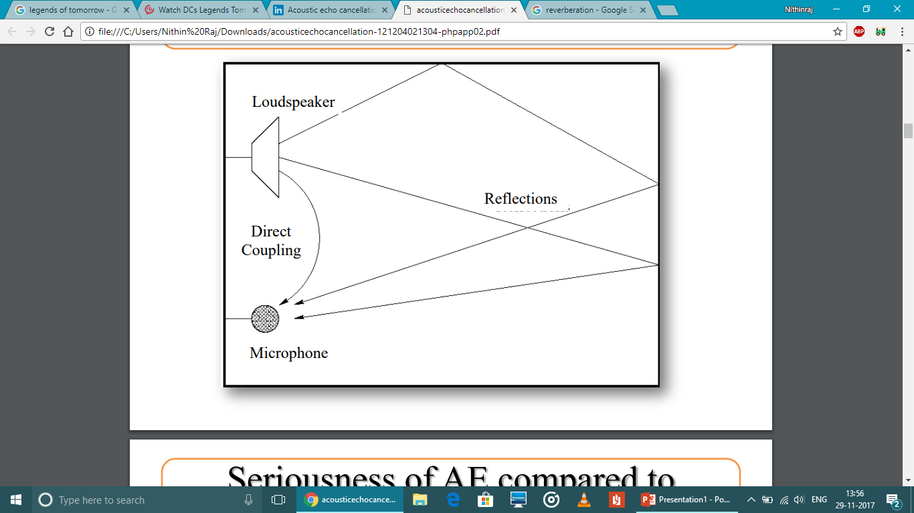

Slide 9
Echo cancellation
The methods for acoustic echo cancellation remove certain unwanted signal components (the echoes) from desired signals.
Since these disturbing sources act as reference signals, echo cancellation allows a high interference rejection if suitable methods are employed.
By adaptive system the echo is compensated.

Slide 10
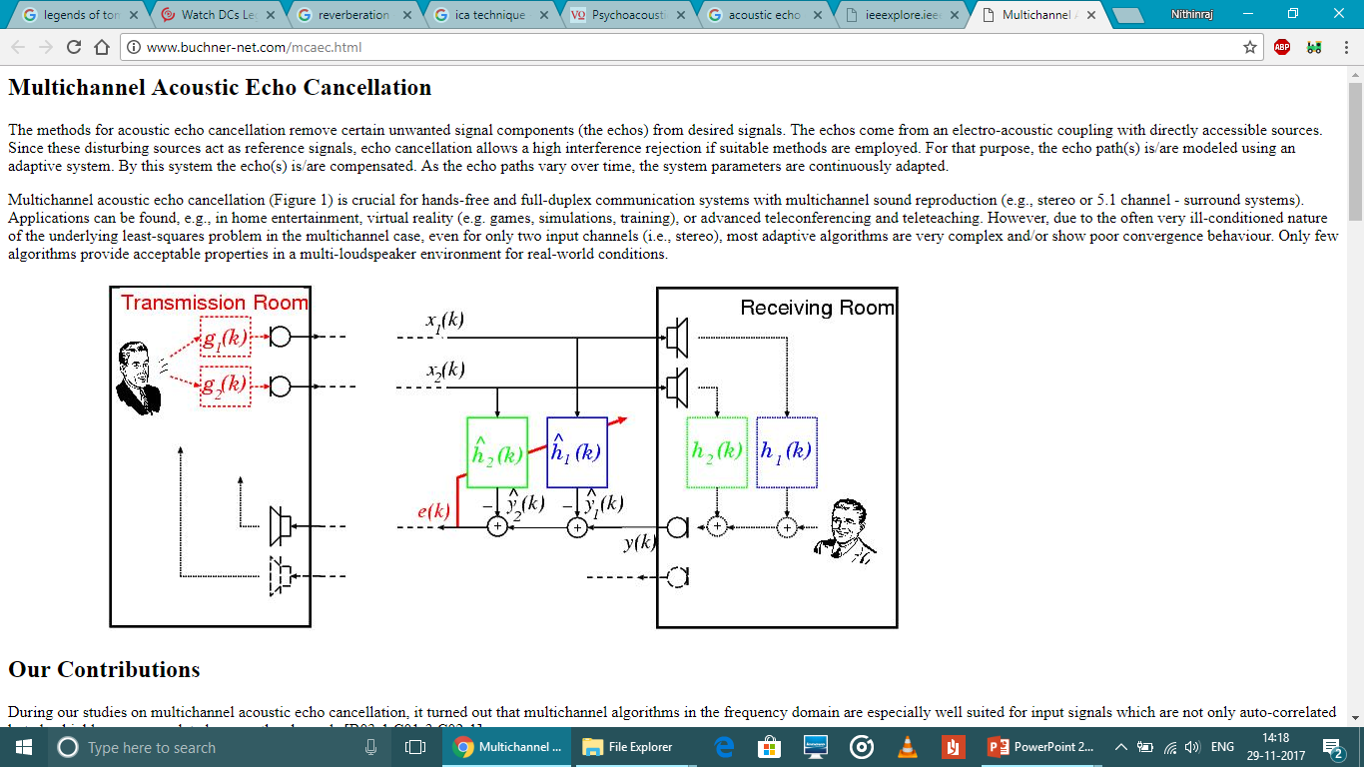

Slide 11
Objective of the project
The following are the objectives of this project:
To develop an ICA based algorithm to cancel the acoustic echo in a multichannel environment.
To calculate the Echo Return Loss Enhancement (ERLE) and make sure that it is between 35 dB to 40dB.

Slide 12
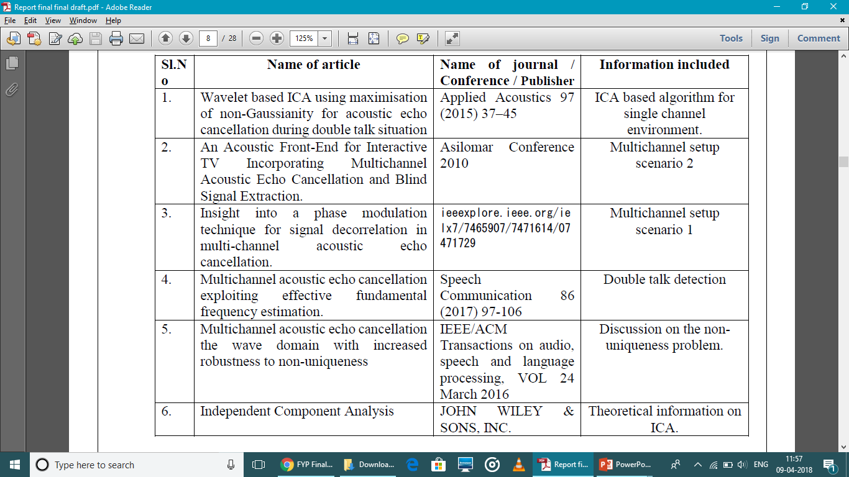
Literature Survey

Slide 13
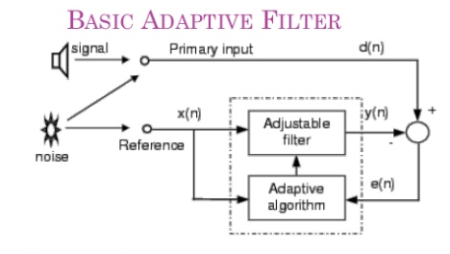

Slide 14
Various adaptive algorithms
Least Mean Square (LMS) algorithm
Normalised Least Mean Square (NLMS) algorithm
Recursive Least Squares (RLS) algorithm
Affine Projection Algorithm (APA)

Slide 15
Dis-advantages
Slow convergence
The value of ERLE<30db.
The adaptive filtering works fine in the single talk situation but fails in the double talk scenario.
Every time a new filter is required when we add a signal to the system. So redundancy increases and efficiency decreases.
All the adaptive filters mentioned before failed to update the co-efficients correctly in the presence of a double talk scenario, thus allowing some part of the echo to pass through.

Slide 16
Technical Specification
Software
Matlab
Method used:
ICA
Proposed algorithm:
Kurtosis using Gradient approach

Slide 17
Independent Component Analysis(ICA)
ICA is a method for finding underlying factors or components from multidimensional statistical data. It differs from other methods by looking its components as statistically independent and non –Gaussian.
There are four ICA estimation principles they are
(i) Non linear de-correlation,
(ii) Maximization of non-gaussianity,
(iii) Maximum likely-hood ratio and
(iv) Minimization of mutual information

Slide 18
Proposed Algorithm
The Algorithm used here is Kurtosis using Gradient approach which is as follows:
Centre the data to make its mean zero.
Whiten the observed data x to give Z=vx (assume x is zero mean), Where v is a whitening matrix.
v=ED^{-1/2}E^{T}
D & E is the Eigen value & Eigen vector matrix of covariance matrix of x.
Choose the initial random mixing matrix W and normalise it.
Let L=1 Take a random initial vector w=0 of norm 1.

Slide 19
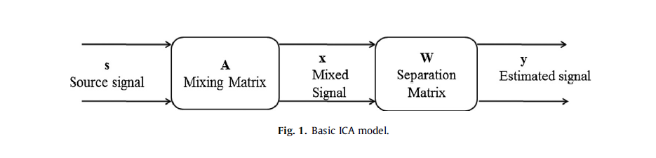
Let w(L)=w(L-1)+eta*E[Z(w(L-1)’Z)3]
Normalise it.

Slide 20
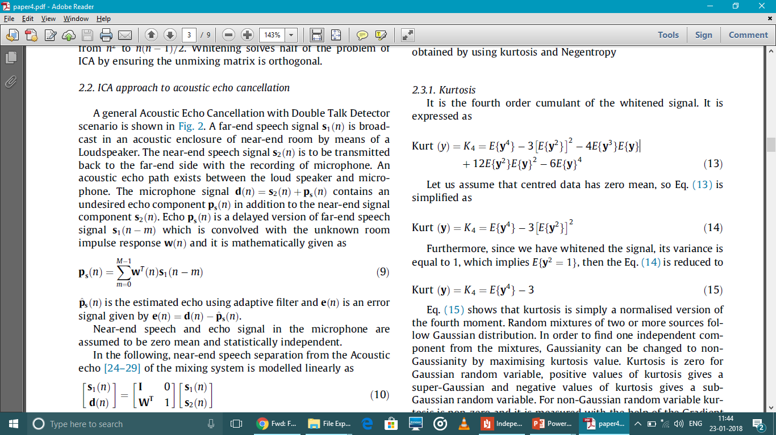

Kurtosis
The sharpness of the peak of a frequency-distribution curve.
It is expressed as
After normalisation:

Slide 21

Single channel
Far end speaker
s2(n)
ERLE 34dB
ICA based
Adaptive
filter
-
+
X
y(n)
Microphone signal
x(n)
Near end speech
s(n)

Slide 22
Multi channel scenario 1
ERLE 36dB
Far end speaker 1
s2(n)
PROCESSING
Far end speaker 2
s3(n)
ICA based
Adaptive
filter
Near end speech
s1(n)
-
x(n)
+
X
y(n)
microphone

Slide 23
Multi channel scenario 2
ERLE 38dB
Far end speaker 1
s3(n)
Processing
PROCESSING
Far end speaker 2
PROCESSING
s4(n)
ICA based
Adaptive
filter
ICA based
Adaptive
filter
-
microphone 1
s1(n)
+
X
-
x1(n)
y1(n)
+
x2(n)
s2(n)
X
y2(n)
microphone 2

Slide 24
Standards
ITU-T G.167 : ERLE standard.
According to ITU-T recommendation G.167 the value of ERLE should be above 25 dB for hands free telephony.

Slide 25
Constraints
To make sure that the basic ICA model just given can be estimated, we have to make certain assumptions and restrictions :
The independent speech signals are assumed to be statistically independent.
The independent speech signals must have non gaussian distributions.
For simplicity purposes, the unknown mixing matrix is assumed to be a square matrix

Slide 26
Alternatives
We are using gradient approach in our design to achieve high quality at the cost of execution time. We can us fast ICA approach to reduce the execution time but will not be able to get good ERLE.
We can also use Negentropy instead of kurtosis.

Slide 27
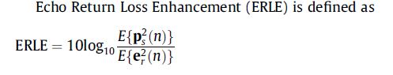
ERLE comparison
The efficiency of the echo removal is estimated by measuring ERLE (Echo Return Loss Enhancement)
the optimum echo cancellation can be achieved when the ERLE lies between 30 and 40dB; higher value of ERLE gives higher cancellation of echo.
Single channel 34dB
Multichannel Scenario 1 36dB
Multichannel Scenario 2 38dB
According to ITU-T recommendation G.167 the value of ERLE should be 25 dB for hands free telephones during double talk.

Slide 28
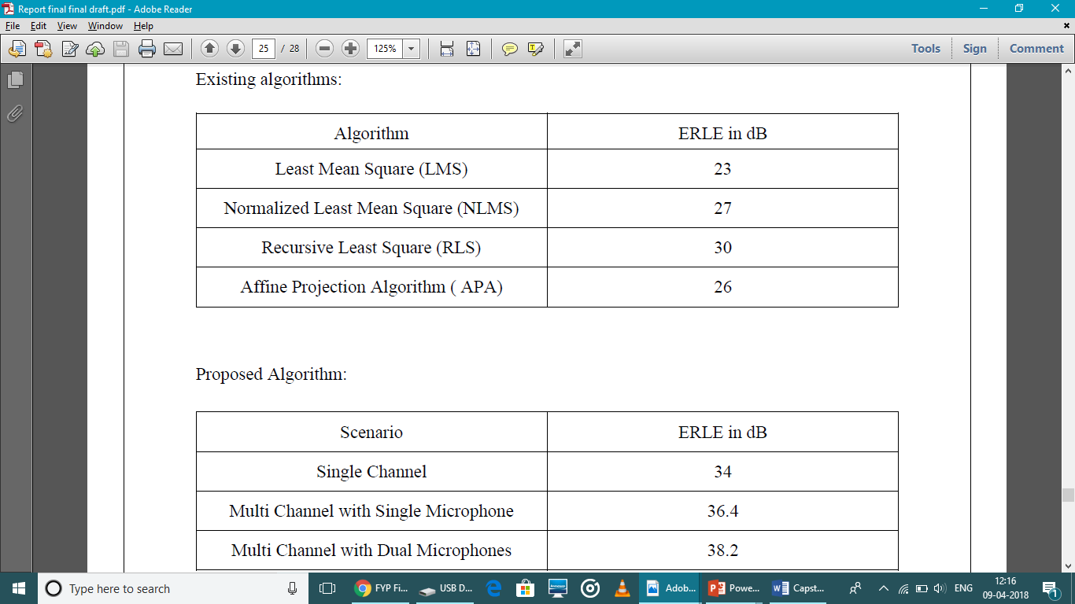
Cost Analysis
Existing algorithms

Slide 29
Proposed algorithm
Apart from ERLE all the above mentioned algorithms fail to perform in double talk situation which is present everywhere in today’s hands free communication environment. This is because the adaptive filter gets confused if more than two signals arrive and the filter coefficients are not updated properly resulting in the partial echo cancellation.

Slide 30
Trade-off
We are using gradient approach in our design to achieve high quality at the cost of execution time. We can us fast ICA approach to reduce the execution time but will not be able to get good ERLE.

Slide 31
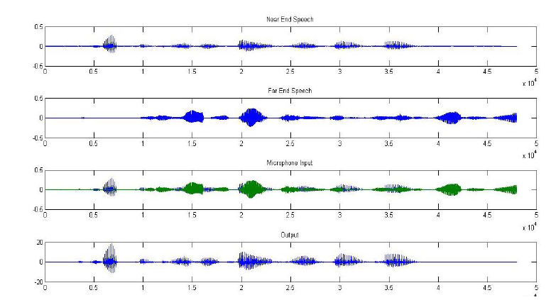
Demonstration/ Result
Single channel:

Slide 32
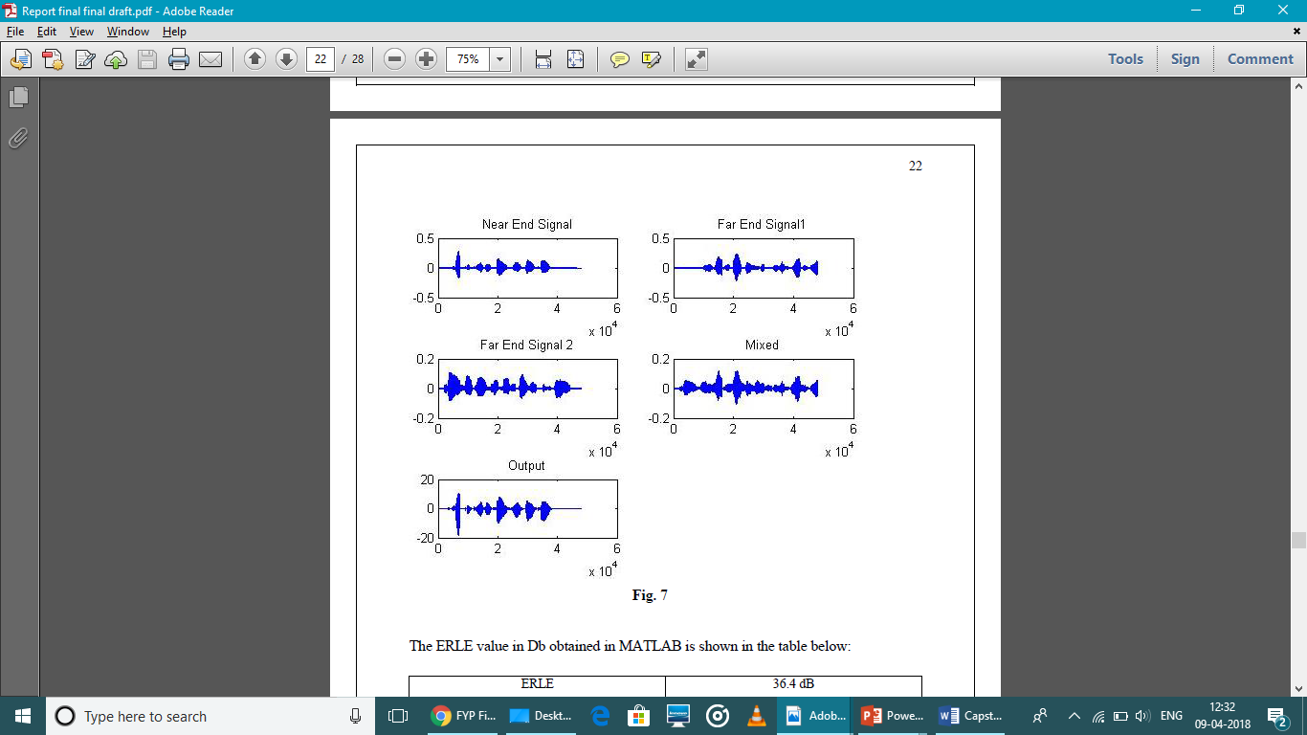
Multi-channel (scenario1)

Slide 33
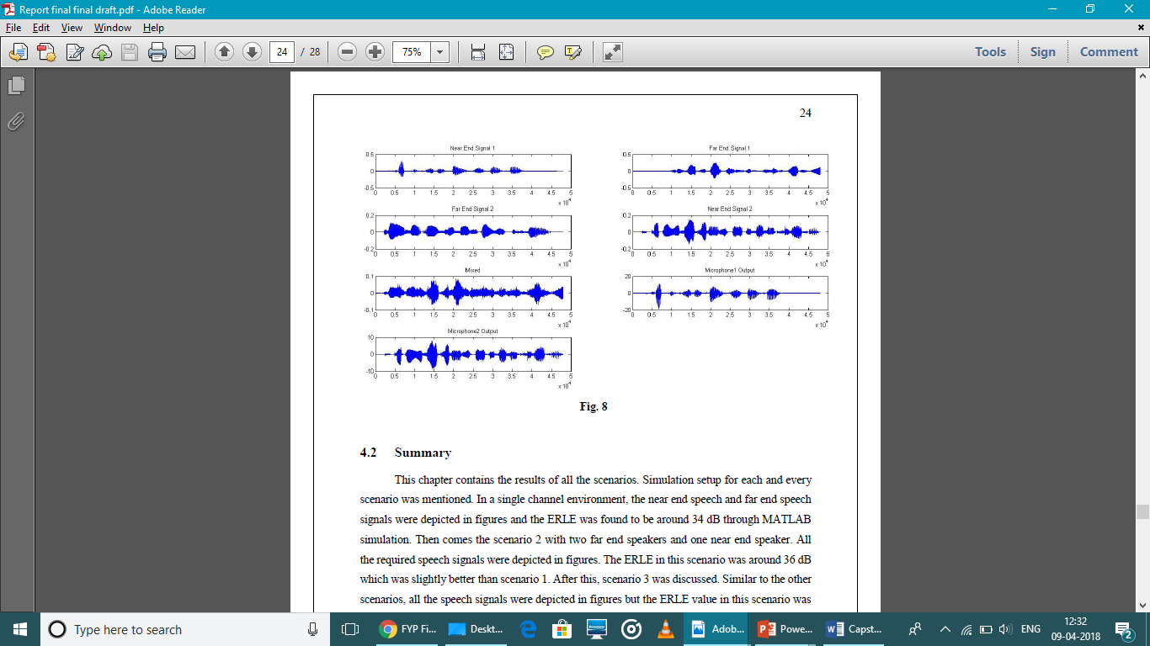
Multi-channel (scenario2)

Slide 34
Conclusion
The primary aim of this project was to cancel the acoustic echo in a multichannel environment by developing an ICA based technique, specifically using maximisation of non-gaussianity. The proposed algorithm was first tested in a single channel environment and when it was successful, it was applied to a multichannel environment.
The multichannel environment was split into two scenarios with the first scenario having only microphone and the second scenario having dual microphones.

Slide 35
The proposed algorithm was applied to both the scenarios and the results were satisfactory with both the scenarios producing ERLE values of above 35 dB.
With the ERLE value above 35 dB, the secondary aim, which was to maintain a good ERLE, was also achieved

Slide 36
Future Work
For any algorithm the execution time is very important, like in this project there is no use if the cancellation of the acoustic echo takes too much time since it is a teleconferencing application. The user of the teleconferencing system cannot wait that long. The best way to reduce the wait time for this algorithm is to improve the pre-processing.
With the help of wavelet based techniques along with centering and whitening the execution time can be reduced. The addition of the wavelet based pre-processing is a good way to go in the future.

Slide 37
REFERENCES
[1] L. Romoli et al./Speech Communication 86 (2017) 97-106.
[2] K. Mohanaprasad, P. Arulmozhivarman/Applied Acoustics 97 (2015) 37-45.
[3]Allen, J.B. , Berkeley, D.A. , 1979. Image method for eﬃciently simulating small room acoustics. J. Acoust. Soc. Amer. 65, 943–950 .
[4] European Broadcast Union , 1988. Sound Quality Assessment Material Recordings for Subjective Tests . Tech. 3253-E.
[5] Benesty, J. , Morgan, D.R. , Sondhi, M.M. , 1998. A better understanding and an im proved solution to the speciﬁc problems of stereophonic acoustic echo cancel lation. IEEE Trans. Speech Audio Process. 6 (2), 156–165 .
[6] Haykin S. Adaptive filter theory. 4th ed. Upper Saddle River, NJ: Prentice-Hall;
2002.
[7] Widrow B, Hoff Tr. ME. Adaptive switching circuits, in IRE Wescon Conv Rec;
1960. p. 96–104.

