Slide 1
BIASING
Diodes,Transistors,Fets
Practical Perspective.
Prof K.Appa rao

Slide 2
BIASING
DIODES,TRANSISTORS,FETS HOW practical perspective
Semiconductor Diodes.
Specs of diodes,
Determine ckt, apparatus for forward bias.
Reverse bias ckt and apparatus
FUN WITH DIODES

Slide 3
BIASING
ZENER DIODES, design supply,estimate ripple
TUNNEL DIODES
FUN WITH ZENERS
TRANSISTORS ..Biasing methods
FUN WITH TRANSISTORS
FETS ..How to bias,..difficulties.

Slide 4
DIODES
FORWARD BIAS
Specs: Vf @ If
Apparatus: DC Power supply
Ammeter , Voltmeter, Diode,
Resistor ,Bread board, Wires
REVERSE BIAS
Specs Ir @ Vr
Apparatus: DC Power supply
Ammeter , Voltmeter, Diode,
Resistor ,Bread board, Wires
Vb
Vb
If

Slide 5
An Engineer specifies thus
Dual/Single Dc Regulated Power supply 0-30v / 1 A ………..1 No.
Moving coil DC milli ammeter 10 ma FSD….. 1 No.
3 ½ digit Digital Multi-meter LCD type ..1No.
Diode type 1N 4148……. 1 No.
Carbon Film resistor 2.7 k ½ w 5 % …1 No..
Bread board….1 No
Single strand 1/20 insulated PVC wires…

Slide 6
How to determine R ? If = 10 ma
Vb volts | R ohms | Pd dissipation | W & tolerance
10 | 820 | 100 mw | ¼ & 5 %
20 | 1800 | 200 mw | ¼ & 5 %
30 | 2700 | 300 mw | ½ & 5 %

Slide 7
Reverse Bias Characteristic….
A widely used circuit, Is it OK ?
what does uA read ?
V read by analog
meter,
by DMM
THINK. !!!
V
ua

Slide 8
Correct Methods….
Solution 1.
I r= Vosc/1 M, say 15 mv/1M =15 nA !!
Ir
1 uF
To CRO
0-30v
1 M ohm

Slide 9
Correct methods..
Solution 2
Solution 2
I r= Vdmm/1 M, say 15 mv/1M =15 nA !!
DMM
0-30v
1 M ohm

Slide 10
FUN WITH DIODES
Enjoy
QUIZ

Slide 11
PROBLEM 1.
I = (a) 10 ma (b) 9.7 ma ( c ) 9.3 ma
1 k
I
10 V
Ge
Si

Slide 12
PROBLEM No 2
I= (a) 9.3 ma (b) 0 ma ( C ) 9.7ma
1 k
I
10 V
Ge
Si

Slide 13
PROBLEM No 3
I = (a) 15 ma (b) 5 ma ( c ) 0 ma
- 10 V
1 K
- 5 V
-

Slide 14
PROBLEM No 4
Vo = (a) 0.7 v (b) – 5 v ( c ) - 4.3 V
1 K
Vo
+ 10 V
- 5 V

Slide 15
PROBLEM No 5
(a) –0.3V (b) -0.7 V ( c ) 1.8 V
1 K
Vo
Ge
LED
20 V
Si

Slide 16
PROBLEM No 6
1 K
Vo
Ge
LED
20 V
Vo = ?
Si

Slide 17
FUN WITH LEDS & RECTIFIERS
Enjoy
QUIZ

Slide 18
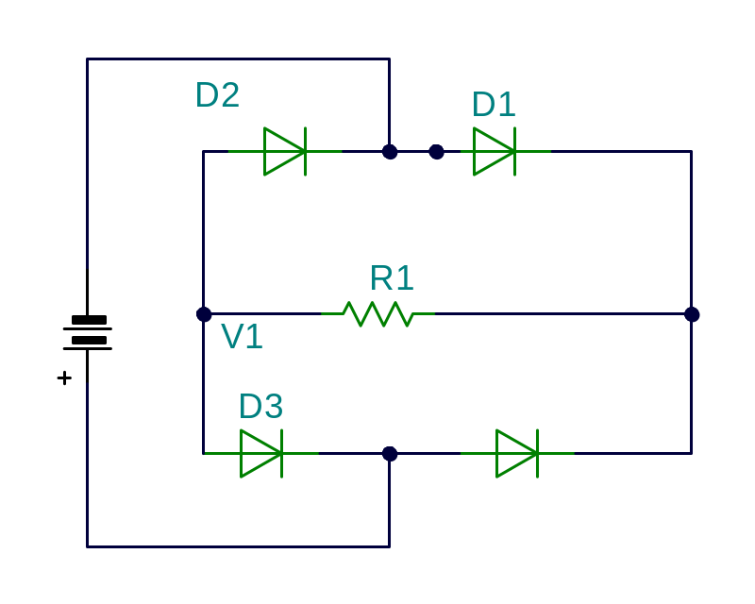
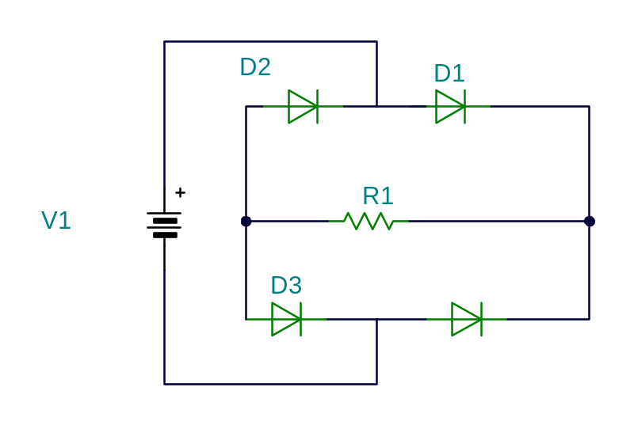
Use LEDs ,Glow on conduction
D4
D4
D1 and D3 conduct
D4 and D2 conduct

Slide 19
Some interesting Applications
USING DIODES

Slide 20
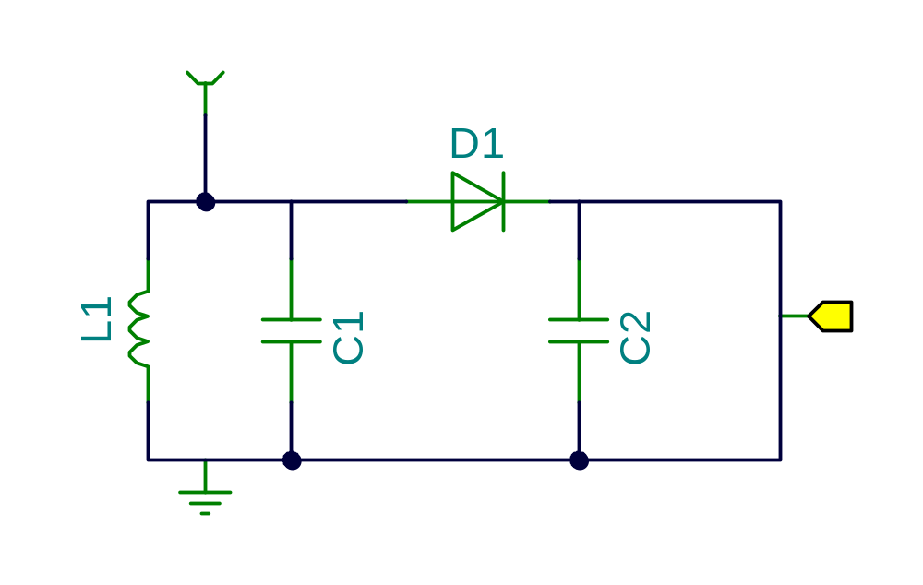
Radio without power
Antenna
Ear phone

Slide 21
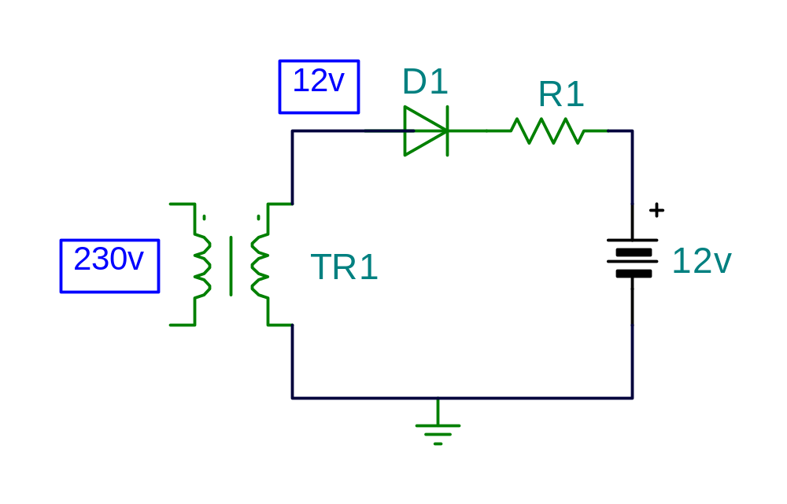
Battery Charger

Slide 22
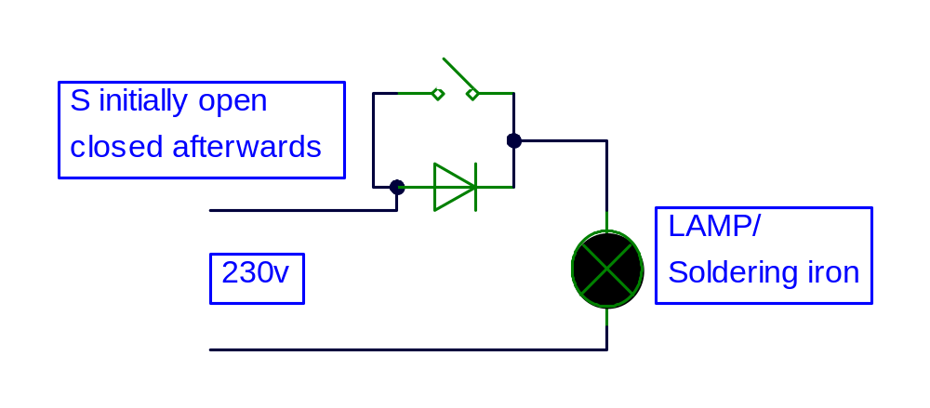
Lamp life protector

Slide 23
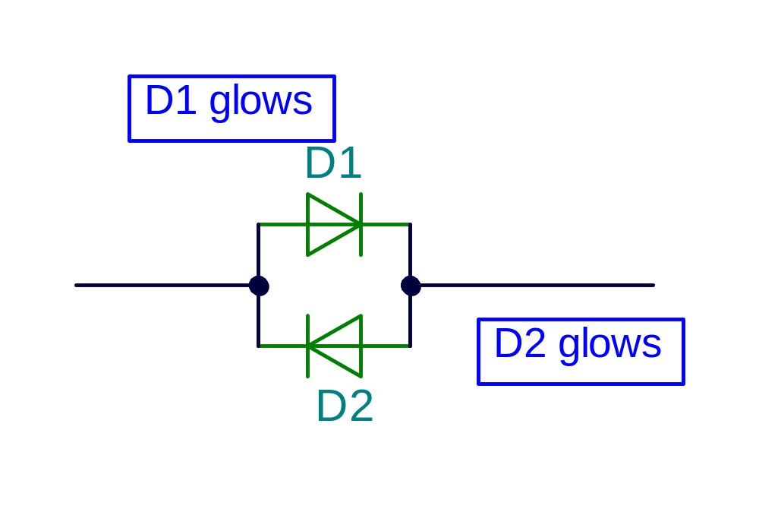
Current direction indicators
Current direction
Current direction

Slide 24
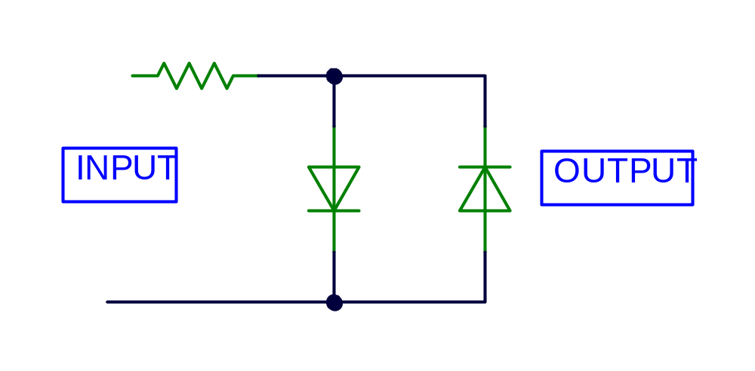
Clip wave around zero

Slide 25
ZENER DIODES
Analysis, Design

Slide 26
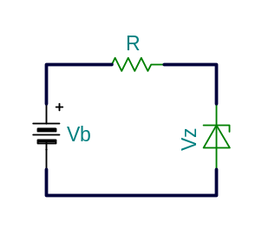
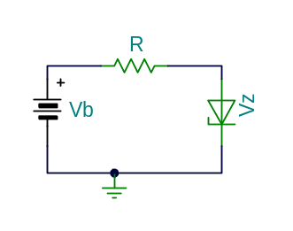
Zener diode
Forward bias, acts like diode
Reverse Bias, acts
Like Zener
I = (Vb-O.7)/R
R = (Vb-Vz)/Iz
I
Iz

Slide 27
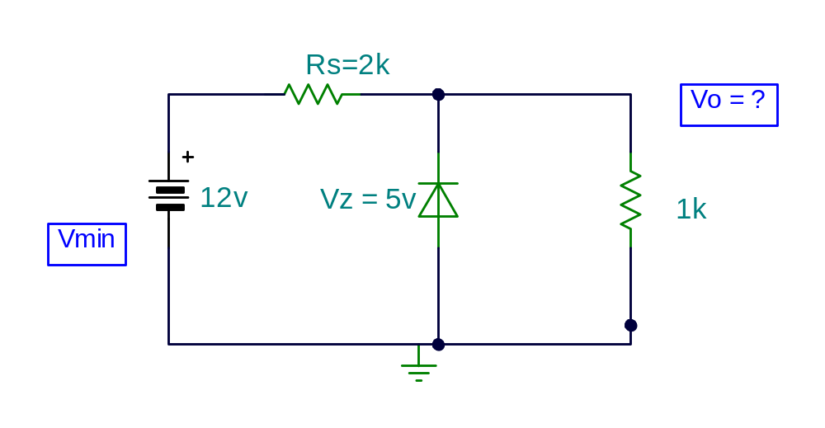
Design of Zener diode supplies
(Vmin x Rl)/(Rl+Rs) = Vz,
,
Vmin = (5(1+2)/1 = 15v

Slide 28
FUN WITH ZENERS
Enjoy
QUIZ

Slide 29
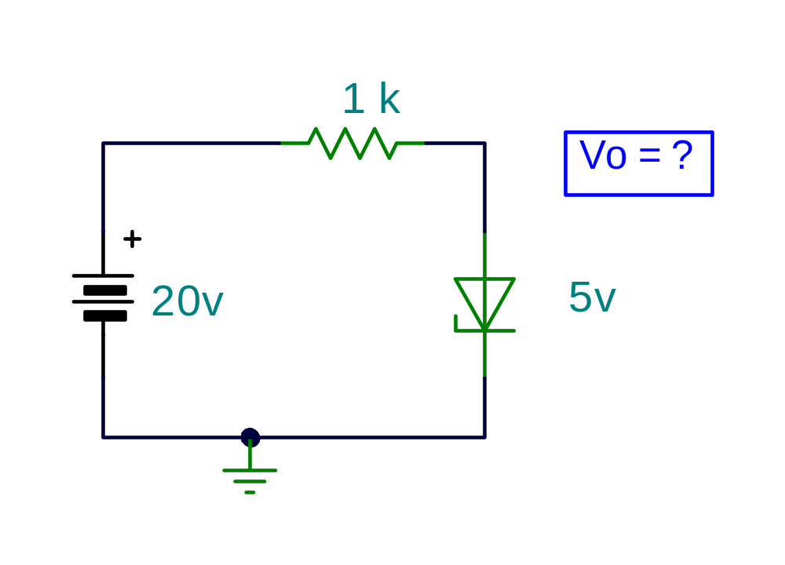
PROBLEM 1
Vo=
0 (b) 5v
(c) 0.7v

Slide 30
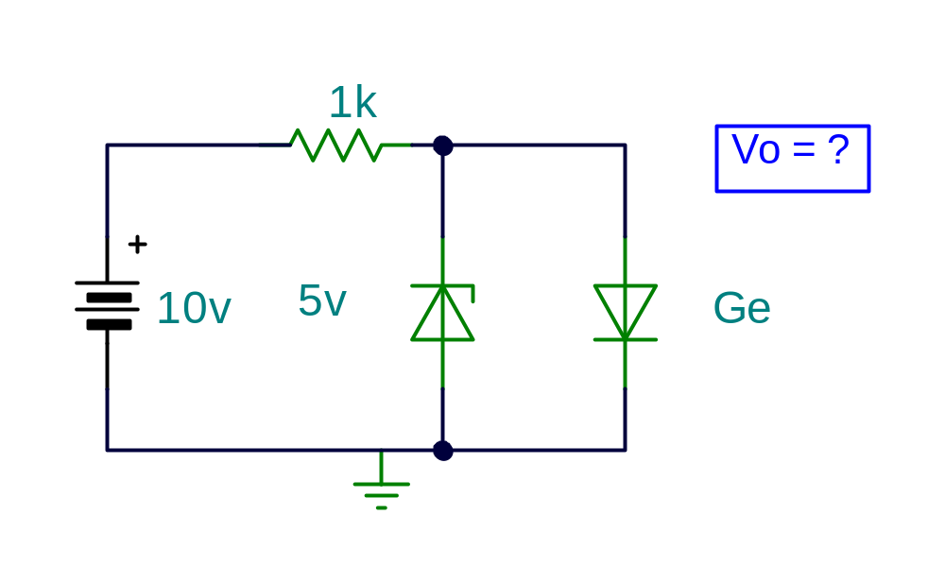
PROBLEM No 2
Vo=
5v (b) 0
(c) 0.3v

Slide 31
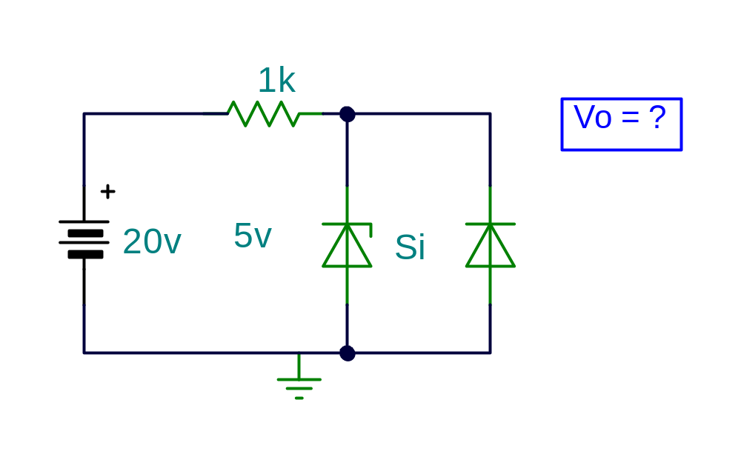
PROBLEM No 3
Vo=
–0.7v
(b) 5
( c ) 0v

Slide 32
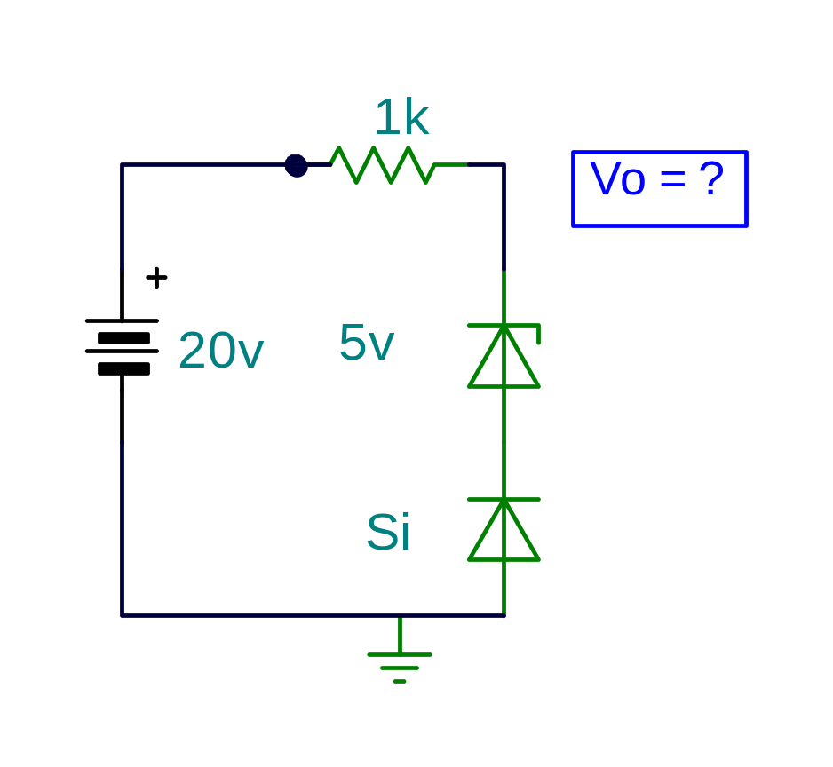
PROBLEM No 4
Vo=
5.6v
(b) 5v
( c ) 20v

Slide 33
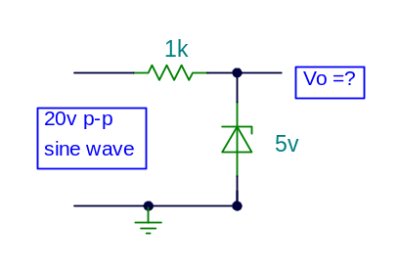
PROBLEM No 5
Clip Waves around zero

Slide 34
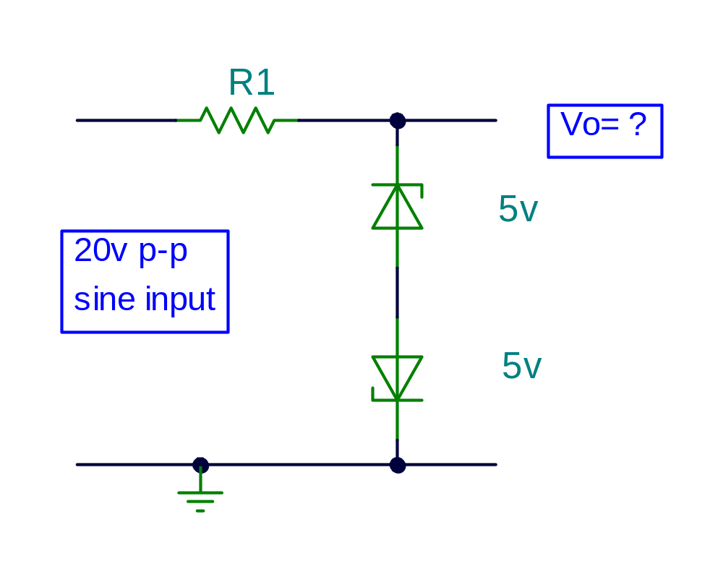
PROBLEM No 6

Slide 35
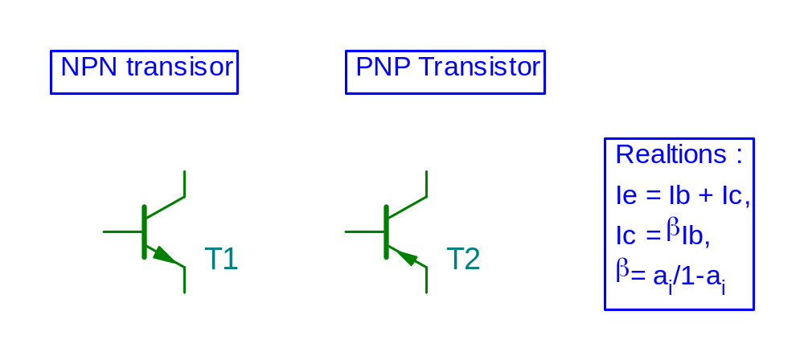
BIASING Transistors
C
C
Ic
Ic
Ib
Ib
Ie
B
B
Ie
E
E
BE jn forward biase Rulesd, BC jn reverse biased

Slide 36
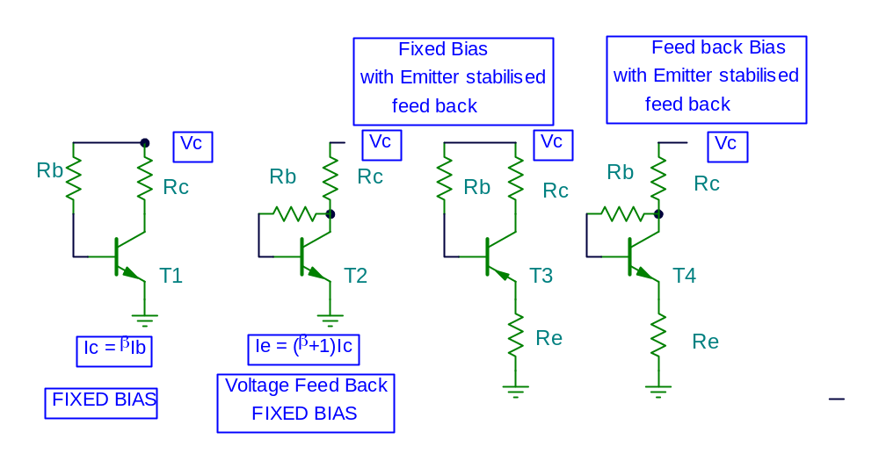
Biasing (Beta dependant)

Slide 37
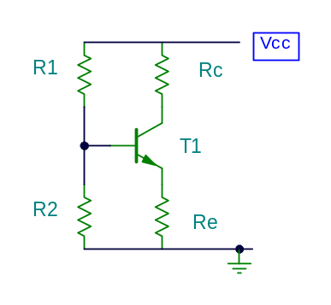
Voltage Divider Bias
Vb = (Vccx R2)/(R1 + R2)
Ve = Vb - Vbe
Ie = Ic = Ve/Re
Keep current thru R1 > 10 times Ib
Stability S = (1+B) ( 1+Rb/Re)/(1+B+ Rb/Re)

Slide 38
FUN WITH TRANSISORS
Enjoy
QUIZ

Slide 39
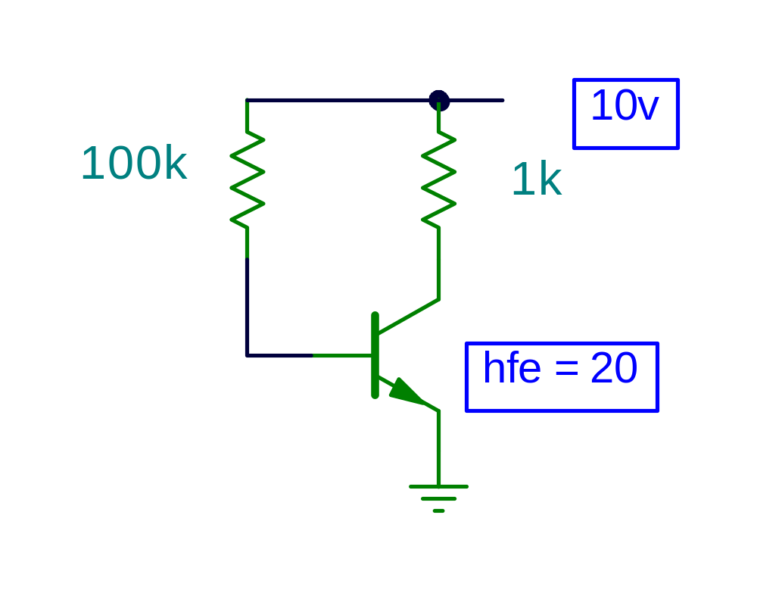
PROBLEM No 1
Ib = (10-0.7)/100
93 uA
Ib
Ic = 20x93 = 1860
1.86 mA
Vc= 10-1.86 = 8.14 v
OK

Slide 40
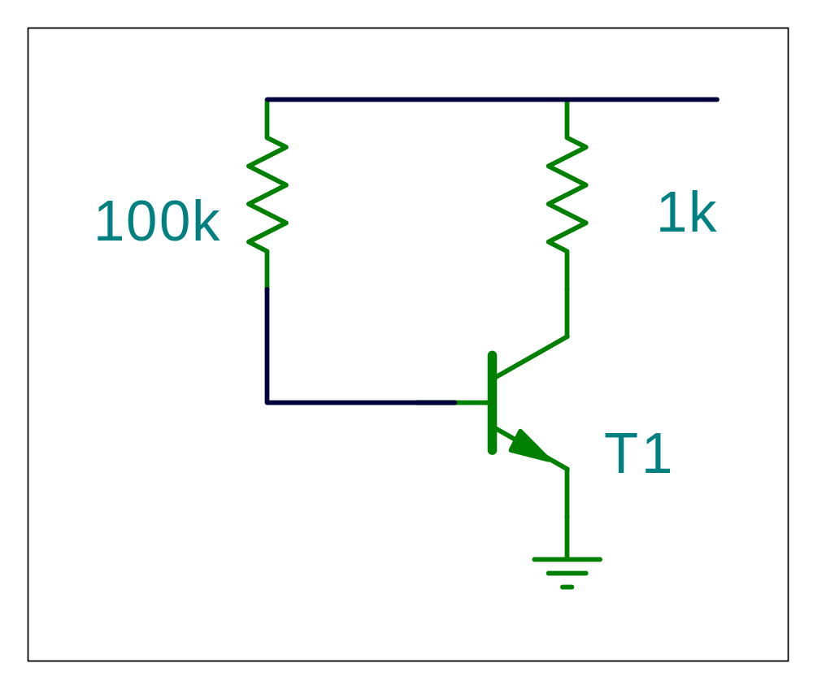
PROBLEM No 2
Ib = ?
Ic = ?
Ie = ?
Hfe=
100
Ib
Hfe
100

Slide 41
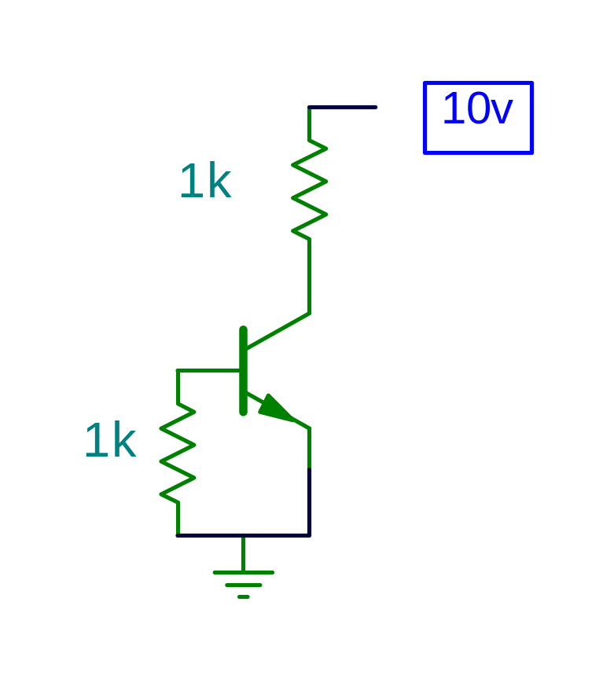
PROBLEM No 3
Ic = ?
Vc = ?

Slide 42
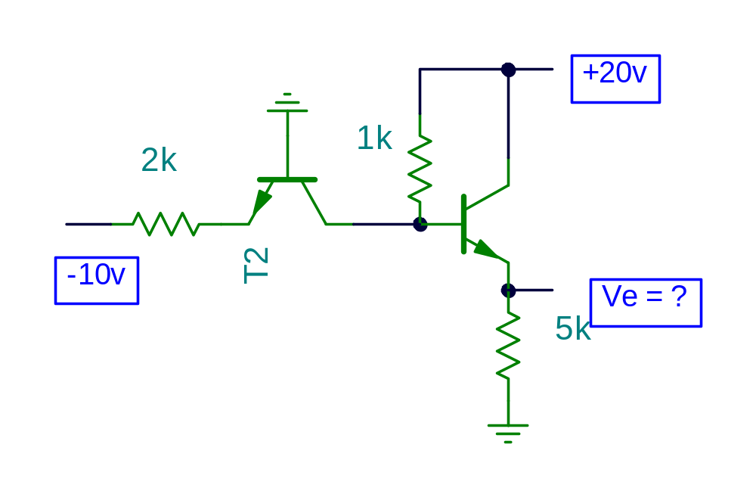
PROBLEM No 4

Slide 43
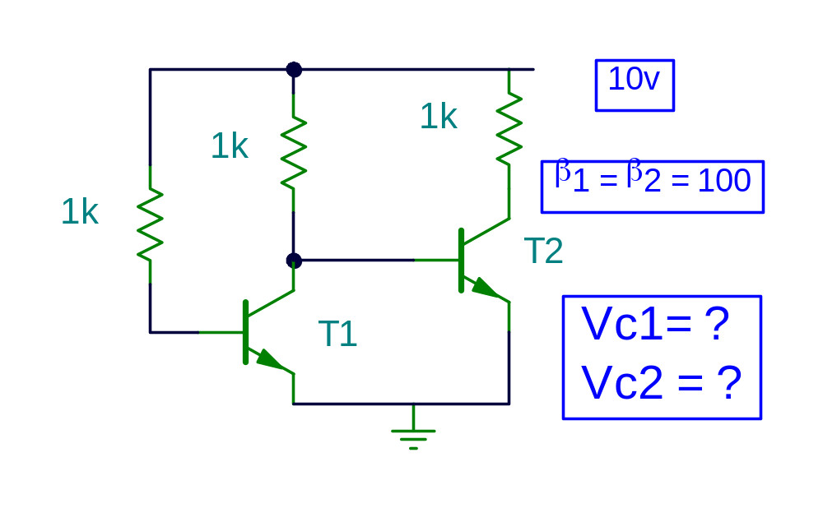
PROBLEM No 5

Slide 44
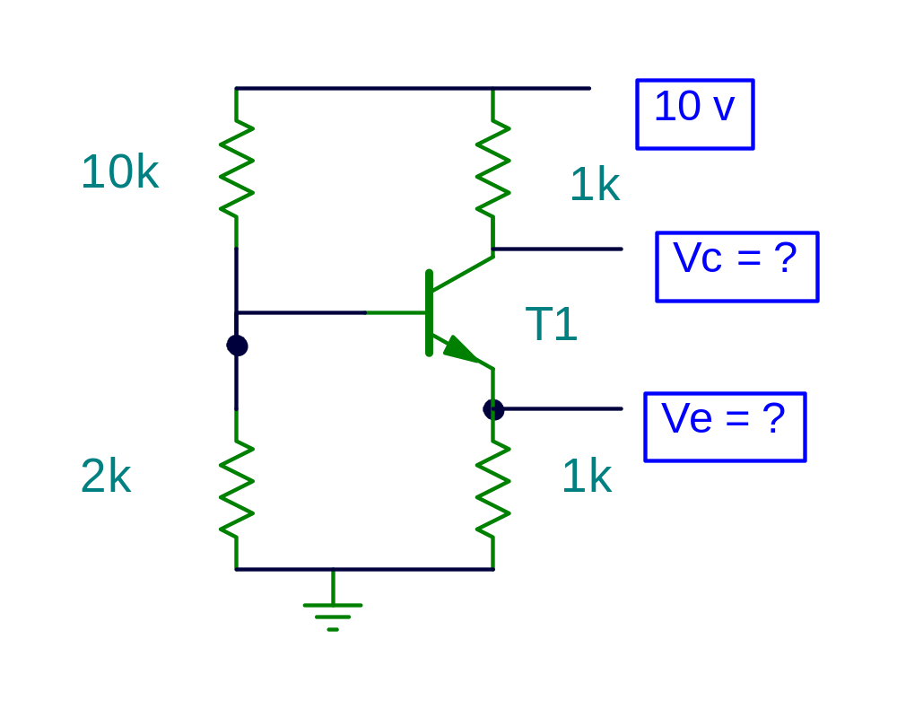
PROBLEM No 6

