Slide 1
THIRDWAVE — FLOOD EARLY-WARNING SYSTEM
MVP FIELD REPORT · 2026
05°33'N 00°13'W ACCRA, GHANA PILOT DISTRICT · 6 ASSEMBLIES
Reading a flooding city with no gauges.
ThirdWave turns free satellite data into an explainable flood-vulnerability picture for Accra, and puts it in front of the two people who need it most during a storm — the government officer deciding where to send a pump crew, and the resident deciding whether to leave.
COMPOSITE SCORE
PILOT COVERAGE
INTERFACES
GROUND TRUTH
SAR + DEM + land cover
319 scored zones, 500m grid
Government console · Citizen app
Zero local sensors

Slide 2
01 — THE PROBLEM
DATA-POOR, STORM-PRONE
Accra floods every rainy season. It has almost nothing to see it coming with.
§1
No dense rain-gauge network. No calibrated hydraulic model of the drainage system — because the drainage system itself is largely undocumented. No shared picture between the officials who'd respond and the residents in the water's path. Kwame Nkrumah Circle floods on a predictable basis, and until this project scored it, that pattern lived in institutional memory and news archives, not in any system a duty officer could query.
0
0
3
2
River or rain gauges instrumenting the pilot district
Documented drain/culvert capacity records available
Free global data sources this project fuses instead
Audiences with no shared system today — govt & citizens

Slide 3

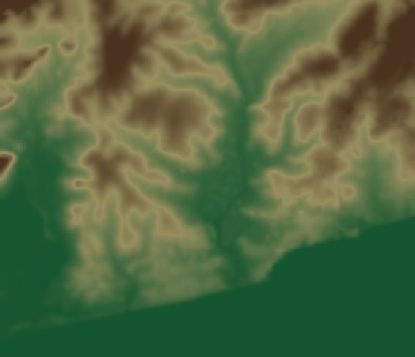
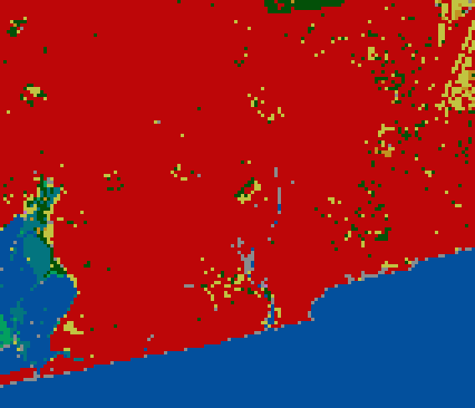
02 — DATA FUSION
FREE, GLOBAL, REAL
Three public satellite layers, fused into one explainable score.
§2
Every plate below is real output from this project's pipeline, over the actual pilot district. Sentinel-1 radar sees standing water through cloud cover; Copernicus DEM gives terrain; ESA WorldCover gives surface type. No signup, no cost.
SAR water occurrence
Elevation
Land cover
Sentinel-1, 2020-2024, 40-scene sample. Darker = more frequently water-like.
Copernicus DEM 30m. Green = low-lying, brown = higher ground.
ESA WorldCover 2021. Red = built-up, blue = water.
SCORE = 0.45 · SAR_OCC + 0.35 · LOW_ELEV + 0.20 · IMPERVIOUS

Slide 4
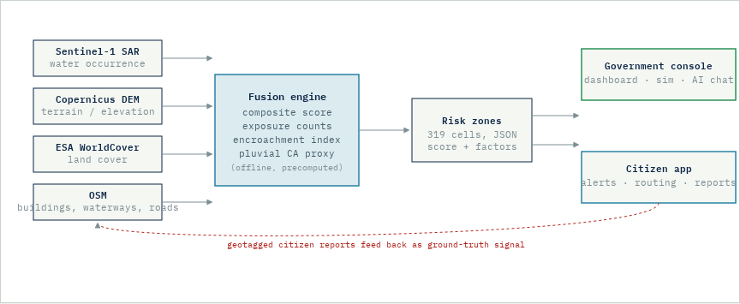
03 — ARCHITECTURE
PIPELINE & CONSUMERS
One computed layer, two very different front doors.
§3
Heavy geospatial fetches and simulation run offline; the interfaces read small, fast, precomputed results.

Slide 5
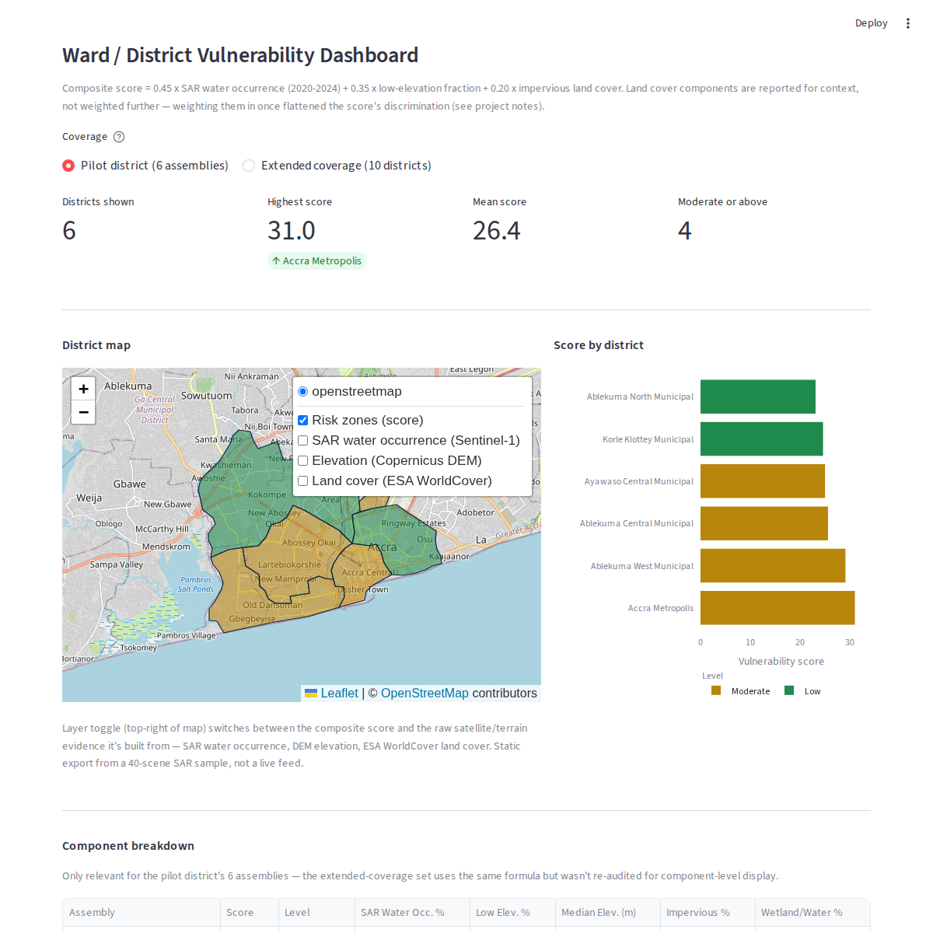
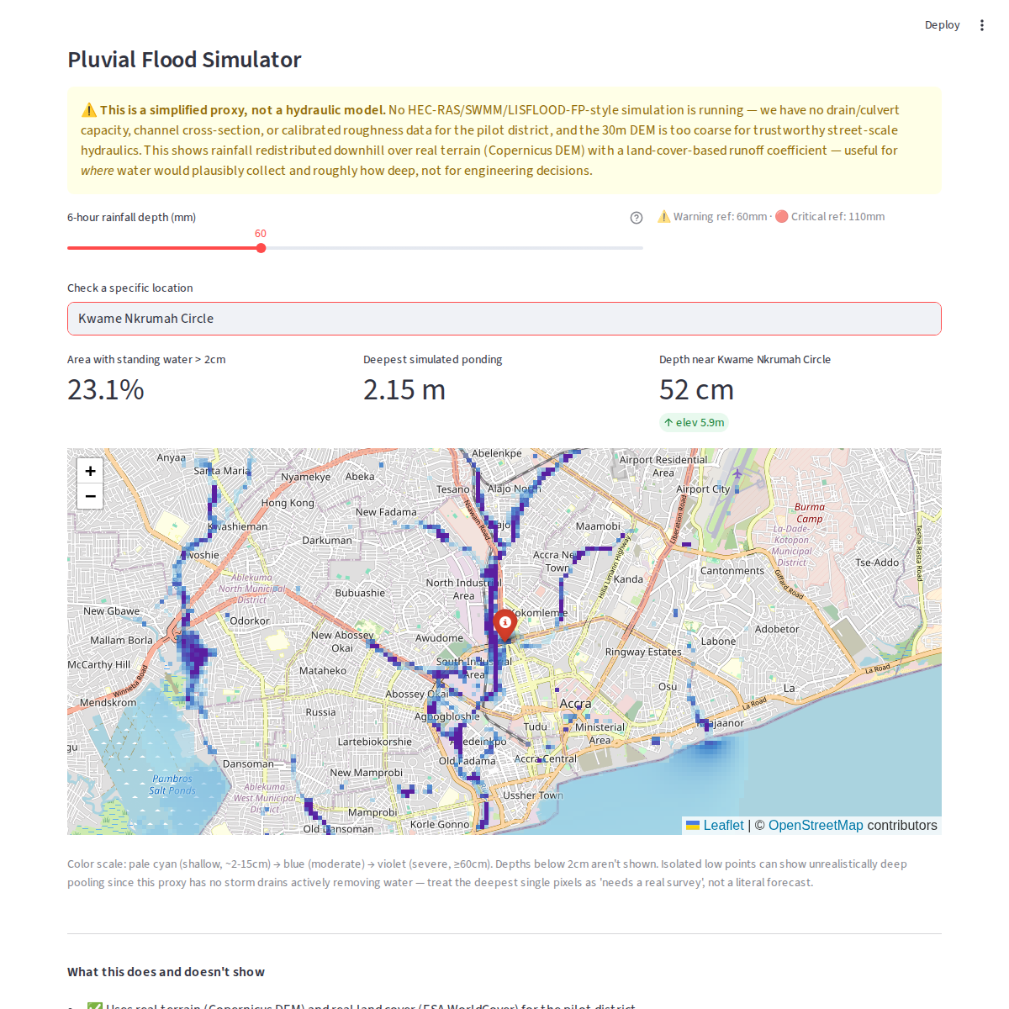
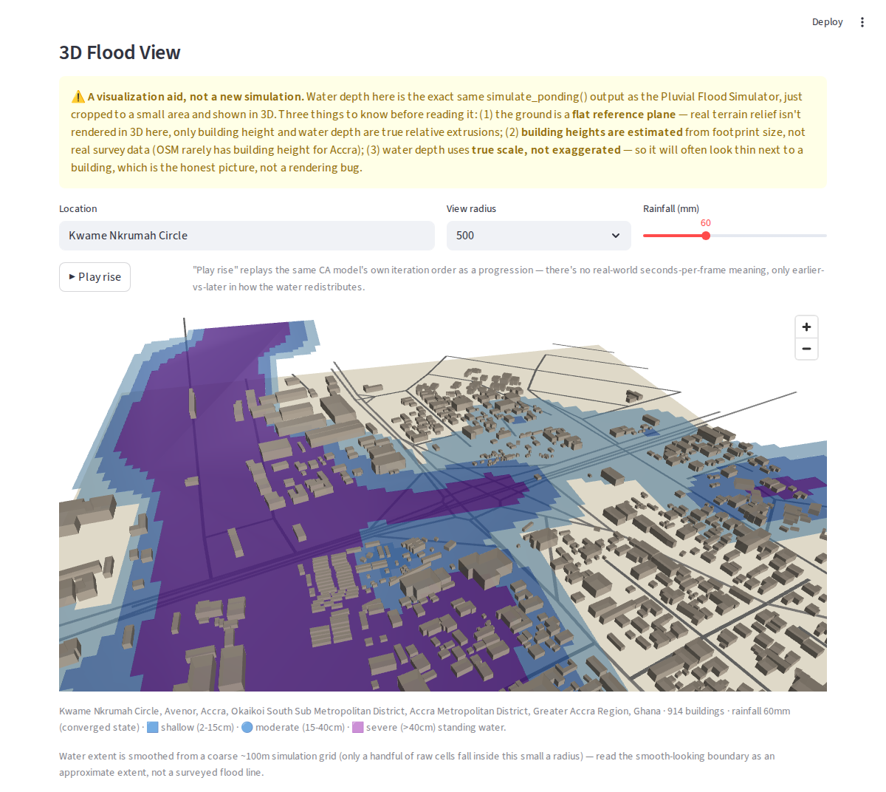
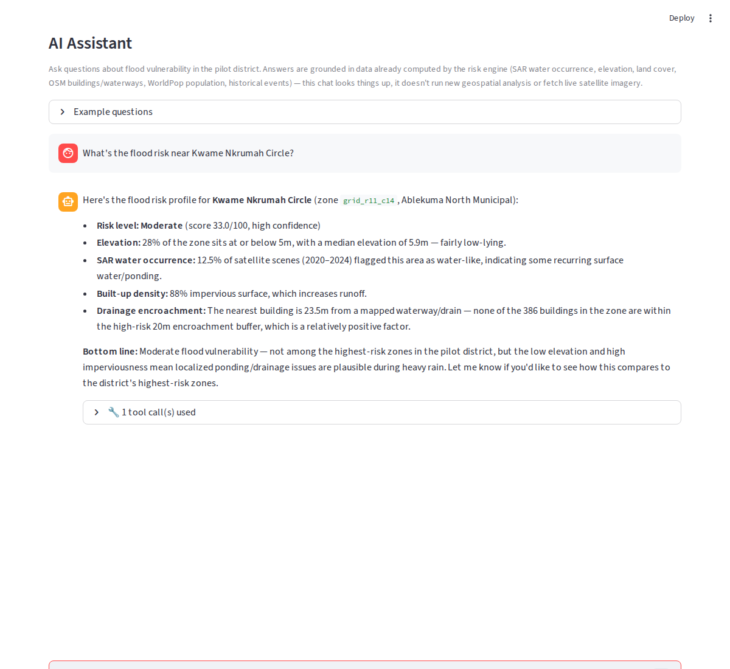
04 — WHAT'S BUILT
WORKING, NOT MOCKED
Four interfaces, all screenshotted from the running app.
§4
District Vulnerability Dashboard
Pluvial Flood Simulator
Composite score per assembly, with a toggle onto raw SAR/DEM/WorldCover evidence.
Rainfall-driven ponding proxy over real terrain — Circle: 52cm at 60mm.
3D Flood View
AI Assistant
Real OSM buildings and roads, true-scale simulated water.
Claude with tool-calling over the real computed data.

Slide 6
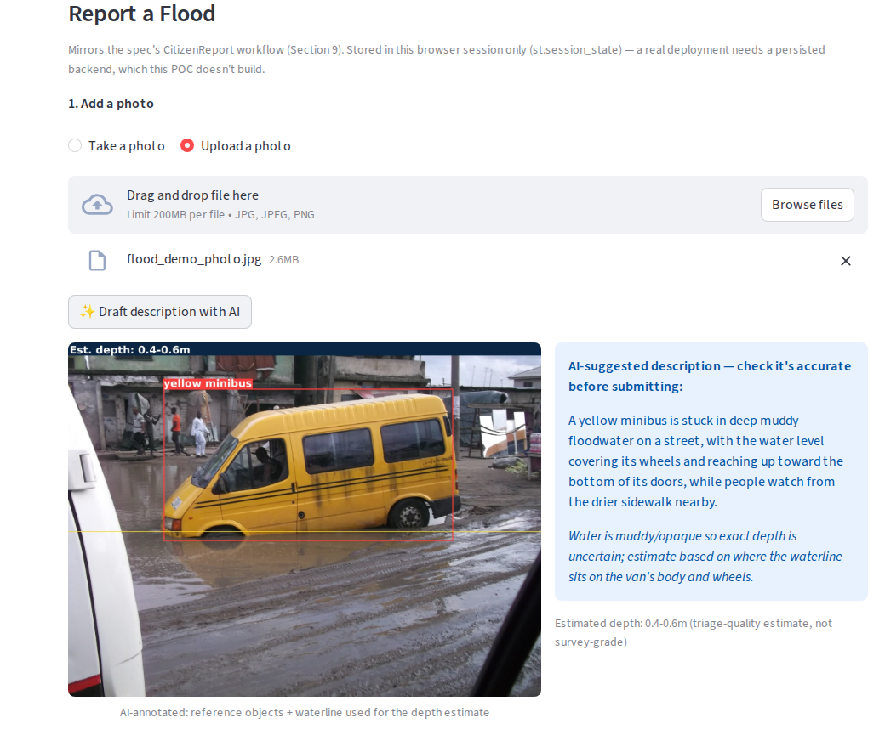
04.1 — CROWDSOURCED REPORTING
THE VLM IN ACTION
A resident's photo becomes a structured, reviewable report.
§4.1
A vision-language model finds a reference object, draws the waterline against it, and drafts a triage-quality depth estimate — before the resident reviews and edits it. Live output from the running app.
Demo photo for this pitch (not a real pilot-district submission): flooded street, Lagos, 2013 — Elgabarty2002, CC BY-SA 4.0, via Wikimedia Commons.

Slide 7
05 — WHERE AI DOES THE WORK
FIVE SPECIFIC JOBS
Not "AI everywhere." AI where the constraint actually required it.
§5
01
Risk assessment with zero local ground truth
Global ML-classified products fused into one score, fine enough to catch the 2015 Circle disaster a coarser score missed.
02
Noisy radar hiding small water bodies
A deep despeckling model (SAR2SAR) cleans Sentinel-1 speckle before water-occurrence is computed.
03
Unstructured citizen photos
A vision-language model turns a submitted photo into a structured depth/severity read, resident-validated.
04
Hydraulic modeling needing data nobody has
A lightweight cellular-automaton proxy over real terrain — disclosed as a proxy, not a calibrated model.
05
GIS tools locking out non-technical officials
Tool-calling chat grounded in the real computed data — plain language in, real answers out.
The core risk score is a transparent formula, not a trained model. We checked whether a public satellite flood-extent dataset could justify a predictive model instead — it couldn't (wrong resolution, not enough local labeled events). Knowing where not to force AI is the same engineering discipline as knowing where to use it.

Slide 8
06 — ROADMAP
HONEST NEXT STEPS
What's next, gated on what would actually make it better.
§6
SHIPPED
Composite risk score, 4 government tools, 5 citizen tools, AI assistant
All screenshotted from the running pilot-district app in this report.
ACCUMULATING NOW
Citizen reports as a real ground-truth stream
Each geotagged report with a VLM depth estimate is a sparse, real observation — the kind of anchor data a physics-informed model needs.
FUTURE DIRECTION
Physics-informed neural network (PINN) for surface flow
Once citizen reports accumulate enough to anchor it, a shallow-water-equation PINN could replace the CA proxy — still bounded by the same missing drainage-capacity data as any hydraulic model.

Slide 9
07 — CLOSE
THIRDWAVE
Built for the officer deciding where to send a pump crew, and the resident deciding whether to leave.
WHAT IT IS
WHAT IT ISN'T
ASK
A working MVP: real satellite fusion, real government & citizen tools, tested end-to-end.
Not a calibrated hydraulic model, not a substitute for real sensors — every tool discloses its own limits in-app.
Feedback on the pilot scope, and a path to real citizen-report volume to anchor what comes next.
THIRDWAVE — ACCRA, GHANA · PLATES 2.1-2.3 DERIVED FROM SENTINEL-1 / COPERNICUS DEM / ESA WORLDCOVER

