Slide 1


COSC41000 Deep Learning for Sequential Analysis Fall 2024
Dr. Priyamvada (Pia) Tripathi
Course Introduction

Slide 2

LAND ACKNOWLEDGEMENT
Durham College is situated on the traditional lands of the First Peoples of the Mississaugas of Scugog Island First Nation. These lands are covered under the Williams Treaties and rest within the traditional territory of the Anishinaabeg. We offer our gratitude to the Indigenous Peoples who care for and, through the treaty process, share the lands on which we live, learn, teach and prosper today.

Slide 3
Class Details
Course Name: COSC41000 Deep Learning for Sequential Analysis Fall 2024
Faculty: Dr. Priyamavada (Pia) Tripathi
Brief Bio: B.S., PhD in computer Science from Arizona State University
LinkedIn: https://www.linkedin.com/in/piatech/
Meeting time and location: Day
Monday 4:10 pm to 7 pm
Room CFCE 318
Modes of delivery
Lecture + Lab
Sept 3, 2024- December 13, 2024

Slide 4

Contact Me
DC connect or Email
Priyamvada.Tripathi@durhamcollege.ca
shall respond within 24 hours
Put name and course number in subject line
Mark urgent if need immediate reply
Office hours: T 11:30 am to 12:30 pm/Meet by Appointment
NO Team chat please!

Slide 5
Course Description
The course introduces students to Methods in Deep Sequential Learning including Recurrent Neural Nets (RNNs), a class of modern artificial neural networks aimed at processing sequential data.
The course goes on to introduce the problems of vanishing and exploding gradients as well as that of long-distance dependencies in sequential processing while offering their corresponding solutions.
Students will focus on the theoretical and practical aspects of various types of sequential architectures (i.e., various types of RNNs and Transformer Architectures)
and study their applications including those in natural language processing (including such tasks as language translation, automatic captioning, handwriting and speech recognition), log/sensor analysis, and time series anomaly detection

Slide 6

Course Evaluation
This course is assessed with
Exams
Assignments
Project
Description (As Per Outline) | Value (Total %)
Assignment 1 | 15
Midterm Test | 25
Assignment 2 | 15
Final test | 25
Project | 20

Slide 7



Important Dates
Date | Activity | Weight (%)
30-Sep-24 | Assignment 1 Due | 15
Oct 7 | Midterm Test | 25
14-Oct-24 | Thanksgiving (No classes)
October 21-25, 2024 | Reading Week
28-Oct-24 | Assignment 2 Due | 15
25-Nov-24 | Project Due | 20
December 9th | Final Test | 25
13-Dec-24 | last day of classes

Slide 8
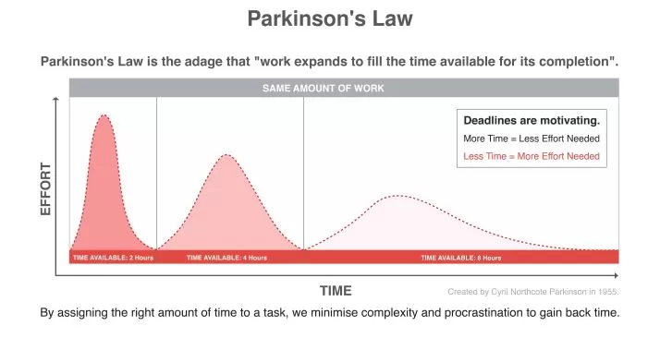
Late assignments
Late assignments can be submitted up to 3 days (72 hours) after the due date. However, there will be a penalty of 25% deducted from the total possible grade for the assignment for all allowed late submissions.
No submissions after 3 days will be accepted/automatic grade 0

Slide 9

Academic Integrity
Academic integrity is essentially honesty in all academic endeavors.
Academic integrity requires that students avoid all forms of academic misconduct or dishonesty, including plagiarism, cheating on tests or exams or any misrepresentation of academic accomplishment.

Slide 10
Disclaimer
While every effort is made by the professor/faculty to cover all material listed in the outline, the order, content, and/or evaluation may change in the event of special circumstances (e.g. time constraints due to inclement weather, sickness, college closure, technology/equipment problems or changes, etc.). In any such case, students will be given appropriate notification.
Basically, some changes may happen as the course moves along!
Like dates/contents may shift around

Slide 11
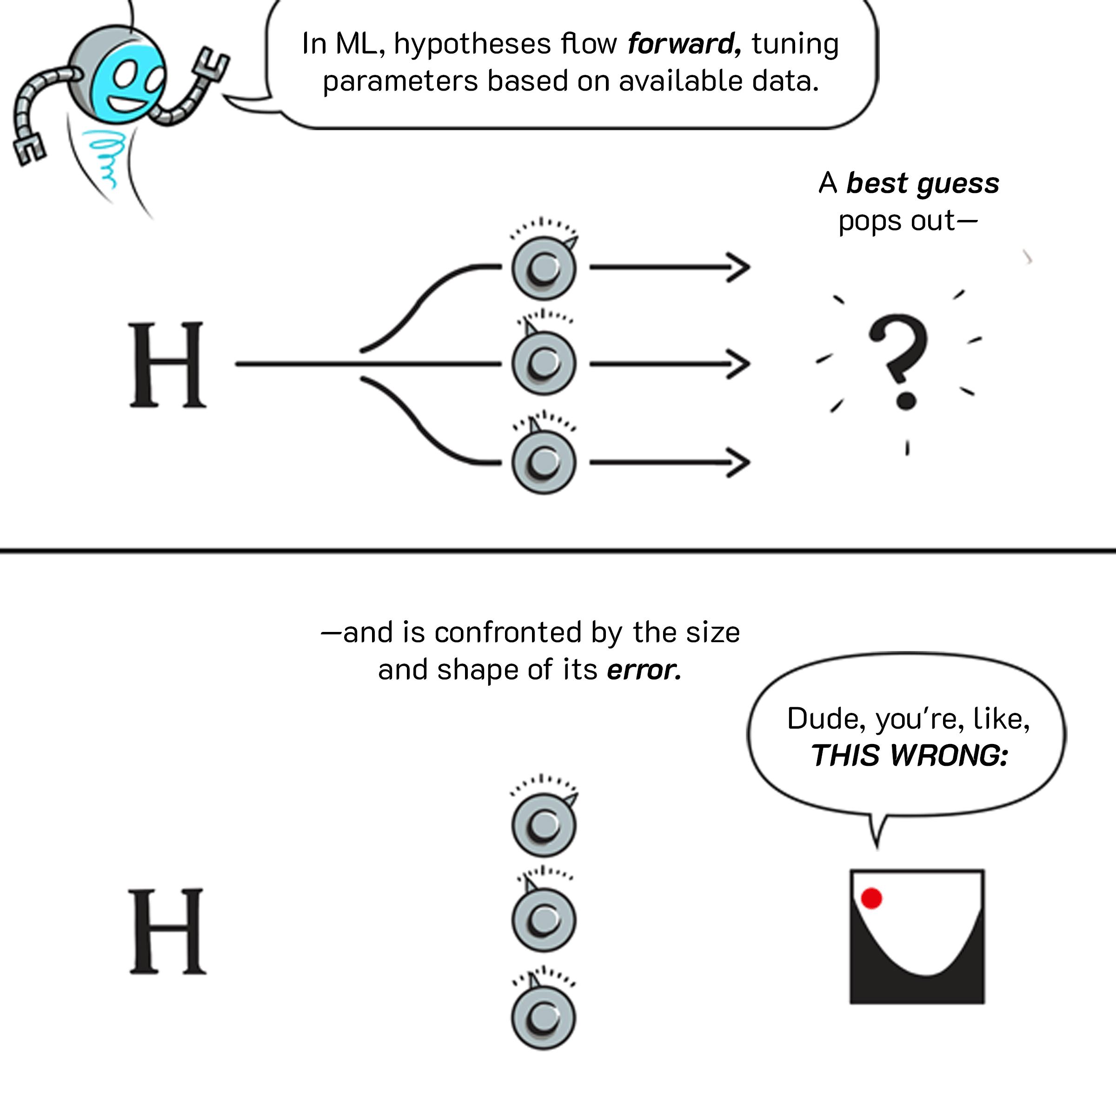
Questions?
AI COMICS!
https://cloud.google.com/products/ai/ml-comic-1
https://cloud.google.com/products/ai/ml-comic-2

