Slide 1


Bank of Baroda Hackathon - 2022
Technology Partner
Your Team Name : Harekrishna
Your team bio : Students who love to solve problems.
Date :20th September 2022

Slide 2
Problem Statement?
Why did you decide to solve this Problem statement?
We decided to solve this problem because many a times we notice that people find it hard to understand actual banking procedures. Either they don’t complete the procedure or even if they complete it many errors are found. Because of these errors their requests are not considered and they find it diffcult and troublesome to go through the same process again and again. Most of the indian masses are not very much educated so there is a requirement of some other entity who would help them understand and carryout each and every process smoothly.

Slide 3
User Segment & Pain Points
Which user /advertiser segment would be early adopter of your product & why?
Common bank customers who have to undergo hectic banking procedures to fill out some of the details which they properly understand. The whole idea is to specially target the group of people who are not educated, because it has been seen in the past that whatever online methods or application come to help people digitally carry out the processes, it always needed some literacy about the technology or it needed someone who is good enough to understand each and every process.

Slide 4
Pre-Requisite
What are the alternatives/competitive products for the problem you are solving?
If we give some serious look into the market, there is not any competition to the problem that we will be solving because we are going to develop a virtual avatar and we have not seen any other oragnization who uses this technology. But even if we consider the mobile apps or the online web apps which help carry many out process like mobile verification, account opening at home, they don’t have smoothness or the ease that a virtual avatar can provide.

Slide 5
Azure tools or resources
Azure tools or resources which are likely to be used by you for the prototype, if your idea gets selected Microsoft Azure SQL Database Azure Storage Azure Analytics services Azure Machine Learning

Slide 6
Any Supporting Functional Documents
We will be developing a virtual avatar which will help customers in many ways:
1-Narrate the procedure or the required steps. The avatar will be multilingual.
2-Whenever the customer is stuck somewhere, they don’t need to find the details on google, our virual avatar will help them understand the procedure in a simple and easy manner.
3-Whenever required the avatar will automatically prompt the user and ask for required documents and scan them to save them on our database for future use cases.
4-There are many requests like email or mobile notification, new pass book, check book issue request. Most of the times these request require us to be present at the branch physically but with help of the avatar this will be automated and initiated by the avatar itself when prompted.
5-The most interesting feature that we will be putting in our avatar will be that it will read out loud the detail to be filled and take voice input and automatically fill the form without the user typing.
This will help the illiterate sector who do not how to type even in their own language this avatar whenever initiated will ask for details by speaking (in the preferred langauge ) and take voice input and itself fill the details.
6-Our avatar will also help do necessary KYC when ver possible without repeatedly asking for same information again and again.

Slide 7
Key Differentiators & Adoption Plan
Our solution has this one feature of narration and taking voice input which doesn’t require any typing so it makes it easier for the uneducated masses to easily access many services provided by the banks.
For example:
If there is this detail like First name whether in native language or English language but the customer doesn’t know to read
So the avatar will speak out loud “What is your name?” or “Aapka naam kya hai?”, so the user will respond “Upendra Pandit” or “My name is Upendra Pandit” or “Mera naam Upendra Pandit” so the data will inputted by recognising the voice and the detail will be automatically filled.
The avatar will have features which are relatable to the specific customer so it would be user friendly.

Slide 8
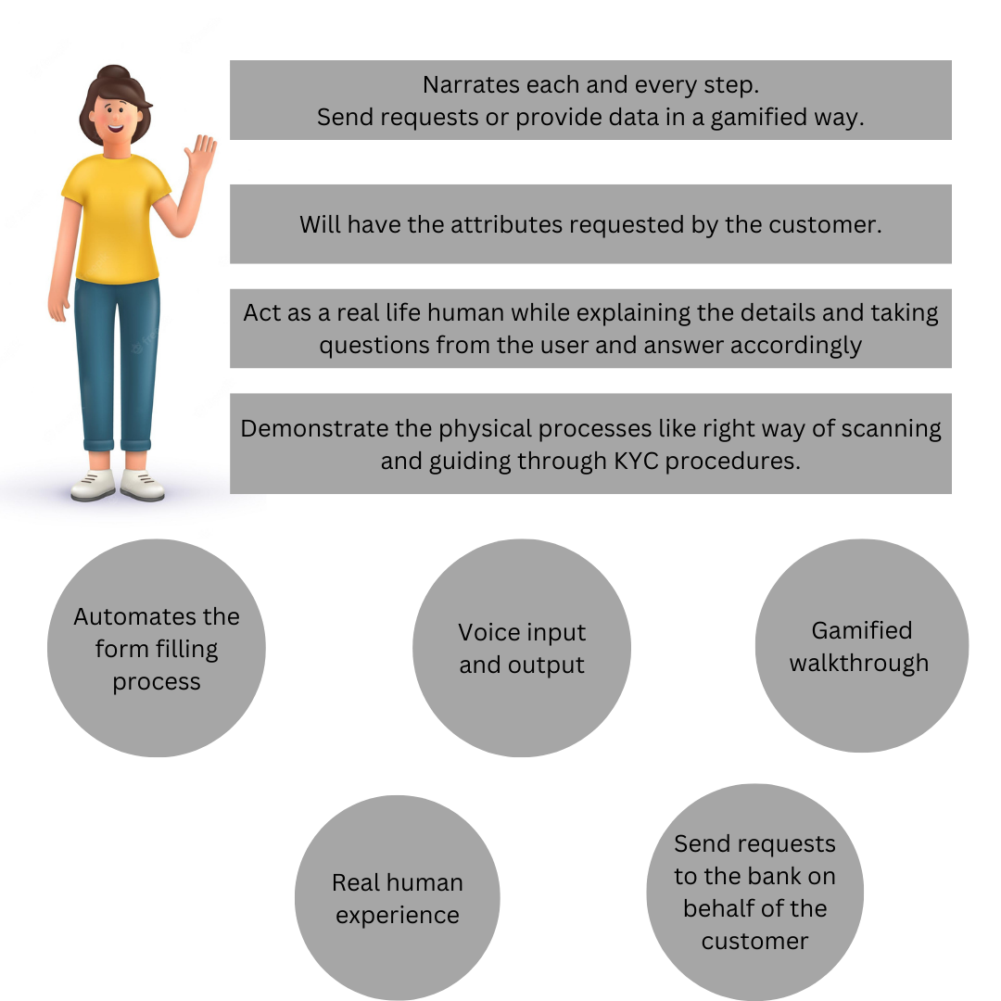
GitHub Repository Link & supporting diagrams, screenshots, if any

Slide 9
Thank You
Upendra Pandit (Leader)
Shanjal Gupta
Ayusman Joshi
Satyam Kumar

