Slide 1
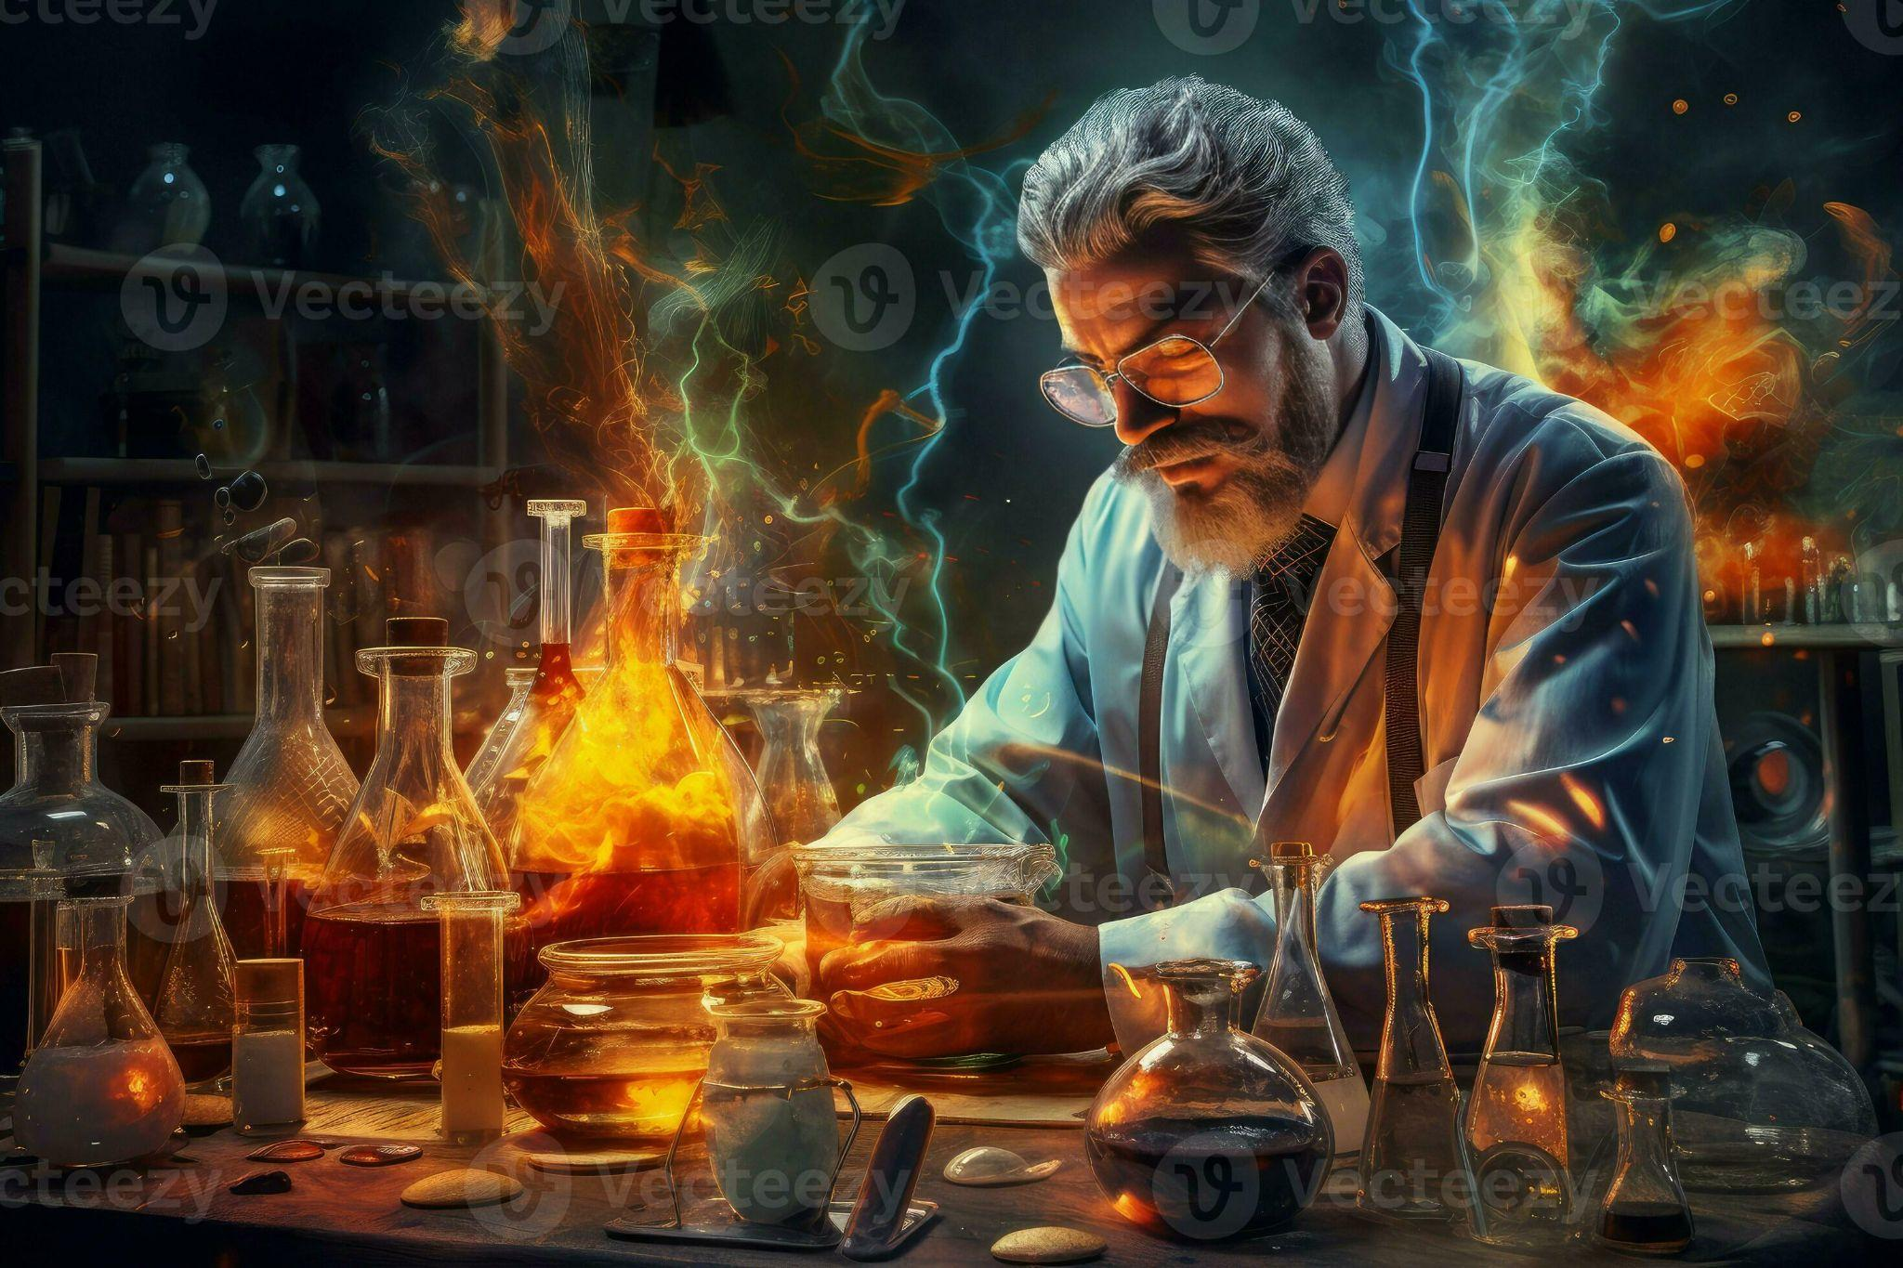
CHEMISTRY

Slide 2

FAVOURITE TOPICS
Electrochemistry is the subdiscipline of Chemistry that deals with the study of the relationship between electrical energy and chemical changes. Chemical reactions that involve the input or generation of electric currents are called electrochemical reactions. Such reactions are broadly classified into two categories:

Slide 3
CHEMICAL REACTIONS
A useful rate measure is the half-life of a reactant, which is defined as the time that it takes for half of the initial amount to undergo reaction. For a special type of kinetic behaviour (first-order kinetics; see below Some kinetic principles), the half-life is independent of the initial amount. A common and straightforward example of a half-life independent of the initial amount is radioactive substances. Uranium-238, for example, decays with a half-life of 4.5 billion years; of an initial amount of uranium, half of that amount will have decayed in that period of time. The same behaviour is found in many chemical reactions.

