Slide 1
CAR RACE GAME USING PYTHON
NAME : K.BHANU SIVA KUMAR
REG NO : 37110352
GUIDE NAME :Dr G.KALAI ARASI M.E.,Ph.D.,

Slide 2
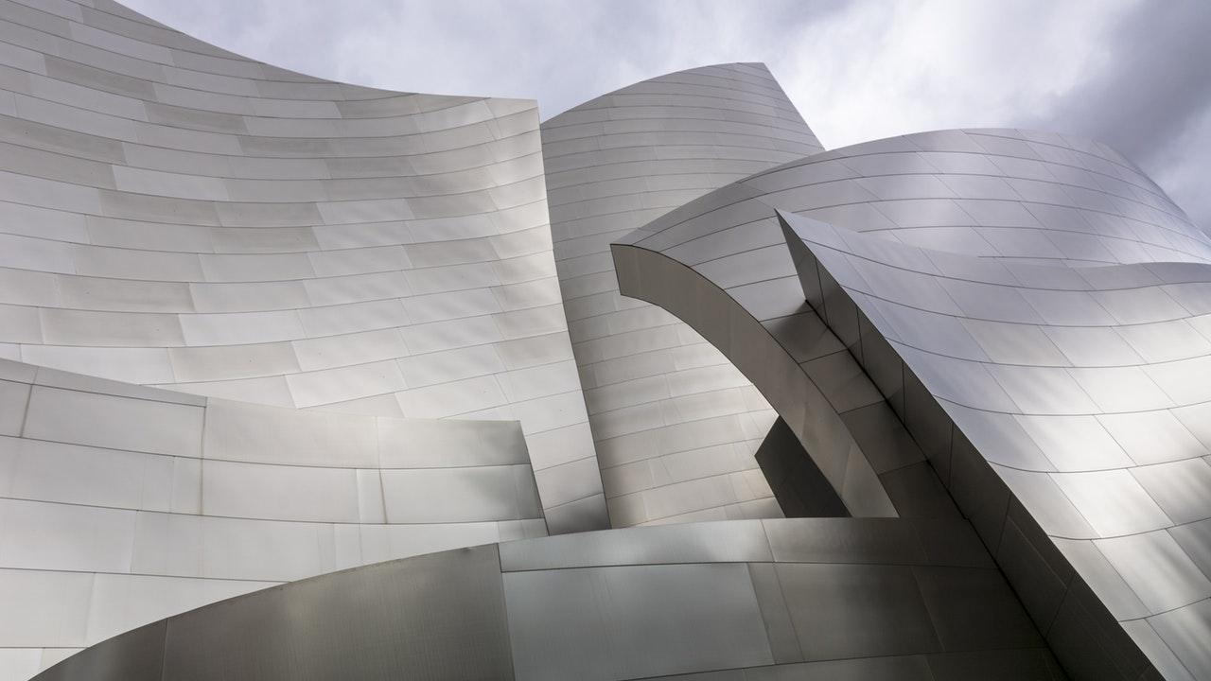
INTRODUCTION
Simple dodge car game is written in python.
The game play is easy to play and graphics are good enough.
The user has to dodge the car from the other cars in order to gain score points.
The player touches other cars,crashes or get the car to the end.
A simple GUI is provided for the easy gameplay.
The game was done in pycharm.

Slide 3

OBJECTIVES
The project mainly focuses on developing a Dodge racing car game, using a process based upon pygame development; an evolutionary development method.
It comprises implementation of game using python programming language.Talking about the gameplay,all the playing methods are to simple
The player has to be as quick as possible because the more you score the point, faster will be the gameplay.
Whenever the player touches other cars, crashes or get the car to the end of the display screen, the game is over which shutdowns the program directly.

Slide 4
The main objective of this game is to score points as much as possible. A simple GUI is provided for the easy gameplay.
The gameplay design is so simple that user won’t find it difficult to use and navigate.
The project mainly focuses on developing a Dodge racing car game, using a process based upon pygame development; an evolutionary development method.
It comprises implementation of game using python programming language.Talking about the gameplay, all the playing methods are too simple

Slide 5
LITERATURE SURVEY
There are so many games done in python to understand and easy play.
Dodge car game is an basic game play done using python.
There are so many such kind of car games done in python ,by taking reference from those games this project is done.
Car games is the most interesting game for everyone now a days.
This game can be easily understand and played.

Slide 6
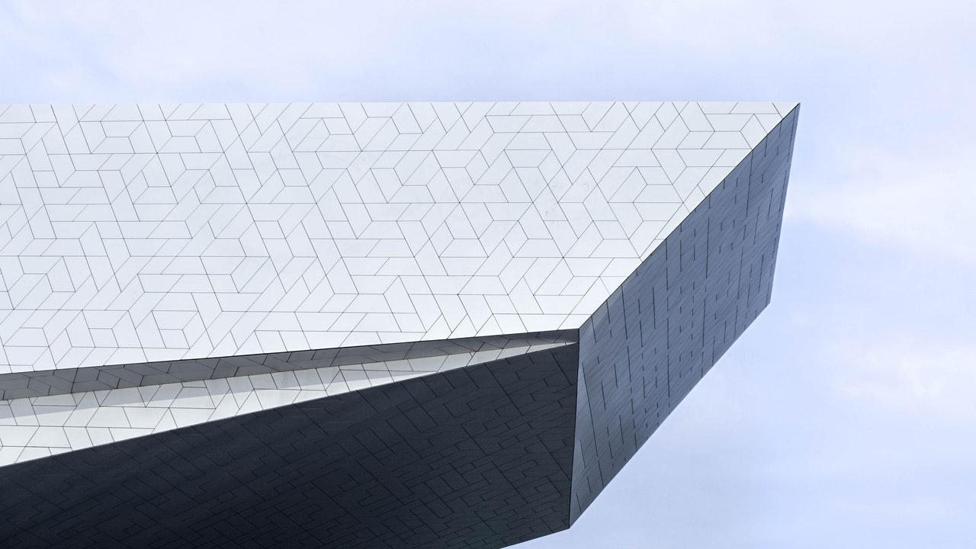
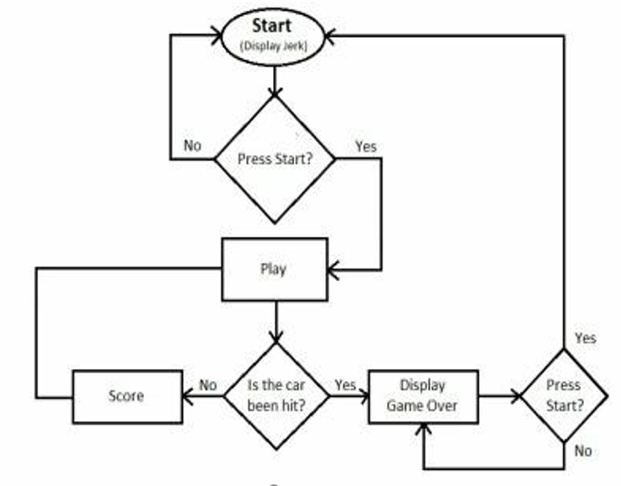
FRAME WORK
Start the game .
Make the choice to start the game .
If yes ,play the game by moving the
car .
Check the status of car if the car hits
then display game over and again
continue the game.
Else play the game.

Slide 7

MODULES
Pygame:Pygame uses the Simple DirectMedia Layer (SDL) library,with the intention of allowing real-time computer game development without the low-level mechanics of the C programming.This is based on the assumption that the most expensive functions inside games can be abstracted from the game logic, making it possible to use a high level programming language, such as Python, to structure the game.

Slide 8
Random Module:
This module contains a number of functions that use random numbers. It can output random numbers, select a random item from a list, and reorder lists randomly. The randomly reordered lists can be output inline, or as various types of ordered and unordered lists.
Random module is used in this code to give the position and speed of the obstacles.
rect: pygame.Rect(random.randint(140, 485), 0 - obstaclesSize, 23, 47),
speed: random.randint(obstaclesMINSPEED, obstaclesMAXSPEED)

Slide 9
PYCHARM INSTALLATION
Download pycharm in this website https://www.jetbrains.com/pycharm/
Select community edition and then select finish.
Choose install locationand select next.
Choose the desktop shortcut launcher and select next.
Choose jet brains and select install.
After installation click the box and select finish.
And select complete installation.

Slide 10
BACKGROUND COLOUR
RGB colour codes:The RGB color model is an additive color model in which red,green and blue light are added together in various ways to reproduce a broad array of colors. The name of the model comes from the initials of the three additive primary colors, red, green, and blue.
These colour codes are used in these code to give background and text colour.
TEXTCOLOR = (0, 255, 255)
BACKGROUNDCOLOR = (119,118,110)

Slide 11
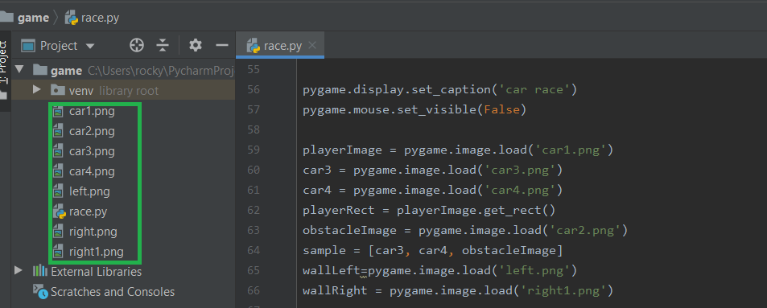
BACKGROUND AND IMAGES
To add the background and images,first download the background image and the images of user car and obstacle cars.
And to set the location of those images in the location of pycharm project.

Slide 12
How to play?
Use the keys to move the object from Use the keys to move the object from one position to another position like front,back,left,right.. use “up” key or “a” key to go front and “down” key or “s” to move down and “left” key or “a” key to go left and “right” key or ”d” key to go right.
Like, event.key == K_LEFT or event.key == ord('a’)
event.key == K_RIGHT or event.key == ord('d'):
event.key == K_UP or event.key == ord('w’)
event.key == K_DOWN or event.key == ord('s')

Slide 13

RESULTS
AND
DISCUSSIONS

Slide 14
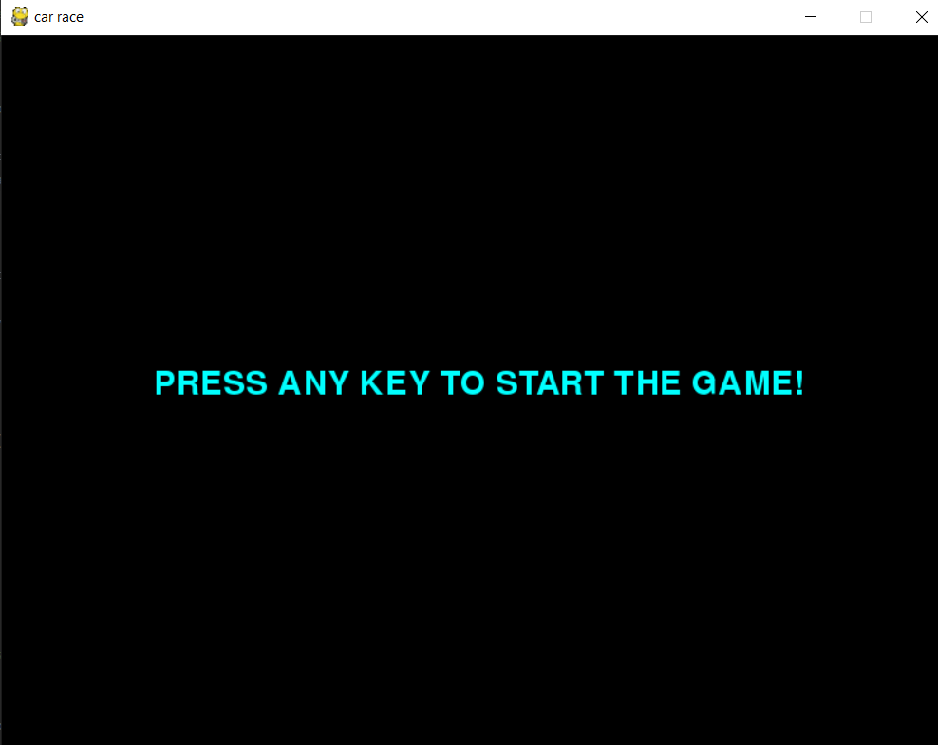
DISPLAYING SCREEN
After we press enter or any key then the game starts.
We have 3 lifes for every life highest score updated as score for next life.
After completion of three lifes game over message displays and starts from first.

Slide 15
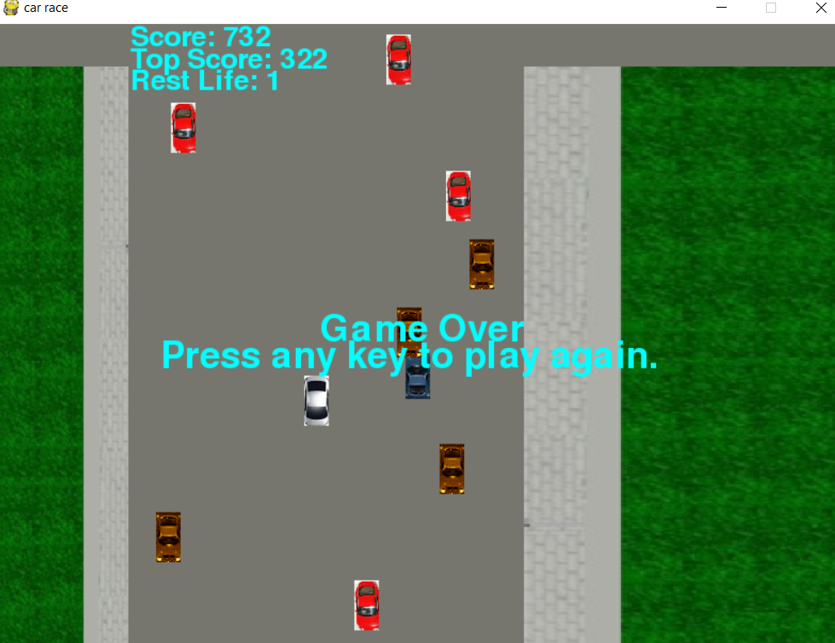
After the completion of three lifes then it displays game over and press any key to play again.
And if we press any key then we can play again or press esc to exit.

Slide 16
CONCLUSION
Simple Car Dodge Game project is written in Python. The project file contains asset files, python scripts and image files. The gameplay Graphics is good enough and the controls are too simple for the users. Talking about the gameplay, all the playing methods are too simple all you have to do is just dodge the car from the other cars. The player has to be as quick as possible because the more you score the point, faster will be the gameplay. To move the car without touching we just have to move the car using front ,bottom,left and right keys.

Slide 17
REFERENCES
https://www.w3schools.com/python/default.asp
https://www.youtube.com/watch?v=SZUNUB6nz3g
Head first Python: A Brain-Friendly Guide, by paul Barry.
Python crash course: A hands-on, project-Based introduction to programming, By Eric Matthes.
Python Programming: A introduction to computer Science, by john Zelle.

Slide 18
THANK YOU
BY K.BHANU SIVA KUMAR

