Slide 1
Covid-19 Pneumonia Identification
Guide : Dr.MeeraGandhi
Team : K Bhanu Siva Kumar – 37110352
K Hema Abhishikth - 37110355

Slide 2
Abstract
The presence of symptoms of COVID-19 pneumonia may be similar to other types of viral pneumonia.
Because of this, it can be difficult to tell what’s causing your condition without being tested for COVID-19 or other respiratory infections.
To determine how COVID-19 pneumonia differs from other types of pneumonia.
Information from these studies can potentially help in diagnosis and in furthering our understanding of how SARS-CoV-2 affects the lungs.

Slide 3
Objective
To Train large amount of chest scan data on artificial neural network.
The recognition framework based on the structured two dimensional convolutional neural networks (CNNs) type of Alex Net to classify the Covid-19&Pneumonia and improve the accuracy of workflow.
To make it best model for deep learning technique to easily classifying “Covid-19” & “Pneumonia”.

Slide 4
Modules
Import the given image from dataset.
To train the module by given image dataset.
Working process of Layers in CNN model.
Deploying the model in Django Framework and predicting
output for given input x-ray.

Slide 5
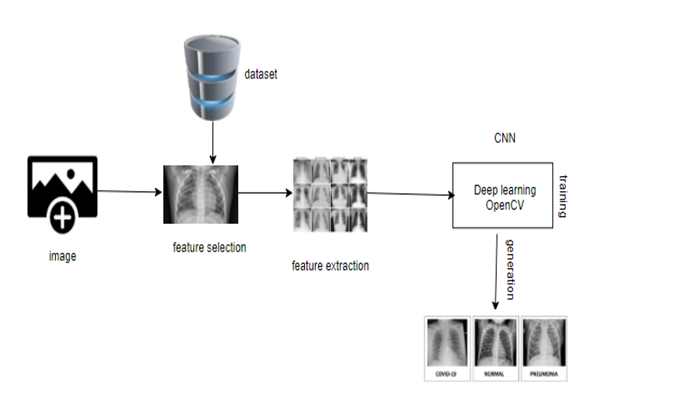
System Architecture

Slide 6
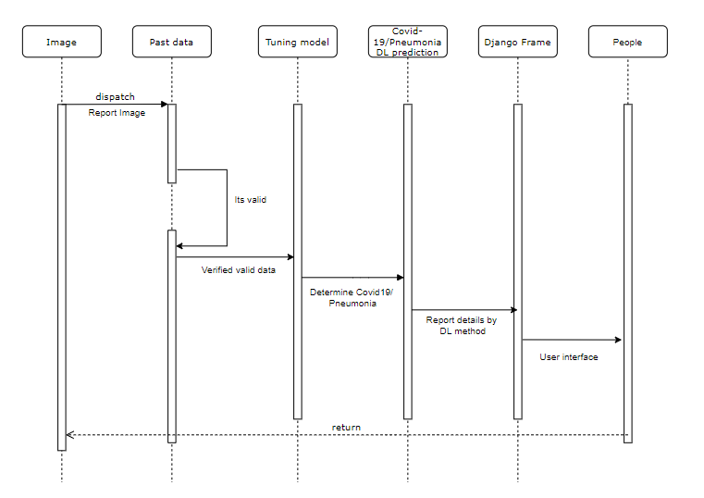
Sequence Diagram

Slide 7
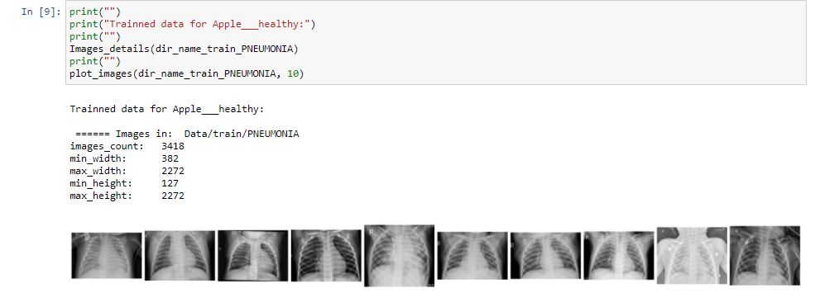
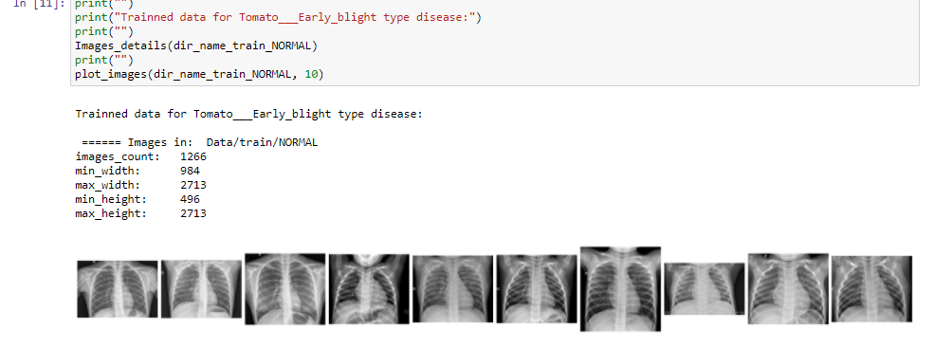
OUTPUT

Slide 8
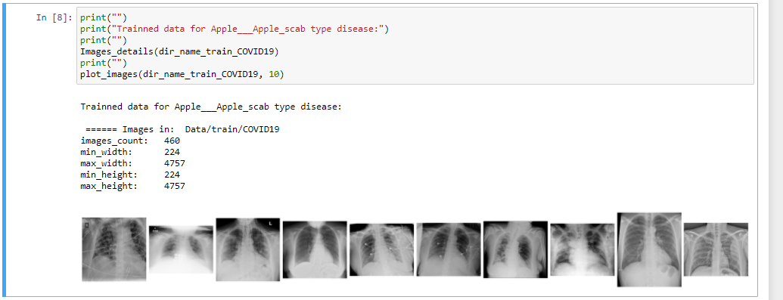
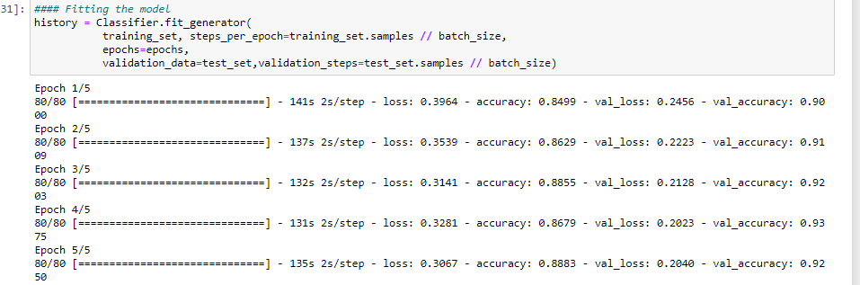

Slide 9
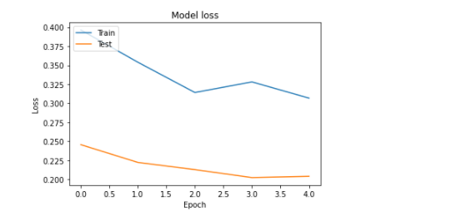
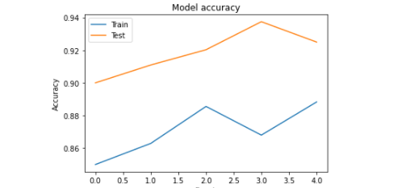

Slide 10
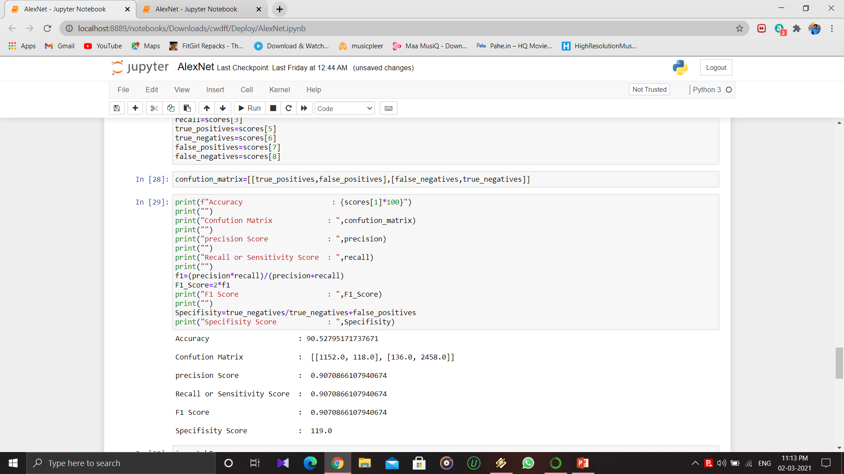

Slide 11
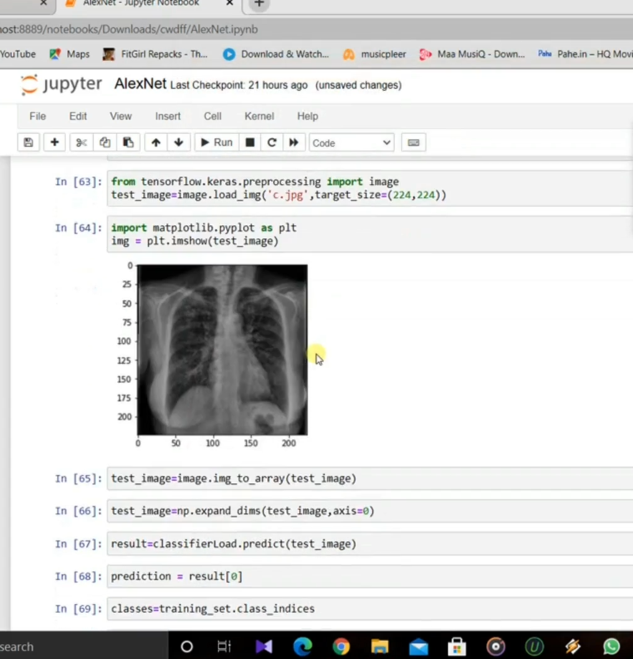
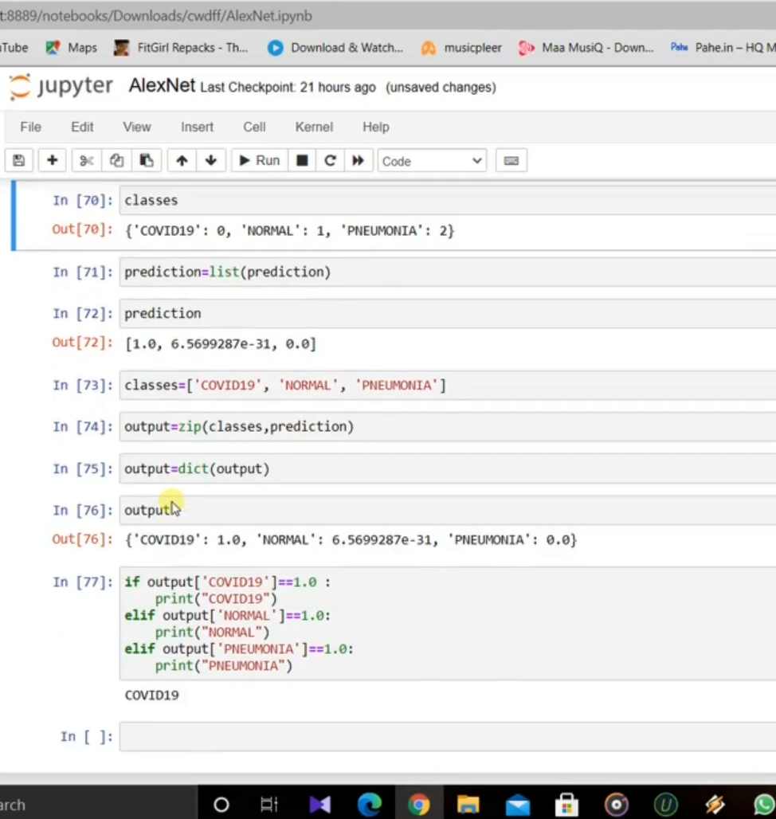

Slide 12
Conclusion
To train a large amount chest scan data on artificial neural network.
To easily classify whether it is covid-19 or other pneumonia based on chest scan.
To increase the recognition rate and classification accuracy for every X-ray that is processed.

Slide 13
Future Work
To deployment real time this process by show the prediction result in web application or desktop application.
To optimize the work to implement in Artificial Intelligence environment.
To deploy this model to AI on web application.

Slide 14
References
N. Zhu, D. Zhang, W. Wang, X. Li, B. Yang, J. Song, X. Zhao, B. Huang, W. Shi, R. Lu, P. Niu, F. Zhan, X. Ma, D. Wang, W. Xu, G. Wu, G. F. Gao, and W. Tan, “A novel coronavirus from patients with pneumonia in China, 2019,” N. Engl. J. Med., vol. 382, pp. 727–733, 2020
D. Benvenuto, M. Giovanetti, M. Salemi, M. Prosperi, C. De Flora, L. C. Junior Alcantara, S. Angeletti, and M. Ciccozzi, “The global spread of 2019-nCoV: A molecular evolutionary analysis,” Pathog. Glob. Health, pp. 1–4, 2020.
F. Shi, J. Wang, J. Shi, Z. Wu, Q. Wang, Z. Tang, K. He, Y. Shi, and D. Shen, “Review of Artificial Intelligence Techniques in Imaging Data Acquisition, Segmentation and Diagnosis for COVID-19,” IEEE Rev. Biomed. Eng., vol. 3333, no. c, pp. 1–13, 2020.
L. Huang, R. Han, T. Ai, P. Yu, H. Kang, Q. Tao, and L. Xia, “Serial quantitative chest CT assessment of COVID-19: Deep-learning approach,” Radiol. Cardiothorac. Imaging, vol. 2, p. e200075, 2020.

