Slide 1

Life Style Store Web Page
Project Supervisor: Dr.S.Prayla Shyry, M.E.,Ph.d.,
Student Name :Mr.Bhanu Siva Kumar K
Reg.No : 37110352

Slide 2
INTRODUCTION
Online shopping is a form of electronic commerce which allows consumers to directly buy goods or services from a seller over the Internet using a web browser.
Consumers find a product of interest by visiting the website of the retailer directly or by searching among alternative vendors using a shopping search engine, which displays the same product's availability and pricing at different e-retailers.
This site makes easier for consumers to buy products they want through online.
customers can shop online using a range of different computers and devices, including desktop computers, laptops, tablet computers, smartphones, and smart speakers.

Slide 3
OBJECTIVE
Promoting a service or product online
Selling a service or product
Providing product support or customer service.
Providing corporate information.
Establishing brand awareness and corporate identity.
Make the products available for consumers to buy at any time, any place and any where through internet.
Makes shopping easier for customers.

Slide 4
HARDWARE REQUIREMENTS
Processor : Pentium 3.0 GHz or higher
RAM : 1024 MB/ 1 GB or more
Hard Driver : 1GB or more
SOFTWARE REQUIREMENTS
Operating System : Window 7 Onwards
Compiler : NetBeans IDE 8.2
Server : WAMP or XAMPP

Slide 5
MODULE IMPLEMENTATION
Download NetBeans IDE 8.2.
Link BootStrap to HTML.
Link JQUERY to HTML.
Creating php files and link to each other.
Download server and cop all the php files in a folder in servers location.
Using root directory login to server and database.
Create database and import the sql files into it.

Slide 6
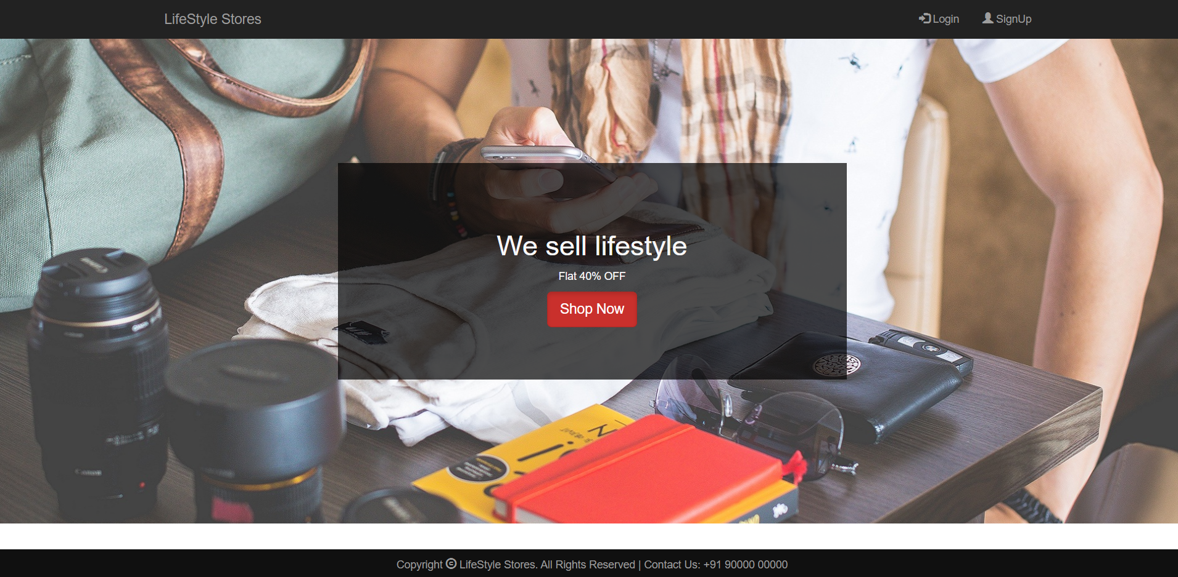
APPLICATION SNAPSHOTS

Slide 7
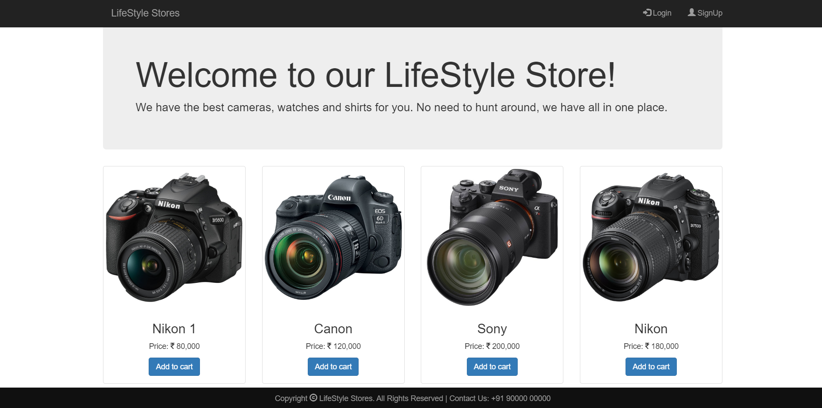

Slide 8
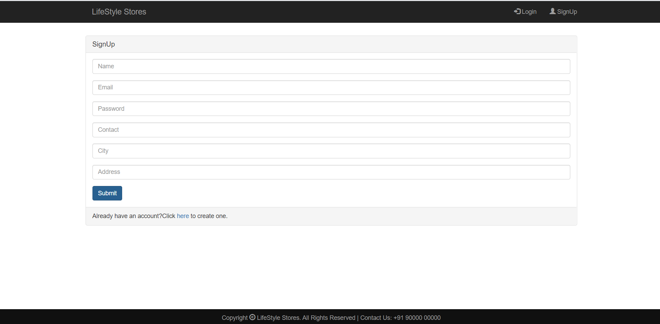

Slide 9
CONCLUSION
Technology has made significant progress over the years to provide consumers a better online shopping experience and will continue to do so for years to come.
With the rapid growth of products and brands, people have speculated that online shopping will overtake in-store shopping.
Online shopping has opened up doors to many small retailers.
Buying products through online has became a popular business now a days.
We can buy anything through internet and shopping sites for different products are increasing rapidly.

Slide 10
REFERENCES
https://www.w3schools.com
https://www.youtube.com/watch?v=KkhdeeXJo6I
https://www.youtube.com/watch?v=EZYcyz9eBHc
https://getbootstrap.com
internshala

