Slide 1
Critical Design Review
Variable Compliant Robotic Prosthetic Thumb

Slide 2
Steps Outlined by PDR
Design body for thumb and chassis to hold motors
Incorporate static wrist
Include additional joint in design
Add Motor Control
Look into different material options for the tendons

Slide 3
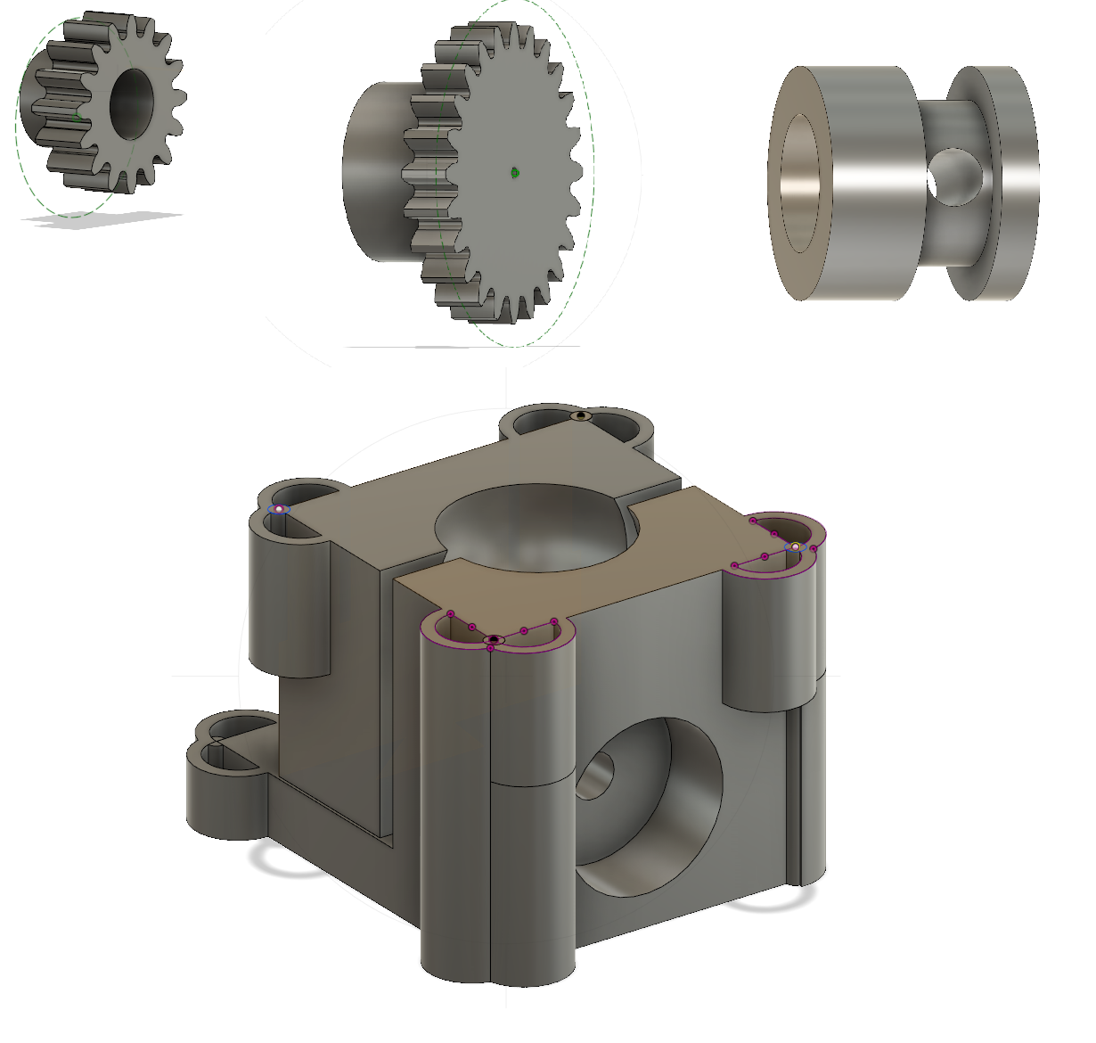
New Parts and Redesigns

Slide 4
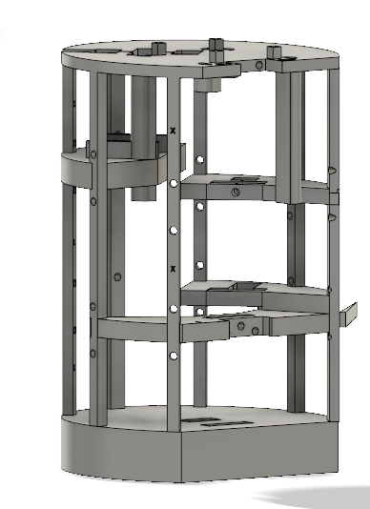
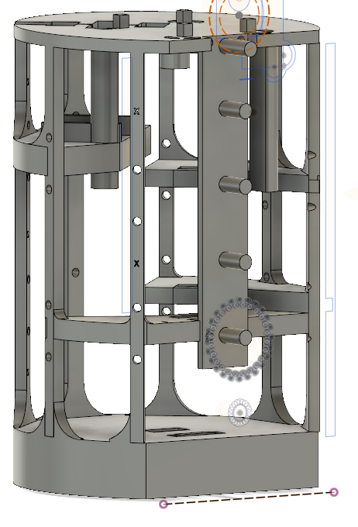
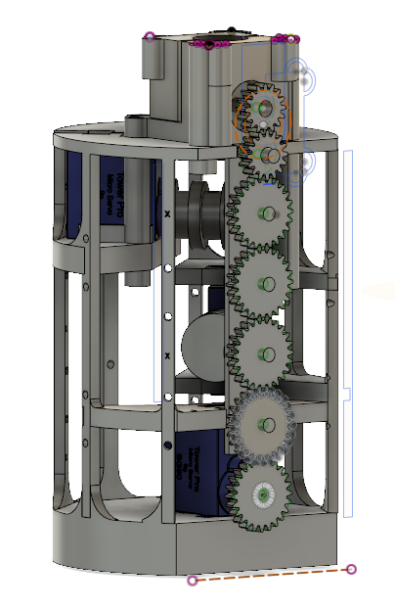
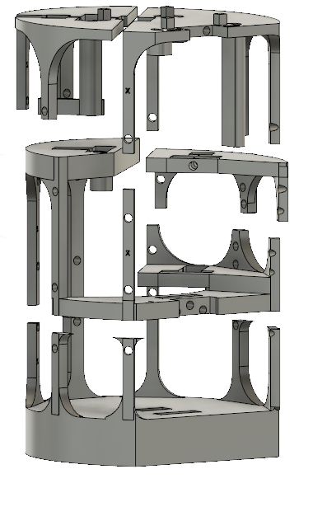
Body for thumb, chassis to hold motors and static wrist

Slide 5
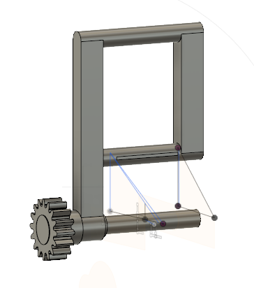
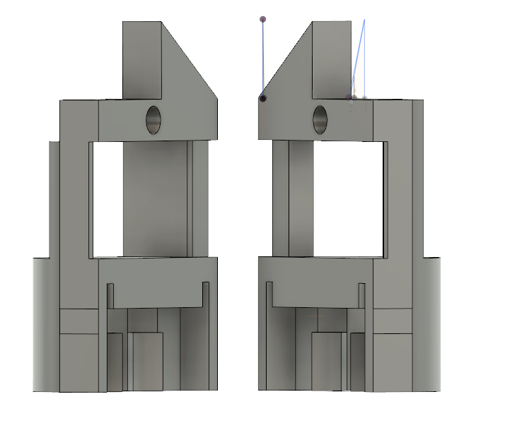
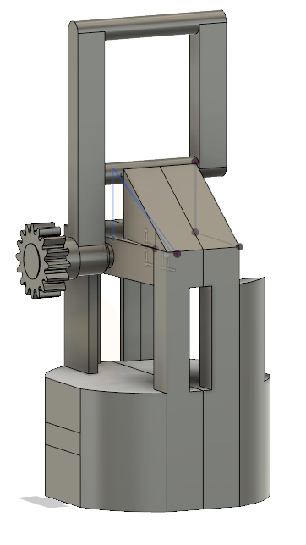
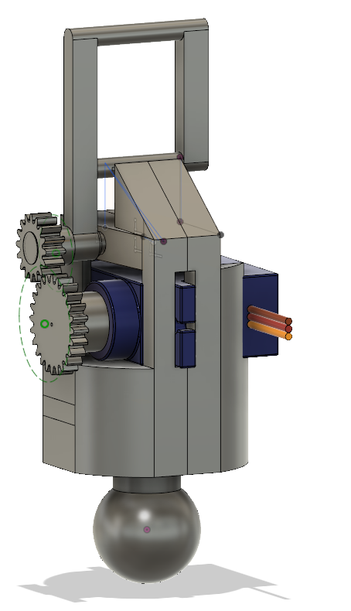
Additional joint in design

Slide 6
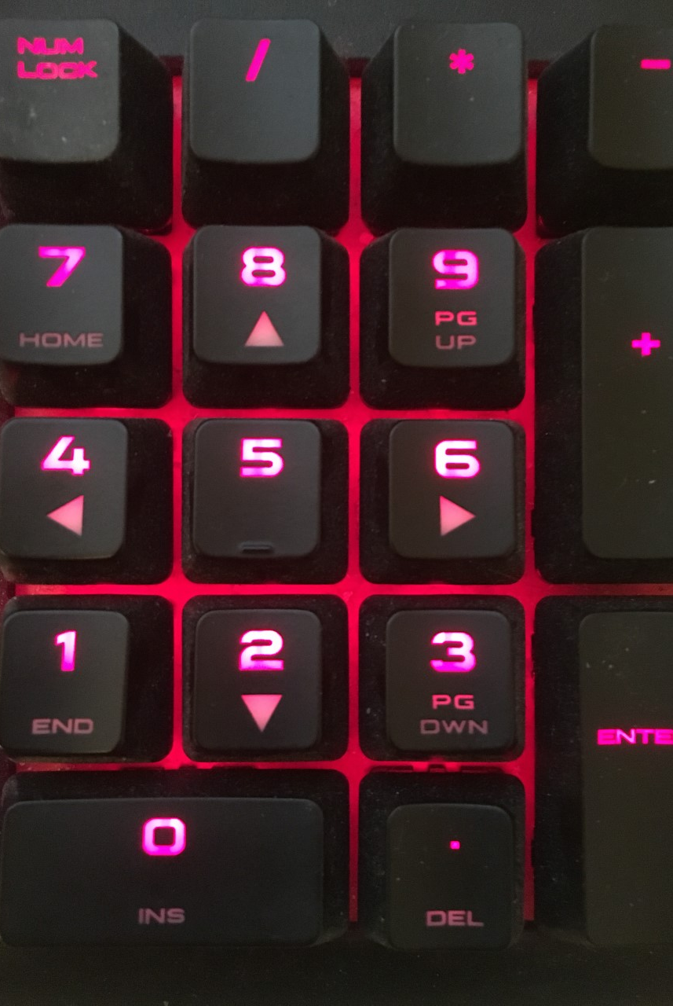
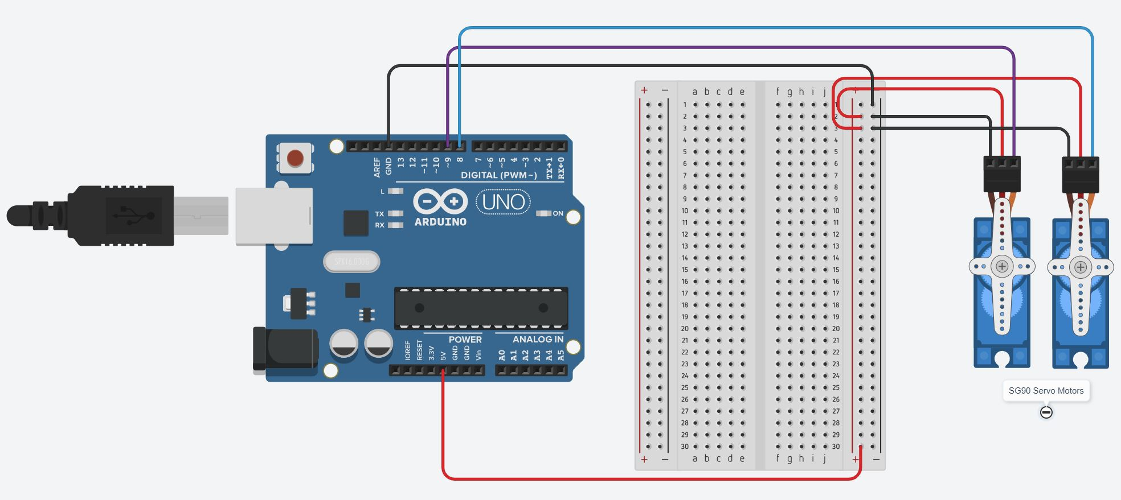
Motor Control

Slide 7
Tendon Materials
Still to be done. Requirements for material:
High Tensile Strength
Durable
Flexible

Slide 8
Still To Do
Finish off motor control
Print and construct thumb
Build remaining chassis parts
FEA on most recent design
Testing different tendon materials

Slide 9
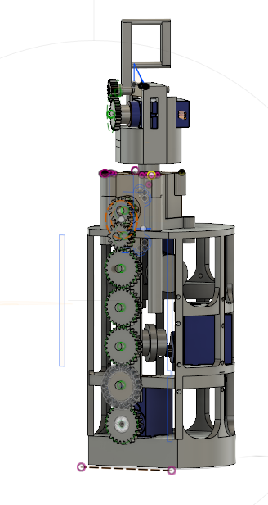
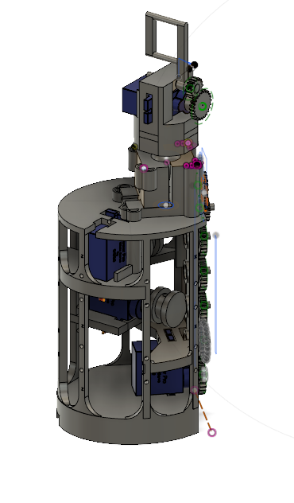
Most Recent Design

