Slide 1



Learn Something Every Day
CONFIDENTIAL & PROPRIETARY 2022 – Adverk Technologies

Slide 2
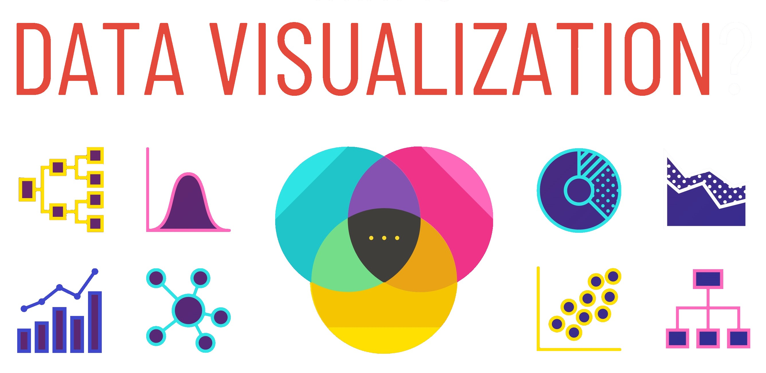
CONFIDENTIAL & PROPRIETARY 2022 – Adverk Technologies

Slide 3
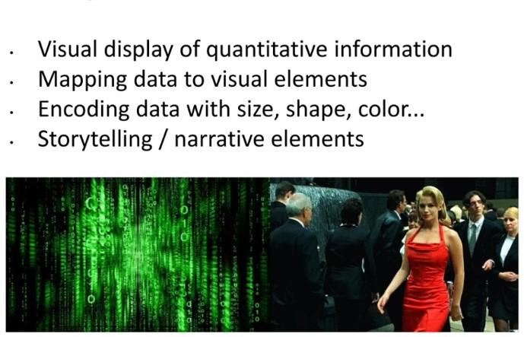
What is Data Visualization
CONFIDENTIAL & PROPRIETARY 2022 – Adverk Technologies

Slide 4
What is Data Visualization
Data visualization is the visual presentation of data or information.
The goal of data visualization is to communicate data or information clearly and effectively to readers.
Typically, data is visualized in the form of a chart, infographic, diagram, map and more.
How does it help?
Identify trends and outliers
Tell a story within the data
Reinforce an argument or opinion
Highlight an important point in a set of data
CONFIDENTIAL & PROPRIETARY 2022 – Adverk Technologies

Slide 5
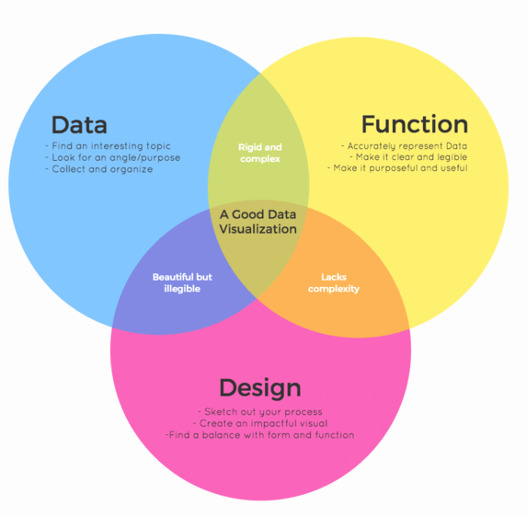
What makes good
Data Visualization
CONFIDENTIAL & PROPRIETARY 2022 – Adverk Technologies

Slide 6
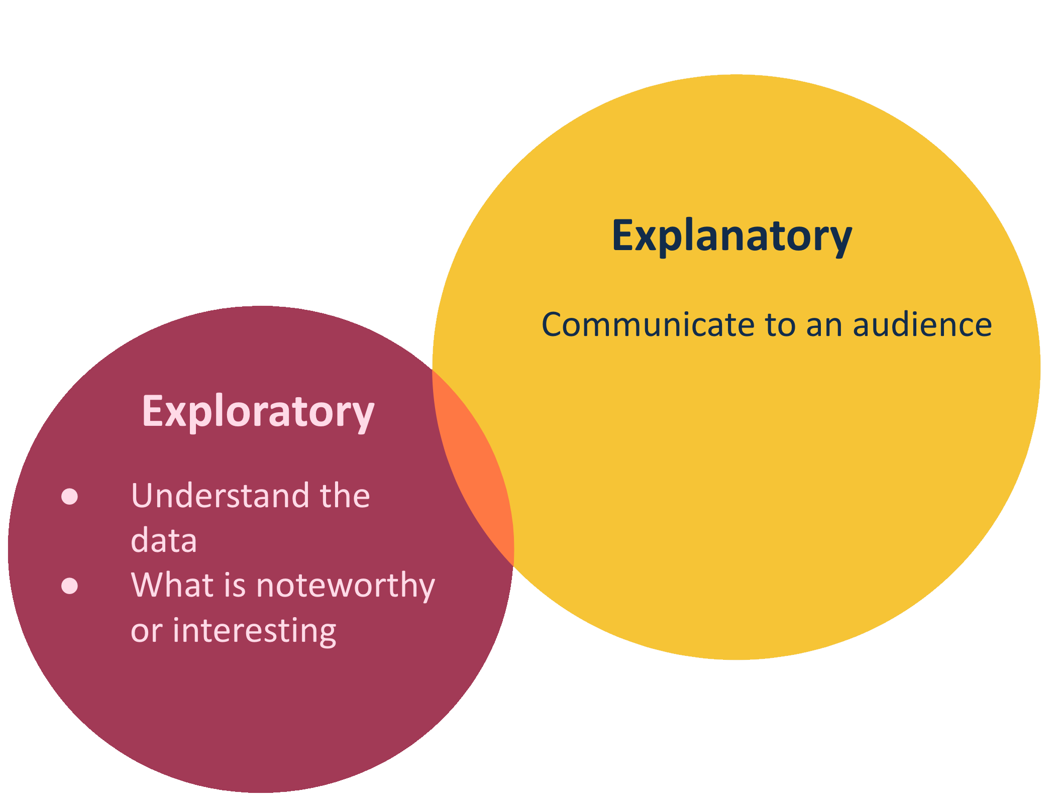
Types of Data Analysis
CONFIDENTIAL & PROPRIETARY 2022 – Adverk Technologies

Slide 7
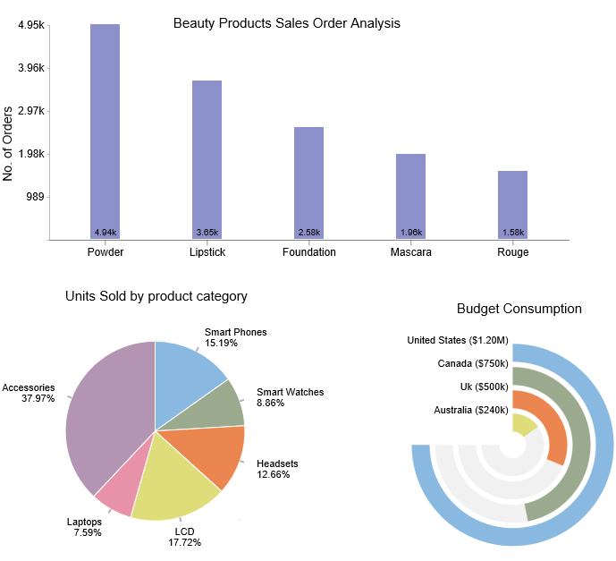
Exploratory Data Analysis
CONFIDENTIAL & PROPRIETARY 2022 – Adverk Technologies

Slide 8
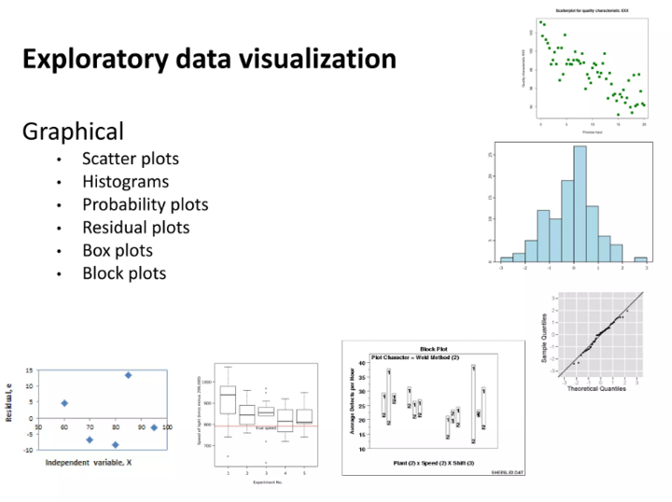
CONFIDENTIAL & PROPRIETARY 2022 – Adverk Technologies

Slide 9
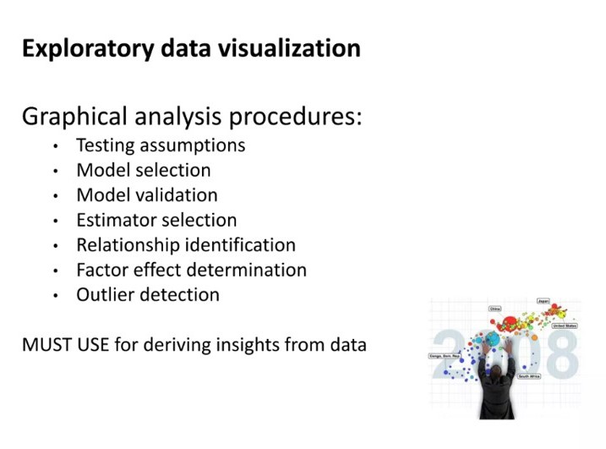
CONFIDENTIAL & PROPRIETARY 2022 – Adverk Technologies

Slide 10
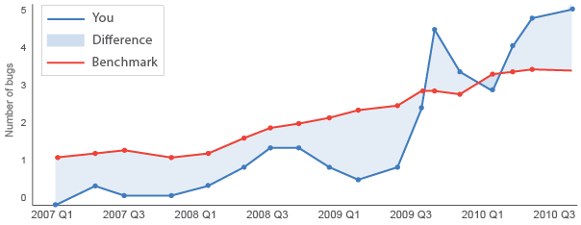
Explanatory Data Analysis
CONFIDENTIAL & PROPRIETARY 2022 – Adverk Technologies

Slide 11
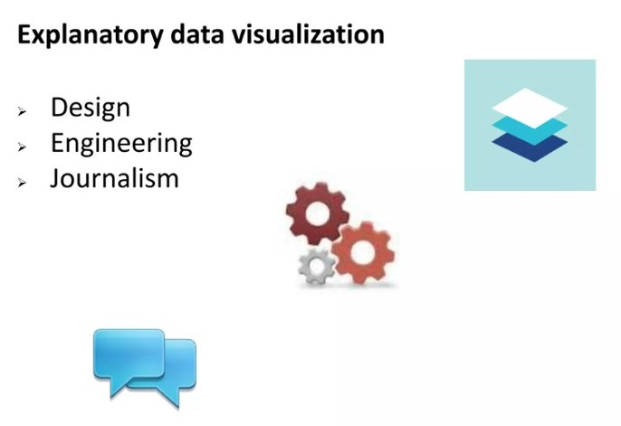
CONFIDENTIAL & PROPRIETARY 2022 – Adverk Technologies

Slide 12
Data Visualization in Data Science | Graph | Bar Graph
 |  | Stack Bar Graph
 | Plot | Scatter Plot & Line Plot
 |  | Box Plot
 |  | Histogram Plot
 | Chart | Pie Chart
CONFIDENTIAL & PROPRIETARY 2022 – Adverk Technologies

Slide 13
Libraries required for data visualization in Python
Matplotlib
Matplotlib is one of the best python data visualization libraries for generating powerful yet simple visualization. It is a 2-D plotting library that can be used in various ways, including Python, iPython sheets, and Jupyter notebooks.
Key Features
It supports various types of graphical representation, including line graphs, bar graphs, and histograms.
It can work with the NumPy arrays and border SciPy stack.
It has a huge amount of plots for understanding trends and making correlations.
Pros And Cons
Interactive platform
Versatile library
CONFIDENTIAL & PROPRIETARY 2022 – Adverk Technologies

Slide 14
Libraries required for data visualization in Python
2. Plotly
The most popular data visualization library in Python is Plotly, which delivers an interactive plot and is easily readable to beginners. It is widely used for handling financial, geographical, statistical, and scientific data.
Key Features
Its robust API functions effectively in both local and web browser modes.
It is an interactive, open-source, and high-level visualization library.
It can be viewed in Jupyter notebooks, standalone HTML files, or even hosted online.
Pros And Cons
Offers contour plots, dimension chars, and dendrograms.
Allows 40 unique chart and plot types
Difficult to use
CONFIDENTIAL & PROPRIETARY 2022 – Adverk Technologies

Slide 15
Libraries required for data visualization in Python
3. Seaborn
Seaborn is the best python library for data visualization, which offers a variety of visualized patterns. It is designed to work more compatible with Pandas data form and is widely used for statistical visualization.
Key Features
It performs the necessary mapping and aggregation to form information visuals.
It is integrated to explore and understand data in a better and more detailed way.
It offers a high level of a crossing point for creating beautiful and informative algebraic graphics.
Pros And Cons
Much more visually appealing representation
Switch to any other data format
Limited customizable options
CONFIDENTIAL & PROPRIETARY 2022 – Adverk Technologies

Slide 16
Libraries required for data visualization in Python
4. Ggplot
GGplot is another popular data visualization library in Python, known as the python implementation of graphics grammar. It refers to the map of the data, with its aesthetic attributes including color, shape, and geometric objects like points and bars.
Key Features
It allows you to build informative visualization substantially with improved representations
It is integrated with Panda to store data in a data frame.
It is based on ggplot2, an R programming language plotting system.
Pros And Cons
Documentation is simple and easy to follow.
Save method to discuss and exhibit plots
Not suitable for creating highly customized graphics.
CONFIDENTIAL & PROPRIETARY 2022 – Adverk Technologies

Slide 17
Libraries required for data visualization in Python
5. Bokeh
Bokeh is another interactive python library for data visualized for modern web browsers. This is best suitable for developing interactive plots and dashboards for complex or streaming data assets.
Key Features
It has a broad range of intuitive graphs which can be leveraged to form solutions.
It is well-known for creating custom-made visualizations.
It includes various generation and plot chart methods, including box plots, bar plots, and histograms.
Pros And Cons
Highest level of control for the rapid creation of charts
Many graphs with fewer codes and higher resolution
No pre-set defaults, and users have to define them each time.
CONFIDENTIAL & PROPRIETARY 2022 – Adverk Technologies

Slide 18
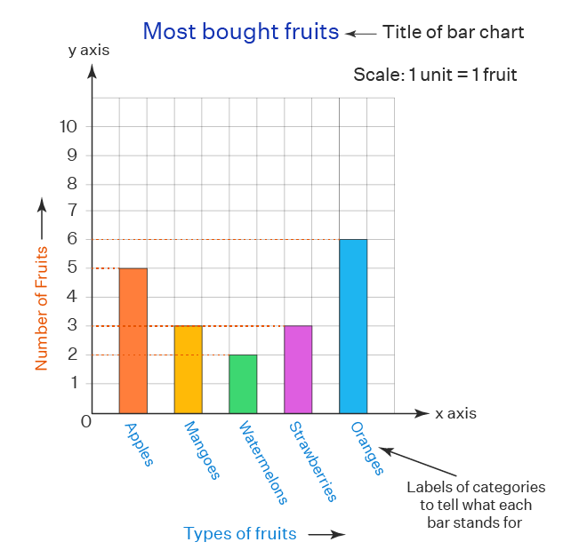
Bar Graph
CONFIDENTIAL & PROPRIETARY 2022 – Adverk Technologies

Slide 19
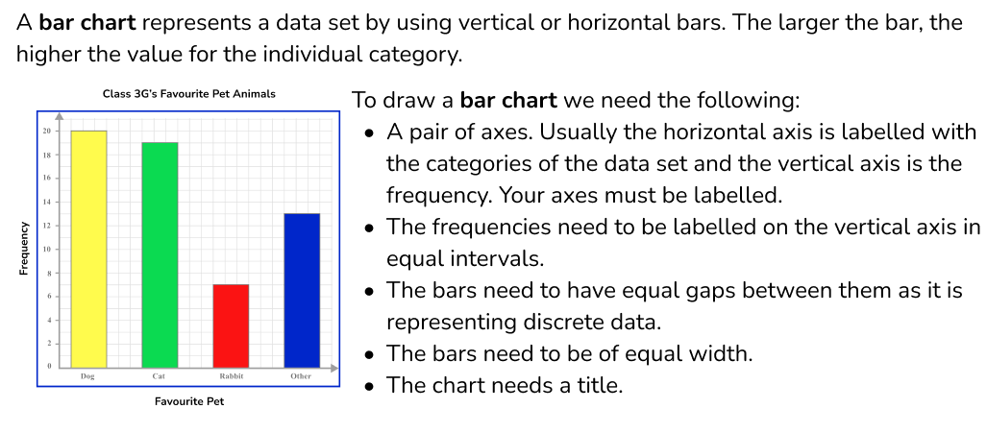
CONFIDENTIAL & PROPRIETARY 2022 – Adverk Technologies

Slide 20
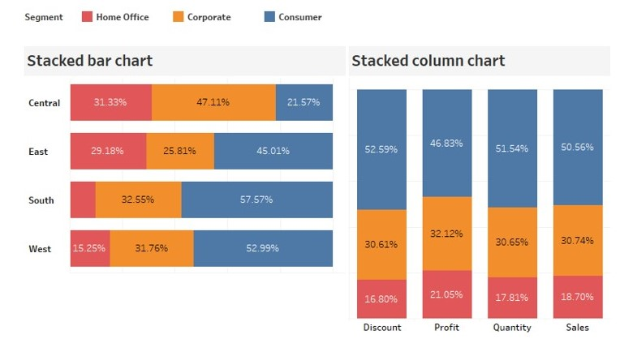
Stacked Bar Graph
CONFIDENTIAL & PROPRIETARY 2022 – Adverk Technologies

Slide 21
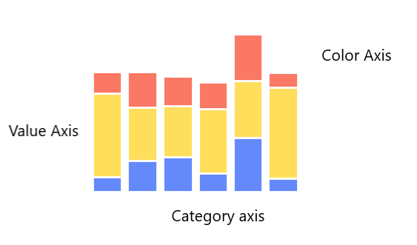
Stack Bar Graph
Stack Bar Graph is a form of bar chart that shows the composition and comparison of a few variables, either relative or absolute, over time. Also called a stacked bar or column chart, they look like a series of columns or bars that are stacked on top of each other.
CONFIDENTIAL & PROPRIETARY 2022 – Adverk Technologies

Slide 22
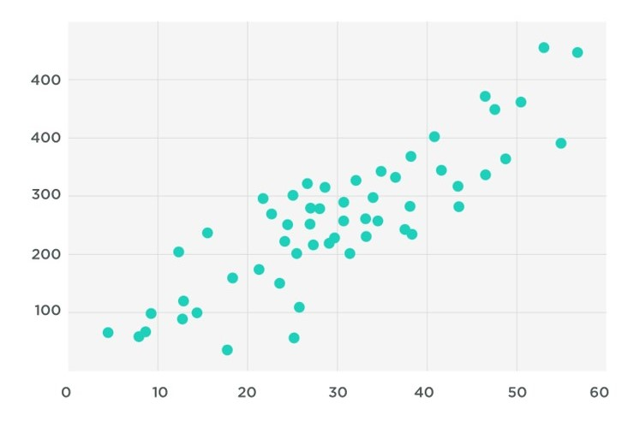
Scatter Plot
CONFIDENTIAL & PROPRIETARY 2022 – Adverk Technologies

Slide 23
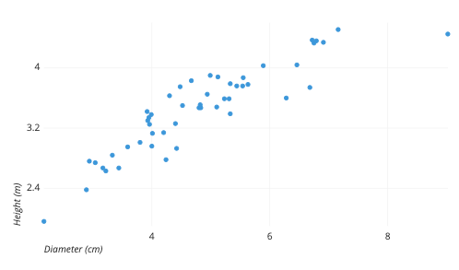
Scatter Plot
A scatter plot uses dots to represent values for two different numeric variables. The position of each dot on the horizontal and vertical axis indicates values for an individual data point. Scatter plots are used to observe relationships between variables.
CONFIDENTIAL & PROPRIETARY 2022 – Adverk Technologies

Slide 24
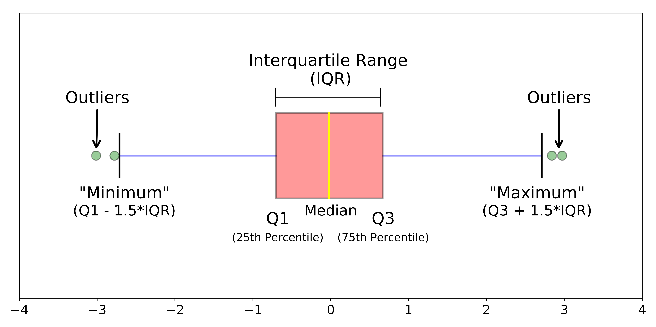
Box Plot
CONFIDENTIAL & PROPRIETARY 2022 – Adverk Technologies

Slide 25
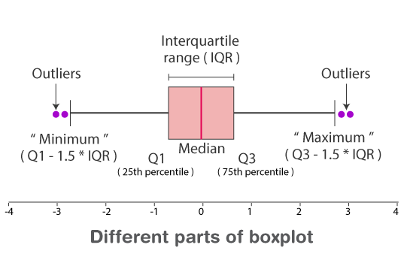
Box Plot
A box plot is a chart that shows data from a five-number summary including one of the measures of central tendency.
It helps to find out how much the data values vary or spread out with the help of graphs.
Minimum: The minimum value in the given dataset
First Quartile (Q1): The first quartile is the median of the lower half of the data set.
Median: The median is the middle value of the dataset, which divides the given dataset into two equal parts. The median is considered as the second quartile.
Third Quartile (Q3): The third quartile is the median of the upper half of the data.
Maximum: The maximum value in the given dataset.
Apart from these five terms, the other terms used in the box plot are:
Interquartile Range (IQR): The difference between the third quartile and first quartile is known as the interquartile range. (i.e.) IQR = Q3-Q1
Outlier: The data that falls on the far left or right side of the ordered data is tested to be the outliers. Generally, the outliers fall more than the specified distance from the first and third quartile.
(i.e.) Outliers are greater than Q3+(1.5 . IQR) or less than Q1-(1.5 . IQR).
CONFIDENTIAL & PROPRIETARY 2022 – Adverk Technologies

Slide 26
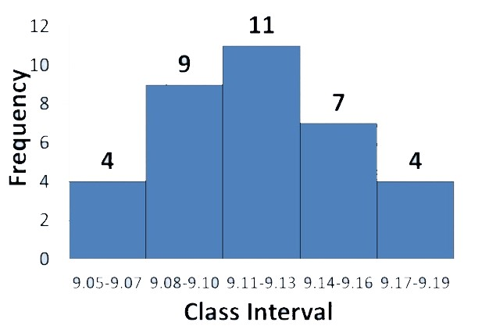
Histogram
CONFIDENTIAL & PROPRIETARY 2022 – Adverk Technologies

Slide 27
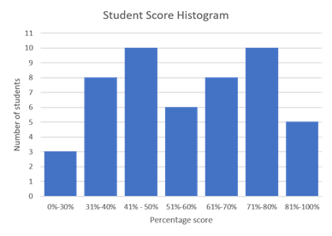
Histogram
A histogram is a graph used to represent the frequency distribution of a few data points of one variable. Histograms often classify data into various “bins” or “range groups” and count how many data points belong to each of those bins.
CONFIDENTIAL & PROPRIETARY 2022 – Adverk Technologies

Slide 28
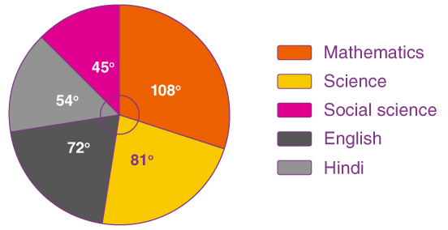
Pie Chart
CONFIDENTIAL & PROPRIETARY 2022 – Adverk Technologies

Slide 29
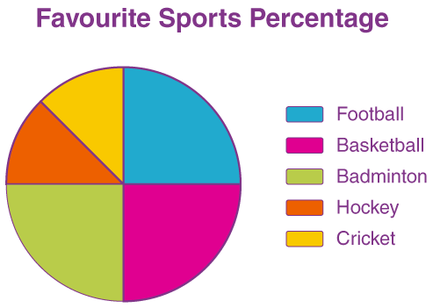
Pie Chart
A pie chart is a type of graph that represents the data in the circular graph. The slices of pie show the relative size of the data, and it is a type of pictorial representation of data. A pie chart requires a list of categorical variables and numerical variables. Here, the term “pie” represents the whole, and the “slices” represent the parts of the whole.
CONFIDENTIAL & PROPRIETARY 2022 – Adverk Technologies

Slide 30
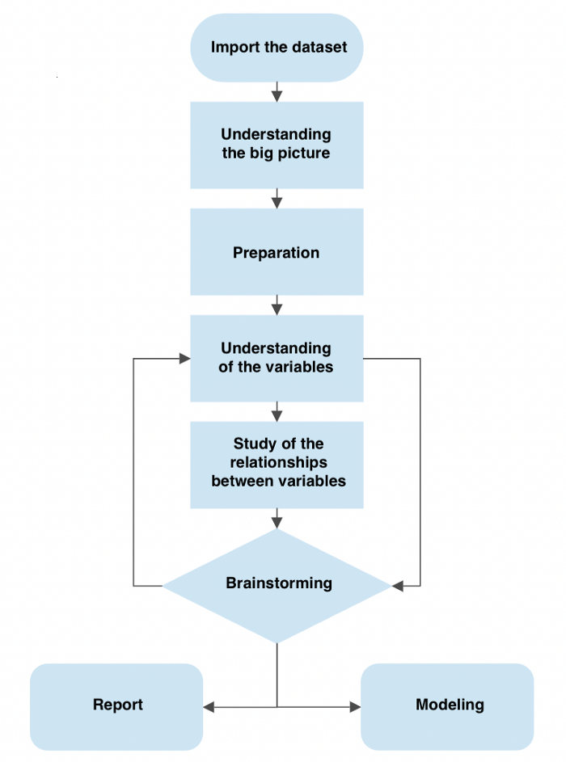
CONFIDENTIAL & PROPRIETARY 2022 – Adverk Technologies

Slide 31
THANK YOU!
CONFIDENTIAL & PROPRIETARY 2022 – Adverk Technologies

