Slide 1



Learn Something Every Day
CONFIDENTIAL & PROPRIETARY 2022 – Adverk Technologies

Slide 2
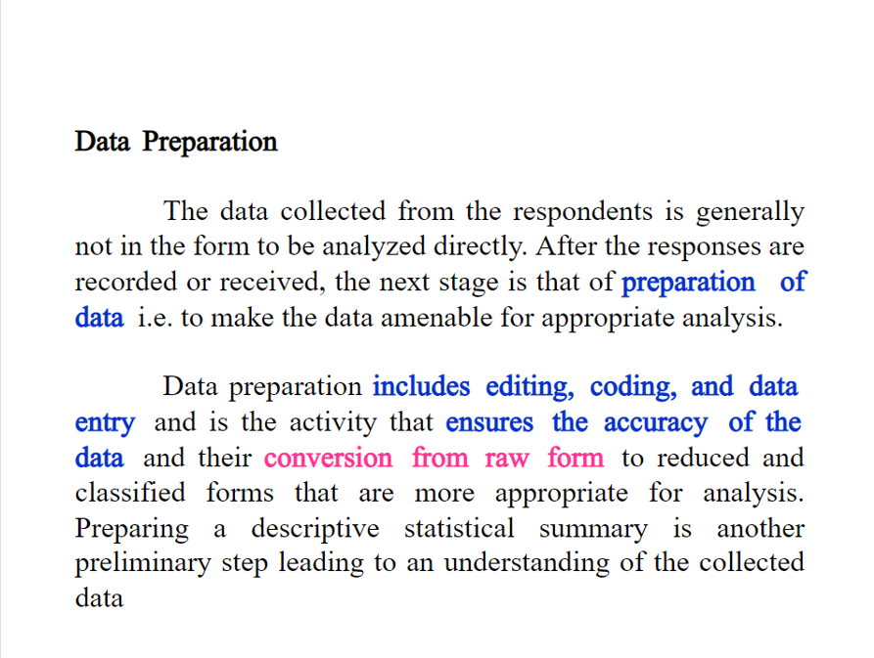
CONFIDENTIAL & PROPRIETARY 2022 – Adverk Technologies

Slide 3
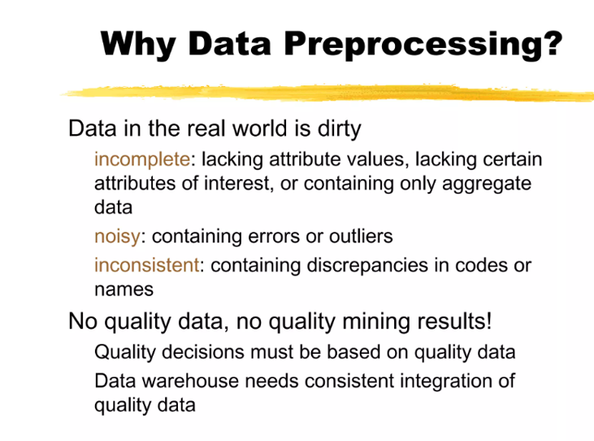
CONFIDENTIAL & PROPRIETARY 2022 – Adverk Technologies

Slide 4
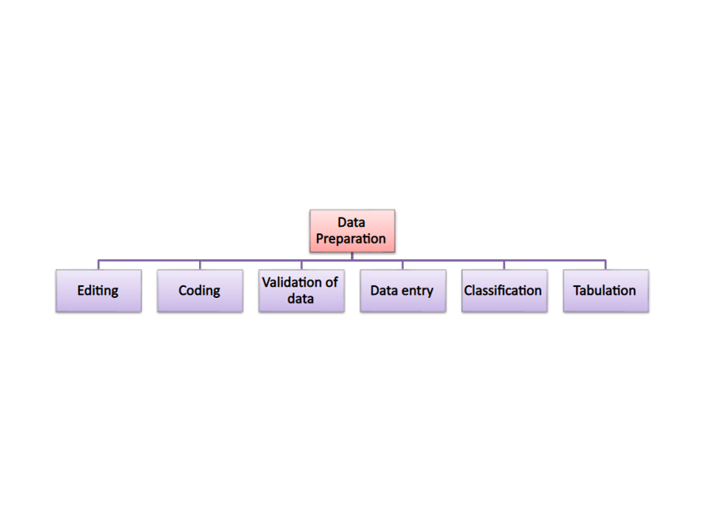
CONFIDENTIAL & PROPRIETARY 2022 – Adverk Technologies

Slide 5
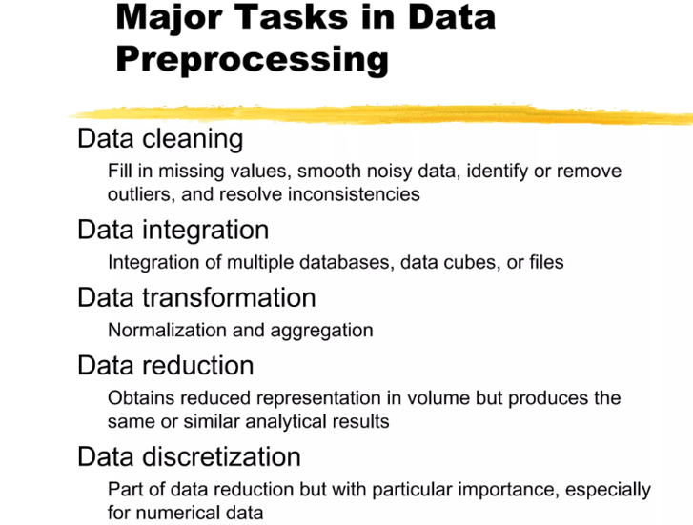
CONFIDENTIAL & PROPRIETARY 2022 – Adverk Technologies

Slide 6
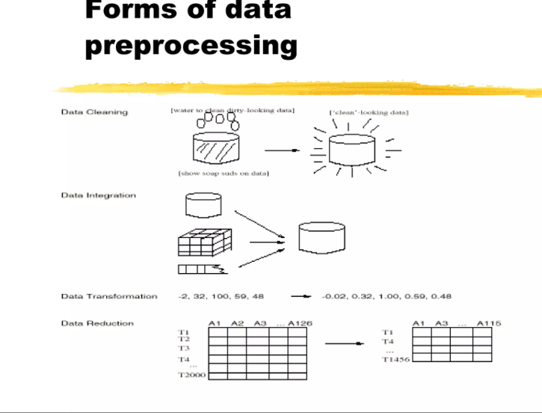
CONFIDENTIAL & PROPRIETARY 2022 – Adverk Technologies

Slide 7
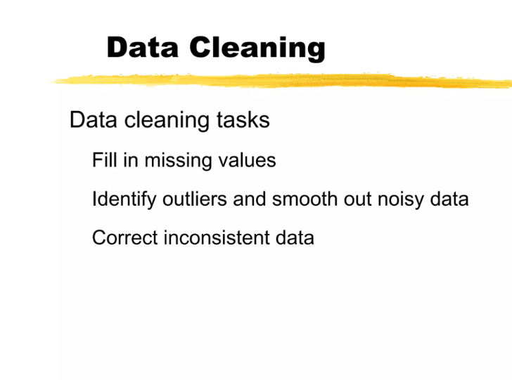
CONFIDENTIAL & PROPRIETARY 2022 – Adverk Technologies

Slide 8
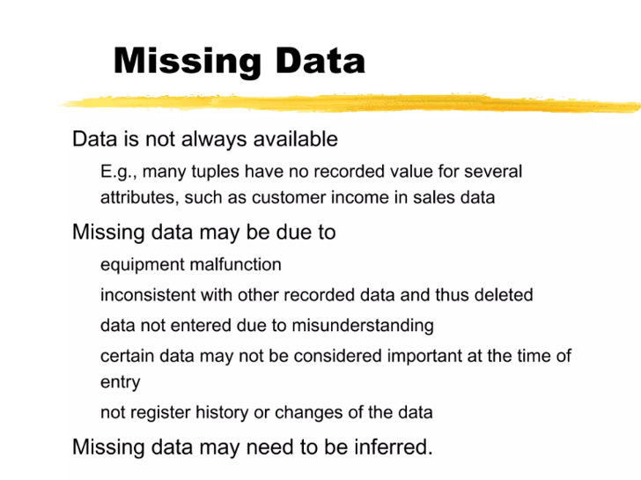
CONFIDENTIAL & PROPRIETARY 2022 – Adverk Technologies

Slide 9
CONFIDENTIAL & PROPRIETARY 2022 – Adverk Technologies

Slide 10
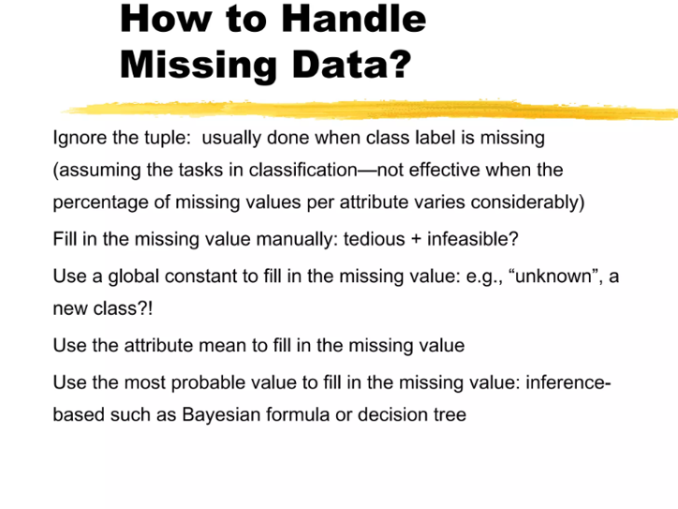
CONFIDENTIAL & PROPRIETARY 2022 – Adverk Technologies

Slide 11
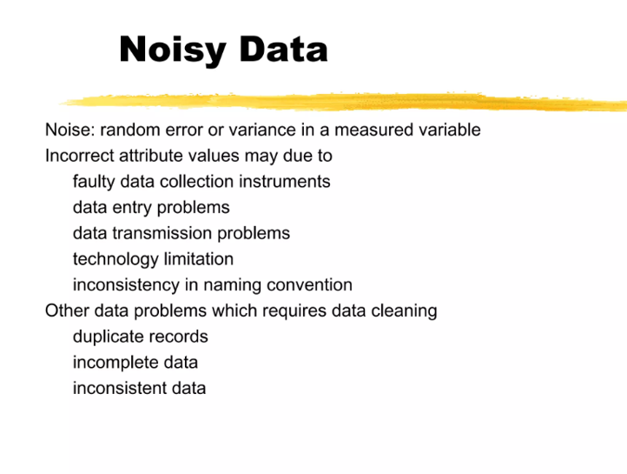
CONFIDENTIAL & PROPRIETARY 2022 – Adverk Technologies

Slide 12
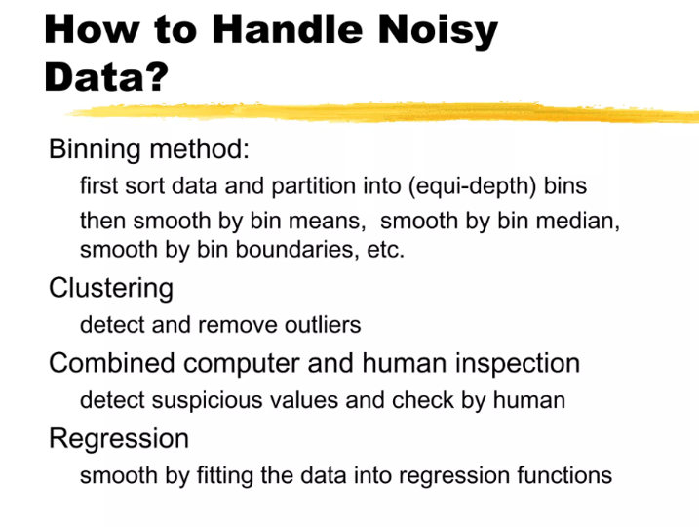
CONFIDENTIAL & PROPRIETARY 2022 – Adverk Technologies

Slide 13
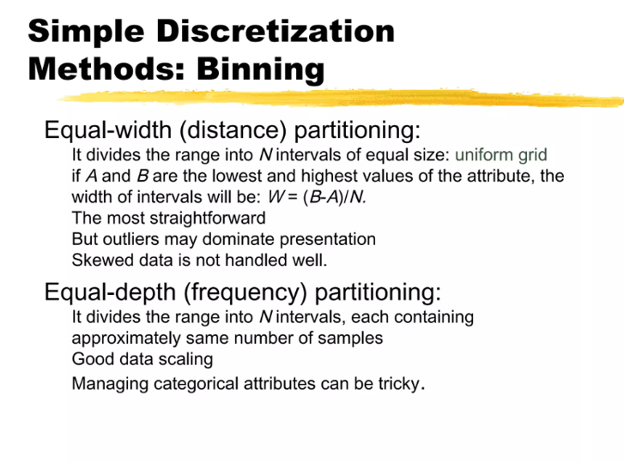
CONFIDENTIAL & PROPRIETARY 2022 – Adverk Technologies

Slide 14
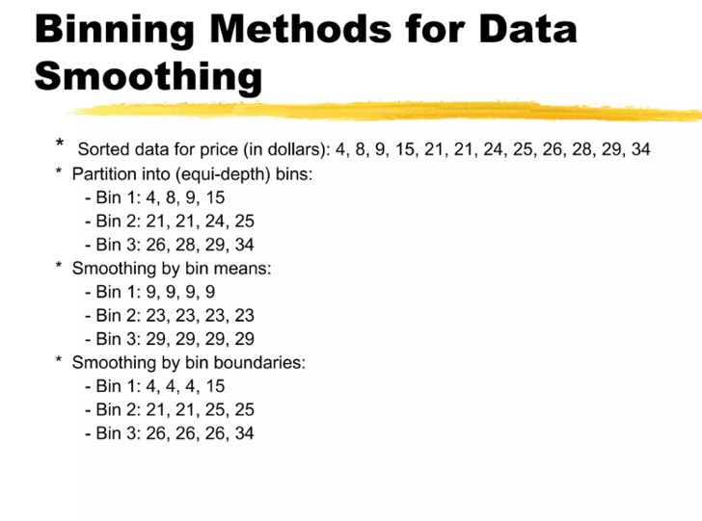
CONFIDENTIAL & PROPRIETARY 2022 – Adverk Technologies

Slide 15
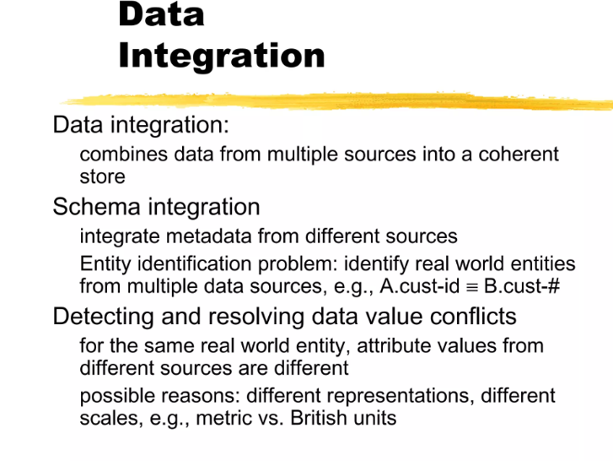
CONFIDENTIAL & PROPRIETARY 2022 – Adverk Technologies

Slide 16
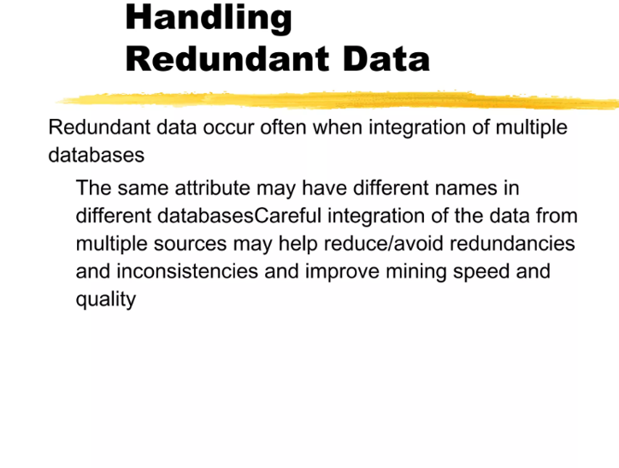
CONFIDENTIAL & PROPRIETARY 2022 – Adverk Technologies

Slide 17
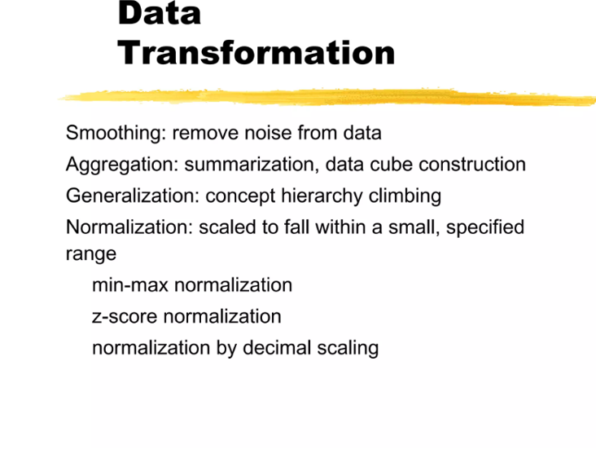
CONFIDENTIAL & PROPRIETARY 2022 – Adverk Technologies

Slide 18
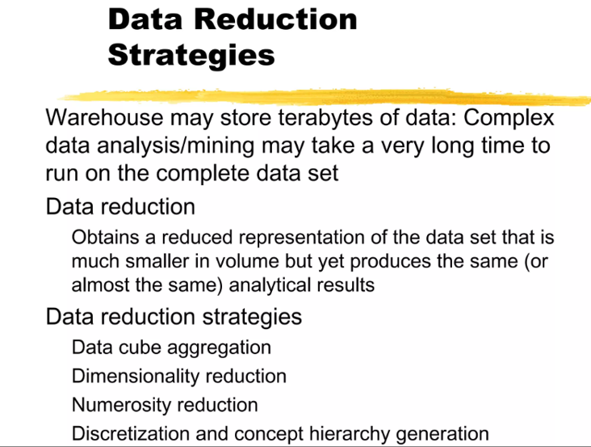
CONFIDENTIAL & PROPRIETARY 2022 – Adverk Technologies

Slide 19
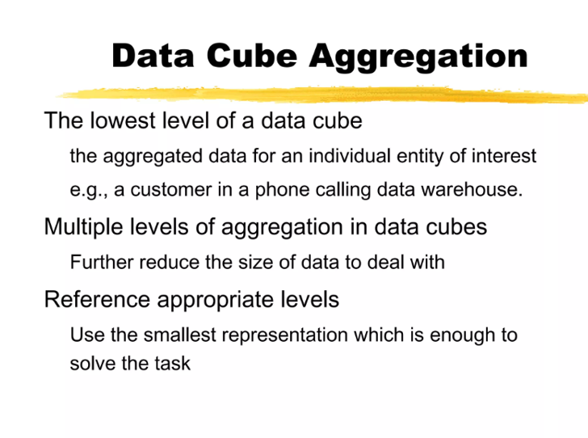
CONFIDENTIAL & PROPRIETARY 2022 – Adverk Technologies

Slide 20
Data Wrangling
What Is Data Wrangling?
Importance of Data Wrangling
Benefits of Data Wrangling
Data Wrangling Tools
Data Wrangling Examples
CONFIDENTIAL & PROPRIETARY 2022 – Adverk Technologies

Slide 21
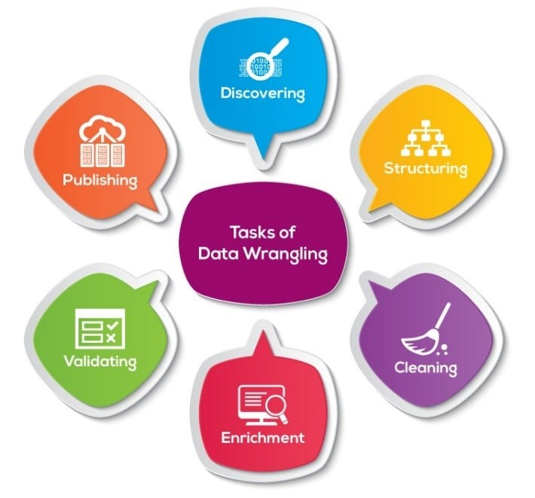
Data Wrangling is the process of removing errors and combining complex data sets to make them more accessible and easier to analyze.
CONFIDENTIAL & PROPRIETARY 2022 – Adverk Technologies

Slide 22
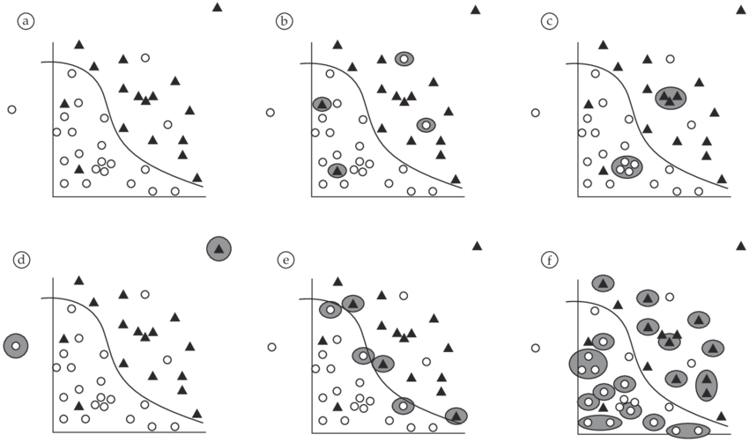
Need of Data Wrangling
CONFIDENTIAL & PROPRIETARY 2022 – Adverk Technologies

Slide 23
Importance of Data Wrangling
Making raw data usable. Accurately wrangled data guarantees that quality data is entered into the downstream analysis.
Getting all data from various sources into a centralized location so it can be used.
Piecing together raw data according to the required format and understanding the business context of data
Automated data integration tools are used as data wrangling techniques that clean and convert source data into a standard format that can be used repeatedly according to end requirements. Businesses use this standardized data to perform crucial, cross-data set analytics.
Cleansing the data from the noise or flawed, missing elements
Data wrangling acts as a preparation stage for the data mining process, which involves gathering data and making sense of it.
Helping business users make concrete, timely decisions
CONFIDENTIAL & PROPRIETARY 2022 – Adverk Technologies

Slide 24





Data Preparation
Data preparation is the process of preparing raw data so that it is suitable for further processing and analysis.
Data Transformation
Data Collection
Data Discovering
Data Cleansing
Data Structuring
CONFIDENTIAL & PROPRIETARY 2022 – Adverk Technologies

Slide 25
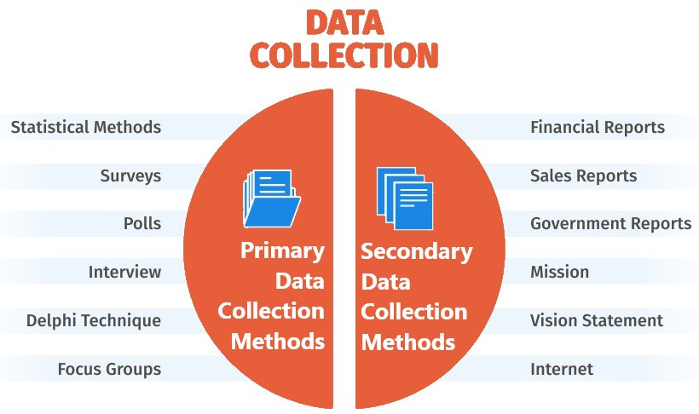
CONFIDENTIAL & PROPRIETARY 2022 – Adverk Technologies

Slide 26
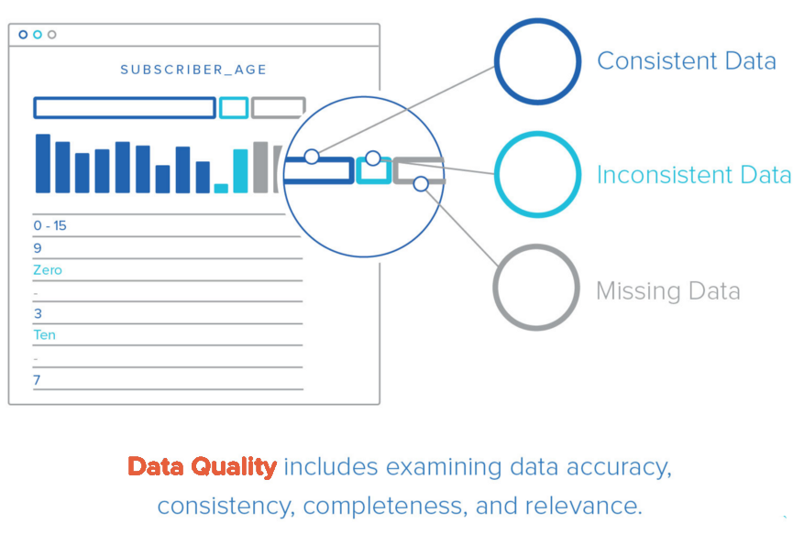
Data Quality
CONFIDENTIAL & PROPRIETARY 2022 – Adverk Technologies

Slide 27
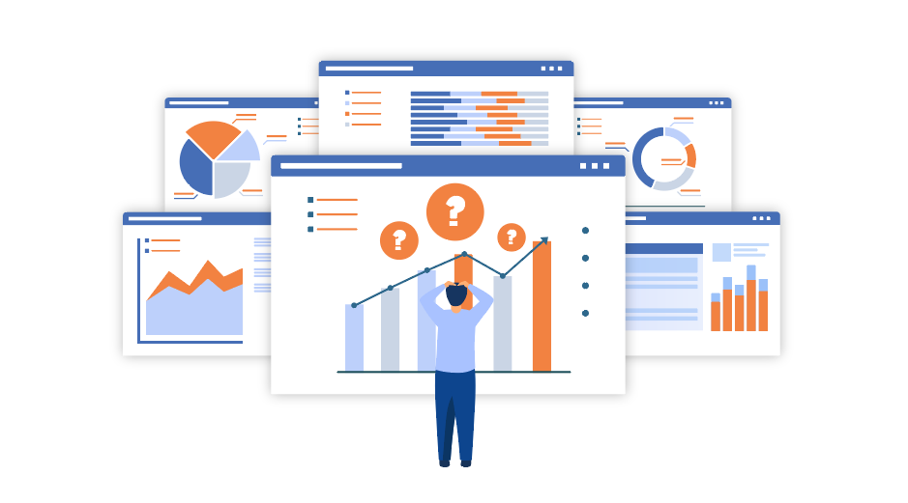
Data Discovery
The second step in the Data Wrangling process is Discovery. This is an all-encompassing term for understanding or getting familiar with your data.
CONFIDENTIAL & PROPRIETARY 2022 – Adverk Technologies

Slide 28
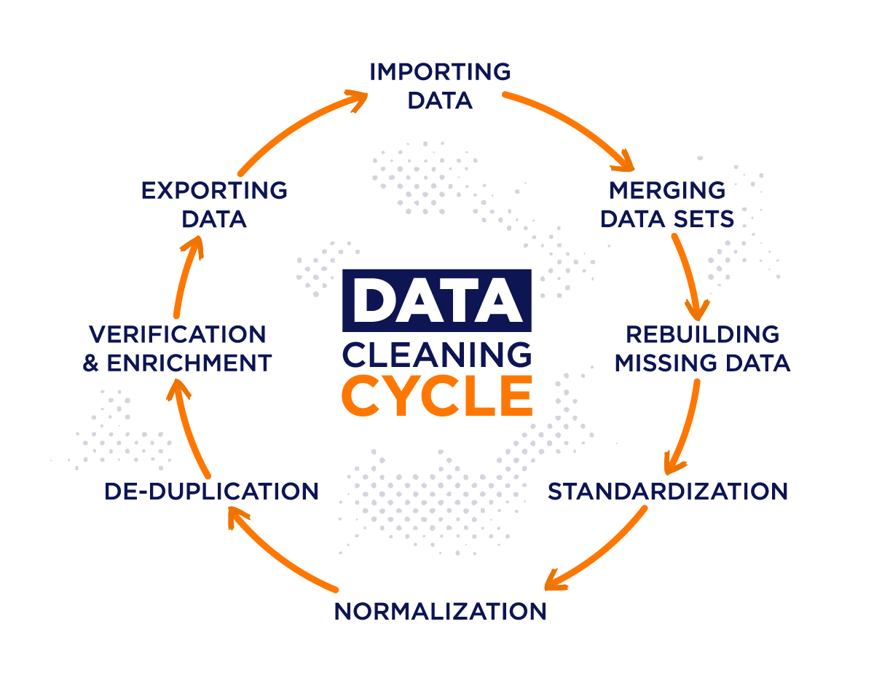
Data Cleaning
Data Cleaning involves Tackling Outliers, Making Corrections, Deleting Bad Data completely, etc. This is done by applying algorithms to tidy up and sanitize the dataset.
CONFIDENTIAL & PROPRIETARY 2022 – Adverk Technologies

Slide 29
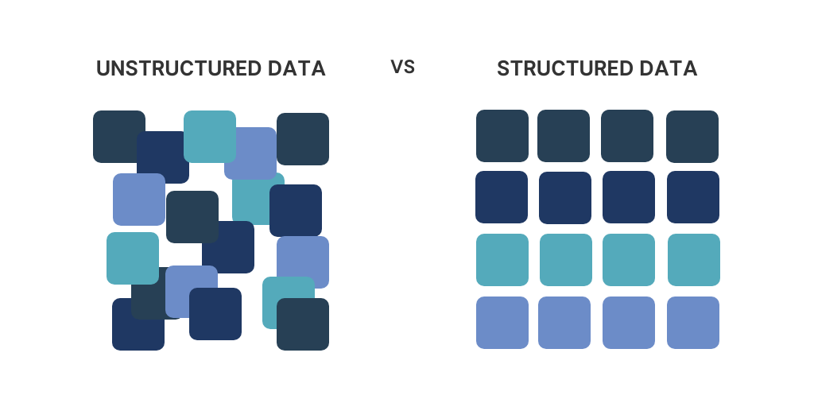
Data Structuring
When raw data is collected, it’s in a wide range of formats and sizes. It has no definite structure, which means that it lacks an existing model and is completely disorganized. It needs to be restructured to fit in with the Analytical Model deployed by your business, and giving it a structure allows for better analysis.
CONFIDENTIAL & PROPRIETARY 2022 – Adverk Technologies

Slide 30
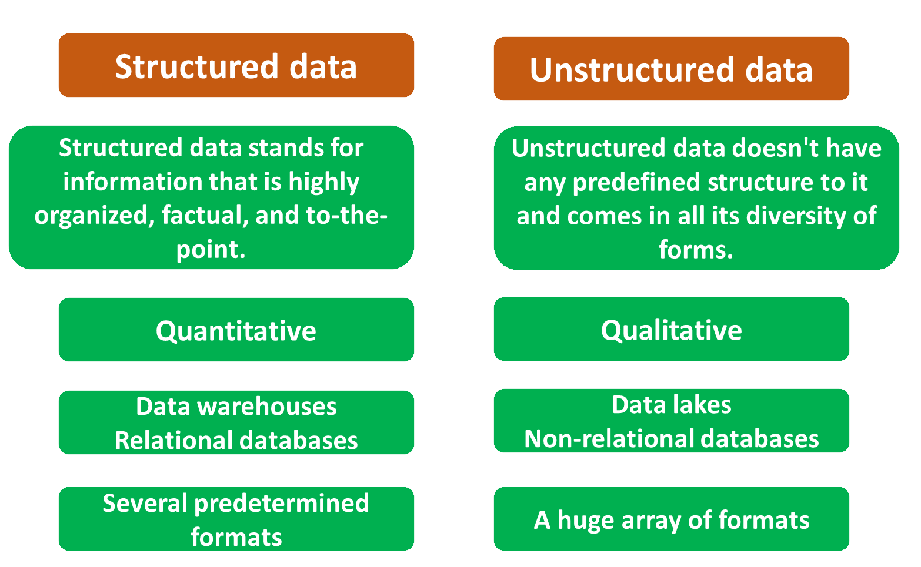
CONFIDENTIAL & PROPRIETARY 2022 – Adverk Technologies

Slide 31
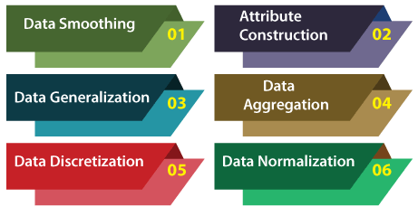
Data Transformation
CONFIDENTIAL & PROPRIETARY 2022 – Adverk Technologies

Slide 32
THANK YOU!
CONFIDENTIAL & PROPRIETARY 2022 – Adverk Technologies

