Slide 1



Learn Something Every Day
CONFIDENTIAL & PROPRIETARY 2022 – Adverk Technologies

Slide 2
Implementation of DS
CONFIDENTIAL & PROPRIETARY 2022 – Adverk Technologies

Slide 3
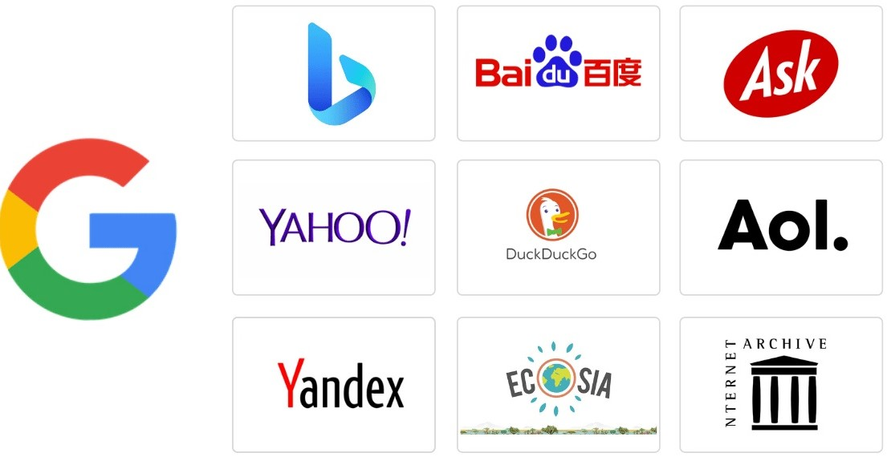

Data Science in Finance
Data Science in Search Engine
CONFIDENTIAL & PROPRIETARY 2022 – Adverk Technologies

Slide 4
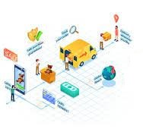

Data Science in Transport
Data Science in E-Commerce
CONFIDENTIAL & PROPRIETARY 2022 – Adverk Technologies

Slide 5

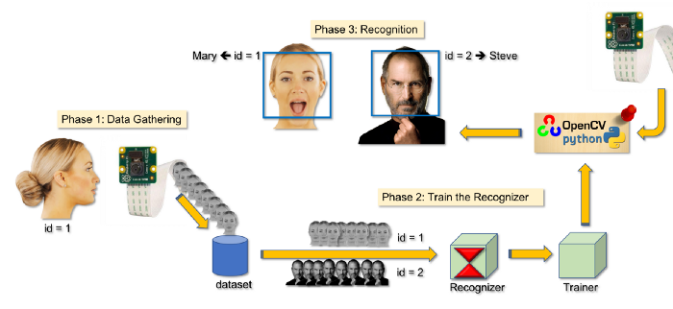
Data Science in Image recognition
Data Science in Health Care
CONFIDENTIAL & PROPRIETARY 2022 – Adverk Technologies

Slide 6
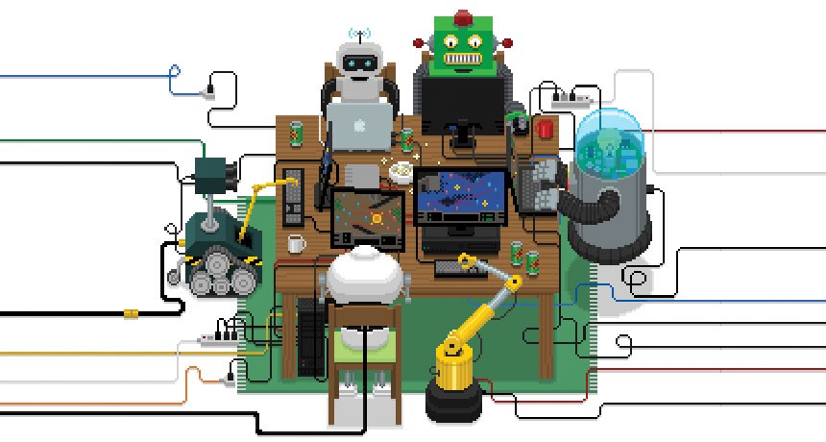
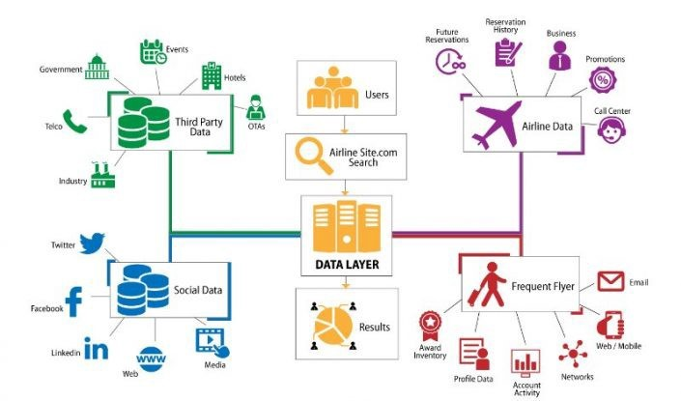
Data Science in
Airline Routing Planning
Data Science in Gaming
CONFIDENTIAL & PROPRIETARY 2022 – Adverk Technologies

Slide 7
Introduction to DS
CONFIDENTIAL & PROPRIETARY 2022 – Adverk Technologies

Slide 8
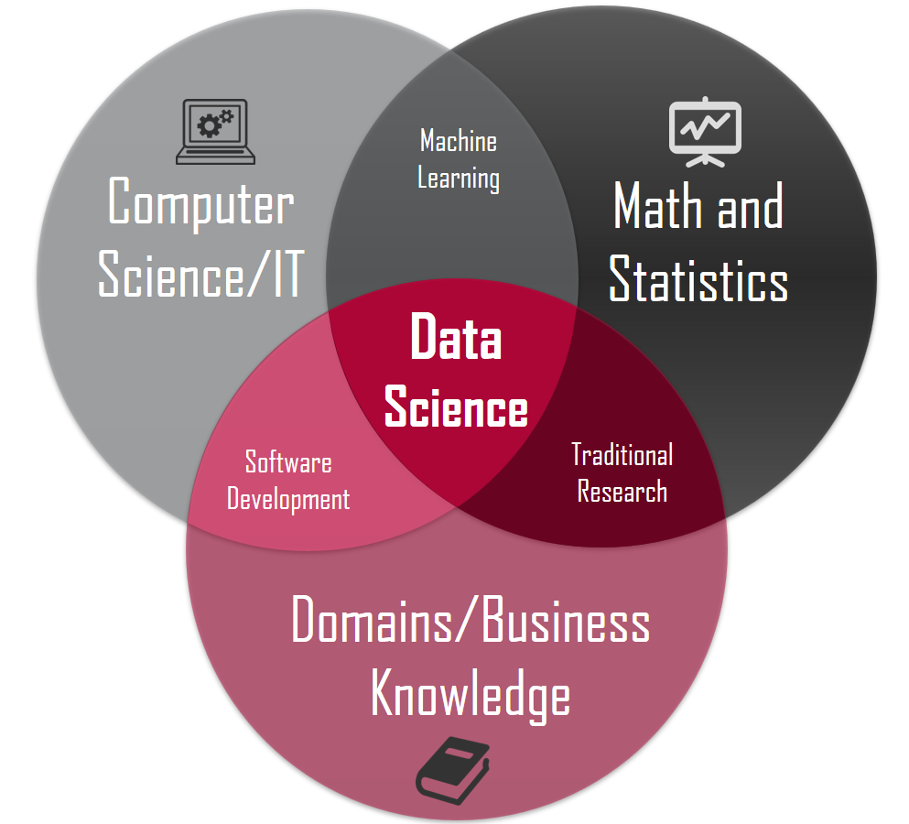
CONFIDENTIAL & PROPRIETARY 2022 – Adverk Technologies

Slide 9
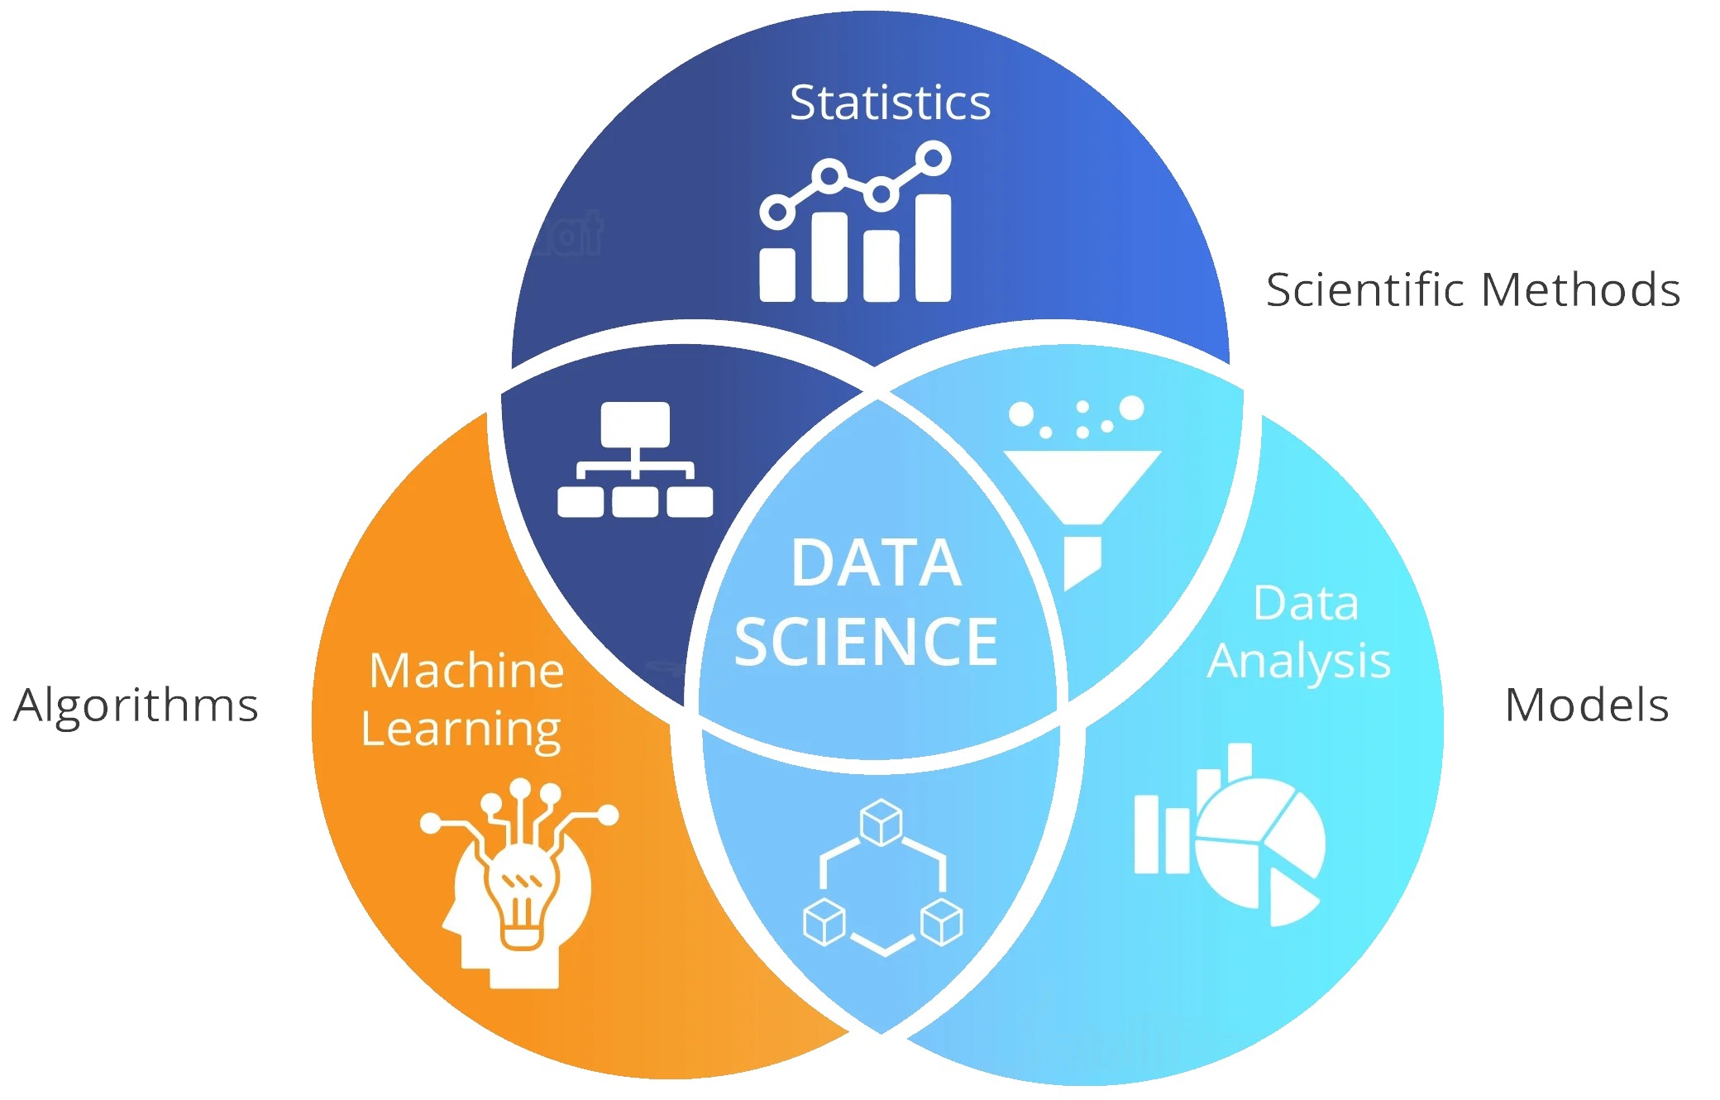
CONFIDENTIAL & PROPRIETARY 2022 – Adverk Technologies

Slide 10
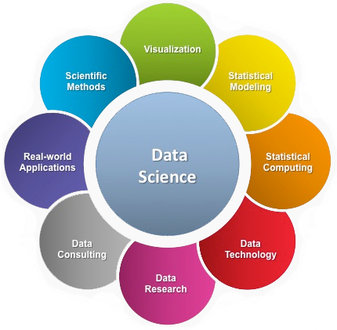
CONFIDENTIAL & PROPRIETARY 2022 – Adverk Technologies

Slide 11
Data Science Basic
CONFIDENTIAL & PROPRIETARY 2022 – Adverk Technologies

Slide 12
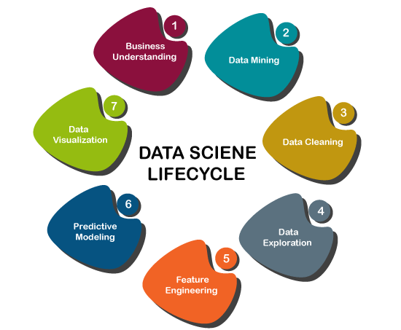
1. Understand the project objectives and requirements from a business perspective, and then convert this knowledge into a data mining problem definition and a preliminary plan designed to achieve the objectives.
CONFIDENTIAL & PROPRIETARY 2022 – Adverk Technologies

Slide 13
2. Data mining is the process of sorting through large data sets to identify patterns and relationships that can help solve business problems through data analysis
CONFIDENTIAL & PROPRIETARY 2022 – Adverk Technologies

Slide 14

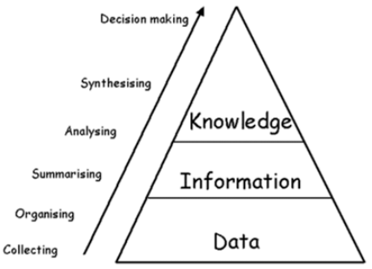
DIKW
–
Analytical
Processing
Transactional
Processing
4
CONFIDENTIAL & PROPRIETARY 2022 – Adverk Technologies

Slide 15
Types of Data
Types of Data
Types of Data
Nominal Data
Ordinal Data
Discrete Data
Continuous Data
CONFIDENTIAL & PROPRIETARY 2022 – Adverk Technologies

Slide 16
Types of variables
Categorical
Numerical
Discrete
Continuous
CONFIDENTIAL & PROPRIETARY 2022 – Adverk Technologies

Slide 17
3. Data cleaning is the process of fixing or removing incorrect, corrupted, incorrectly formatted, duplicate, or incomplete data within a dataset
CONFIDENTIAL & PROPRIETARY 2022 – Adverk Technologies

Slide 18
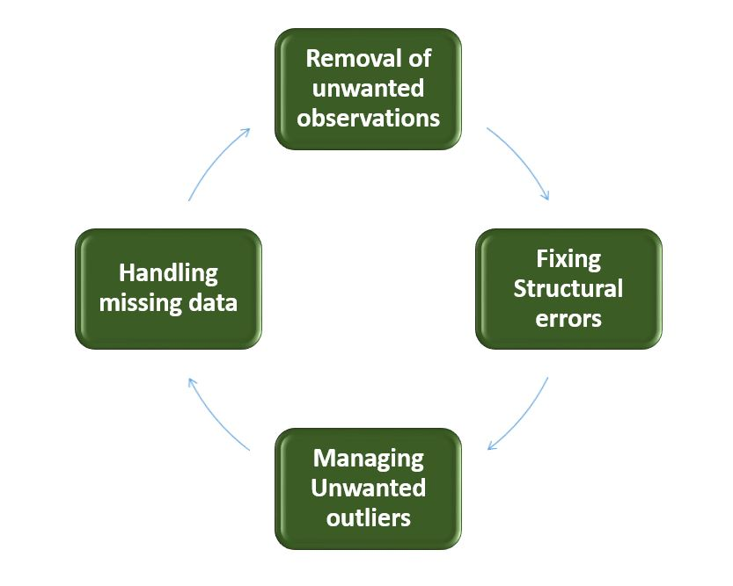
Data Cleaning
CONFIDENTIAL & PROPRIETARY 2022 – Adverk Technologies

Slide 19
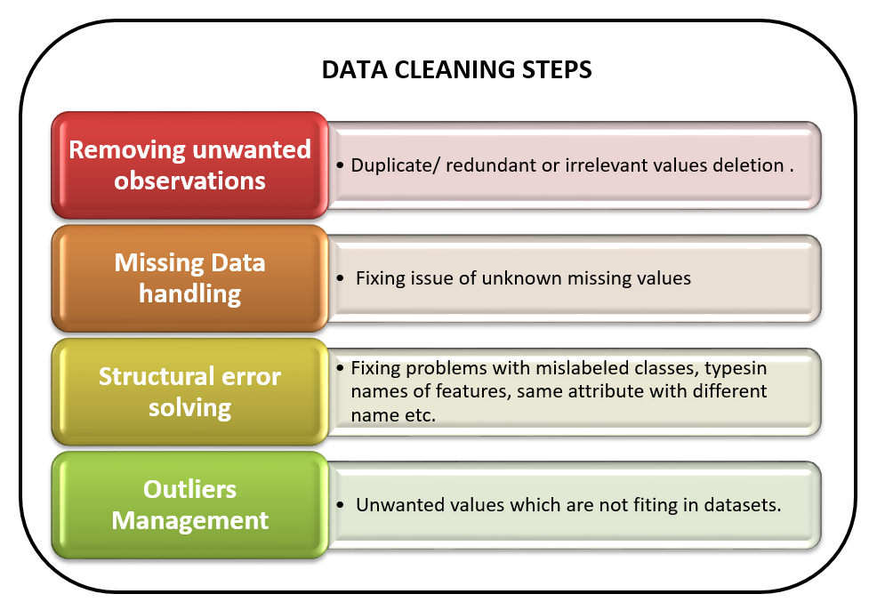
CONFIDENTIAL & PROPRIETARY 2022 – Adverk Technologies

Slide 20
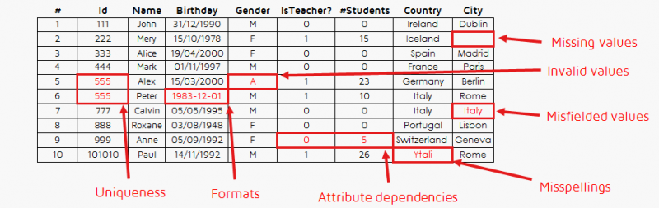
CONFIDENTIAL & PROPRIETARY 2022 – Adverk Technologies

Slide 21
4. Data exploration refers to the initial step in data analysis in which data analysts use data visualization and statistical techniques to describe dataset characterizations, such as size, quantity, and accuracy, in order to better understand the nature of the data.
CONFIDENTIAL & PROPRIETARY 2022 – Adverk Technologies

Slide 22
Steps in the Data Analysis Process
Step 1: Decide on the objectives or Pose a Question
Step 2: What to Measure and How to Measures
Step 3: Data Collection
Step 4: Summarizing and Visualizing Data
Step 5: Data Modelling
CONFIDENTIAL & PROPRIETARY 2022 – Adverk Technologies

Slide 23
5. Feature engineering is a machine learning technique that leverages data to create new variables that aren't in the training set.
CONFIDENTIAL & PROPRIETARY 2022 – Adverk Technologies

Slide 24
6. Predictive modeling is a mathematical process used to predict future events or outcomes by analyzing patterns in a given set of input data.
CONFIDENTIAL & PROPRIETARY 2022 – Adverk Technologies

Slide 25
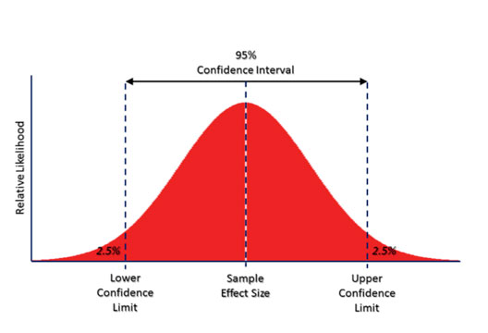
A Confidence Score is a number between 0 and 1 that represents the likelihood that the output of a Machine Learning model is correct and will satisfy a user's request.
CONFIDENTIAL & PROPRIETARY 2022 – Adverk Technologies

Slide 26
7. Data visualization is the practice of translating information into a visual context, such as a map or graph, to make data easier for the human brain to understand and pull insights.
CONFIDENTIAL & PROPRIETARY 2022 – Adverk Technologies

Slide 27
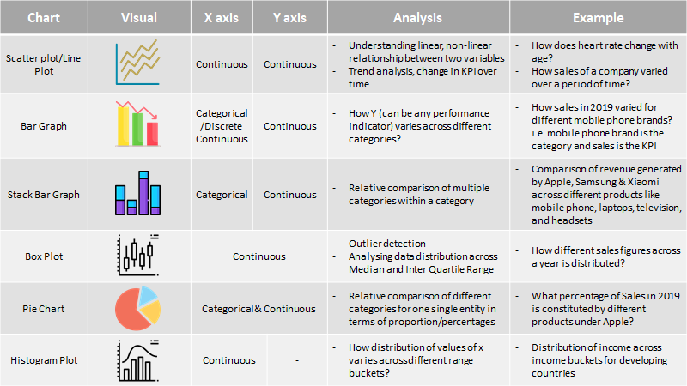
CONFIDENTIAL & PROPRIETARY 2022 – Adverk Technologies

Slide 28
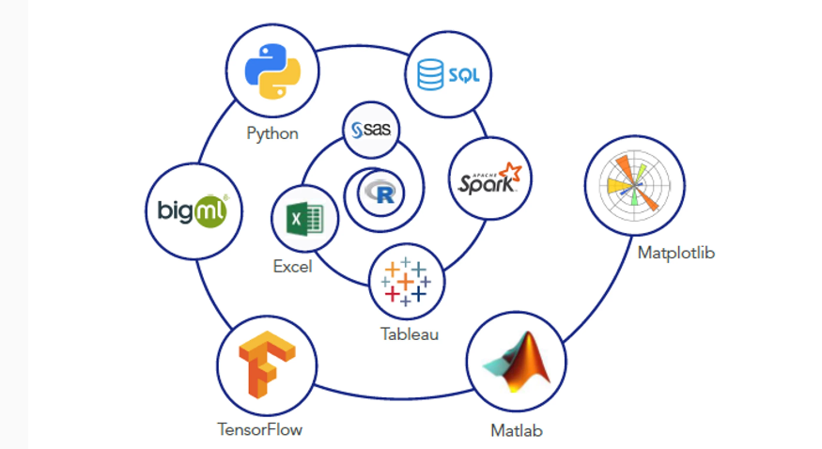
Data Science Tools
CONFIDENTIAL & PROPRIETARY 2022 – Adverk Technologies

Slide 29
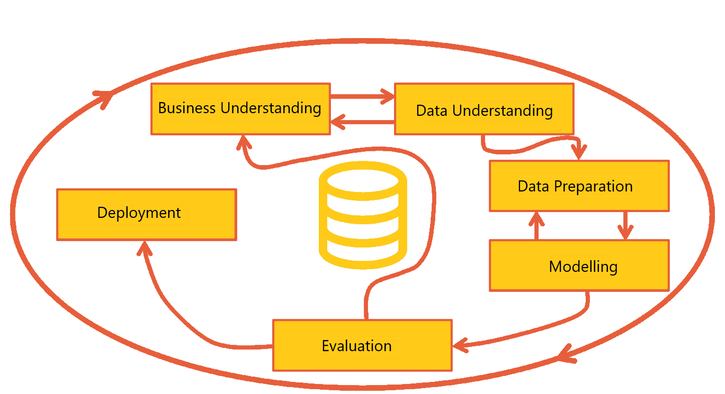
Data Science Basics
CONFIDENTIAL & PROPRIETARY 2022 – Adverk Technologies

Slide 30


Modelling in Data Science
Data Preparation
Modelling
CONFIDENTIAL & PROPRIETARY 2022 – Adverk Technologies

Slide 31

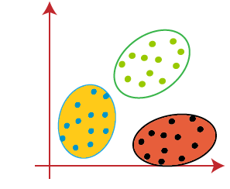
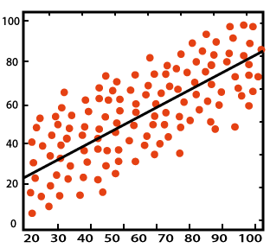
Data Science Task
ML Algorithms
Classification
Clustering
Regression
Association
(A, B) C
(D, E) F
(A, E) G
CONFIDENTIAL & PROPRIETARY 2022 – Adverk Technologies

Slide 32
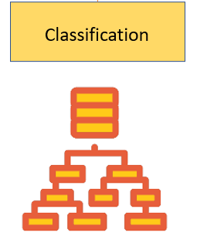
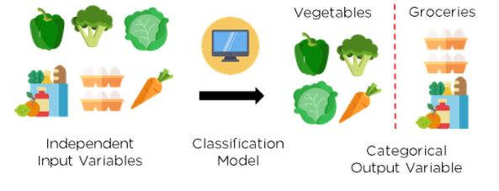
CONFIDENTIAL & PROPRIETARY 2022 – Adverk Technologies

Slide 33
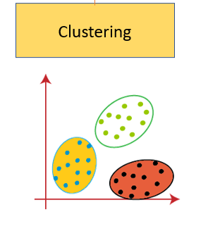
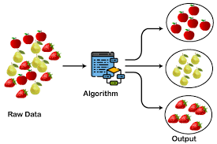
CONFIDENTIAL & PROPRIETARY 2022 – Adverk Technologies

Slide 34
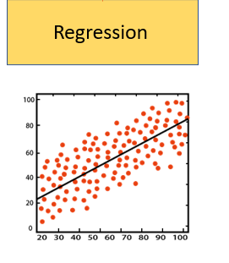
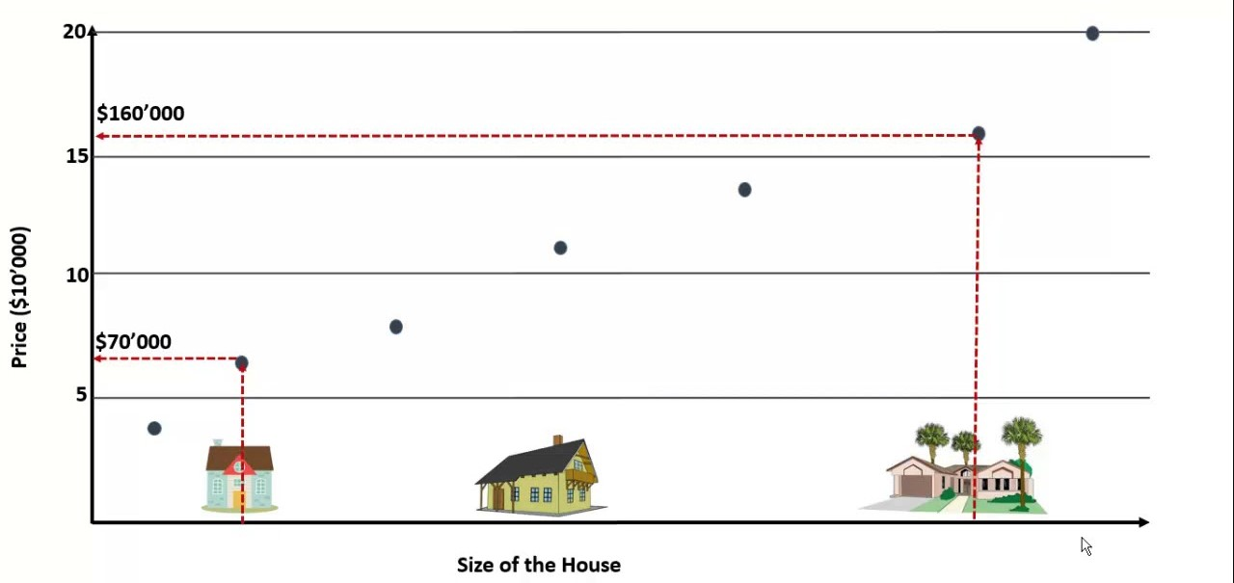
CONFIDENTIAL & PROPRIETARY 2022 – Adverk Technologies

Slide 35
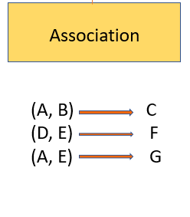
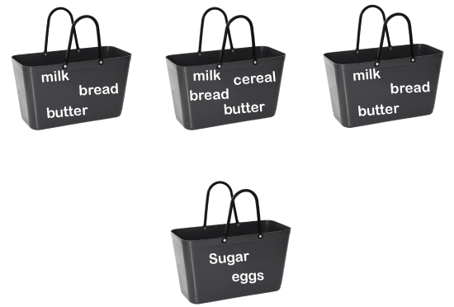
Customer 1
Customer 2
Customer 3
Customer n
CONFIDENTIAL & PROPRIETARY 2022 – Adverk Technologies

Slide 36
THANK YOU!
CONFIDENTIAL & PROPRIETARY 2022 – Adverk Technologies

