Slide 1
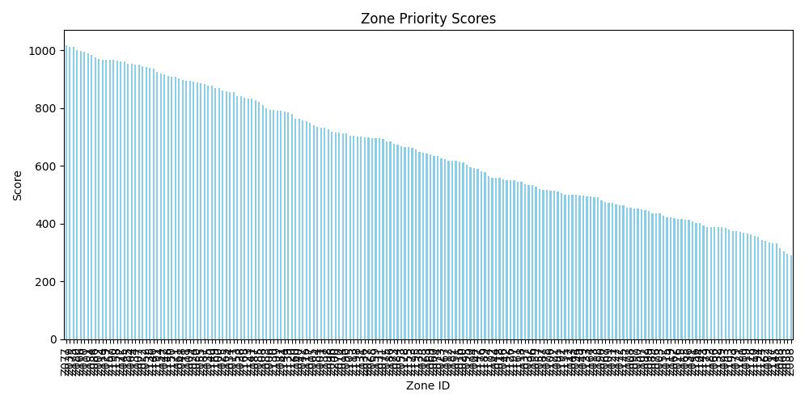
Zone Demand Chart

