Slide 1
THREE.Js Report
Name : Rohan.S.Wankhede
2019-B-28121999

Slide 2
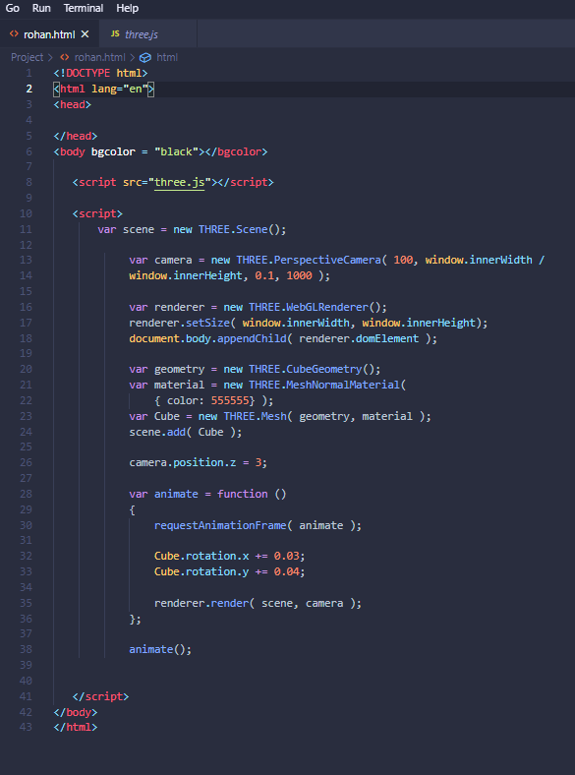
HTML SYNTAX
Using “ ! - Exclamation mark ” Key we can Create Html Syntax

Slide 3
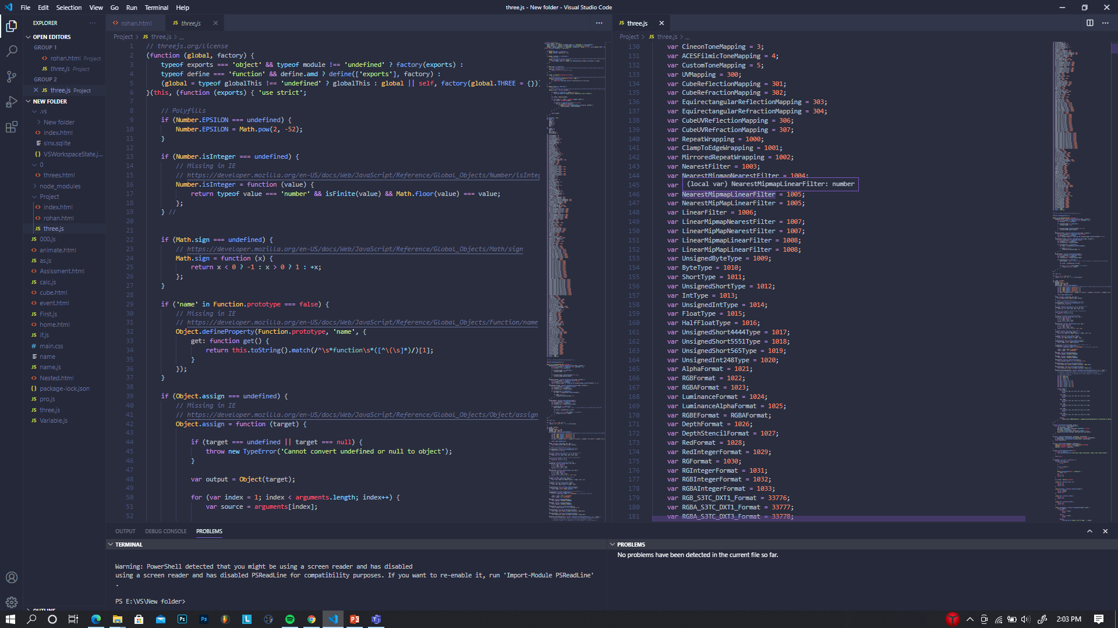
Three.js
Three.js is a Library
for creating 3D Graphics
On web Browser /
Live server
This is Downloaded file
From Google

Slide 4
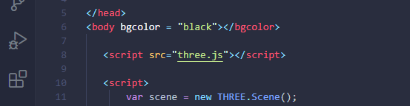
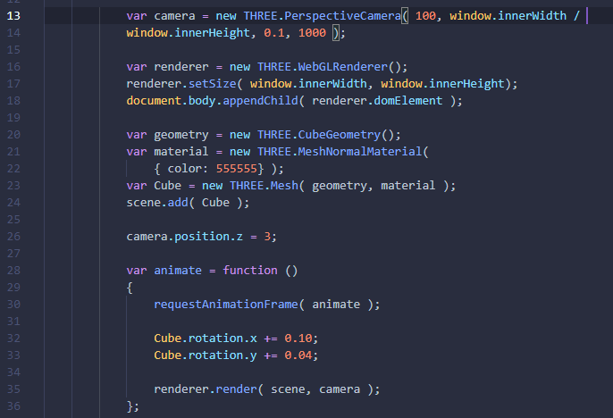
I have Imported the three.js
file in my project.
In this I used Elements of
three.js which are:
Renderer, Geometry, Material,
Scene and Camera.

Slide 5

Output:

Slide 6
THANKYOU
Rohan.wankhede@adypu.edu.in

