Slide 1
AI-Enhanced Tuberculosis Detection
S.V.Yokesh
Department of AI&DS
Sri Ramakrishna Engineering College
Coimbatore, India. yokesh.2211064@srec.ac.in
S.Hariharan
Department of AI&DS
Sri Ramakrishna Engineering College
Coimbatore, India. hariharan..2211065@srec.ac.in
C.B.Rohid
Department of AI&DS
Sri Ramakrishna Engineering College
Coimbatore, India. rohid.2211069@srec.ac.in
Mr.K.Lingkash
Department of AI&DS
Sri Ramakrishna Engineering College
Coimbatore, India. lingkash.k@srec.ac.in
Abstract For respiratory infections like pneumonia and tuberculosis (TB), early diagnosis is essential to minimize mortality rates and improve treatment success rates. This paper proposes an AI-assisted multi-modal healthcare system that uses chest X-ray images, cough audio samples, and patient symptoms to make an early prediction about the risk of disease. The proposed system uses a Convolutional Neural Network (CNN) for image analysis, an MFCC-based audio classification model for cough detection, and a symptom risk scoring module. The system uses a late fusion approach to combine the results of individual models to improve their diagnostic capabilities. The proposed system is developed as a web-based application that enables real-time screening and decision support, especially in distant and resource-constrained healthcare environments.
To overcome these limitations, an AI-based multimodal healthcare system, which can be used to detect pneumonia or tuberculosis using chest X-ray images, cough sounds, and symptoms of the disease, is proposed. In the proposed system, deep learning algorithms may be used for image analysis, where machine learning methodologies are adopted to classify cough sounds, while a system of risk scoring the symptoms of disease may be proposed. Late fusion strategies may be adopted to fuse the output of the individual models, which helps in developing a better prediction output.
Furthermore, the proposed framework can be implemented as a web-based healthcare application, which will enable users to input their healthcare data and receive automated risk assessment as well as obtain medical recommendations.
Thus, the proposed system intends to contribute to the era of preliminary diagnosis of respiratory diseases, as it is easier and less expensive to implement, allowing more people to access the said healthcare service, especially in remote areas.
I. Introduction
Respiratory infections like pneumonia and tuberculosis remain prominent killers throughout the globe. Specialized medical professionals are not available in the rural and underdeveloped regions that are affected by these respiratory infections. Early detection is highly critical in controlling the severity of the disease. In traditional systems, timber is checked manually by examining the images of the chest images obtained by the X-rays. Manual checks include tests and clinical examinations. However, the lack of facilities in the underdeveloped regions has created a critical need for automated systems to handle diagnostic and appraisal functions.
However, recent advances in artificial intelligence (AI) and deep learning have remarkably improved the effectiveness of computer-aided diagnosis systems, particularly for medical image analysis. For example, it has been reported that Convolutional Neural Networks (CNNs) achieved high effectiveness with respect to abnormal pattern detection in chest X-ray images, as well as machine learning algorithms utilizing audio signals of respiratory sounds, which have been promising in recognizing abnormal cough patterns. Moreover, there are also models that use a set of symptoms as input data, which can render significant contextual information. Thus far, most computer-aided diagnosis systems have been designed to use a specific modality of input data.
II. The Evolution of Phishing Detection
Early detection of diseases related to the respiratory system using computational tools and techniques has witnessed considerable research interest in recent years owing to the advancements in artificial intelligence, machine learning, and signal processing techniques. Research on various computational techniques for diagnosing pneumonia and tuberculosis using images, sounds, and data is discussed. This section discusses research articles related to image diagnosis, audio diagnosis, and hybrid healthcare systems.
A. Image-Based Detection of Pneumonia and Tuberculosis
Chest X-ray imaging is one of the most commonly deployed techniques for pulmonary disease diagnosis. Several works have reported, in fact, the efficiency of deep learning approaches, primarily CNNs, in the analysis of chest X-ray images for the diagnosis of pneumonia and tuberculosis. Pre-trained architectures such as VGGNet, ResNet, DenseNet, and Inception have been widely adopted due to their strong feature extraction capabilities.

Slide 2
The concept of transfer learning has been proven to offer significant gains when dealing with limited-size medical datasets. Various works have reported fine-tuned CNN models for open-source chest X-ray datasets and outperformed traditional machine learning methods based on handcrafted features.
However, image-only systems often suffer from misclassifications in the case of poor image quality, overlapping symptoms, or an infection caught in its incipient stage. preliminary diagnosis of respiratory diseases, as it is easier and less expensive to implement, allowing more people to access the said healthcare service, especially in remote areas.
III. LITERATURE REVIEW
Early detection of diseases related to the respiratory system using computational tools and techniques has witnessed considerable research interest in recent years owing to the advancements in artificial intelligence, machine learning, and signal processing techniques. Research on various computational techniques for diagnosing pneumonia and tuberculosis using images, sounds, and data is discussed. This section discusses research articles related to image diagnosis, audio diagnosis, and hybrid healthcare systems.
A. Image-Based Detection of Pneumonia and Tuberculosis
Chest X-ray imaging is one of the most commonly deployed techniques for pulmonary disease diagnosis. Several works have reported, in fact, the efficiency of deep learning approaches, primarily CNNs, in the analysis of chest X-ray images for the diagnosis of pneumonia and tuberculosis. Pre-trained architectures such as VGGNet, ResNet, DenseNet, and Inception have been widely adopted due to their strong feature extraction capabilities.
The concept of transfer learning has been proven to offer significant gains when dealing with limited-size medical datasets. Various works have reported fine-tuned CNN models for open-source chest X-ray datasets and outperformed traditional machine learning methods based on handcrafted features. However, image-only systems often suffer from misclassifications in the case of poor image quality, overlapping symptoms, or an infection caught in its incipient stage.
B. Audio-Based Cough Analysis
Analysis of cough sound has emerged as an alternative method, which is non-invasive and has less economic impact, to detect respiratory diseases. The cough sounds can be categorized as normal or abnormal using machine learning and deep learning algorithms. For example, it can be done using the extracted feature sets of cough sound, which are Mel Frequency Cepstral Coefficients, spectral centroid, zerocrossing rate, etc. Support Vector Machine classifier, Random Forest classifier, and deep neural networks have also been considered in various studies. Also, recent papers have investigated audio classifier approaches based on deep learning techniques, along with both recurrent and convolutional approaches, but with a representation in terms of a spectrogram for the cough signal.
It is presumed that while examining the cough signal, the analysis itself might not be completely effective in accurately identifying the disease, though this also acts as additional information, especially in cases of remote diagnosis via audiobased methods. The key limitation lies in terms of the dataset and the environment.
C. Symptom-Based Clinical Decision Support Systems
Clinical decision support systems based on patient-reported symptoms have been traditionally used for the primary screening of diseases. In rule-based systems and other statistical methods, weighted scores for diseases based on the severity of the symptoms like fever, duration of cough, weight loss, pain in the chest, or night sweats are obtained. These methods are more viable in resource-constrained environments where sophisticated diagnostic aids may not be readily available. However, these methods themselves may not be very objective and may lead to an ambiguous outcome based on the similarities in the presentation of various respiratory diseases.
D. Multimodal and Fusion-Based Healthcare Systems
In order to mitigate some of these problems, which have limited the capabilities of these unimodal approaches, more current research emphasis has been given to multimodal healthcare approaches that have employed fusion techniques involving multiple sources of health data. This has included approaches such as early fusion and late fusion approaches.
A key type of late fusion that has been applied with success, due to their relative robustness and adaptability, is that which aggregates all possible models.
Researchers have already established that improving the diagnostic results and generality is achievable using the fusion techniques compared to individual models. Nevertheless, it has been noted that the approaches developed have only been experimental and not deployed in real-time scenarios with interactive frontends. Furthermore, there has been a lack of approaches where all three modality sources, images, audios, and symptoms, are included for the purpose of detecting respiratory diseases.
E. Gap in Research and Motivation
While significant strides have been made within AI-assisted respiratory disease diagnosis, there remains a lack of comprehensive systems that unifies chest X-ray imaging, cough audio analyses, and symptom-based assessments into one deployable framework. Most existing studies are limited to isolated modalities or fail to provide an appropriate implementable work for practical applications in real-world usage. Motivated by the diverse spectrum of limitations based on the identified literature gap analysis, the proposed work proposes a multimodal AI health system using the late fusion strategy in order to improve pneumonia and tuberculosis detection, facilitating an accessible, web-based platform for diagnostic support.

Slide 3
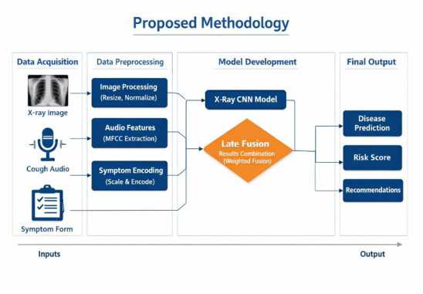
III. METHODOLOGY
The proposed system would comprise a multimodal artificial intelligence-based healthcare system, which would aid in detecting pneumonia and tuberculosis based on chest X-ray images, cough audio recordings, and patient symptoms. The methodology that would be used in this regard comprises data acquisition, data preprocessing, two separate models, and a late fusion mechanism.
A. System Overview
The system utilizes a sequential processing pipeline in which users can pass medical inputs to the web interface to upload the medical data into the system. After the medical data is uploaded, it is sent to the backend server where the AI models process each modality separately, and finally, the outputs from the image model, audio model, and symptom scoring module are integrated using the weighted late fusion approach for the final result and recommendation.
B. Data Acquisition
The proposed framework works with three different kinds of inputs: Chest X-ray Images: These images help in the detection of radiological patterns related to diseases like pneumonia and tuberculosis.
Cough Audio Recordings: They can be employed to identify abnormal respiration sounds that might imply the possibility of an infection in the
Patient Symptoms: These are clinical parameters, such as the presence of fever, cough, the nature of chest pain, smoking status, night sweats, age of the patient, and so on.
C.Data Preprocessing
1) Image Preprocessing: There are preprocessing steps applied to chest X-ray images to enhance model performance, which are:
i. Re-sizing the image to a standard size (224x224 dimension)
ii. Pixel normalization
iii. Image data augmentation like flipping and rotation for better generalization
iv. Noise reduction and contrast enhancement
2) Audio Preprocessing: Cough recordings undergo processing to derive essential features:
i. Background noise reduction
ii. Silence trimming
iii. Signal Normalization
iv. Feature extraction using Mel-Frequency Cepstral Coefficients (MFCCs), which are a spectral feature of the coughing sound
3) Symptom Data Processing: The information related to the symptoms of the patient is further converted into numerical format by applying categorical encoding and feature scaling. A weighted score is assigned to the symptoms on the basis of their clinical importance in diagnosing the respiratory disease.
D. Model Development
1) Image Classification Model A Convolutional Neural Network is used for image processing for the images related to the chest X-ray. These images are classified based on different diseases. A Convolutional Neural Network is used for the feature extraction of images related to lung opacities, consolidations, and structural abnormalities before classifying them.
2) Audio Classification Model
The MFCC features extracted using the cough audio are provided as input to a machine or deep learning classifier that can classify whether the respiratory sound is normal or abnormal. A probability score is generated as output.
3) Symptom Risk Scoring Module
A symptom-based scoring mechanism is used to determine a cumulative risk score according to the weight assigned to the symptom. Based on the cumulative risk score obtained, the presence or absence of respiratory diseases is established.
E. Multimodal Late Fusion Strategy
In order to make predictions more robust, a multimodal late fusion strategy is used, in which each modality is used separately and a separate model is applied for each modality. At the decision level, the predictions are combined, resulting in a risk assessment. In this approach, modality-specific outputs are aggregated to make the final prediction based upon a set of existing modality importance weights, which define the relative levels of reliability associated with particular sources of data. Through the aforementioned, it can be seen that predictions made by different models are aggregated, thus preserving the individual effectiveness of these models.
This latter process of fusion is beneficial in improving overall diagnostic performance. It is especially beneficial in situations that involve one or more noisy or less-informative imaging modalities. The proposed model of fusion is compared to multi-modality methods in that better accuracy and generalization can be achieved through this particular model.
F. Deployment Framework
The trained models are integrated into a web-based healthcare application developed using the React-based frontend with the Flask backend. The backend, in turn, exposes REST APIs for receiving user inputs, carrying out model inference, executing fusion computation, and sending back prediction results along with medical recommendations. The system is designed to handle the data securely by storing it temporarily and embedding validation mechanisms at all stages of data processing.

Slide 4
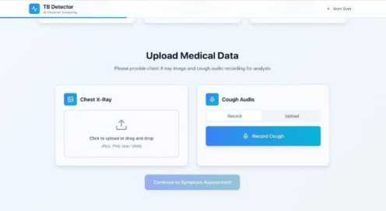
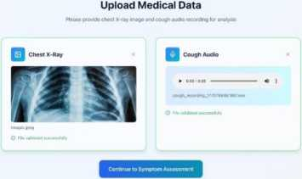
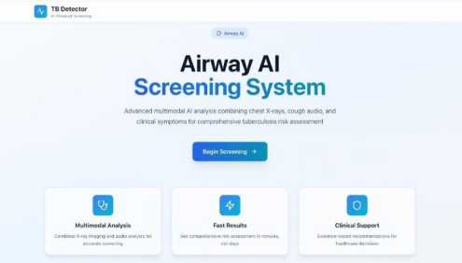
IV. IMPLEMENTATION
The design and development of the proposed multimodal health care system adopt a web-based application that integrates front-end GUI interfaces, backend processing services, and the trained artificial intelligence models for respiratory disease detection. This implementation takes into account the need for real-time data upload, automation in inference, multimodal fusion, and visualization of results with security and scalability.Additionally, the already-existing backend intelligence is alleviating the communication process through the accessible interface of the assistant service. It needn't support patients with the answers, prescriptions, and booking appointments while the other part used Optical Character Recognition (OCR) to permit the system to quickly understand and navigate unstructured, complex data through medical image reading including reports or prescriptions. Retrieval-Augmented Generation consists of: Named Entity Recognition, summarization, and scheduling in a single pipeline, therefore all processes contender creation with correct domain-specific knowledge. In addition to accelerating the processes of collaborative decision-making, the solution improves quality and heightens personalization of healthcare services. The deployment signals a new era of digitally linked health care, raising the bar for data-oriented and responsive solutions for scheduling.
A. Development Environment
The system is developed based on the usage of the latest technology in both web development and machine learning. In the front-end user interface design, Reactjs, HTML, CSS, and Tailwind CSS are used to deliver an interactive user interface. On the other hand, the back-end side is built based on the Python Flask framework, which is used for the development of the RESTful API to handle user requests and the functionality to interact with the machine learning model. In the machine learning model training phase, both TensorFlow and PyTorch may be used.
C. Backend Implementation
The backend server is in charge of handling the operations for data processing and model inference. The operations carried out by the backend server after receiving inputs from users through API endpoints are as follows:
i. Validates the uploaded files and symptom data.
ii. Applies data preprocessing techniques like image resizing, audio feature extraction, and symptom encoding.
iii. Sends processed data to the appropriate trained models.
iv. Gathering prediction outputs from each modality.
v. It executes the late fusion algorithm to calculate the final risk score.
vi. This function returns the prediction results and recommendations to the frontend.Temporary storage mechanisms are used to guarantee data privacy; further, unwanted data files are removed once the processing is done.
B. Frontend Implementation
The front-end application possesses an intuitive application as it allows users to:
Uploading images of chest X-rays
Record or upload cough sound samples
Enter symptom-related information in structured forms
Review prediction results and medical recommendations Input validation will be performed to ensure the correct file type, size, and completion of the form before submission. The frontend communication with the backend will be done by making HTTP protocol API requests to exchange the user data securely.
D. Model Integration
Image classification models, cough audio models, and symptom scoring models are pre-trained models that are serialized and integrated into the backend environment. At runtime, the backend invokes the pre-trained models in real time for user inputs. The image model uses a CNN architecture for analyzing X-ray images, while the audio model uses MFCC extracted from cough audio. The symptom model calculates the risk score using weights.

Slide 5
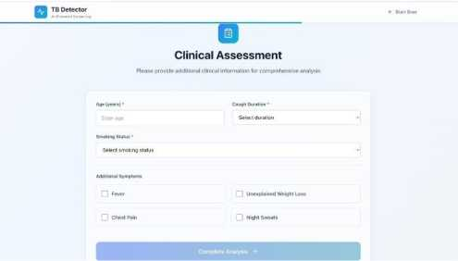
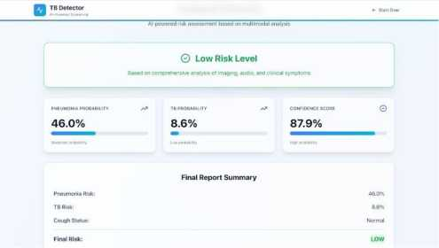
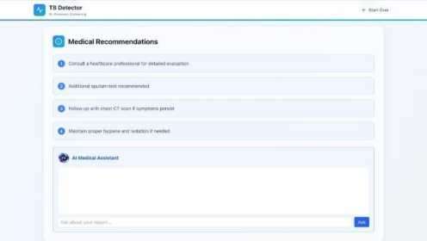
V. RESULTS AND DISCUSSION
The performance of the suggested multimodal system was assessed via a consideration of the prediction accuracy of individual modalities as well as the multimodal fusion mechanism. Within this regard, a set of experiments was conducted using chest X-ray images, cough sound recordings, and symptoms that were split into sets for training, validation, and testing. Assessment of the proposed system was carried out with the aim of ascertaining whether multimodality improves the performance of respiratory disease detection or not.
A. Performance of Individual Modalities
The image-based CNN model proved to be highly competent in recognizing patterns of pneumonia and tuberculosis through images of chest x-rays, which resulted in very high accuracy in pattern classification owing to its ability to recognize distinct features. The audio-based model used to recognize patterns of abnormal or normal cases of cough sounds via MFCC-based features was able to distinguish very well. The performance of this model was still lower due to dissimilarities in environment. The symptom-based model proved to be useful for providing scores in relation to context; however, it remained absolutely incapable on its own in diagnosing diseases owing to overlapping symptom patterns.
B. Multimodal Fusion Performance
The proposed method of late fusion based on the aggregation of predictions pertaining to the image, audio, and symptom modules appeared to show promise in improving the overall system performance as against the performance of the individual modules working separately. For instance, the combined system facilitated a reduction in the number of misclassifications that often occurred when the system was subjected to either image or audio-based input separately.
Evaluation through experimental evaluation revealed that overall prediction accuracy, along with better recall for diseasepositive samples, could be obtained using the multimodal framework. The evaluation validates that overall diagnosis reliability can be enhanced and that screening for diseases is possible through integration with multimodal healthcare data.
c. Discussion
These findings from the experiment emphasize the power of fusing multiple sources of healthcare information related to respiratory diseases. Image is the most informative of the diagnostic inputs, with the audio/symptom inputs serving more of a supplementary role to add robustness. Such a late fusion method offers flexibility to each model through independent optimization while still taking advantage of the results of the combined effort. Despite the achievement of these enhanced performance results, some challenges that the system has to contend with include the effect of the accuracy of the dataset used to train the models when it comes to the categorization of the cough audio signals.
E. Result Visualization and Reporting
The current system shows the prediction results in a user-friendly format that can be easily interpreted with disease percentage probability, the overall risk level of the disease, and the medical recommendations that can be made. Further, the current system shows the results of the prediction with risk levels such as low, medium, and high risks, as well as the level of confidence associated with the predictions.
F. Deployment and Scalability
This application can be deployed on any cloud platforms like Render, Railway, or Firebase, ensuring access remotely and the scalability aspect. Large-scale user access and future expansion of the system could also be supported using different containerized deployment approaches. Due to the modular implementation design, future integrations related to disease detection models and healthcare features are pretty easy to accommodate within the application.

Slide 6
Moreover, the system cannot be used as a replacement for the professional medical diagnostic process. Overall, the findings have shown that the proposed multimodal AI-based system is effective for early screening of pneumonia and tuberculosis, particularly for remote environments where efficient preliminary screening is critical for remotely delivering healthcare services.
VI. CONCLUSION AND FUTURE SCOPE
A. Conclusion
Furthermore, this paper proposed an AI technology-driven multimodal system for early disease detection of pneumonia and tuberculosis with the help of image processing of cough X-ray images and audio signal processing of patient cough sounds along with symptom-driven risk calculation. Here, deep learning algorithm-driven image processing of cough X-ray images with audio signal processing of patient cough sounds and symptom-driven risk calculation help in disease prediction with the help of late fusion.
The proposed system, which implements an intelligent healthcare screening system, proves that it is possible to use a web-based platform to provide users with the opportunity to upload their medical data and receive risk prediction as well as medical recommendations. From the experimental results, it is evident that using a model of multimodal fusion improves the accuracy of the predictions by aggregating features from different heterogeneous medical data inputs. It can be used as an effective tool to help in the decision-making process in the early detection of respiratory diseases, especially in remote areas where access to medical facilities is difficult.
B. Future Scope
Several enhancements may be added as future work to enhance the performance and applicability of the proposed system:
i. Integration of other respiratory diseases detection systems such as COVID-19, asthma, and chronic obstructive pulmonary disease (COPD).
ii. Expansion of the training datasets using diverse and clinically validated samples to improve generalization.
iii. Creation of a mobile application version that facilitates the large-scale community-level screening.
iv. Addition of real-time telemedicine facilities to consult healthcare experts directly.
v. Implementation of state-of-the-art advanced multimodal fusion techniques like attention-based fusion model and deep fusion model to improve the accuracy of predictions.
vi. Deployment on large-scale cloud infrastructures for nationwide and global health care accessibility.
Further, with these improvements in the future, it can be inferred that the proposed healthcare model, which is based on multiple modalities, has the potential to become a comprehensive intelligent screening system for preventive healthcare.
REFERENCES
1). A. Adly, Y. Farag, and A. E. Hassanien, “Early detection of tuberculosis with machine learning cough audio analysis: Towards more accessible global triaging usage,” arXiv preprint arXiv:2310.17675, 2023. [Online]. Available: https://arxiv.org/pdf/2310.17675
2). N. Thakur, A. Yadav, and S. K. Chauhan, “Artificial intelligence in diagnosing tuberculosis: A review,” in Proceedings of the International Conference on Innovative Computing and Communications (ICICC), 2019, pp. 1-8. [Online]. Available: https:// www.researchgate.net/publication/331479045
3). A. R. A. Ghani, A. Mohamed, R. S. Ahmad, and S. R. S. M. Rahim, “Evolution of machine learning in tuberculosis diagnosis: A review of deep learning-based medical applications,” Electronics, vol. 11, no. 17, p. 2634, 2022. [Online]. Available: https:// www.mdpi.com/2079-9292/11/17/2634
4). R. D. Rohila, P. Khurana, and A. Khurana, “A comprehensive review on synergy of multi-modal data and AI technologies in medical diagnosis,” Bioengineering, vol. 11, no. 3, p. 219, 2024. [Online]. Available: https://www.mdpi.com/23065354/11/3/219
5). M. R. Rehman, M. R. Hasan, F. A. Talukder, and M. S. Kaiser, “Multimodal medical image classification using deep residual network and genetic algorithm,”PLOS ONE, vol. 18, no. 7, p. e0287786, 2023. [Online] .Available: https://journals.plos.org/plosone/article?id=10.1371/journal.pone.0287786

