Slide 1


SMART INDIA HACKATHON 2026
TITLE PAGE
Problem Statement ID –: SIH26153
Problem Statement Title –: AI based Network Attack Forecasting from Network Traffic Data
Theme –: Blockchain & Cybersecurity
PS Category –: Software
Team ID –: 180189
Team Name –: _Celeryy_
NETFORECAST
AI World Model for Network Attack Forecasting

Slide 2

NETFORECAST — PROPOSED SOLUTION
_Celeryy_
Problem
Conventional IDS models often classify flows independently. This loses the temporal sequence of an intrusion and can raise alerts only after malicious traffic is observed.
NetForecast
Learns network-state transition dynamics P(Sₜ₊₁ | Sₜ) and performs a K-step forward rollout to forecast infiltration risk before the next attack stage is observed.
Why it is different
World model + temporal memory + ATTACK stage forecast + explanations. The model simulates the likely trajectory instead of only assigning a label to the current flow.
REACTIVE IDS → observes first, alerts later
Scan
Exploit
Lateral
C2
Exfil
ALERT
NETFORECAST → predicts the trajectory while it unfolds
Observed
Context
Forecast
ATTACK
Risk
EARLY WARNING
Innovation: a learned simulator of network evolution, not a per-flow classifier.

Slide 3
TECHNICAL APPROACH
KHUSHAL
_Celeryy_
Technology stack
Python
PyTorch
LSTM + Attention
scikit-learn
SHAP
pandas / NumPy
Streamlit
CIC-IDS2017
End-to-end methodology
Traffic
CSV / PCAP flow records
State Builder
30 s windows → Sₜ ∈ R³³
World Model
Encoder → 2-layer LSTM → attention
Forecast
K-step autoregressive rollout
Decision Support
ATT&CK stage + risk + explanations
State representation
33 engineered features: flow/packet statistics plus scan ratio, half-open ratio, beacon regularity, admin-port ratio and other kill-chain signals.
Three prediction heads
Next-state dynamics (MSE) • attack stage (cross-entropy) • infiltration probability (BCE). Combined training forces the model to learn traffic dynamics.
Explainability
Attention weights show which recent windows mattered; gradient × input saliency highlights the traffic features driving the forecast. SHAP is used for the baseline.
Prototype flow
Offline Streamlit demo → rolling risk timeline → K-step forecast → MITRE ATT&CK stage → flagged flows + explanations

Slide 4
FEASIBILITY AND VIABILITY
KHUSHAL
_Celeryy_
Feasibility
Working prototype
Offline Streamlit demo, real CIC-IDS2017 checkpoint and synthetic development checkpoint are included in the repository.
Reproducible stack
Python + PyTorch + scikit-learn + SHAP + pandas/NumPy; no cloud API dependency.
Deployable design
Current batch CSV/PCAP pipeline can be extended to streaming NetFlow/Kafka without changing the core rollout logic.
Enterprise path
Future per-host graph state + GNN can replace the single aggregated state for larger topologies.
Key challenges & mitigation
Challenge | Risk | Mitigation
CIC-IDS2017 schema lacks IPs, timestamps and packet fields | Medium | Adapter uses row-order chronology, fixed-flow windows and zero-fills unavailable features.
No Exfiltration labels in CIC-IDS2017 | Medium | Explicitly documented as a dataset limitation; synthetic checkpoint covers Exfiltration for development.
Autoregressive rollout error can accumulate | Medium | Evaluate at the trained K-step horizon; do not cherry-pick shorter horizons.
Single aggregated state limits topology detail | Low | Extend to per-host graph state + GNN while keeping forecast heads/rollout logic.
Next steps: streaming ingest • per-host GNN state • more real datasets • SIEM/SOAR integration

Slide 5
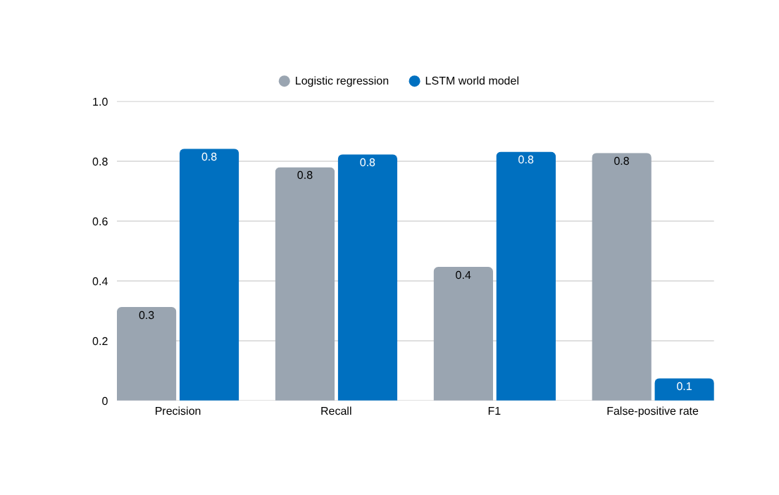
IMPACT AND BENEFITS
KHUSHAL
_Celeryy_
Measured performance — real CIC-IDS2017
Impact on defenders
Early warning
Forecasts the likely infiltration trajectory before future attack-stage traffic is observed.
Lower alert fatigue
Benchmark shows a much lower false-positive rate than the matched logistic-regression baseline.
Actionable context
Predicted MITRE ATT&CK stage plus feature/time-step explanations help analysts understand why risk is rising.
CII-friendly
Offline/on-prem design avoids cloud-API dependency and keeps inference within the monitored environment.
F1: 0.832
vs 0.447 baseline
FPR: 0.075
vs 0.828 baseline
Core value: move from reactive detection → proactive, explainable cyber defence.

Slide 6
RESEARCH AND REFERENCES
KHUSHAL
_Celeryy_
Project repository
github.com/ROHIT-25607/netforecast
Key research & framework references
• [1] Ha & Schmidhuber — World Models (2018), arXiv:1803.10122
• [2] Hochreiter & Schmidhuber — Long Short-Term Memory (1997)
• [3] Bahdanau, Cho & Bengio — Attention / alignment (ICLR 2015)
• [4] Lundberg & Lee — SHAP / model interpretation (NeurIPS 2017)
• [5] MITRE ATT&CK Enterprise — tactics & techniques framework
• [6] Sharafaldin, Lashkari & Ghorbani — CIC-IDS2017 dataset (ICISSP 2018)
Implementation / reproducibility
• README: project scope, architecture, setup and run commands
• docs/architecture.md: model, state representation and benchmark methodology
• submission/PRESENTATION.md: SIH presentation narrative
• assets/screenshots/: prototype / explainability views
Benchmark basis
Chronologically held-out real CIC-IDS2017 traffic; logistic regression and LSTM world model use the same context, horizon and test split.
Research framing: learn network dynamics → simulate future states → forecast attack progression → explain the warning.

